Slide 1
Use of Total Lightning Data at
Chattanooga, Tennessee (Hamilton County) For Public Safety and Decision Making
What is the utility of using Lightning Mapping Array (LMA) data for public safety and decision making for Emergency Management?
Geoffrey Stano – ENSCO / SPoRT
David Hotz and Anthony Cavalluci – WFO Morristown, TN
Tony Reavley – Director of Emergency Services
& Homeland Security of Hamilton
County (Tennessee)
September 2012
Notes:
1

Slide 2
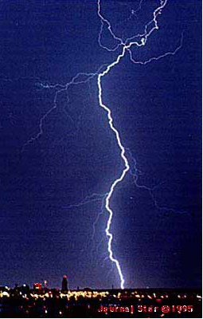
What is Meant by Total Lightning?
The Lightning Mapping Array (LMA) observes the individual stepped leaders of the entire flash, also called sources
Observes flashes not detected by the NLDN
Observes intra-cloud and cloud-to-ground lightning
Related to the strength of storm

Slide 3
What is the Purpose of the Study?
This is a collaboration project between ENSCO/SPoRT, NWS Morristown, Tennessee, and Chattanooga EMA to evaluate the usefulness of using LMA data at the local Emergency Management (EM) level for public safety.
The local EM will have access to the latest LMA output to aid in public safety decisions. We will stress to the EM that the total lightning data is experimental and should be used in conjunction with other preparedness tools, such as the doppler radar.
Before and during the project, ENSCO/SPoRT and NWS will provide training to the local EM on the best ways to evaluate the total lightning data.

Slide 4
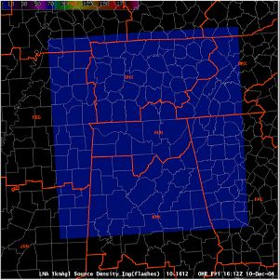
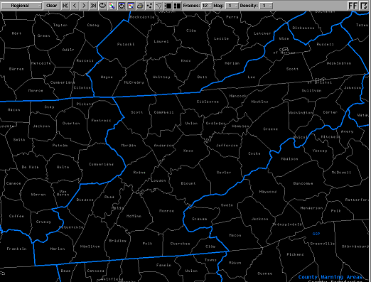
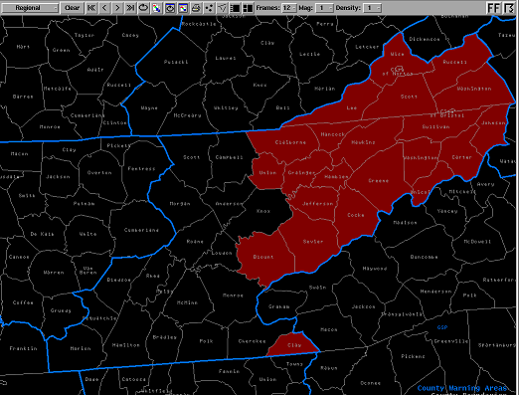
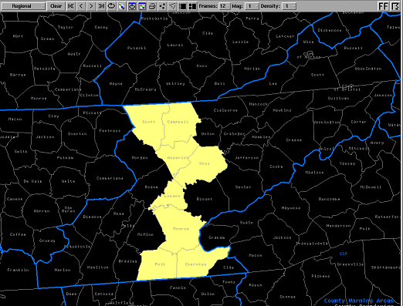
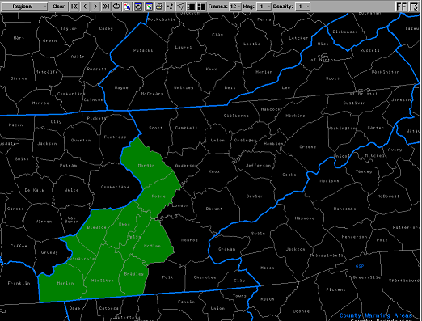
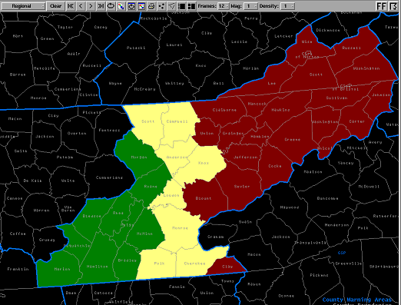
Why Focus on Chattanooga?
NALMA Domain
No Coverage
Partial Coverage
Full Coverage
Notes:
4

Slide 5
What is the Practical Benefit of Total Lightning?
Intra-cloud lightning generally occurs between 5 and 10 minutes before Cloud to Ground Lightning
Source density “jump” noted in advance of many severe weather occurrences
Notes:
5
It has been stated several times that the source densities can be used to infer storm strength and severity. This and the following slide will give an example of how. Notice the trends of intra-cloud lightning, in red, and cloud-to-ground lightning, in blue, leading up to a tornado touchdown in the graphic provided. The additional intra-cloud observations show a clear trend. The source densities are increasing as the vortex “spins-up” and the updraft intensifies. Conversely, the cloud-to-ground observations show no clear change leading up to the touchdown. This shows that the intra-cloud flashes correlate with the storm updraft strength as well as the incipient storm severity. This source density “jump” is noted in advance of many severe weather occurrences. Let’s return to the original animation example.

Slide 6
Benefit: Lead time for first Cloud-to-Ground
“First Strike” Forecasting
90% of lightning intra-cloud
Lead time for initial cloud-to-ground strike
First IC typically precedes first CG by 5-10 min
Aviation applications
Update TAFs
Airport Weather Warnings
Public service applications
First IC to First CG Delay
Number of Storms
Time (min)
Notes:
6
It has been stated several times that the source densities can be used to infer storm strength and severity. This and the following slide will give an example of how. Notice the trends of intra-cloud lightning, in red, and cloud-to-ground lightning, in blue, leading up to a tornado touchdown in the graphic provided. The additional intra-cloud observations show a clear trend. The source densities are increasing as the vortex “spins-up” and the updraft intensifies. Conversely, the cloud-to-ground observations show no clear change leading up to the touchdown. This shows that the intra-cloud flashes correlate with the storm updraft strength as well as the incipient storm severity. This source density “jump” is noted in advance of many severe weather occurrences. Let’s return to the original animation example.

Slide 7
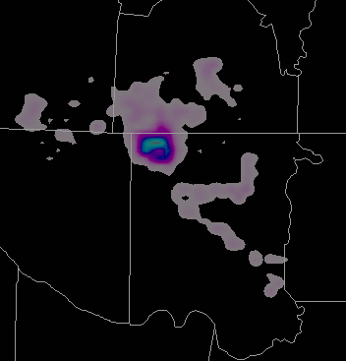
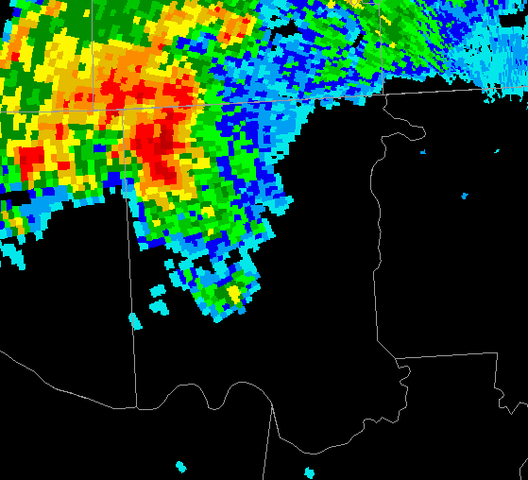
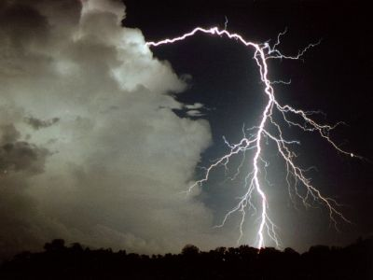
Benefit: Spatial Extent
Lightning Awareness
Total lightning not a point observation
Observes spatial extent
Lightning may extend many miles from storm’s core
Typical Horizontal Extent
Within 10 miles
40 km Flash
Notes:
7
It has been stated several times that the source densities can be used to infer storm strength and severity. This and the following slide will give an example of how. Notice the trends of intra-cloud lightning, in red, and cloud-to-ground lightning, in blue, leading up to a tornado touchdown in the graphic provided. The additional intra-cloud observations show a clear trend. The source densities are increasing as the vortex “spins-up” and the updraft intensifies. Conversely, the cloud-to-ground observations show no clear change leading up to the touchdown. This shows that the intra-cloud flashes correlate with the storm updraft strength as well as the incipient storm severity. This source density “jump” is noted in advance of many severe weather occurrences. Let’s return to the original animation example.

Slide 8
We need your evaluation of Total
Lightning Data and the Display
Some potential evaluation questions:
Want to get a sense of the pros and cons of the current lightning data.
How to improve the display GUI?
Is the lightning data valuable to your operations and decision making?
If so, how did you use the data?
Are there other EMA operations this can be used with?
Notes:
8

Slide 9
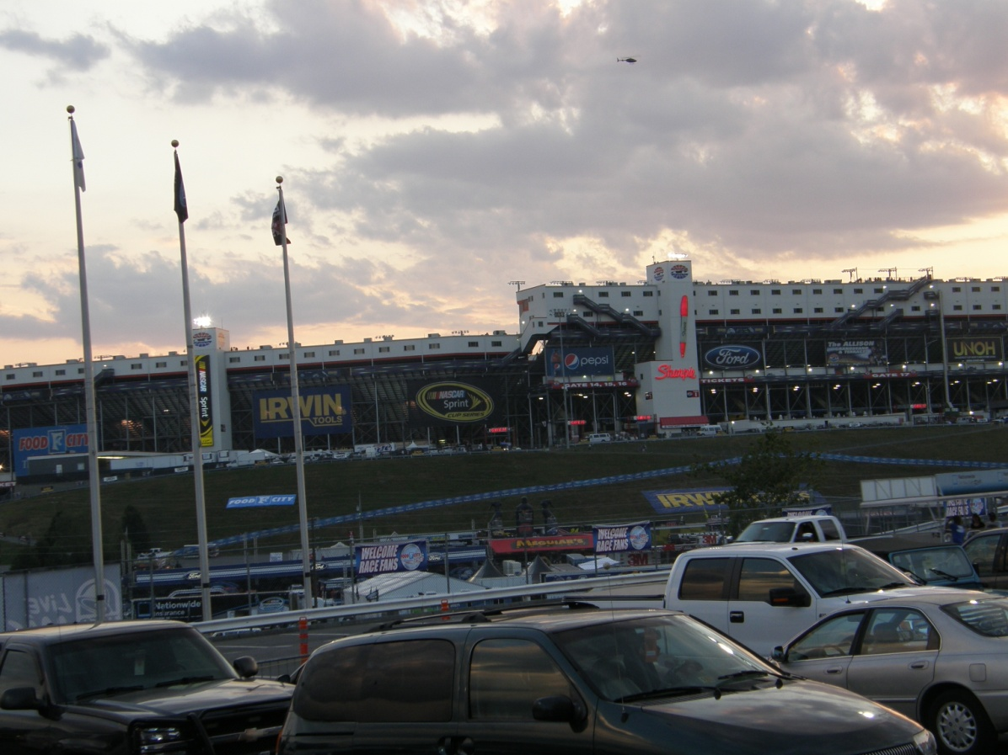
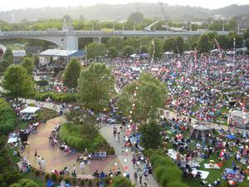
Increased Awareness of Total Lightning Activity can Save Lives
Decision Support Services
Outside Sport Activities
Outside Summer Events
Notes:
9

Slide 10
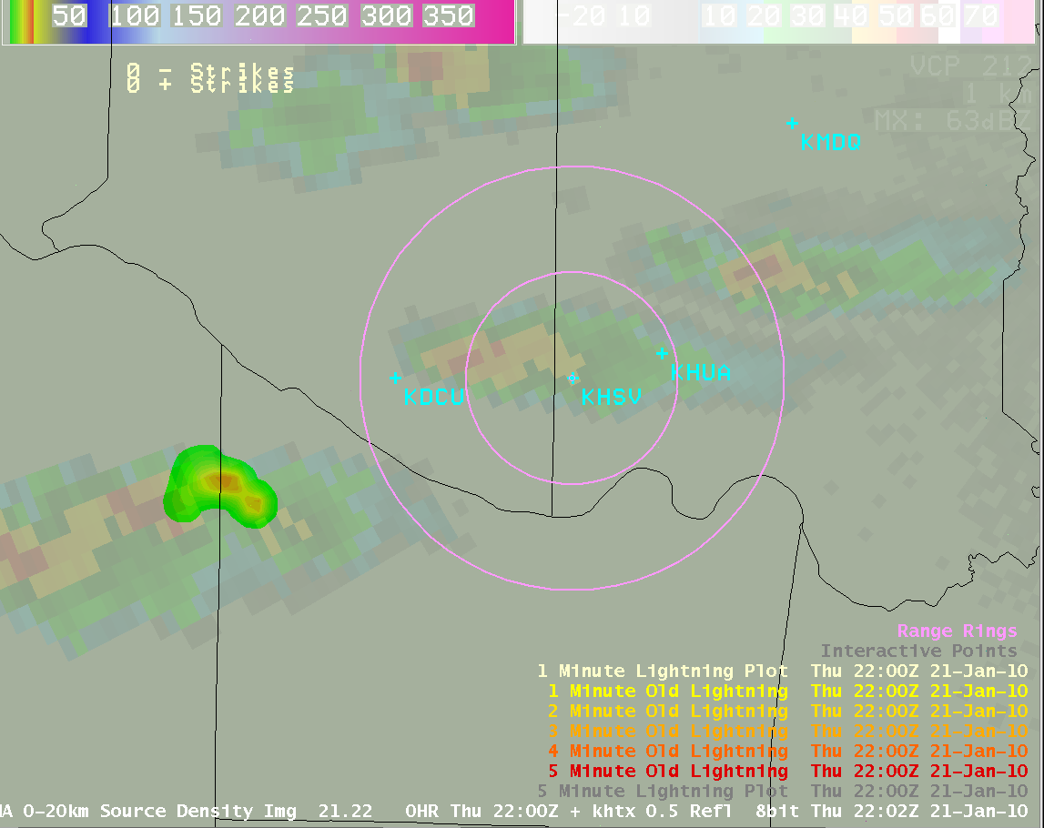
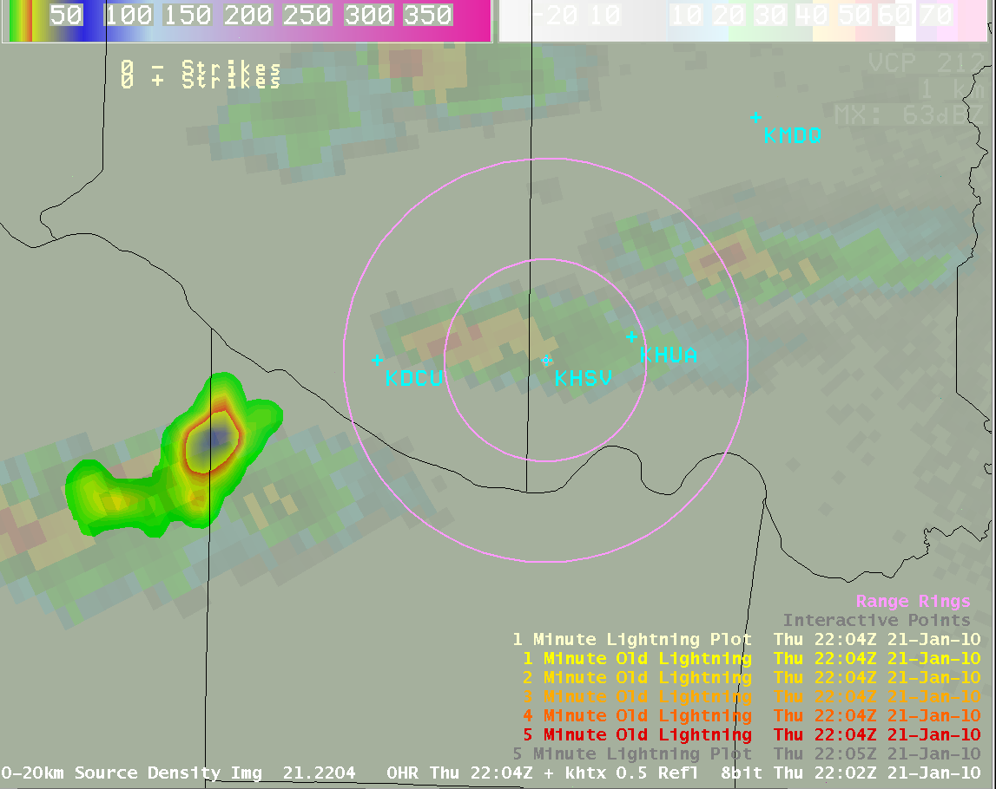
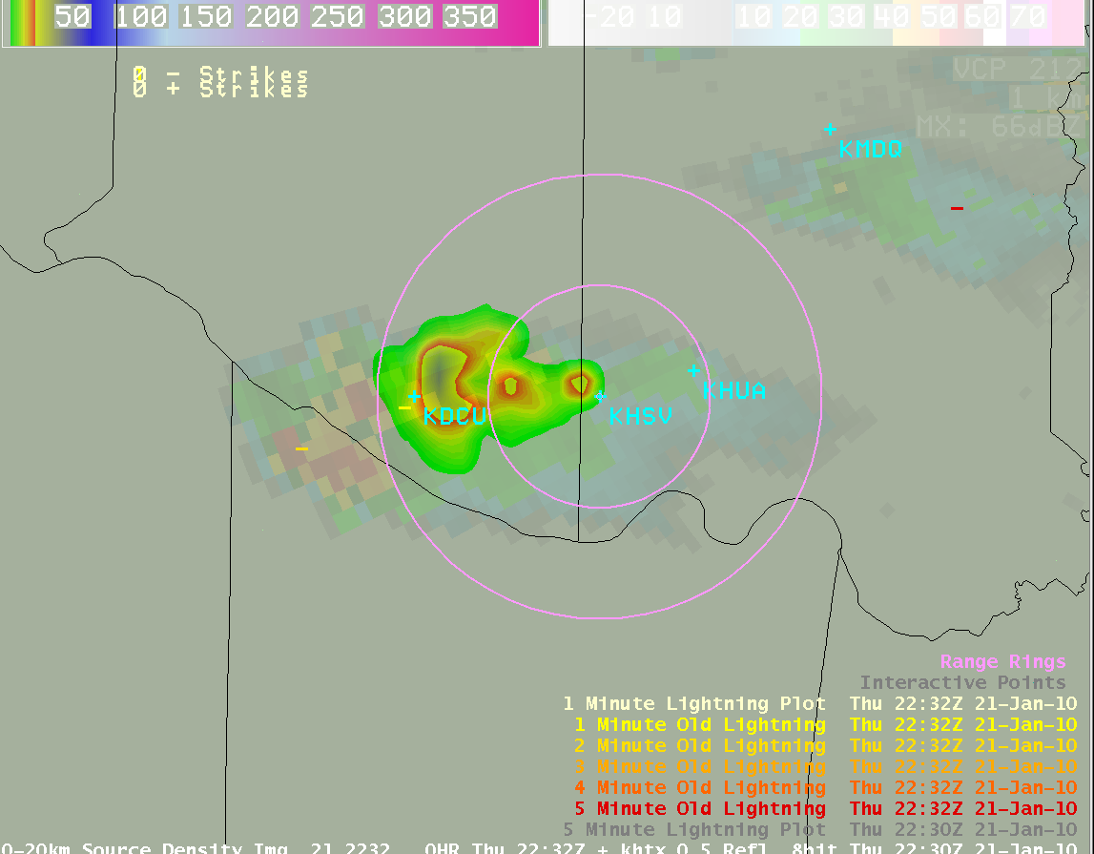
Tools for Viewing Total Lightning Data
Traditional Paradigm
AWIPS
Main NWS decision support system
EMA does not have this
Solution
Web-based product
LMA+radar+NLDN in AWIPS
Notes:
10

Slide 11
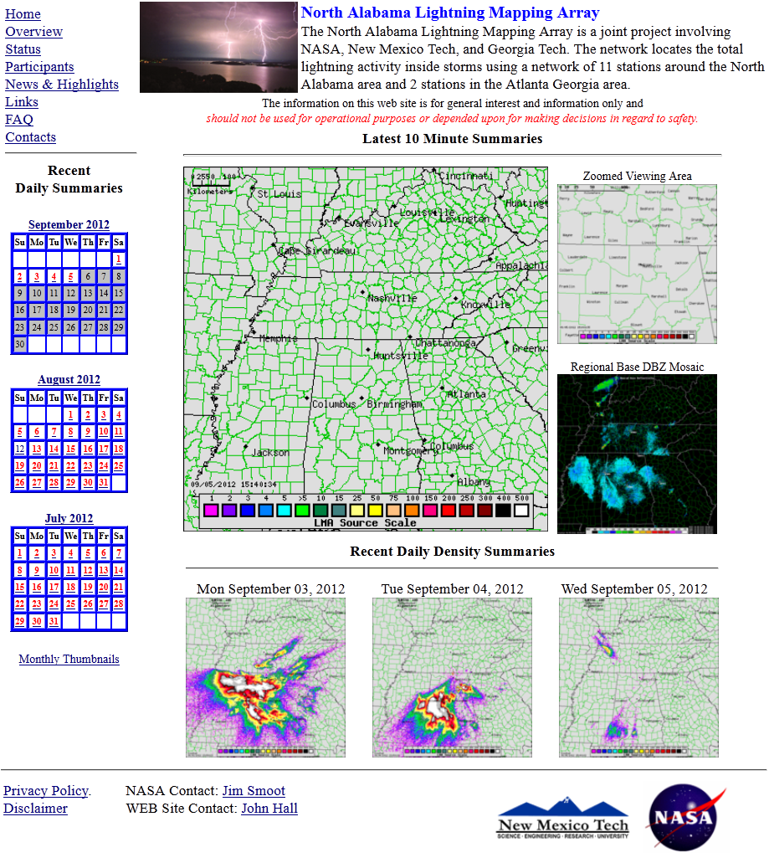
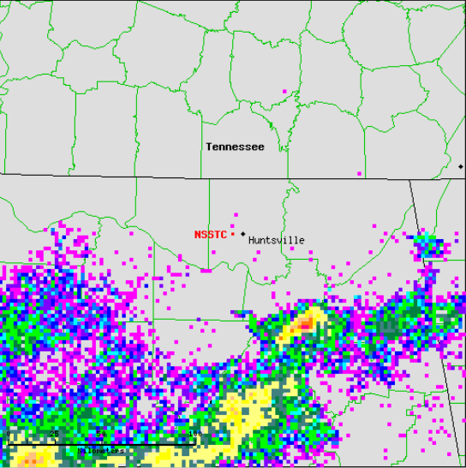
Current Web Display
Excellent page for overview
Browse past events
Main issue for project
10 min summaries
No animation
Notes:
11

Slide 12
How Do You Access the Total Lightning Data
NASA SPoRT has developed on-line access to the total lightning data. The link is the following:
http://weather.msfc.nasa.gov/sport/lma/nalma.html
The internet access is a Google Earth page. The page will overlay the data over Google Earth allowing you to zoom in and out of the area of interest.
Notes:
12

Slide 13
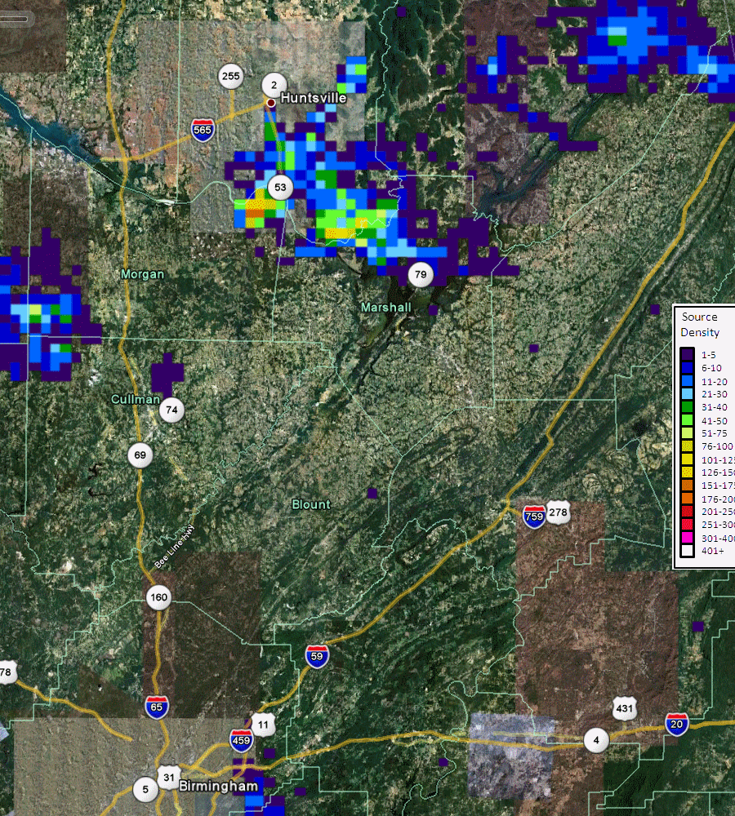
Example Output of Total Lightning Data
How to Read the Data
Data is updated every 2 minutes.
Source Density Scale:
Measures the number of sources (pieces of a lightning flash) over the past 2 minutes.
Source Density Data on October 7th, 2009 between 0600-0630 UTC
Notes:
13

Slide 14
Future of Total Lightning Data
The LMAs have a short range of no more than 200 km. This is being addressed with the next generation geostationary satellite, GOES-R, which will boast the Geostationary Lightning Mapper (GLM). SPoRT, in conjunction with NOAA’s GOES-R Proving Ground, is working to prepare the end user community for the GLM era using the LMA observations as a demonstration tool. Working collaboratively with our NWS partners, SPoRT is working to determine how best to integrate these future observations to improve both severe storm warnings and lightning safety.
Notes:
14

Slide 15
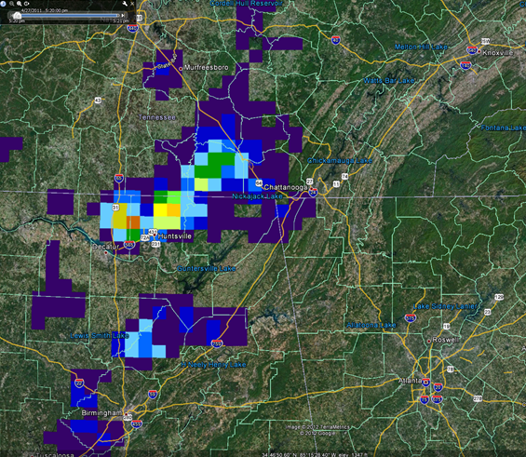
Future of Total Lightning Data
Pseudo-GLM (PGLM)
Demo tool of future GLM observations
Uses LMA data
10 km resolution
Advantages
Flash-based product
Learn operational uses now ahead of GOES-R launch
PGLM Flash Density
(Chattanooga-centered Google Earth display)

