Slide 1
SPoRT Virtual Workshop 2012 September 12-13
AWIPS II Status
Jason Burks, Matt Smith, Kevin McGrath

Slide 2
AWIPS I to AWIPS II
NWS Moving to AWIPS II, SPoRT wants to provide data on native Decision Support System
Assessment of Plug-ins needed at time:
MODIS data in McIDAS (image)
LMA data in NetCDF (image/3D)
Other unimplemented in AWIPS I
Surveyed existing Raytheon Plug-ins
Satellite plug-in
Grib2 plug-in
Require custom plug-ins.

Slide 3
Schedule Change
The previous schedule had almost all WFOs being transitioned to AWIPS II by the end of calendar 2012.
The new schedule has all remaining WFOs transitioning AFTER the approval of all Field OT&E offices.
HUN is an OT&E site

Slide 4
Status
NOAA/NWS and Raytheon are still forging the governance process.
Several groups will be involved (SPoRT, CIMSS, CIRA, Unidata, et al.)
SPoRT is on the cutting edge of trying out governance policy.

Slide 5
AWIPS II Plug-in Architecture
HDF5
Raw Data
EDEX
Plug-in
Data
Plug-in
DAO
Data
Plug-in
CAVE
Viz
Plug-in
PostgreSQL
EDEX plug-in - handles data ingest/decoding.
Data plug-in – Object Data Model
Viz plug-in - communicates with DAO to retrieve data and provides visualization in CAVE.

Slide 6
Product Status
SPoRT has developed plug-ins for about 90% of SPoRT’s products.
Total Lightning
Satellite imagery (McIDAS)
Convective Initiation
Smoke (new)
Hot Spots (new)
We plan to have the final 10% ready within the next several months
LIS, WRF, other model output (GRIB2)
Ocean Wind Vector (new)

Slide 7
Product Plug-ins

Slide 8
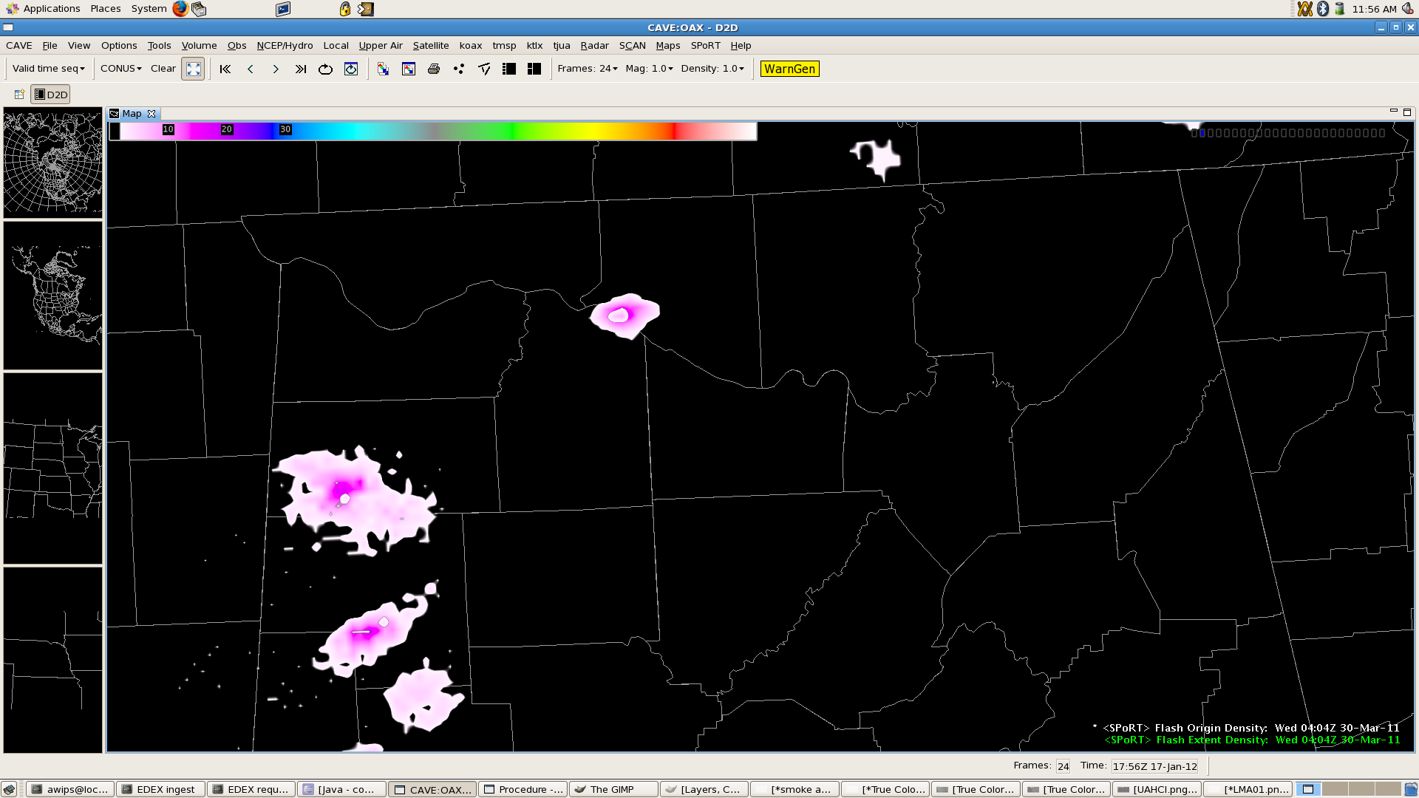
Lightning Mapping Array

Slide 9
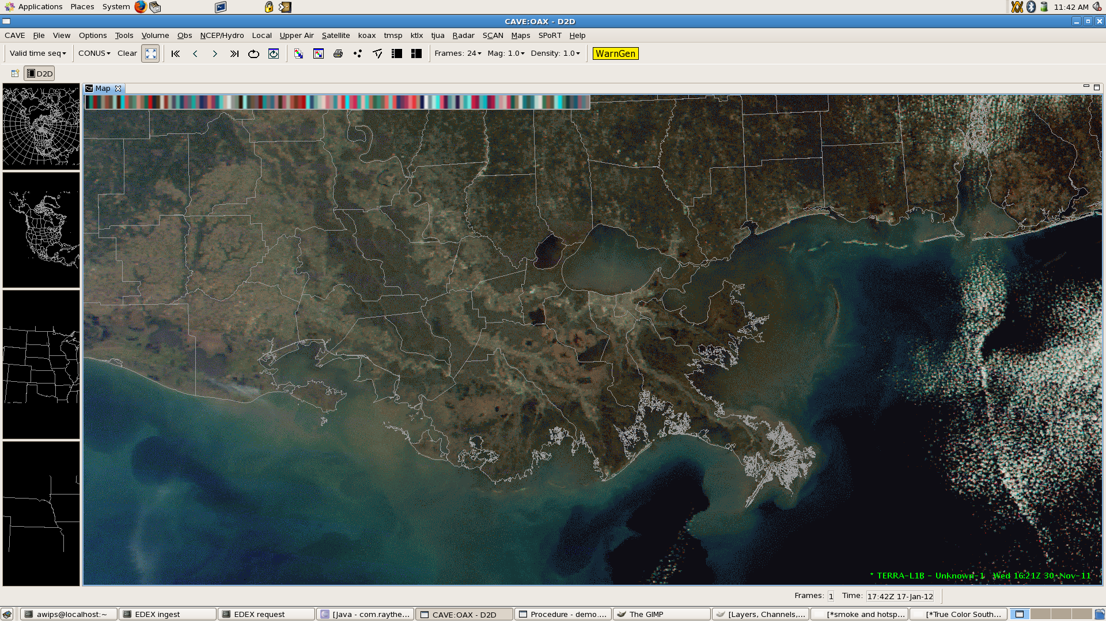
Satellite / McIDAS AREA

Slide 10
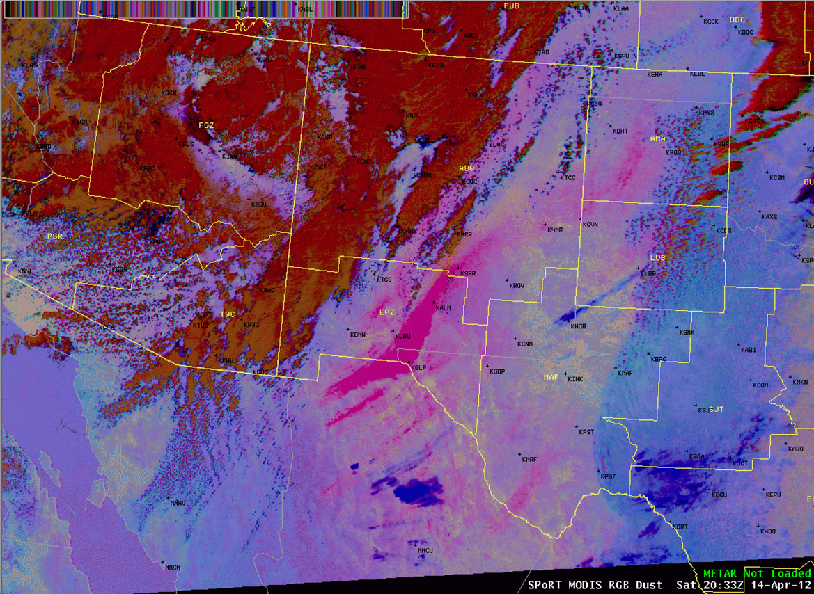
RGB Products

Slide 11
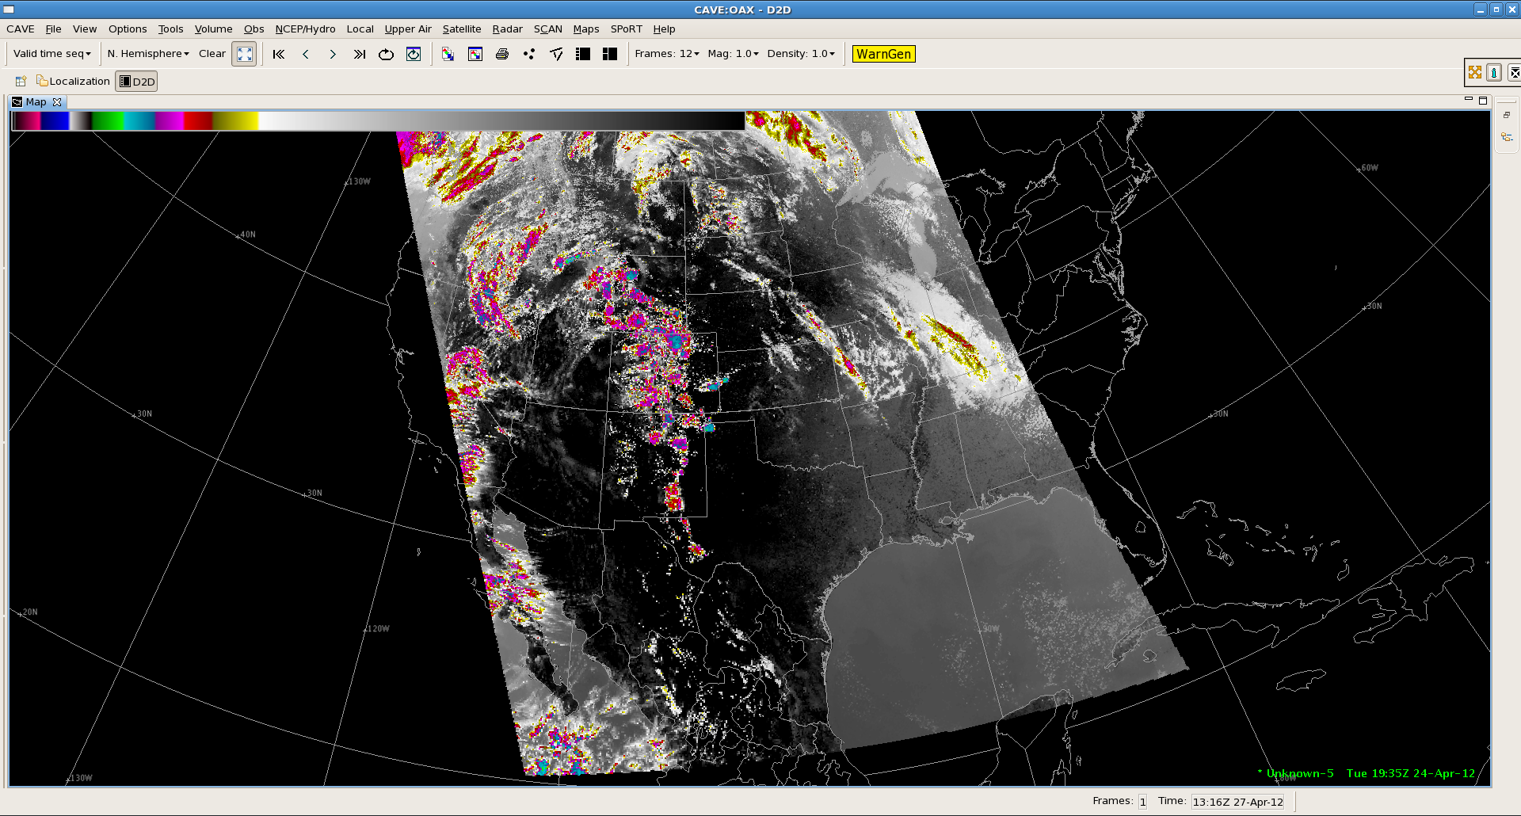
VIIRS

Slide 12
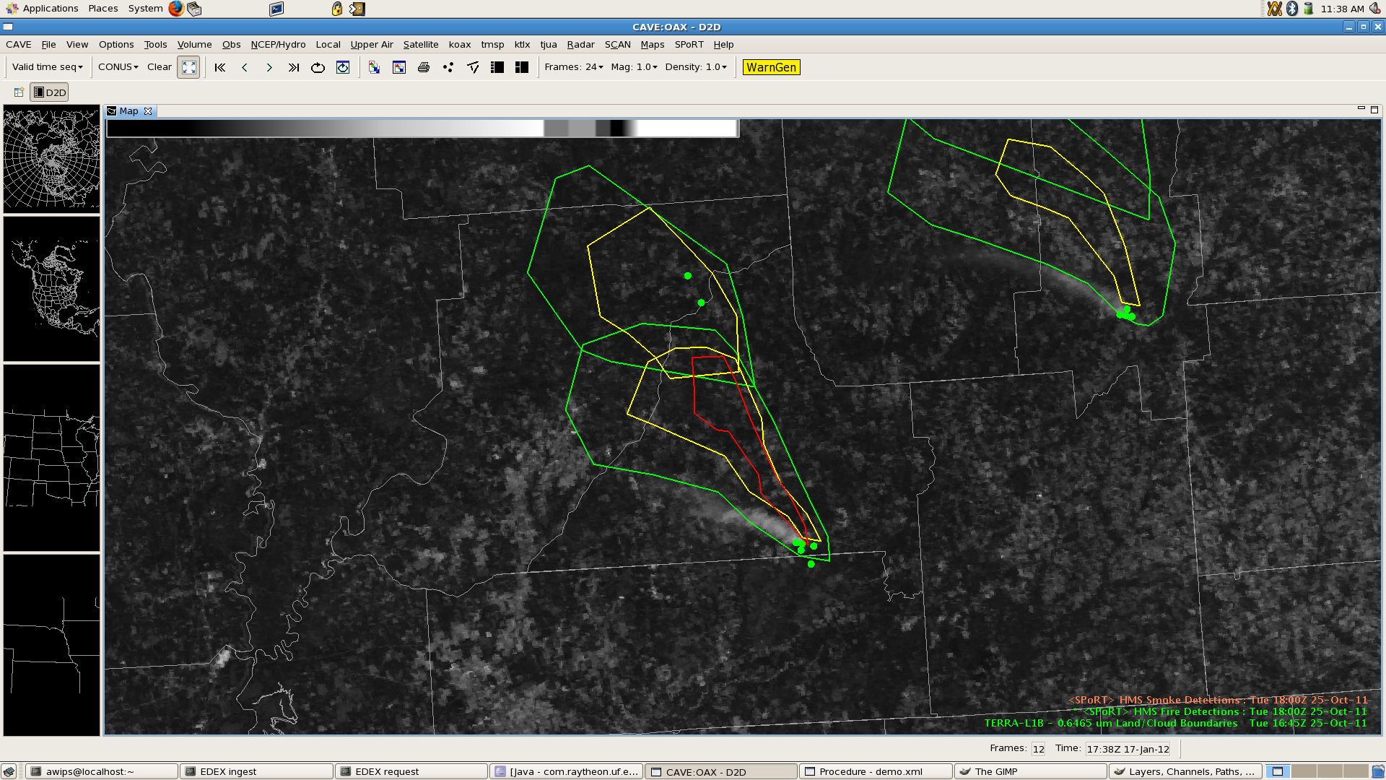
Hazard Mapping System Smoke & Hot Spots

Slide 13
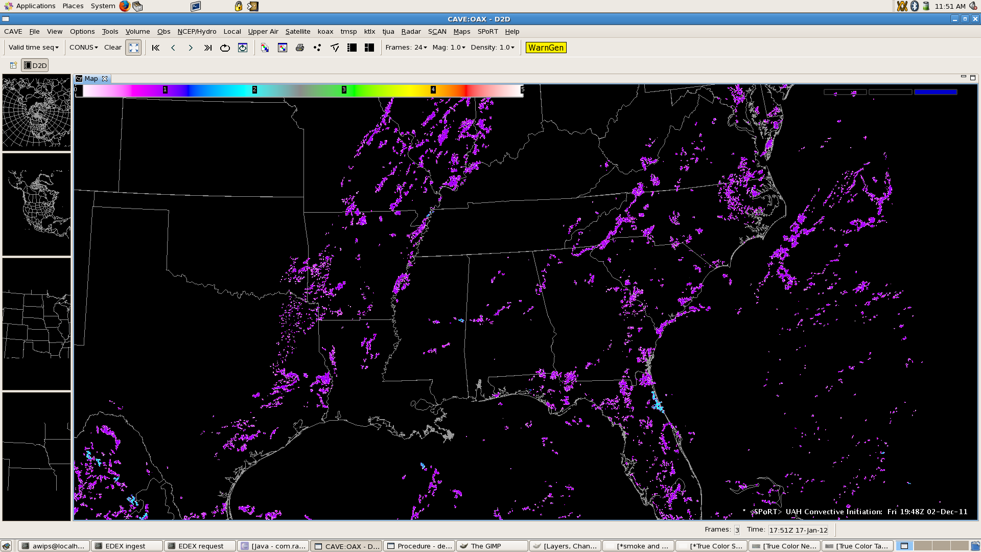
Convective Initiation

Slide 14
Tool Plug-ins

Slide 15
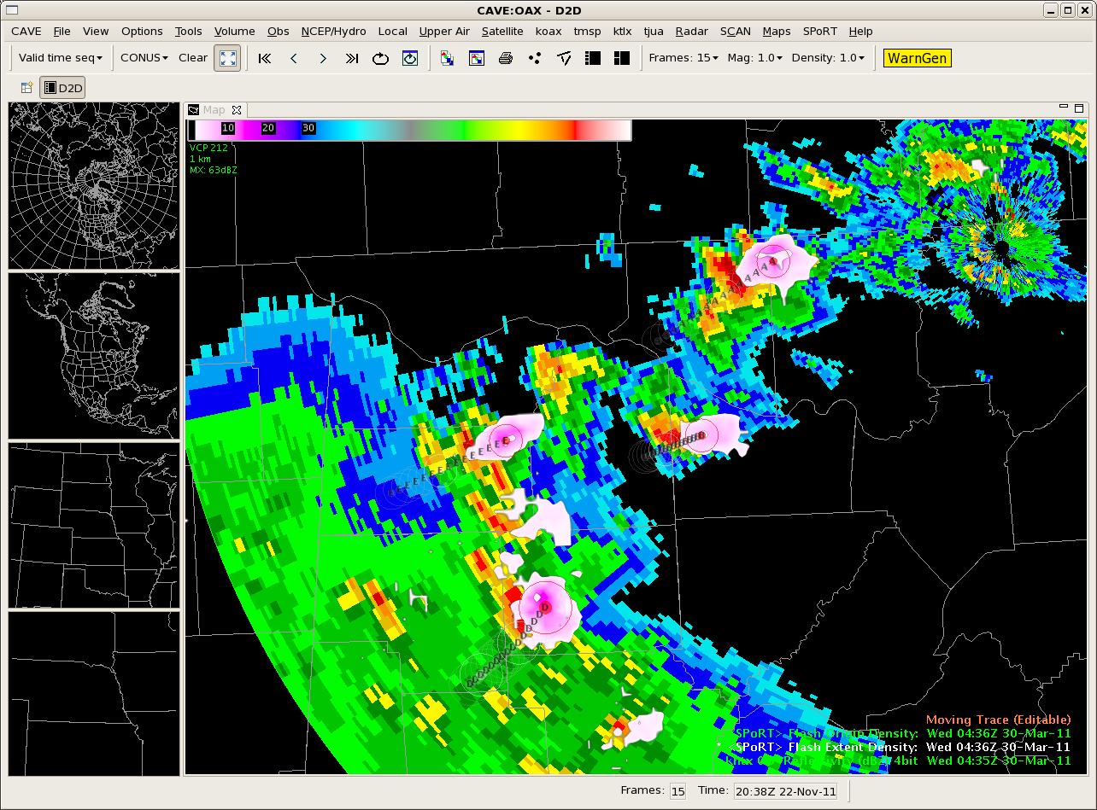
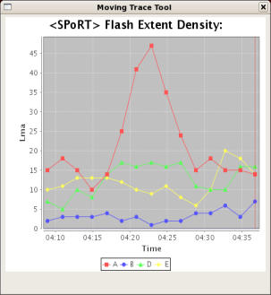
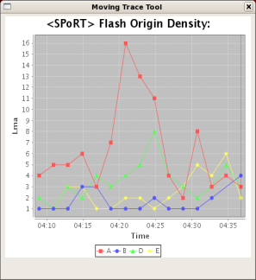
Lightning Tracking Tool
Total lightning jumps are sometimes related to severe weather. Forecasters can quickly track several storms, charting their intensity.

Slide 16
Current and Ongoing
Pioneering NOAA AWIPS II governance procedures
Upcoming SPoRT visit to CIRA in October 2012
Share AWIPS II development experiences
Discuss formalized collaboration and upcoming developer training
Upcoming Experimental Product Development Team (EPDT) to address SPoRT and PG Applications
Developer Workshop in mid-November
~13 people: Some from each NWS Region and Proving Ground Partners

Slide 17
Future
Additions to McIDAS plug-in
Additional projections
Additional products
Implement various RGB approaches for display within the SPoRT data feed
Develop more SPoRT unique tools and displays for interrogation of data
3D Lightning data, along with cross sections

Slide 18
Questions?

Slide 19
BACKUP SLIDES

Slide 20
SPoRT Common Plug-in
CAVE
SPoRT
Common
Viz
Plug-in
SPoRT
Viz Plug-ins
SPoRT
Viz Plug-ins
Discovered need for common architecture plug-in
Adds stub menu structure
Adds basic tools needed for plug-ins

Slide 21
Summary of data type plug-ins
Data Format | Data Name | Data Source
ASCII->NetCDF | LMA, LDAR, PGLM | NASA, OU, NMTech
ASCII | MODIS hotspots | UM FIRMS
ASCII | POES/GOES hotspots | NOAA Hazard Mapping System
ASCII (KML) | POES/GOES smoke plumes | NOAA Hazard Mapping System
NetCDF | Convective Initiation | UAHuntsville
McIDAS AREA | Satellite | NASA/SPoRT, UW/SSEC
Binary->NetCDF | WindSat | NRL/ SPoRT
Binary | Multi-byte | UW/SSEC, UAF, NRL, NESDIS, etc.

