Slide 1
Demonstration of RGB Composite Imagery at NWS forecast offices in preparation for GOES-R
Kristopher D. White
Kevin Fuell

Slide 2
Topics covered…
What is RGB imagery and how is it made?
What are some of the RGB products available?
Who is using it?
How can it help with situational awareness and the forecast process?
What is in store for the future of this imagery?

Slide 3
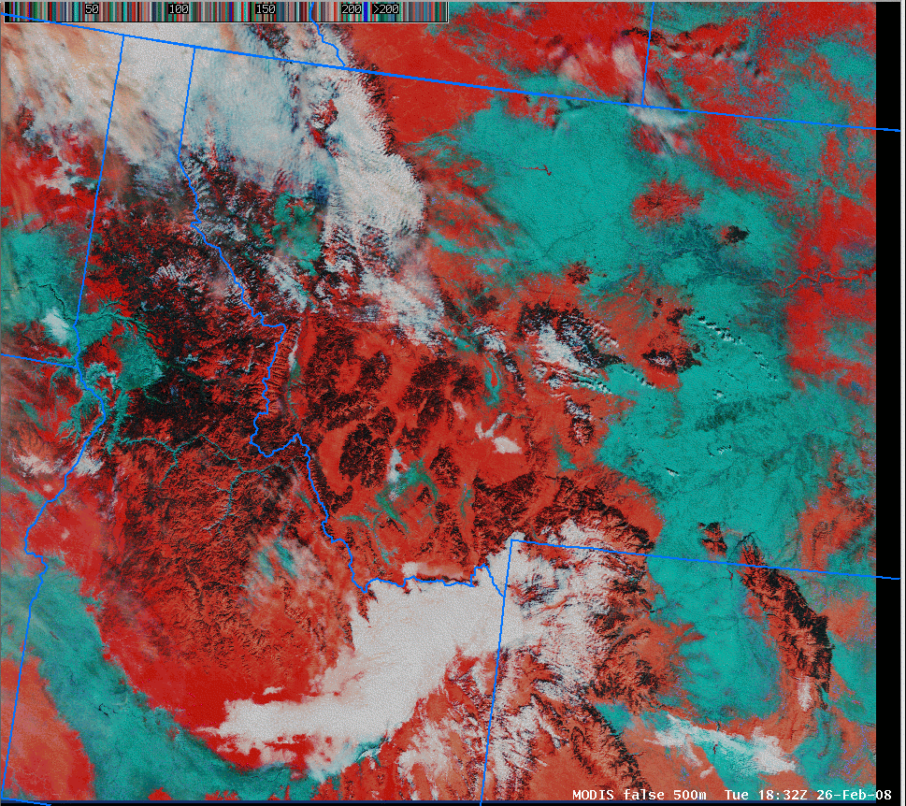
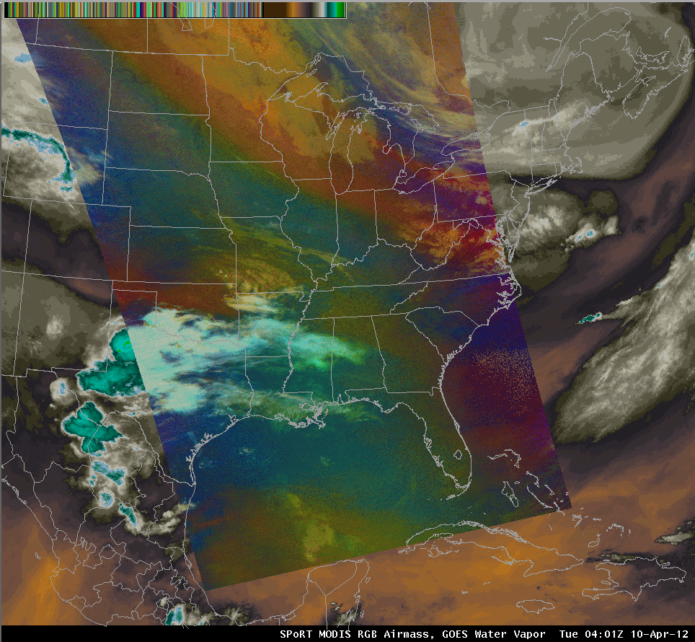
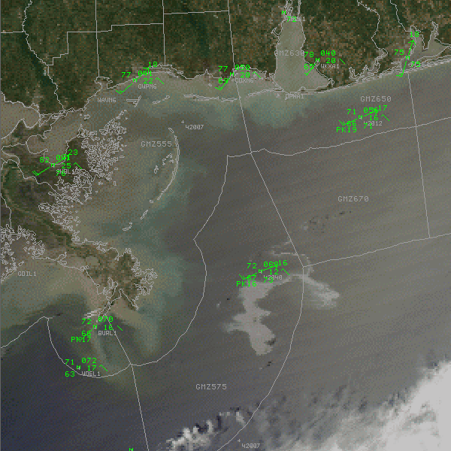
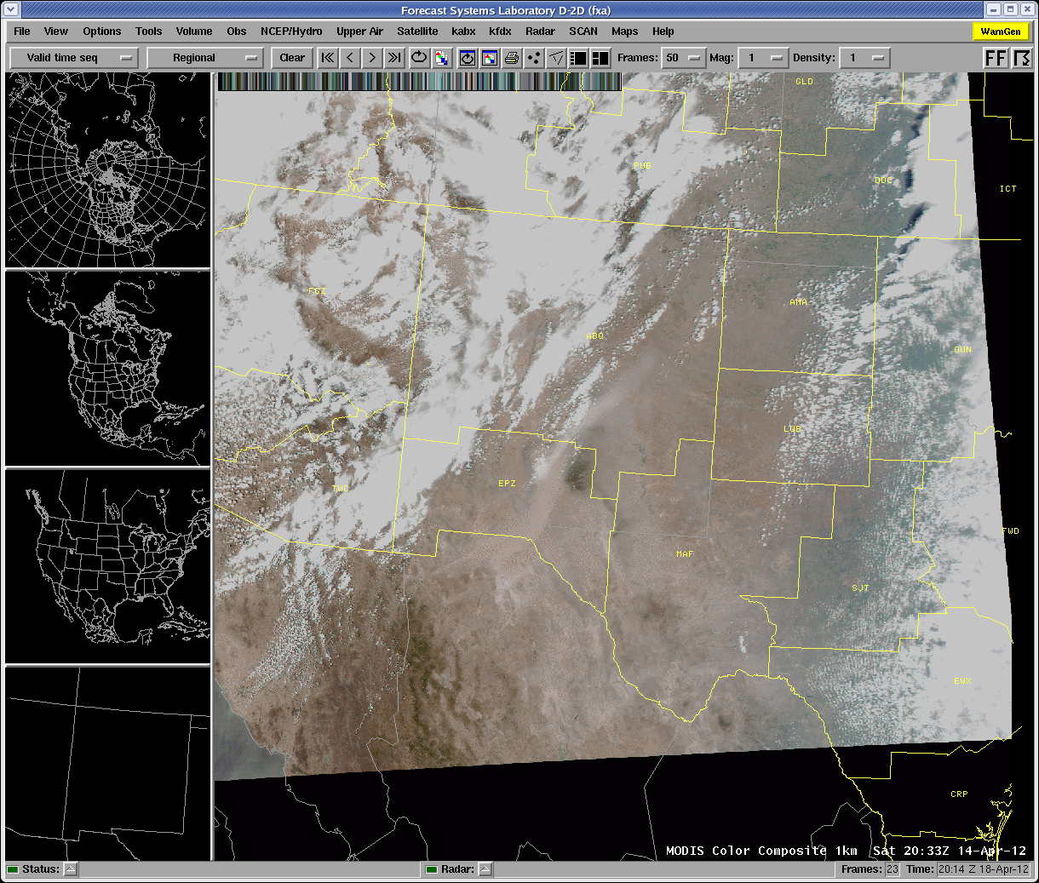
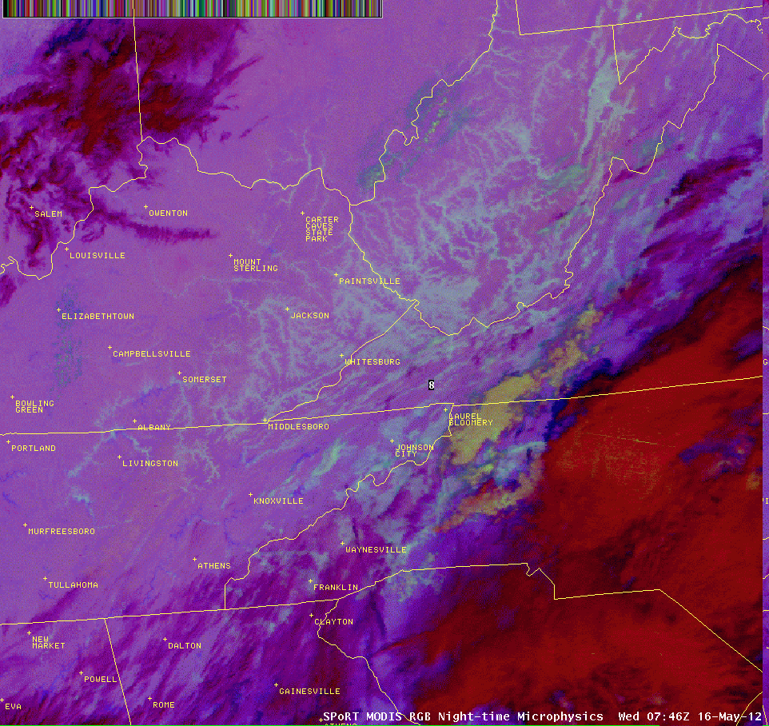
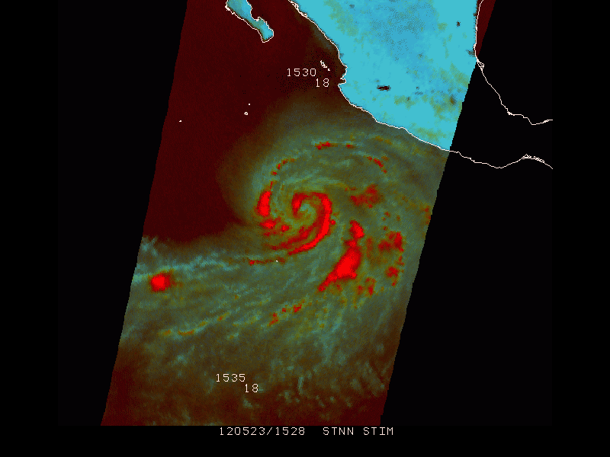
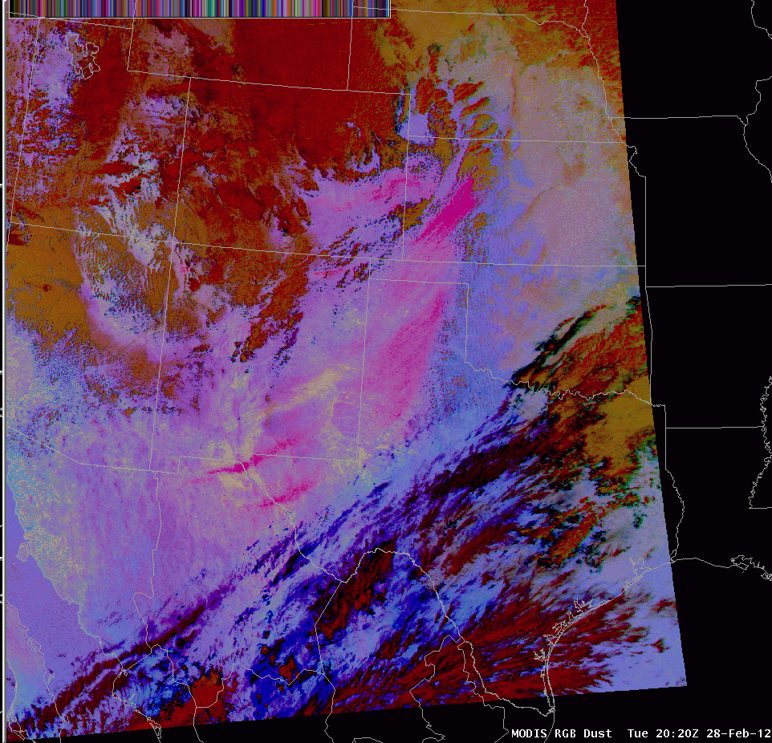
What is RGB Imagery?
Some examples with which you are probably already familiar…
Now, some examples with which you may or may not be familiar…
RGB stands for the Red, Green, and Blue in the processing of the imagery. Next, we’ll look at how this imagery is created.
False Color
RGB True Color Product
RGB Airmass Product
True Color
RGB Nighttime Microphysics Product
91 GHz RGB Product
RGB Dust Product

Slide 4
What is RGB Imagery and How is it Created?
In a 24-bit image, pixels occur as all possible combinations of RGB.
R
RGB imagery assign values for the R, G, and B color components using 8-bit values (0-255), resulting in 24-bit image.
AWIPS and NAWIPS can only display 254 or 95 colors, respectively.
Therefore, RGB images in these systems are quantized (not ideal, but exposes users to RGB concept ahead of 24-bit capability).
G
B
Quantization selects an ideal subset of colors to represent the image.
Some color detail is lost as a compromise to make the imagery available in N/AWIPS.

Slide 5
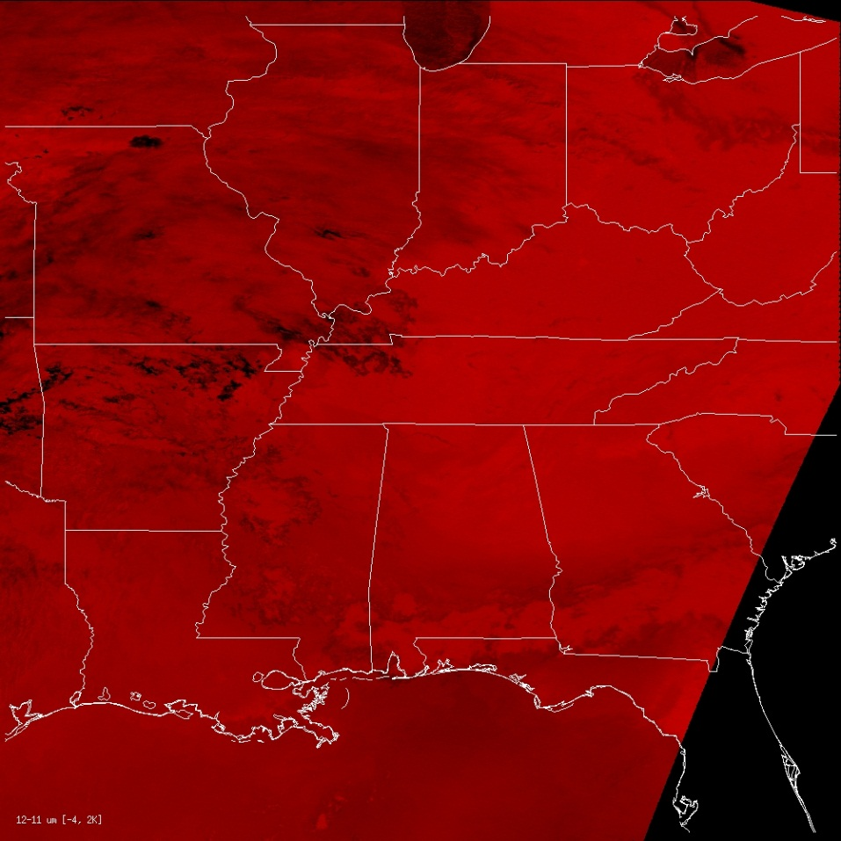
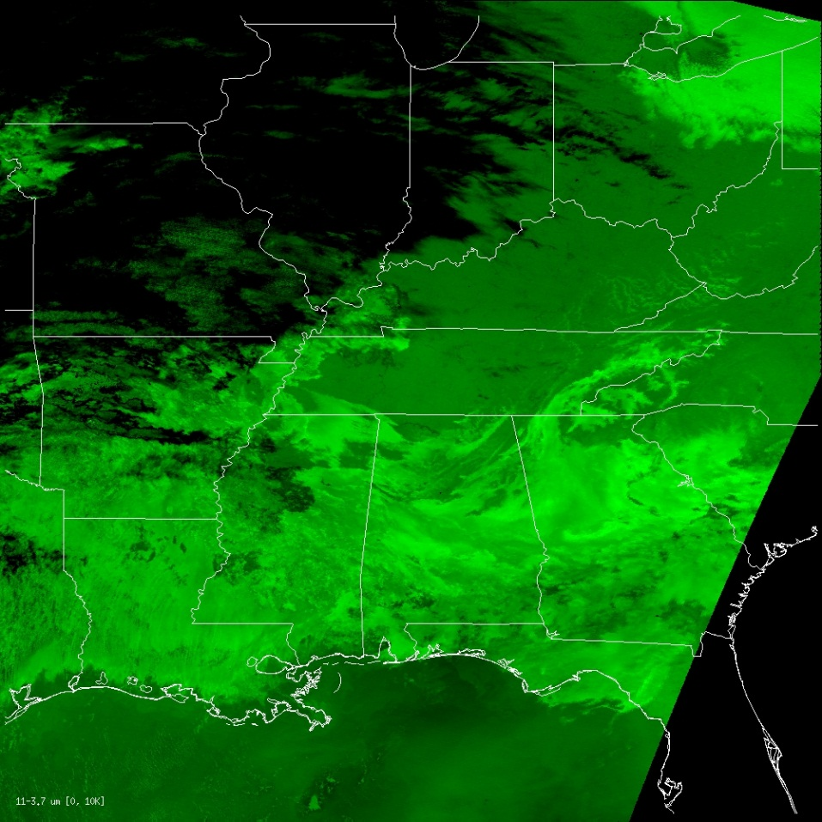
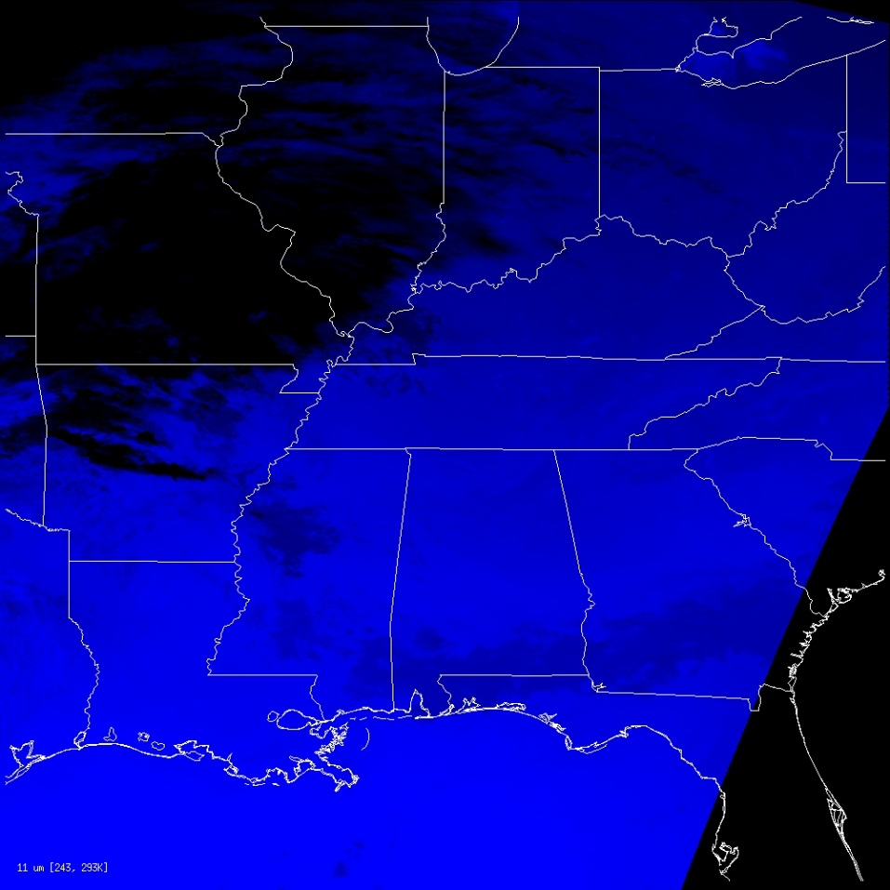
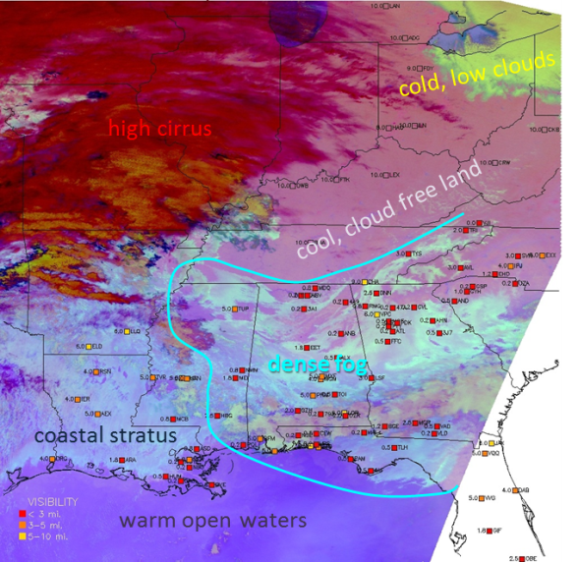
What is RGB Imagery and How is it Created?
Let’s look at a nighttime microphysics example. In this particular example…
Red color = 12.0-10.8 µm channel difference
Green color = 10.8-3.9 µm channel difference
R: 12.0-10.8 μm
G: 10.8-3.9 μm
Blue color = 10.8 µm channel
Combine those colors together and you get…
B: 10.8 μm

Slide 6
What is RGB Imagery and How is it Created?
Let’s look at another nighttime microphysics example, this time from the tropics…
Red color = 12.0-10.8 µm channel difference
Physically relates to cloud depth
12µm-10.8µm Difference Cloud Depth
10.8µm-3.9µm Difference Cloud Phase, Size
Green color = 10.8-3.9 µm channel difference
Physically relates to cloud phase, size
Blue color = 10.8 channel
Physically relates to temperature
10.8µm Temperature of Surface
Night-time Microphysics RGB

Slide 7
What is RGB Imagery and How is it Created?
The RGB Dust Product
Red color = 12.0-10.8 µm channel difference
Physically relates to cloud depth
Green color = 10.8-8.7 µm channel difference
Physically relates to particle phase
Dust = magenta and pinks
Blue color = 10.8 channel
Physically relates to temperature
http://weather.msfc.nasa.gov/sport/training/rgb_dust/RGB%20Dust%20Reference%20Guide.pdf

Slide 8
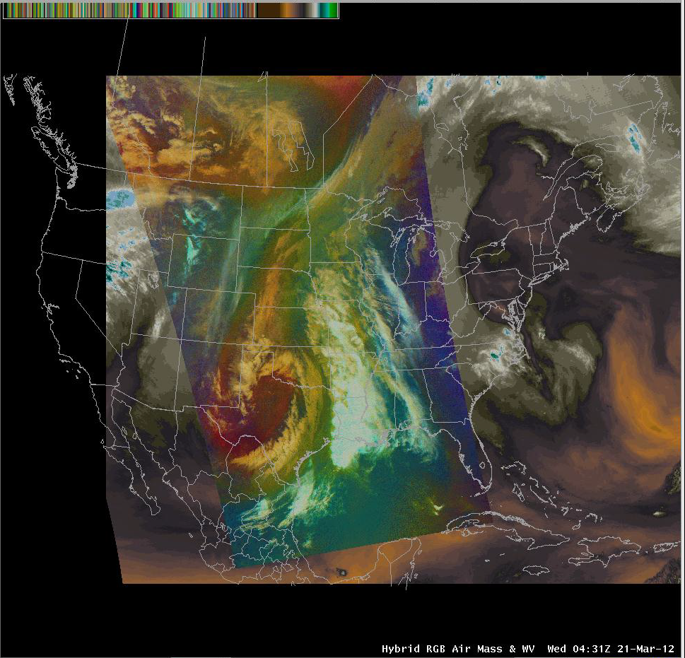
What is RGB Imagery and How is it Created?
The RGB Airmass Product
Purple = Limb cooling due to stratospheric absorption (less green) and false indication of cold, polar air
Red color = 6.7-7.3 µm channel difference
Physically relates vertical water vapor difference
Red = dry stratospheric air on descending flank of upper jet
Green color = 9.7-10.7 µm channel difference
Physically relates to estimate of tropopause height based on ozone
White = Thick, high clouds
Blue color = 6.7 channel
Physically relates to water vapor in layer from ~200-500 mb
Boundary at upper levels between warm, moist mid-levels (olive) and warm, moist upper levels (bluish green)
http://weather.msfc.nasa.gov/sport/training/rgb_airmass/RGB%20Air%20Mass%20Reference%20Guide.pdf

Slide 9
RGB Products and Users
RGB Products | User | Comments
MODIS: True, Snow/Cloud | TFX, SR WFOs | Initial transition of RGBs (2003)
MODIS & SEVIRI: Air Mass, Dust, Night Microphysics GOES Sounder (CIRA): Air Mass | HPC, OPC, SAB | SEVIRI for Atlantic area and MODIS and GOES Sounder for CONUS. (2011)
SEVIRI: Air Mass, Dust GOES Sounder (CIRA): Air Mass | NHC | TC Analysis and monitoring (2011)
MODIS: Air Mass, Dust, Night Microphysics | SR WFOs | 2012
GOES Sounder (CIRA): Air Mass | SPC & HWT | 2012
MODIS Air Mass | Near-term Future: National Centers | Extended domain for Atlantic and Pacific
Passive Micro. 89 and 37 GHz | Near-term Future: NHC | NRL Collaboration
Other MODIS & SEVIRI RGBs as well as VIIRS/CrIS RGB suite | Longer-term Future: National Centers and WFOs | Based on end user forecast needs / priorities

Slide 10
Products and Users – Training
Page 2 of Air Mass Quick Guide
RGB Quick Guides – 2-3 page document
Page of text and page with example
Why is RGB important?
What specifically to look for in the imagery
List of potential caveats
Reference EUMETrain and COMET materials
Future: Collaborate with users to capture cases for library of examples

Slide 11
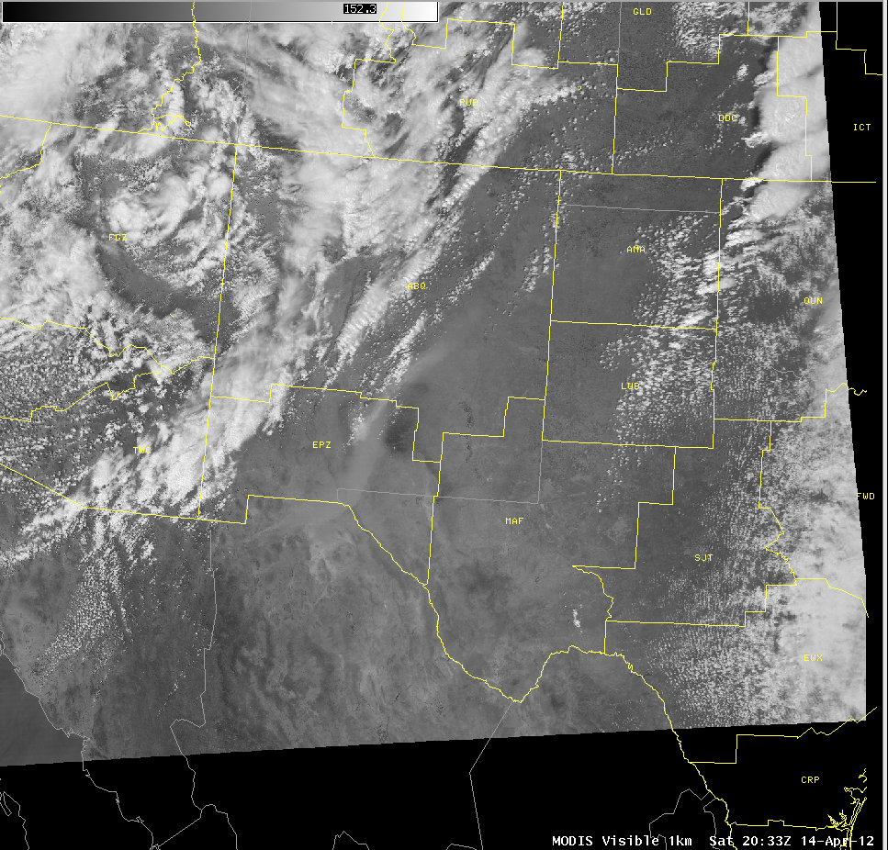
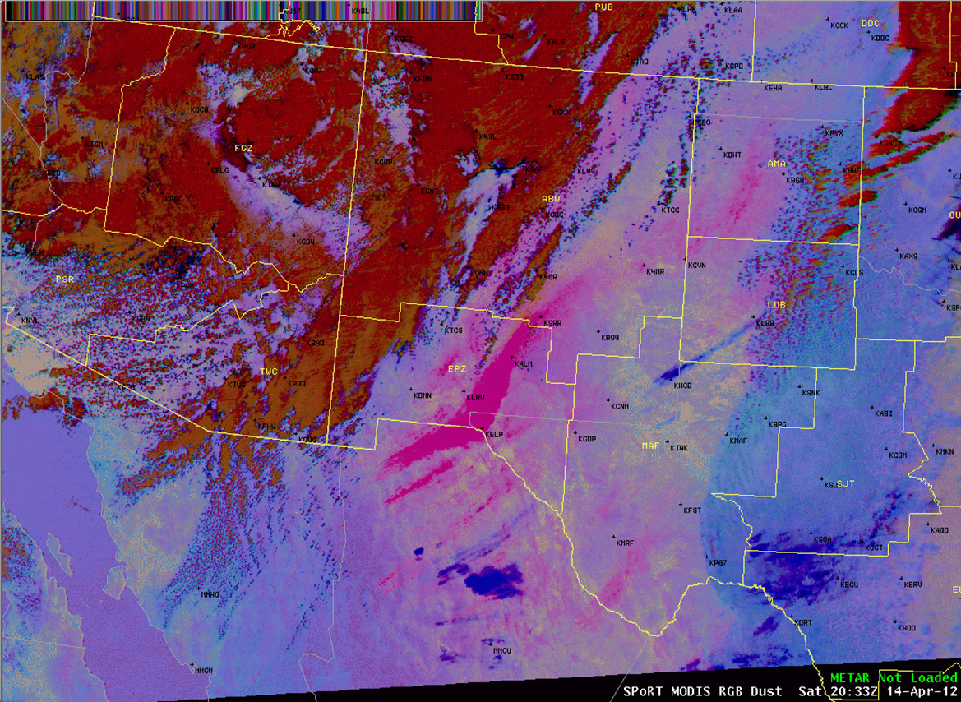
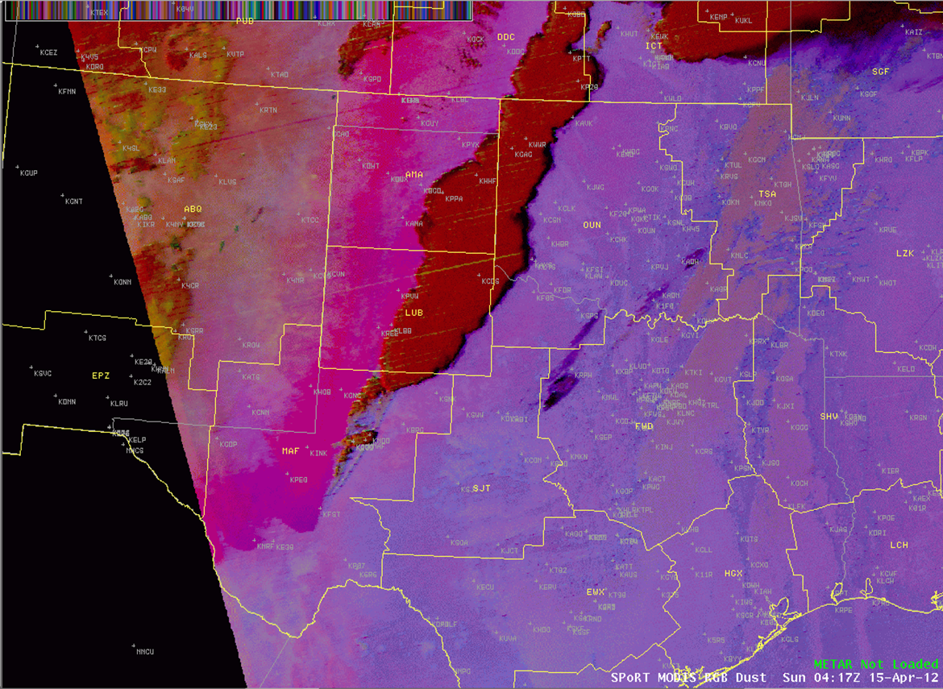
How can RGBs help with situational awareness and the forecast process?
The RGB Dust Product
Especially for western offices that are affected by dust
Early detection of dust possible, but product timeliness may be an issue (polar orbiter)
Dust = magenta and pinks

Slide 12
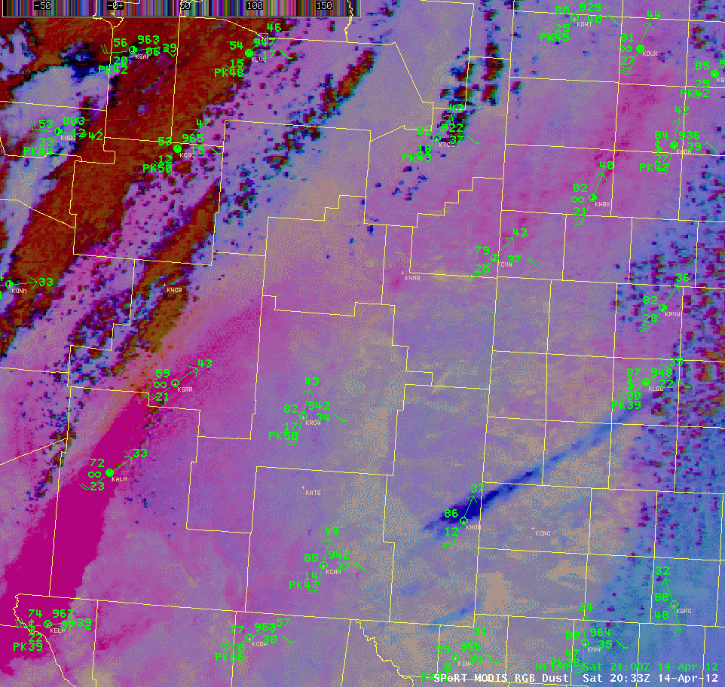
How can RGBs help with situational awareness and the forecast process?
The RGB Dust Product
Another interesting feature…the dryline!
Dryline

Slide 13
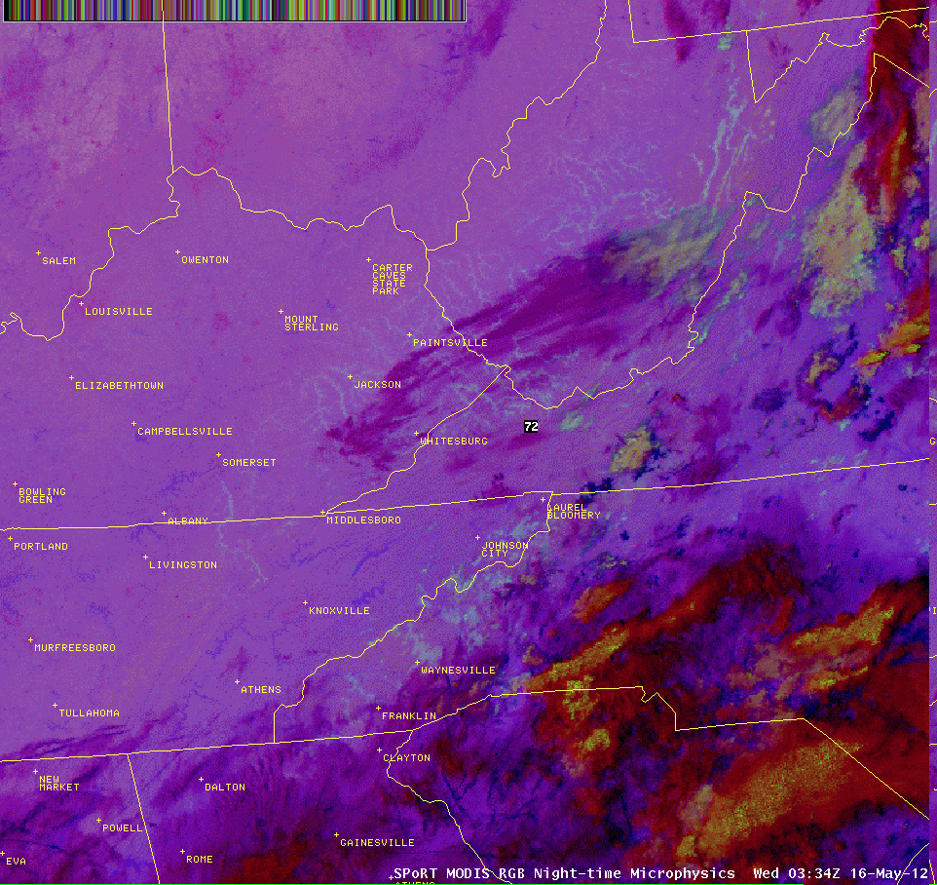
How can RGBs help with situational awareness and the forecast process?
The RGB Nighttime Microphysics Product
Notice that some fog appears discernible in the central and southern Appalachian Valleys in this standard MODIS-GOES 11-3.9 µm channel difference product at 0334Z 16 May, 2012. This is with the MODIS 1 km resolution swath.
Now, notice have much easier it is to see the fog in the RGB product. Here, the fog and low clouds appear as the light aqua colors spanning some of the valleys of central and southern Appalachia and are much more discernible from the mid and high clouds in the region. This helps to detect fog more readily early in its formative period.

Slide 14
How can RGBs help with situational awareness and the forecast process?
The RGB Nighttime Microphysics Product
Fog appears widespread across the valleys of central and southern Appalachia in this standard MODIS-GOES 11-3.9 µm channel difference product from later that morning at 0746Z. This is with the MODIS 1 km resolution swath.
In the RGB image, notice the area of clouds (denoted by the yellow colors) in NW North Carolina. The RGB product tells us that these are mostly mid clouds, which was not possible to detect in the standard 11-3.9 µm imagery.

Slide 15
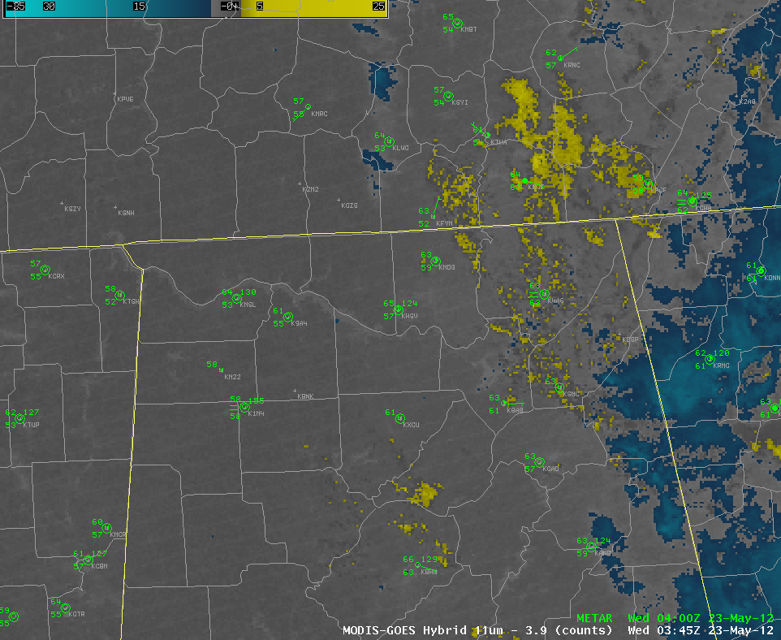
How can RGBs help with situational awareness and the forecast process?
The RGB Nighttime Microphysics Product
Easier to distinguish between low and mid level clouds

Slide 16
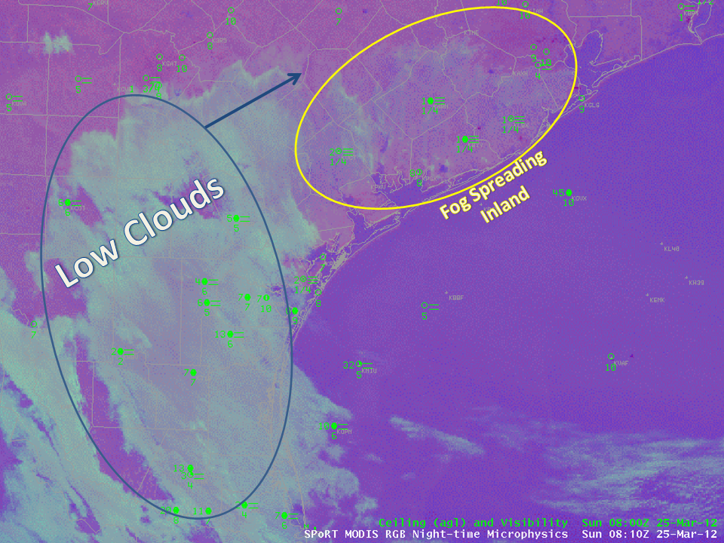
How can RGBs help with situational awareness and the forecast process?
The RGB Nighttime Microphysics Product
Awareness of visibility and airborne hazards to aviation for TAF forecasts
Communication to public for travelling hazards

Slide 17
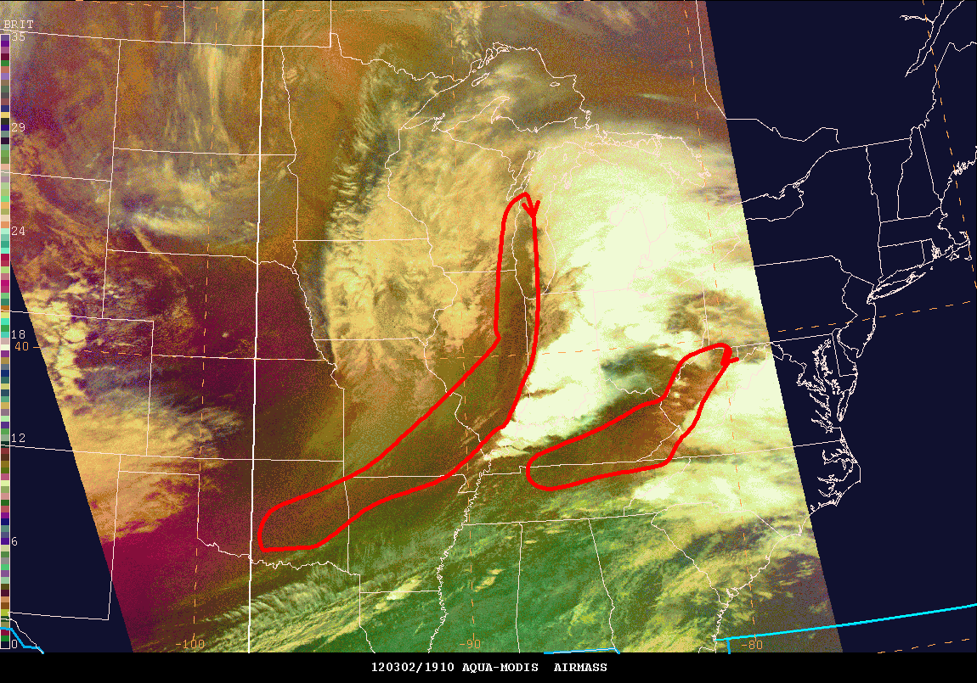
How can RGBs help with situational awareness and the forecast process?
The RGB Airmass Product
Detection of rapid cyclogenesis
Jet stream analysis
PV analysis
Red areas indicate dry air
and subsidence associated
with complex jet structure

Slide 18
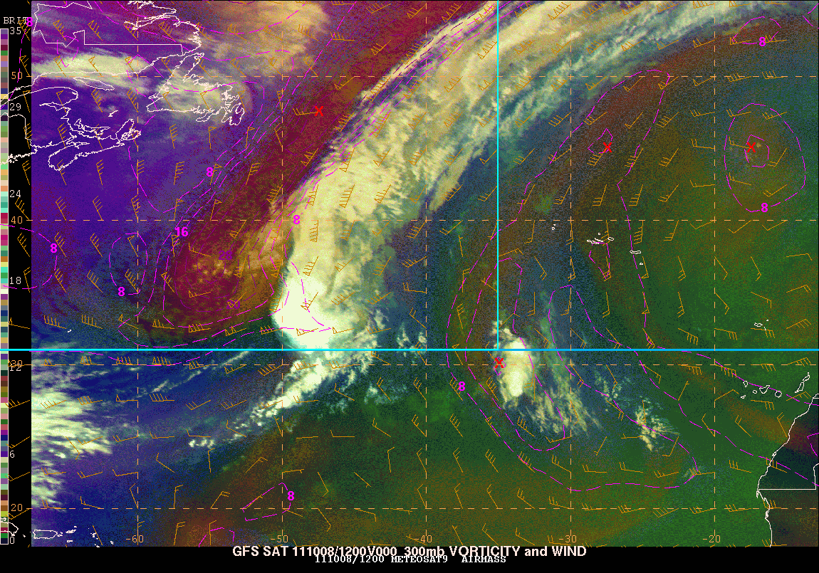
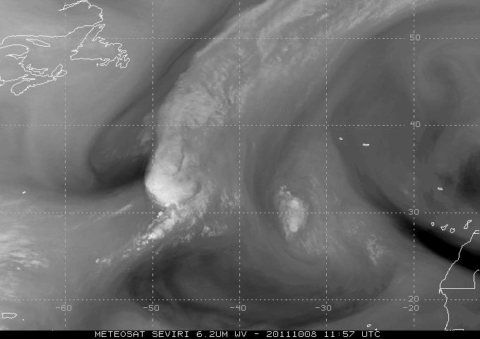
How can RGBs help with situational awareness and the forecast process?
The RGB Airmass Product
Detection of rapid cyclogenesis
Jet stream analysis
PV analysis
Jet Streak
Pink area denotes
PV anomaly

Slide 19
What is in store for the future of this imagery?
GOES-R Capabilities
RGB capability and more rapid updates with GOES-R era of satellites

Slide 20
What is in store for the future of this imagery?
Incorporation of data from the VIIRS instrument aboard the Suomi NPP satellite
Wider swath widths
Higher temporal resolution when included in the hybrid (loop) product

Slide 21
What is in store for the future of this imagery?
Evaluation of VIIRS RGB Products
Fall 2012
BHM
HUN
RAH
OHX
MRX

Slide 22
Questions?

