Slide 1

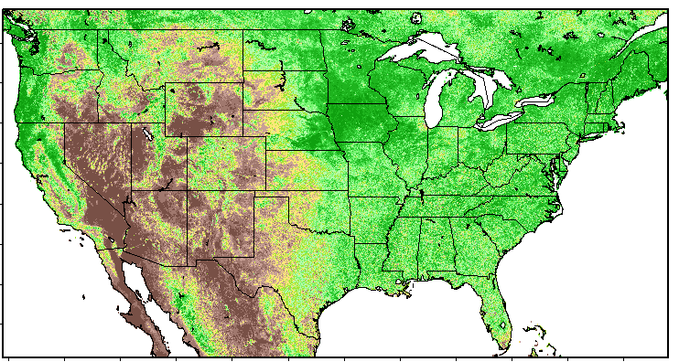


Update on SPoRT Initialization Datasets for the STRC
Environmental Modeling System
Jonathan Case
NASA Short-term Prediction Research and Transition Center/ENSCO, Inc.
Second SPoRT Partner Virtual Workshop
13 September 2012
SPoRT Virtual Workshop, 13 September 2012

Slide 2
Outline
STRC EMS Overview
SPoRT datasets for use in STRC EMS
  Multi-sensor sea surface temperature (SST), including Great Lakes lake surface temperature (LST) and ice cover
  SPoRT Daily MODIS Green Vegetation Fraction (GVF)
  Land Information System (LIS) land surface fields
Updates to SPoRT datasets in the past year
Instructions on incorporating data into STRC EMS
Summary
SPoRT Virtual Workshop, 13 September 2012

Slide 3

Overview of the STRC EMS
Weather Research and Forecasting (WRF) model
  Community numerical weather prediction (NWP) system
  Contains two distinct NWP models
    Advanced Research WRF (ARW, NCAR)
    Non-Hydrostatic Mesoscale model (NMM, NCEP)
Environmental Modeling System (EMS)
  NWS Science and Training Resource Center (STRC)
  End-to-end system that runs ARW or NMM models in real time
  Manages acquisition and interpolation of initial/boundary conditions
  Automated post-processing can produce graphical output and
  display forecasts in AWIPS/AWIPS II
  New version forthcoming that includes NCEP NMM-B model
Simple Changes to EMS Enables Use of SPoRT Datasets
SPoRT Virtual Workshop, 13 September 2012

Slide 4
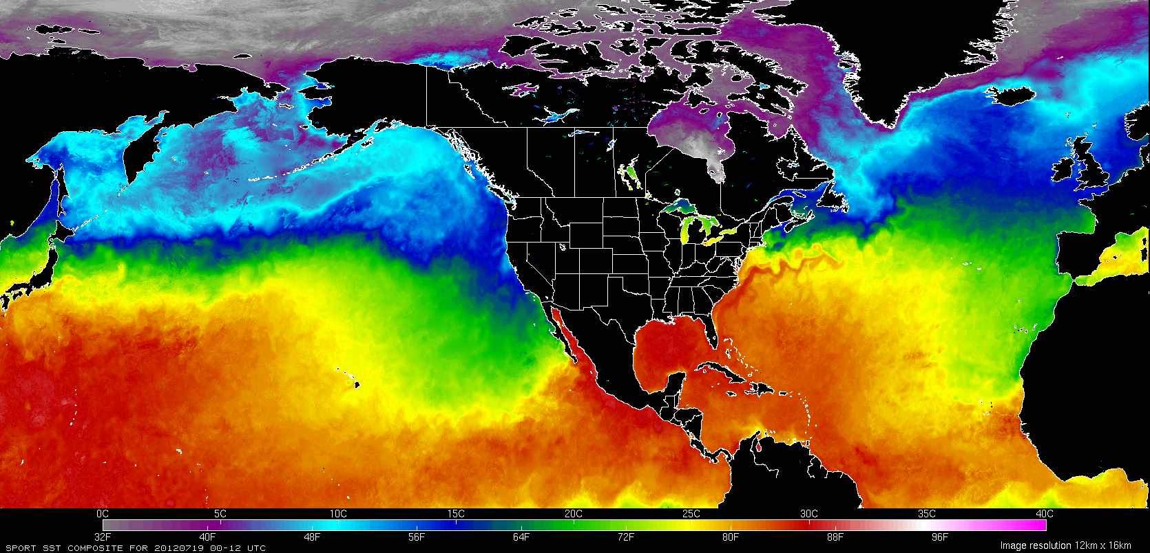
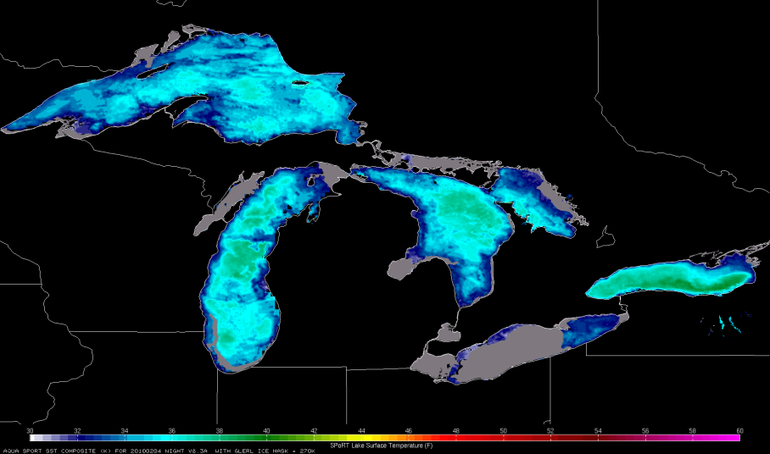
SPoRT SST (Great Lakes LST & Ice)
SPoRT SST composites
  Time latency-weighted blend of MODIS, NESDIS GOES/POES, and global OSTIA analysis
  2-km resolution; twice-daily composites for day (18z) and night (06z)
  Hemispheric coverage from 0° to 80°N lat and 130°E to 10°E lon
  Highly detailed compared to operational NCEP Real-Time Global SST
Great Lakes LST and Ice Cover
  Blend of MODIS and Great Lakes Surface Environmental Analysis (GLSEA2) from NOAA Great Lakes Environmental Research Laboratory (GLERL)
  Lake ice cover incorporated from National Ice Center, (ice > 90% fractional threshold)
  LST set to 270K where ice is present
NOAA / GLERL Ice Mask (gray)
SPoRT Virtual Workshop, 13 September 2012

Slide 5
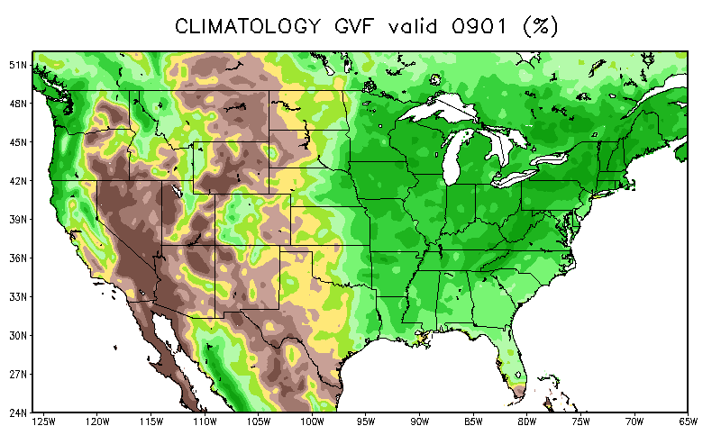
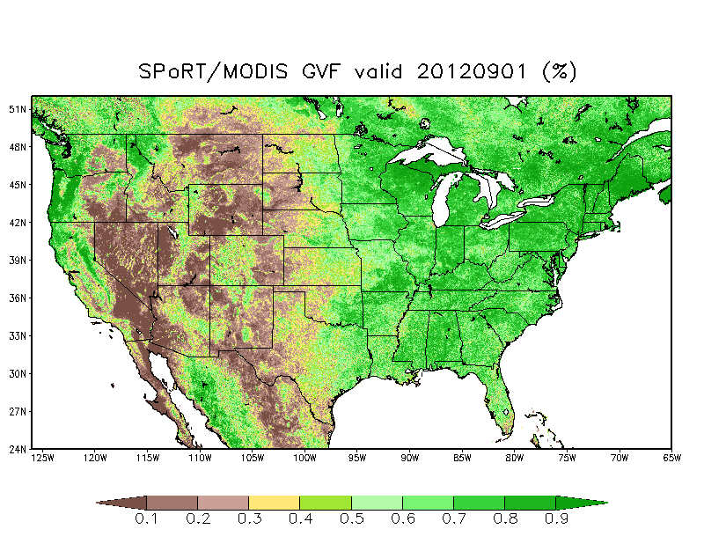
SPoRT/MODIS Real-time GVF
SPoRT GVF Composite Product
  GVF: Percent coverage of healthy green vegetation at a given grid pixel
  MODIS swaths of Normalized Difference Vegetation Index (NDVI) mapped to CONUS grid
  Latency-weighted composite of NDVI, similar
  to SST compositing technique
  Updated daily with new MODIS swaths
  NDVI converted to GVF by vegetation type following Zeng et al. (2000); Miller et al. (2006)
Benefits over default GVF
  Default GVF in STRC EMS is a monthly climo
    Represents GVF the same from year to year
    Cannot account for anomalies caused by weather extremes, wildfires, urbanization, etc.
  Much higher spatial resolution (1 km vs. 16 km)
Climo
SPoRT
SPoRT Virtual Workshop, 13 September 2012

Slide 6
SPoRT/MODIS GVF Examples:
Significant deviations from climatology
SPoRT Virtual Workshop, 13 September 2012

Slide 7
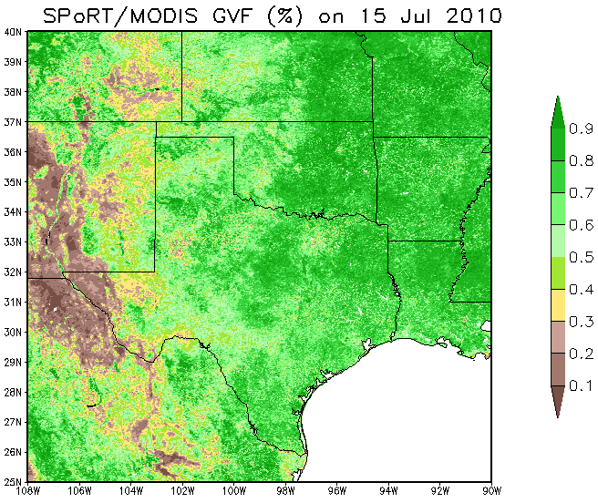
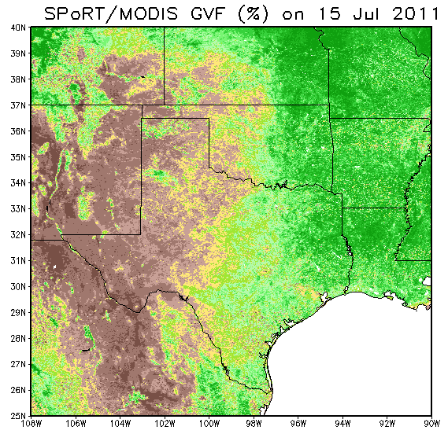
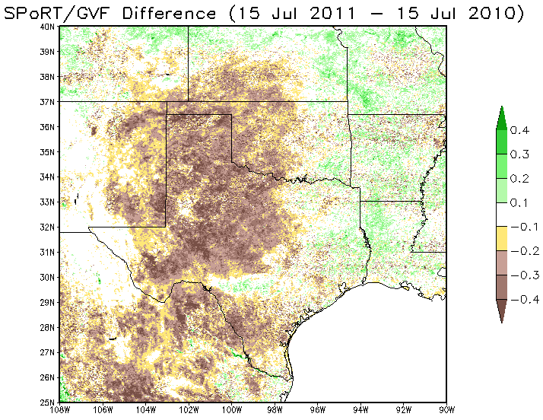
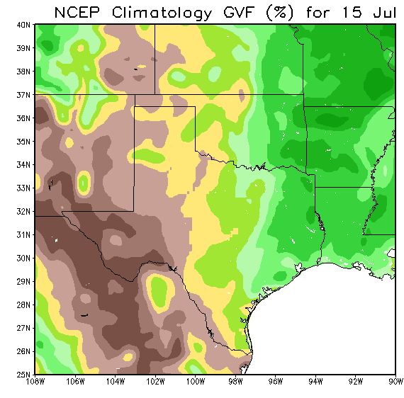
2011 Texas Drought: 1-year Diff on 15 July
Big 1-yr diff in GVF
  TX was very wet in early summer 2010
  Virtually no rain in TX/OK in 2011
  1-yr reduction in GVF, up to 40%+
  Shows how much GVF can change from year to year
  Climo doesn’t cut it!
  2011 MODIS GVF actually compares better to NCEP climo
  Texas summers should be dry!

Slide 8
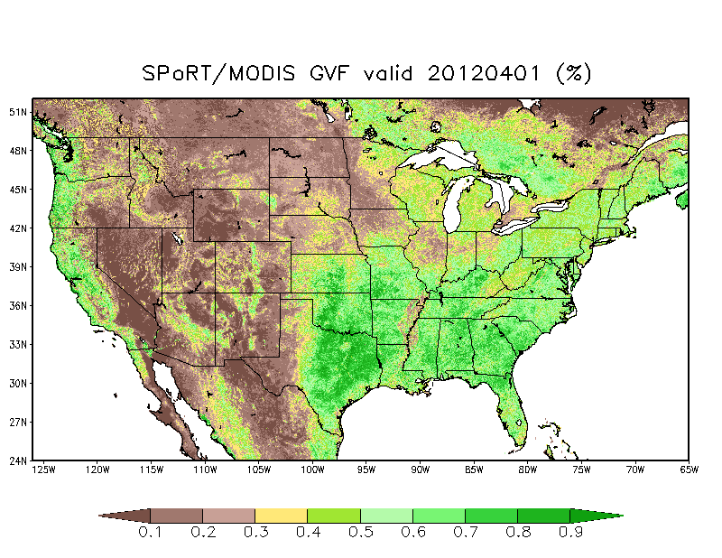
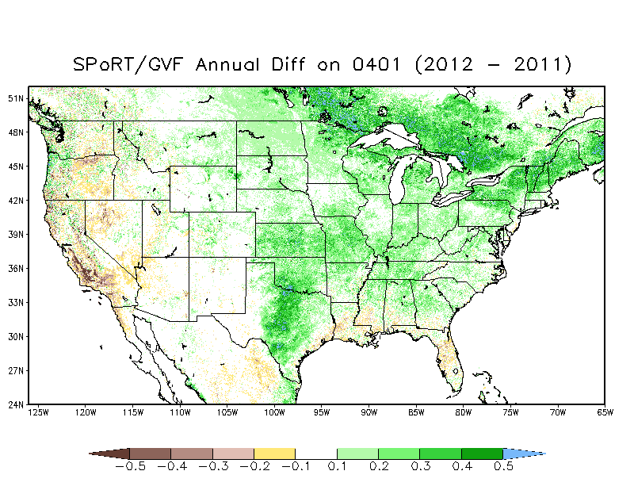
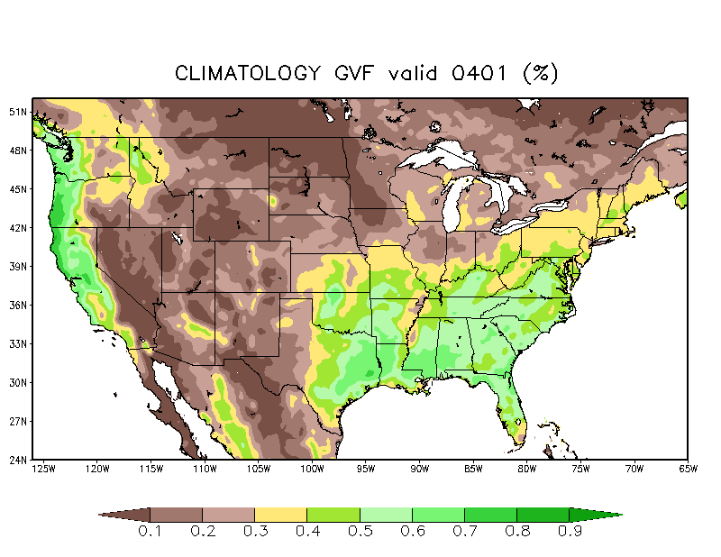
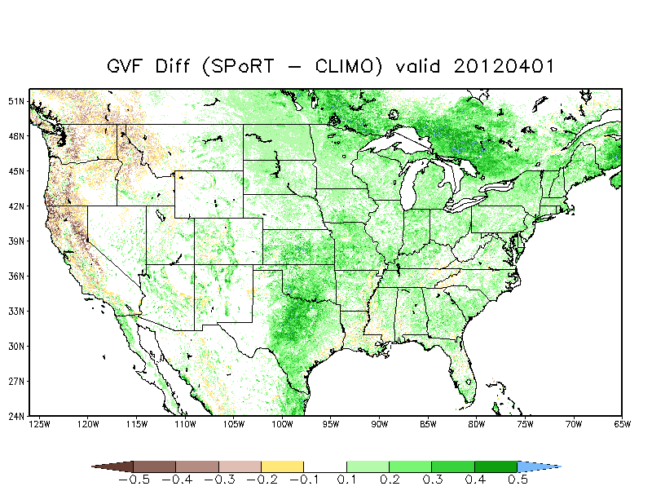
Spring 2012 Early Green-up
Record warmth in March 2012 in eastern U.S.
Dramatic response in vegetation
1-yr change > 40% in southern Canada
Differences from climatology on
1 April closely follow 1-year change in SPoRT-MODIS GVF

Slide 9
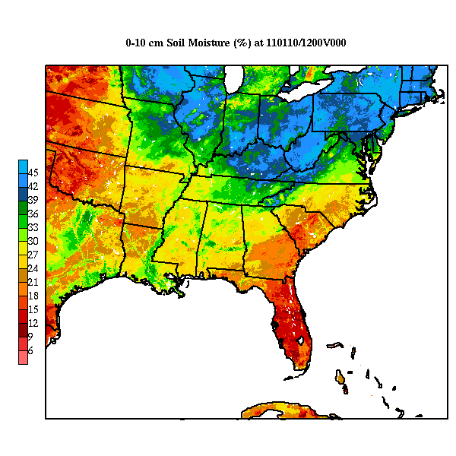
LIS Land Surface Initialization
Land Information System (LIS)
  NASA system to perform land surface modeling & assimilation of land datasets
  Runs variety of Land Surface Models (LSMs)
  Uses satellite, ground, and reanalysis data to integrate LSMs apart from NWP model
  Can run coupled to Advanced Research WRF
SPoRT Real-Time LIS Run
  Runs operational Noah LSM on 3-km grid over eastern/southern U.S.
  High-resolution spin-up ensures soil fields are consistent with local model runs
  NCEP operational analyses drive LSM
    GDAS, NLDAS2 & Stage IV precipitation
  Incorporates SPoRT-MODIS GVF every day
  Output every hour for initializing STRC EMS
SPoRT Virtual Workshop, 13 September 2012

Slide 10
Updates to SPoRT Datasets in the Past Year
SPoRT Virtual Workshop, 13 September 2012

Slide 11
SPoRT SST Updates
SST
  Expanded Domain to much of northern and western hemispheres
  Coarsened Resolution to 2-km grid spacing
    Necessary to accommodate larger domain
  Replaced AMSR-E loss with NESDIS GOES/POES
Great Lakes LST
  Replaced consistently latent REMSS with GLERL GLSEA2 analysis for background information
SPoRT Virtual Workshop, 13 September 2012

Slide 12
SPoRT/MODIS GVF Updates
Just one: expanded the northern, western, and eastern edges of domain
  Mainly done to support SPoRT-WRF model runs that emulated the real-time NSSL WRF domain
  New domain extent now 23-55°N latitude and
  130-62°W longitude
SPoRT Virtual Workshop, 13 September 2012

Slide 13
SPoRT-LIS Updates
Table 1. List of configuration details of the real-time SPoRT LIS, notation as to whether the configuration is unchanged or modified, and specific noteworthy details.
Configuration Detail | Unchanged | Modified | Notes
Domain extent | X |  | Eastern United States
Grid spacing | X |  | 3 km
Soil type | X |  | State Soil Geographic database
Land use |  | X | Upgraded to IGBP/MODIS 20-class vegetation type
Land surface model |  | X | Upgraded to Noah version 3.2 (formerly v2.7.1)
GVF database | X |  | Daily real-time SPoRT-MODIS Green Vegetation Fraction generated at native 0.01° resolution
Surface albedo |  | X | Improved look-up table methodology based on input real-time SPoRT-MODIS GVF
Atmospheric forcing (excludes precip) |  | X | Long-term Noah LSM integration driven by NLDAS-2 (formerly first-generation NLDAS)
Precipitation forcing | X |  | Hourly NCEP Stage IV precipitation analyses
SPoRT Virtual Workshop, 13 September 2012

Slide 14
Instructions for using SPoRT Datasets in STRC EMS
SPoRT Virtual Workshop, 13 September 2012

Slide 15
How do I use SPoRT SST?
ems_prep:
  Add “--sfc sstsport,ssthr” to your ems_prep entry
  Example: “ems_prep --dset namptile --sfc sstsport,ssthr”
  SPoRT recommends the “--besthr sstsport” option to best match the SST hour with the model initialization hour
    SSTs can have a diurnal signal, depending on atmospheric conditions
    This option will often result in using yesterday’s SST data
    SSTs don’t change much from day-to-day, however, so that’s OK
ems_autorun:
  Edit the <rundir>/conf/ems_auto/ems_autorun.conf file
  Set “SFC = sstsport,ssthr” and “BESTHR = sstsport”
SPoRT Virtual Workshop, 13 September 2012

Slide 16
How do I use Great Lakes LST?
See Previous slide
(Great Lakes LST is blended into the SPoRT SST composite)
SPoRT Virtual Workshop, 13 September 2012

Slide 17
How do I use Great Lakes Ice Cover?
Recommended method: (configuration file entry)
  Default values in run_physics.conf should suffice
  To verify appropriate setting:
    Edit the <rundir>/conf/ems_run/run_physics.conf file
    Ensure that 270K < SEAICE_THRESHOLD < 273 K
    Ensure that “FRACTIONAL_SEAICE = 0”
    WRF initialization routine (real.exe) changes open water points to ice points when SST < SEAICE_THRESHOLD
    Land use changes from water to land/ice
SPoRT Virtual Workshop, 13 September 2012

Slide 18
How do I use SPoRT LIS?
ems_prep:
  Add “--lsm lis” to your ems_prep entry
  Example: “ems_prep --dset namptile --lsm lis”
  A backup lsm option is available in EMS v3.2.1beta+
    e.g. ems_prep --dset namptile --lsm “lis|namptile”
    Note the need for double quotes around the lsm option
ems_autorun:
  Edit the <rundir>/conf/ems_auto/ems_autorun.conf file
  V3.1.1: Set “LSM = lis”
  V3.2.1beta+: “LSM = lis|namptile” or “LSM = lis|gfsptile”
Use Noah LSM physics option:
  Set “SF_SURFACE_PHYSICS = 2” in <rundir>/conf/ems_run/run_physics.conf
SPoRT Virtual Workshop, 13 September 2012

Slide 19
Important notes for using LIS data
Important Notes:
  Must use Noah LSM physics option because the SPoRT/LIS runs the standard operational Noah and its soil layers
    Set “SF_SURFACE_PHYSICS = 2” in conf/ems_run/run_physics.conf
  Use namptile as a backup option for consistency with the Noah LSM. gfsptile is acceptable, but is lower resolution data
  It is highly recommended to use the MODIS 20-class land-use data, set within the domain wizard during domain setup
    Check the box “Use MODIS Data” when configuring grids
    The Noah LSM is the only SF_SURFACE_PHYSICS option that will work with MODIS land use classification
SPoRT Virtual Workshop, 13 September 2012

Slide 20
How do I use SPoRT/MODIS GVF?
A little more involved, but in a nutshell:
  Create new directory in $EMS/data/geog, called “sportgvf”
  Create “index” file to define the new GVF data
  Modify “GEOGRID.TBL” file to support new dataset
  Download compressed file from SPoRT’s ftp site each day
  Re-localize domain by running the “ems_domain” script
  Repeat steps (4) and (5) daily as new GVF data are acquired, for all EMS domains of interest
SPoRT instructions document available
  Detailed instructions available for those interested
  Sample script provided that automatically downloads data each day and re-localizes EMS domains of interest
SPoRT Virtual Workshop, 13 September 2012

Slide 21
Summary of SPoRT Data for EMS
SPoRT has three products for use in the STRC EMS
  SPoRT SST composites
    Hemispheric MODIS/GOES-POES/OSTIA twice daily at 2-km resolution
    Includes GLERL Great Lakes LST and NIC ice cover
  Real-time, daily MODIS Green Vegetation Fraction (CONUS)
  3-km LIS land surface initialization data over the southern/eastern CONUS, incorporating SPoRT-MODIS GVF
Possible Future SPoRT Capabilities in Modeling/EMS
  Developing a set of model verification scripts using NCAR’s
  Model Evaluation Tools (SR Modeling Collaboration), designed to work in conjunction with the STRC EMS
Questions?
SPoRT Virtual Workshop, 13 September 2012

