Slide 1
The Utility of the Real-Time NASA Land Information System for Drought Monitoring Applications, Assessing Flood Potential, and Use in Collaborative Local Modeling at NWS Huntsville, AL
Kristopher D. White
Jonathan L. Case

Slide 2
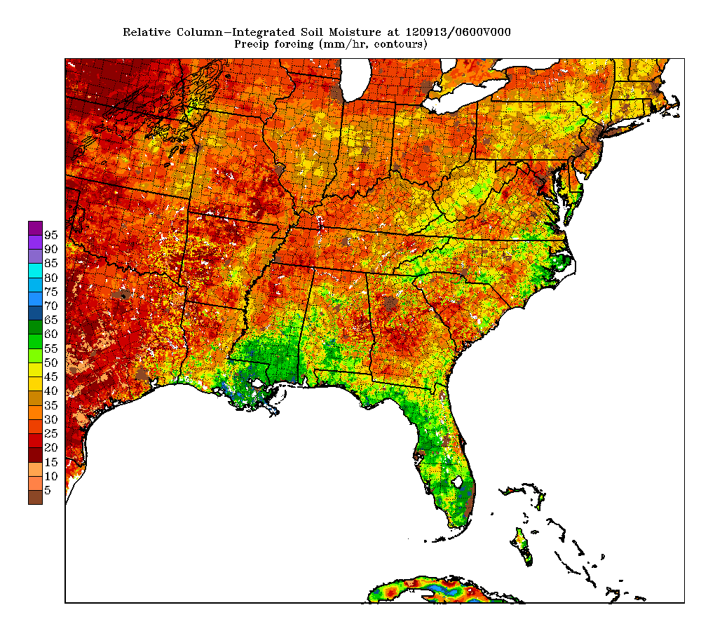
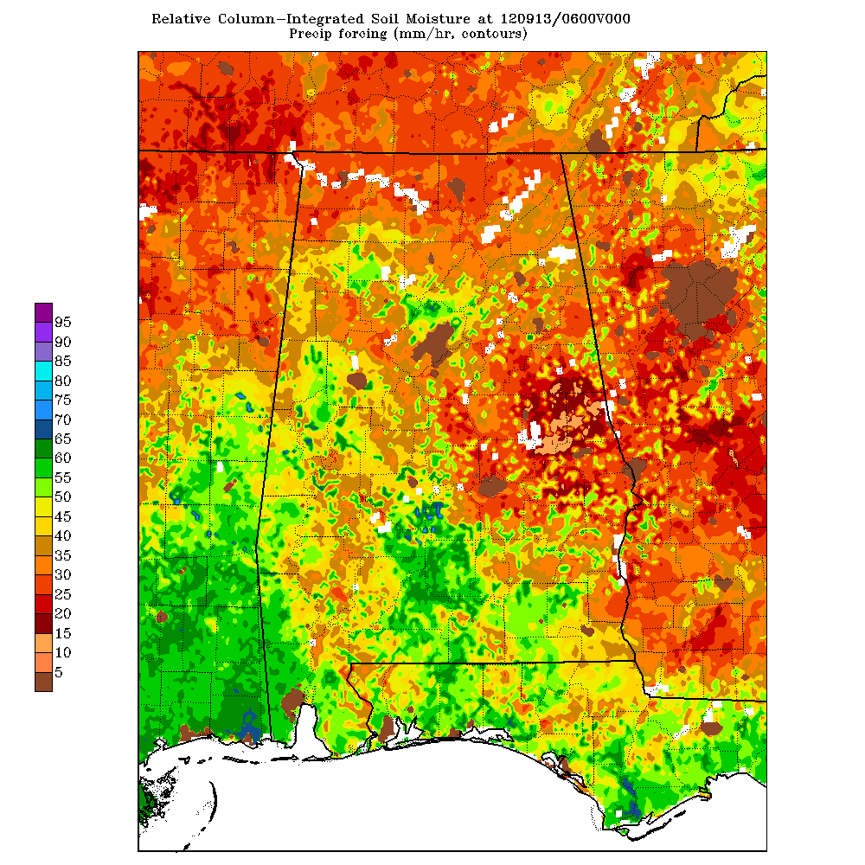
SPoRT LIS Soil Moisture Plots
3-km SPoRT LIS relative column integrated (0-200 cm) soil moisture (%) – SE Conus
3-km SPoRT LIS relative column
(0-200 cm) integrated soil moisture – AL

Slide 3
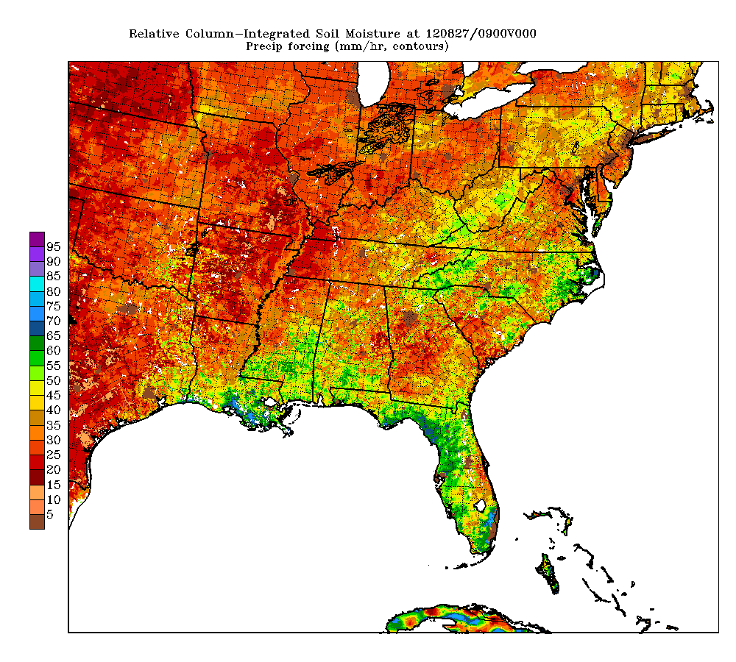
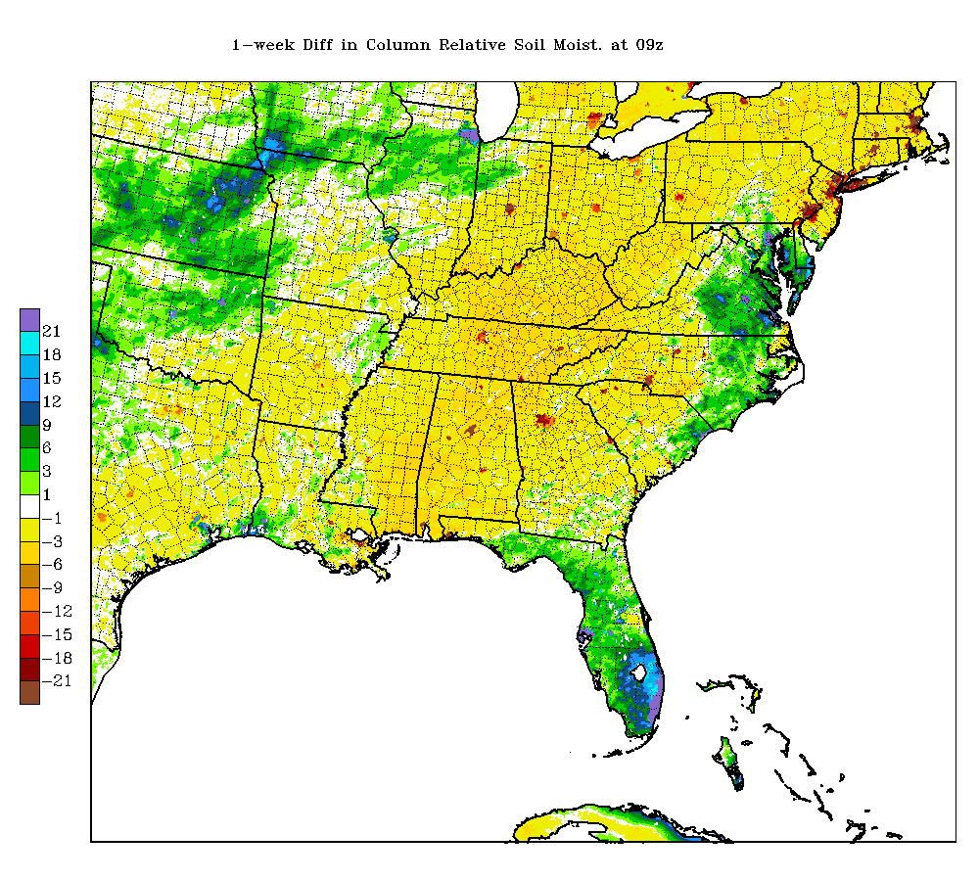
SPoRT LIS Soil Moisture Plots
3-km SPoRT LIS relative column integrated (0-200 cm) soil moisture (%)
3-km SPoRT LIS relative column integrated
(0-200 cm) weekly soil moisture difference

Slide 4
SPoRT LIS Soil Moisture Plots
Soil Moisture Output
SOIM-10 = Soil Moisture % (0-10 cm)
SOIM40-100 = Soil Moisture % (40-100 cm)
RSOIM = Relative Soil Moisture (0-10 cm)
Wilting point / Saturation point
INT-RSOIM = Integrated Relative Soil Moisture (0-200 cm)
Wilting point / Saturation point
LHFX = LIS-Noah Latent Heat Flux (W/m²)
RSOIMDIFF = Integrated Relative Soil Moisture Difference (0-200 cm)
Weekly Change
SHFX = LIS-Noah Sensible Heat Flux (W/m²)
TSKIN = LIS-Noah Skin Temperature (°C)
VEGFR = Green Vegetation Fraction %
MODIS derived
http://weather.msfc.nasa.gov/sport/case_studies/lis_AL.html

Slide 5
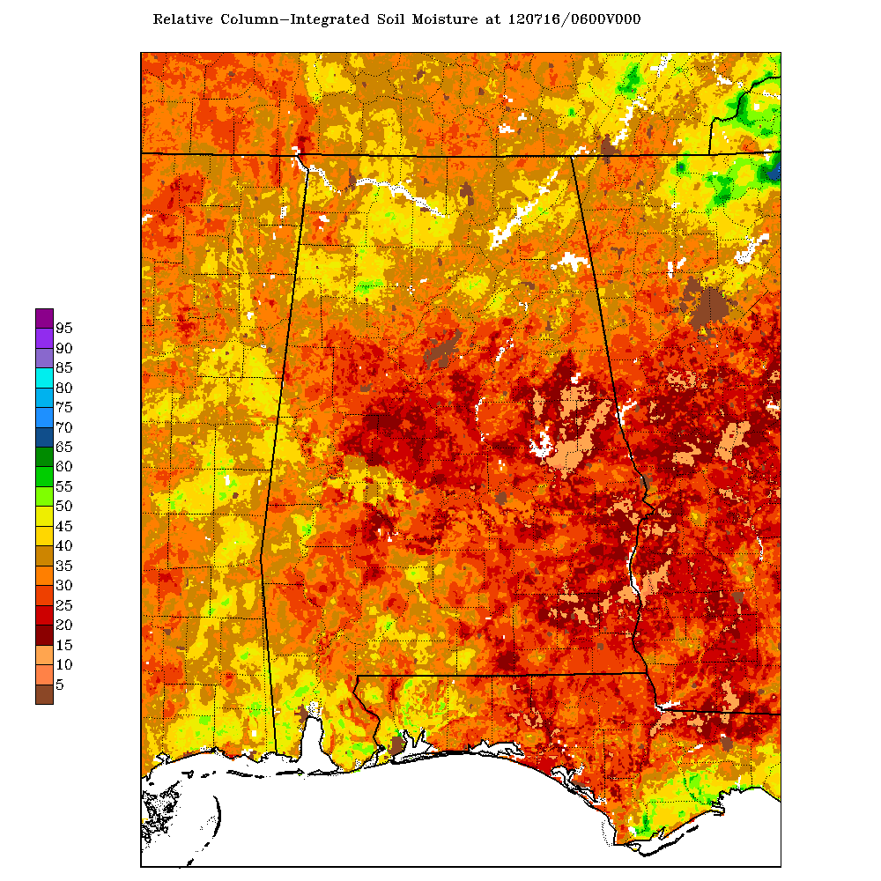
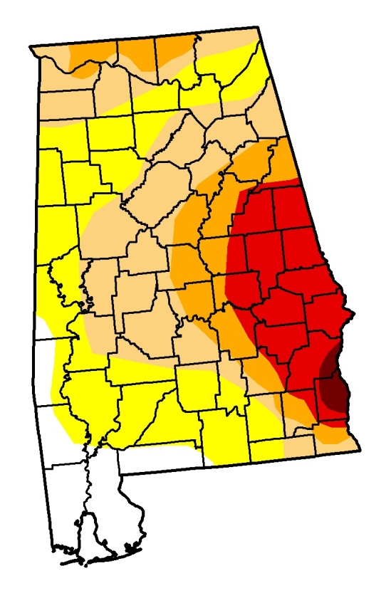
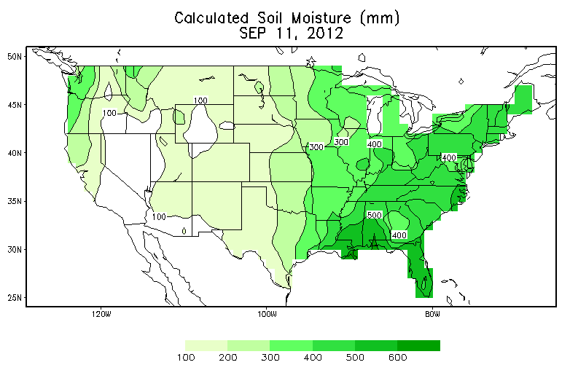
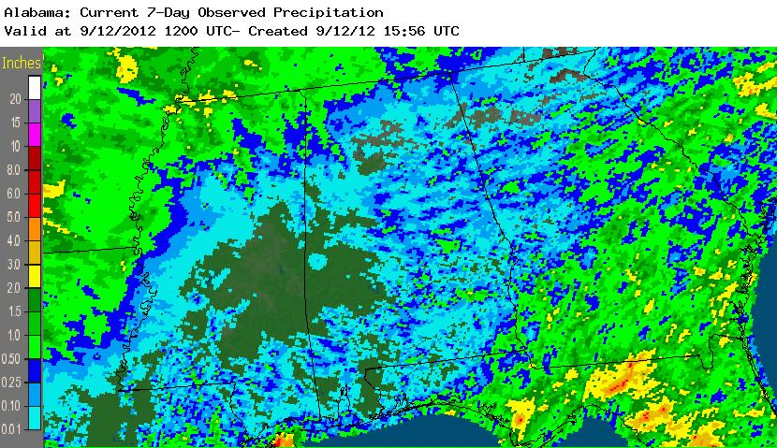
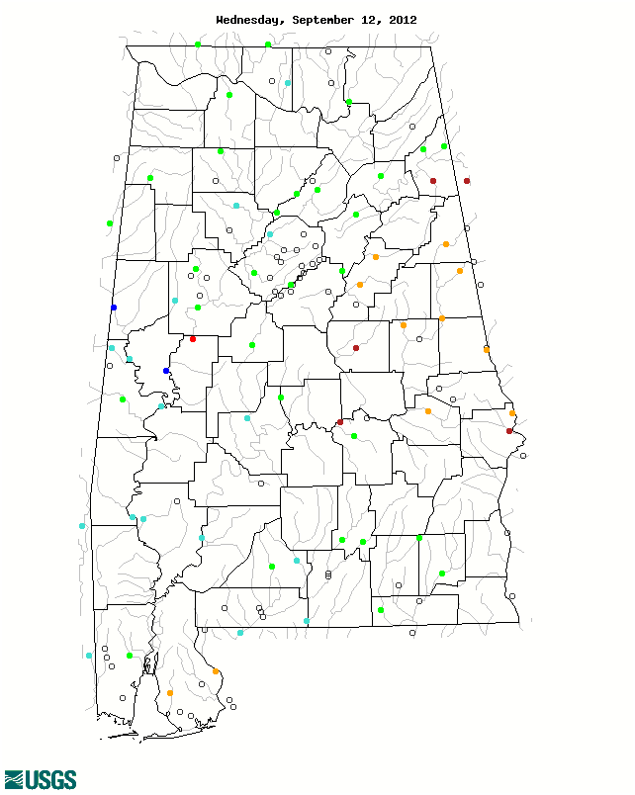
SPoRT LIS Soil Moisture Plots for Drought Monitoring
AHPS (Stage-IV) Precipitation
Sample calculated soil moisture (mm) from the Climate Prediction Center.
Daily streamflow
From USGS
U.S. Drought Monitor for the state of Alabama
Sample NASA LIS 3-km
0-10 cm soil moisture plot.

Slide 6
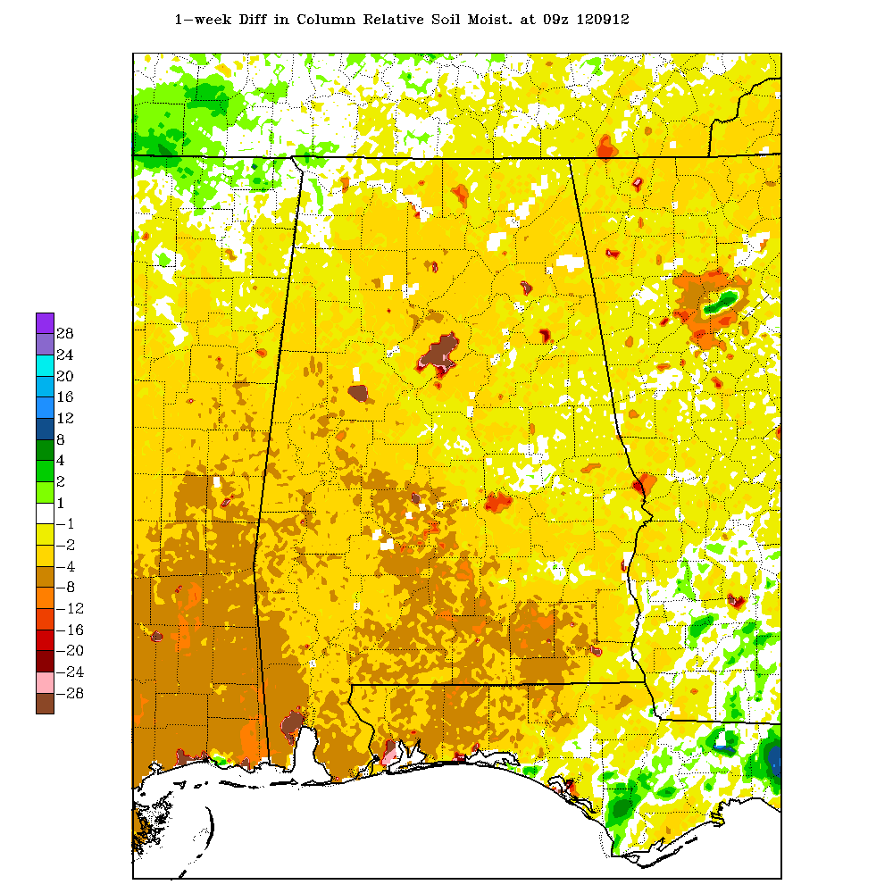
SPoRT LIS Soil Moisture Plots for Drought Monitoring – How is Soil Affected by Rainfall?
Weekly Rainfall ending 9/12/2012
Weekly Relative Soil Moisture Difference (0-200cm) 9/12/12
Relative Soil Moisture (0-200cm) 9/12/12

Slide 7
SPoRT LIS Soil Moisture Plots for Drought Monitoring
July 26, 2011
August 2, 2011
NASA LIS 1-km 0-10 cm soil moisture plots. Degraded areas are circled in white. Data were used for input to the U.S. Drought Monitor

Slide 8
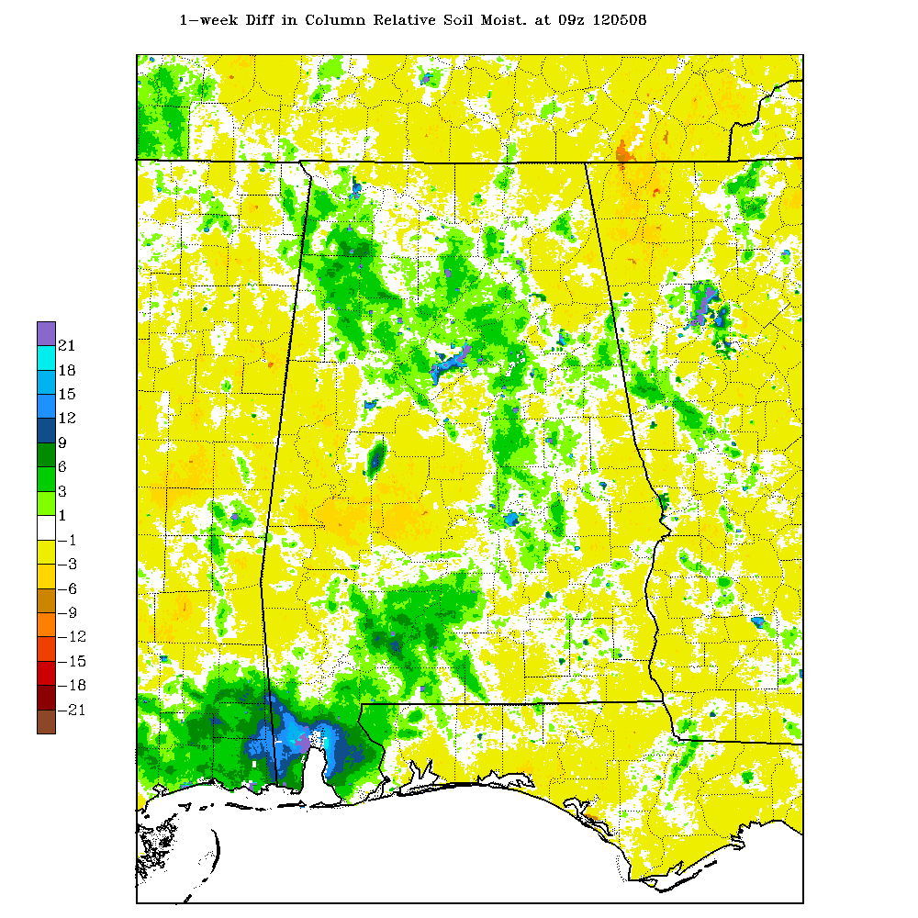
SPoRT LIS Soil Moisture Plots for Drought Monitoring
0-10 cm Soil Moisture – 5/8/2012
0-200 cm Relative Soil Moisture – 5/8/2012

Slide 9
SPoRT LIS Soil Moisture Plots for Drought Monitoring
U.S. Drought Monitor – 5/1/2012
U.S. Drought Monitor – 5/8/2012
Notice the expansion
in this area

Slide 10
SPoRT LIS Soil Moisture Plots for Drought Monitoring – Future Work
Incorporation of LIS soil moisture into the GriDSSAT crop model

Slide 11
Use of NASA Land Information System (LIS)
for monitoring flood potential
Early March 2011 Case…
NASA LIS 1-km Integrated Relative Soil Moisture
03/04/2011
Antecedent relative soil moisture values were around 45-55% before heavy rains moved into the area over the next week.

Slide 12
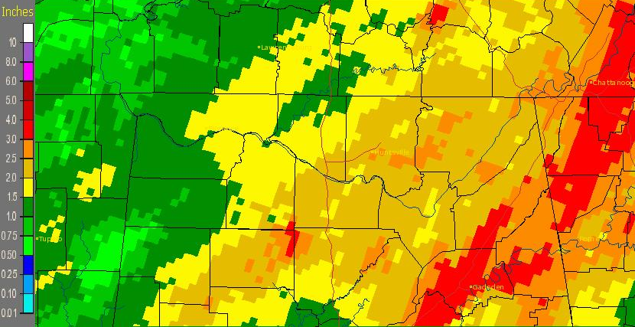
Use of NASA Land Information System (LIS)
for monitoring flood potential
Early March 2011 Case…
24-Hour Stage IV Precipitation Totals
NASA LIS Integrated Relative Soil Moisture
03/06/2011
03/07/2011
A first round of rain on the 5th and 6th brought around 1-3 inch totals to the area.
Soil moisture increased with values around 50-60% after the initial rains.

Slide 13
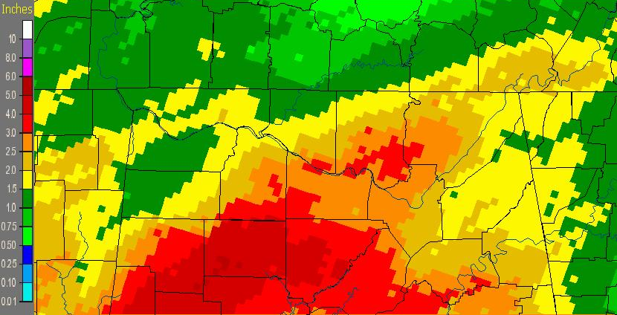
Use of NASA Land Information System (LIS)
for monitoring flood potential
Early March 2011 Case…
24-Hour Stage IV Precipitation Totals
NASA LIS Integrated Relative Soil Moisture
03/09/2011
09/07/2011
03/09/2011
A second round of rain on the 8th and 9th brought another 1-4 inches to the area.
Soil moisture increased with values around 60-75% after the second round of rain.

Slide 14
Use of NASA Land Information System (LIS)
for monitoring flood potential
Early March 2011 Case…
23 Flood warning products resulted across the Huntsville County Warning Forecast Area
Flooding in numerous locations, with many road closures.
Moderate flooding along the Tennessee, Big Nance and Flint Rivers
Widespread one to four inch rainfall totals on top of relatively moist soils led to sufficient runoff to generate minor to moderate flooding.

Slide 15
Use of NASA Land Information System (LIS)
for monitoring flood potential
Now, let’s look at another case in early September 2011…
NASA LIS 1-km Integrated Relative Soil Moisture
09/04/2011
Relative soil moisture values were around 20-40% before heavy rains moved into the area in association with the remnants of tropical storm Lee.

Slide 16
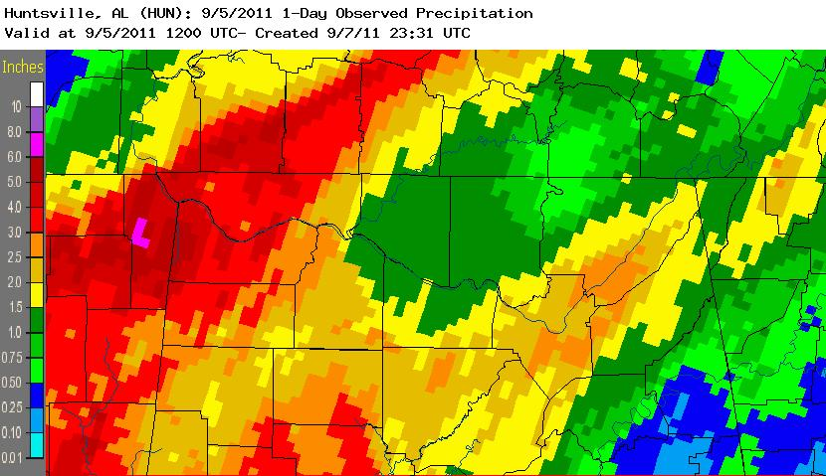
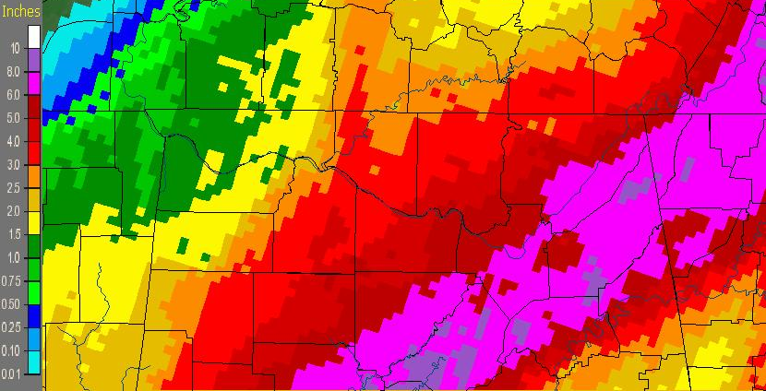
Use of NASA Land Information System (LIS)
for monitoring flood potential
24-Hour Stage-IV Precipitation Totals
09/05/2011
Rainfall amounts for the two-day period ranged from around 4 to 10 inches. Huntsville received it’s largest calendar day rainfall in over 10 years.
However, little flooding was actually reported as a result of the heavy rainfall due in part to the very dry antecedent soil moisture conditions.
09/06/2011

Slide 17
Use of NASA Land Information System (LIS)
for monitoring flood potential
NASA LIS 1-km Integrated Relative Soil Moisture
09/07/2011
Relative soil moisture values only increased to around
40-55% after the rain moved out of the area.

Slide 18
Use of NASA Land Information System (LIS)
for monitoring flood potential
Early September 2011 Case…
Flood warnings issued for several river locations, including the Big Nance, Flint River, Paint Rock River and Tennessee River…none of which verified.
Moderate flooding forecast for Flint River was overestimated by 10 feet!
Minor flooding did occur along the Big Wills Creek in Ft Payne, where rainfall amounts were around 10 inches.
Dry antecedent soil moisture played a large role in reducing flooding potential.

Slide 19
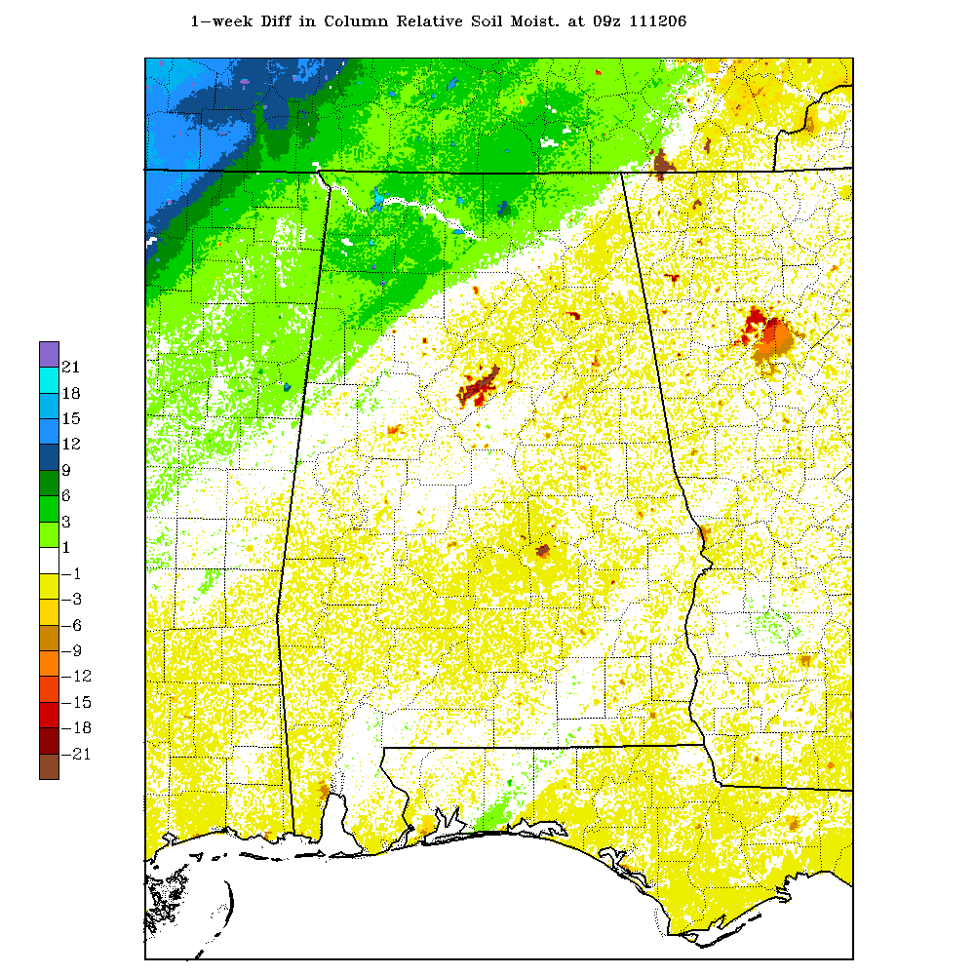
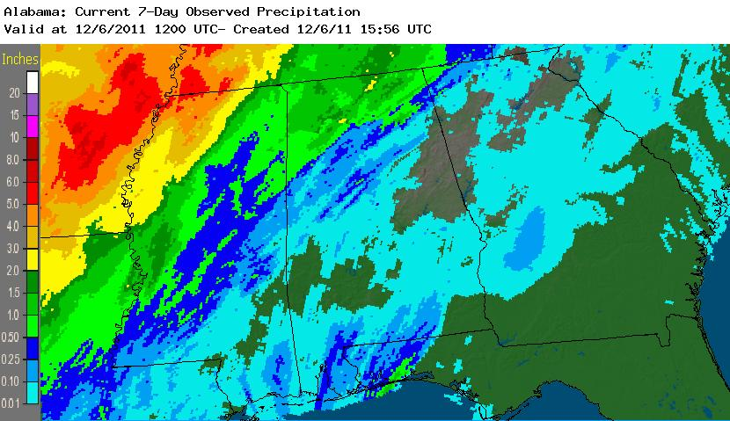
SPoRT LIS Soil Moisture Weekly Difference Plots for Drought Monitoring – Alabama scale
3-km SPoRT LIS relative column integrated (0-200 cm) soil moisture (%)
3-km SPoRT LIS relative column integrated (0-200 cm) weekly soil moisture difference

Slide 20
Huntsville – SPoRT Modeling Collaboration
Nested 3 km Domain
9 km
Outer domain

Slide 21
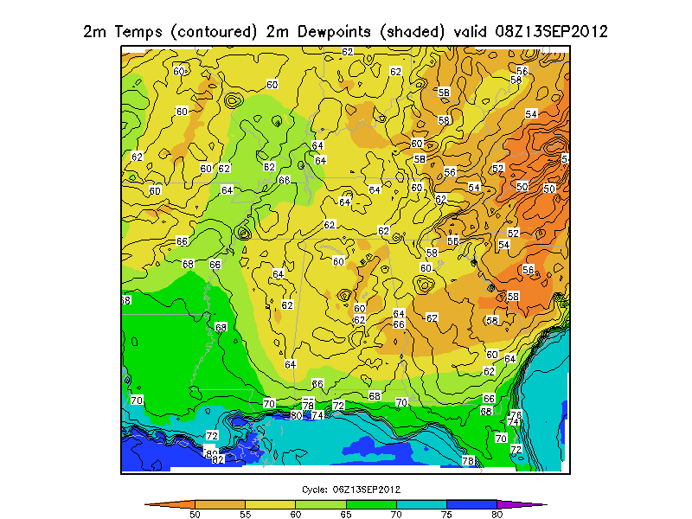
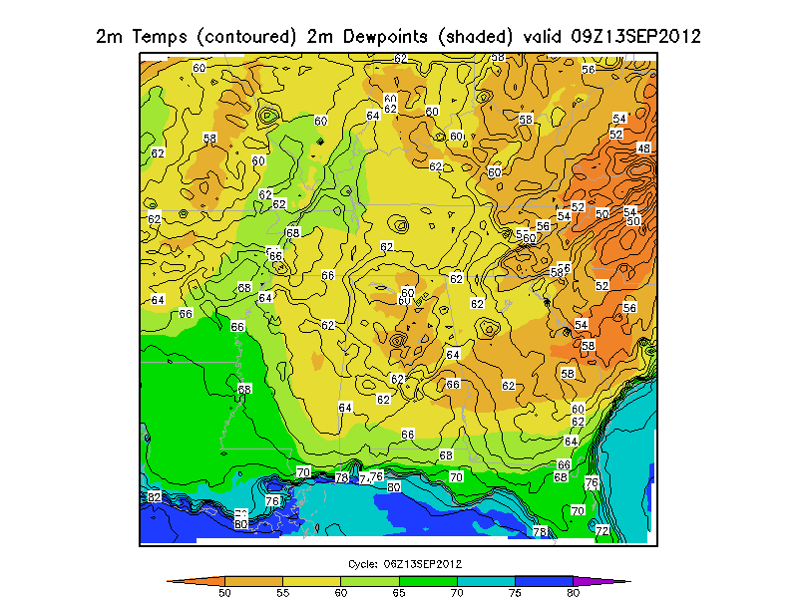
Huntsville – SPoRT Modeling Collaboration
WRF EMS run with SPoRT datasets (GVF, LIS soil moisture, SSTs)
WRF EMS run without SPoRT datasets
2m Temps (contoured) 2m Dewpoints (shaded) valid 08Z 13Sep 2012
2m Temps (contoured) 2m Dewpoints (shaded) valid 08Z 13Sep 2012

Slide 22
Questions?
kris.white@noaa.gov
Jonathan.Case-1@nasa.gov

