Slide 1
The Development of GOES-R GLM case studies for use in the AWC Operational Setting
Ed Holicky- AWC
Dr. Mark Anderson-UNL
Dr. Geoffrey Stano-NASA SPoRT
Amanda Terborg-GOES-R Liason CIMSS/SSEC
(Funded by COMET)

Slide 2
Aviation
The onset of electrification within convection is a significant hazard to the aviation community and is critical to aviation forecasters

Slide 3
GOES-R Data Potentially Beneficial in Both Domestic and International Branches

Slide 4
Domestic Branch Convective SIGMET
1 Forecast Desk 24/7
SIGMET for thunderstorms
“Warning” Product
Associated Hazards: Turbulence
Icing
Wind Shear
CONUS and Coastal Waters
Issued Hourly / Valid for 2 hrs
~ 30,000 issued annually
SIGC
CONVECTIVE SIGMET 55C
VALID UNTIL 1655Z
MI IL LM FROM 20SE GRR-40NE ORD-JOT-40NW BDF
LINE TS 30 NM WIDE MOV FROM 27030KT. TOPS ABV FL450.
OUTLOOK VALID 221655-222055
FROM 30E PXV-30S BNA-30NE IGB-CEW-180S CEW-120SSW LCH-TXK-40NW DYR-30E PXV WST ISSUANCES EXPD. REFER TO MOST RECENT ACUS01 KWNS FROM STORM PREDICTION CENTER FOR SYNOPSIS AND METEOROLOGICAL DETAILS.

Slide 5
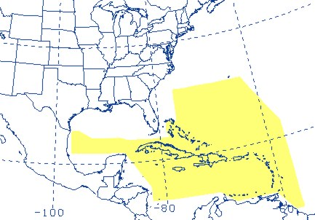
International Branch Gulf of Mexico & Caribbean Area Forecasts
1 Forecast Desk 24/7
Oceanic (Atlantic and Pacific) SIGMETs
Forecasts primarily for Helicopter Operations
Clouds
Visibility
Thunderstorms
Rain/Fog
Wind
4,000 Operating Oil Platforms
30,000 personnel living on oil platforms
600 Helicopters
1.3 Million flights annually

Slide 6
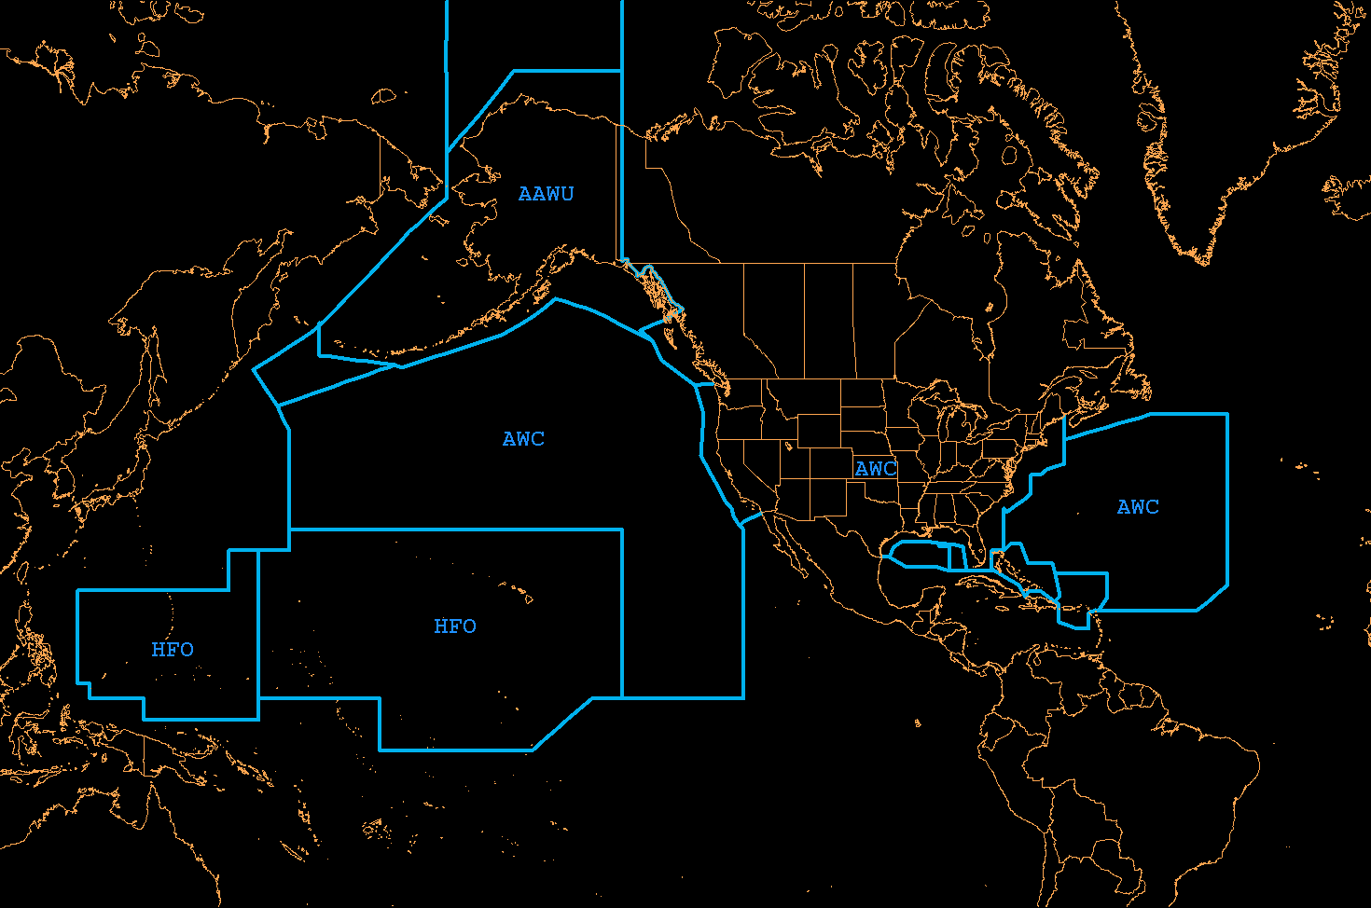
AWC-International SIGMET
Area of Responsibility

Slide 7
Main Objective
To illustrate PGLM data and develop case studies to show how they can be used in aviation

Slide 8
Objective of this Case study
To illustrate PGLM data and how variations in the flash density observations occurred with the convection over northern Virginia and aviation applications on
30 June -1 July 2012

Slide 9
Features
Initiation of convection and how this was observed several times in the PGLM data before the LTNG data
Increase in PGLM flash density data (“jumps”) before or during increases in convective activity
Increase in PGLM flash density before the development of a tornadic storm

Slide 10
Aviation Applications
A major impact in the DC region including ZDC air space throughout the period
Several air routes were shut down
Limitations in departures

Slide 11
Methodology
Present radar loop during the event
Present PGLM flash densities and cloud to ground flashes
Present close-ups of the tornadic event
Present aviation situations

Slide 12
Radar Data
30 June – 1 July 2012

Slide 13
Key Features
Back building of the convection
Movement of the convection
Increase in dBZ levels in convection
Stratiform precipitation forms N/NE of main cells

Slide 14
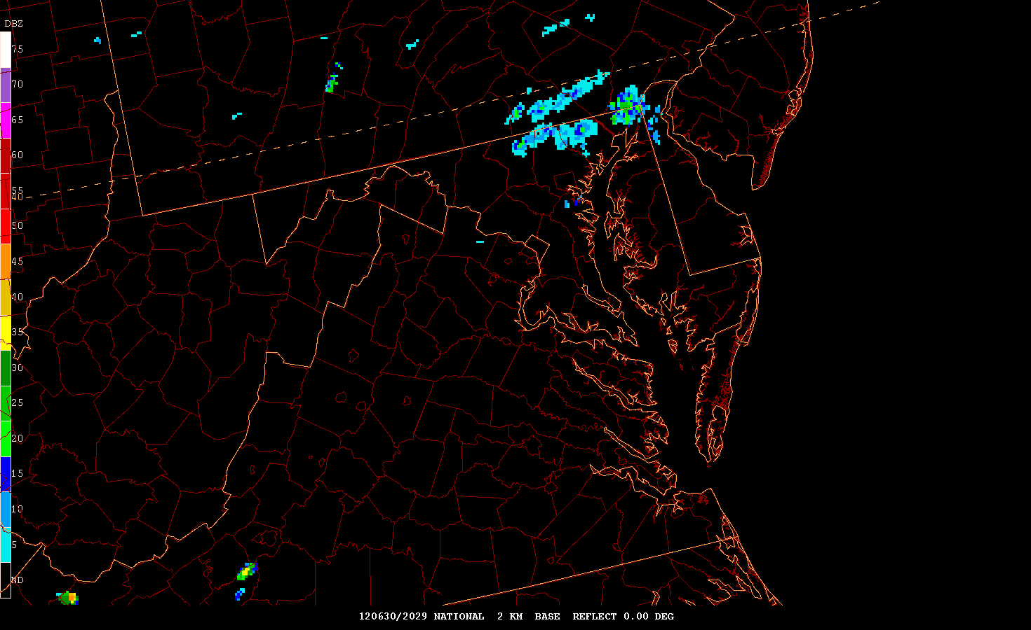

Slide 15
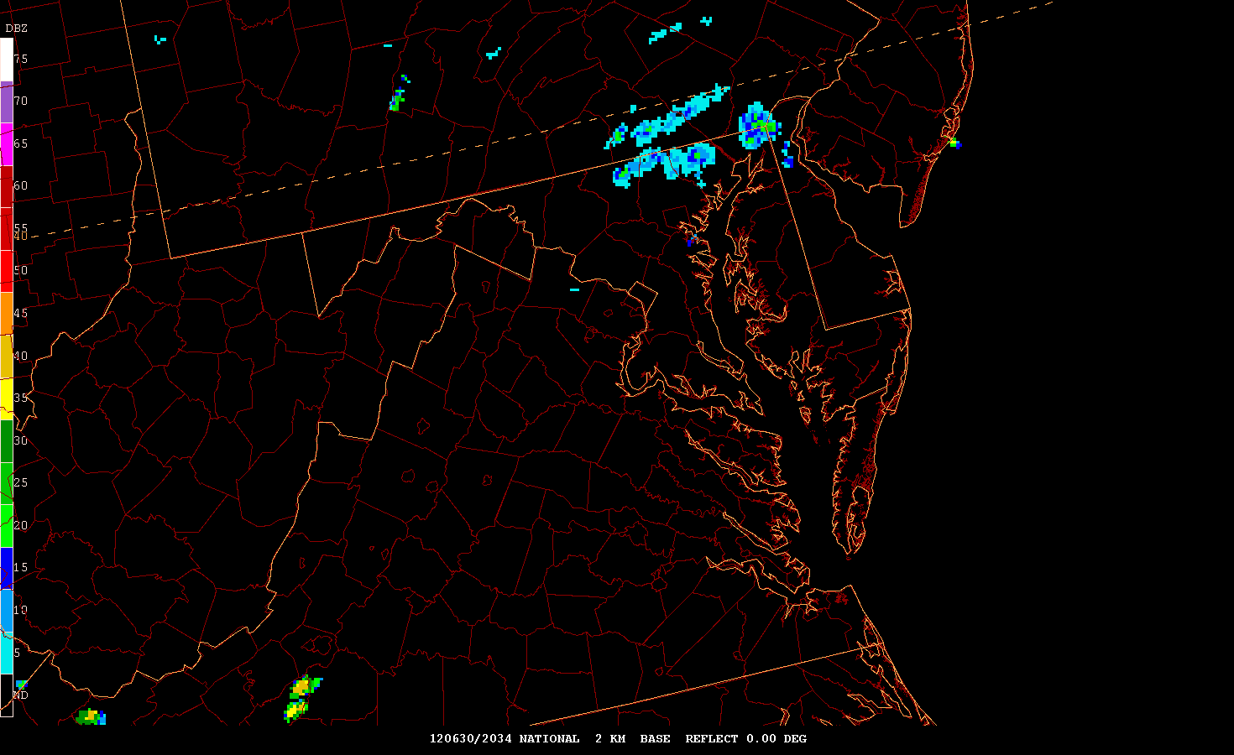

Slide 16
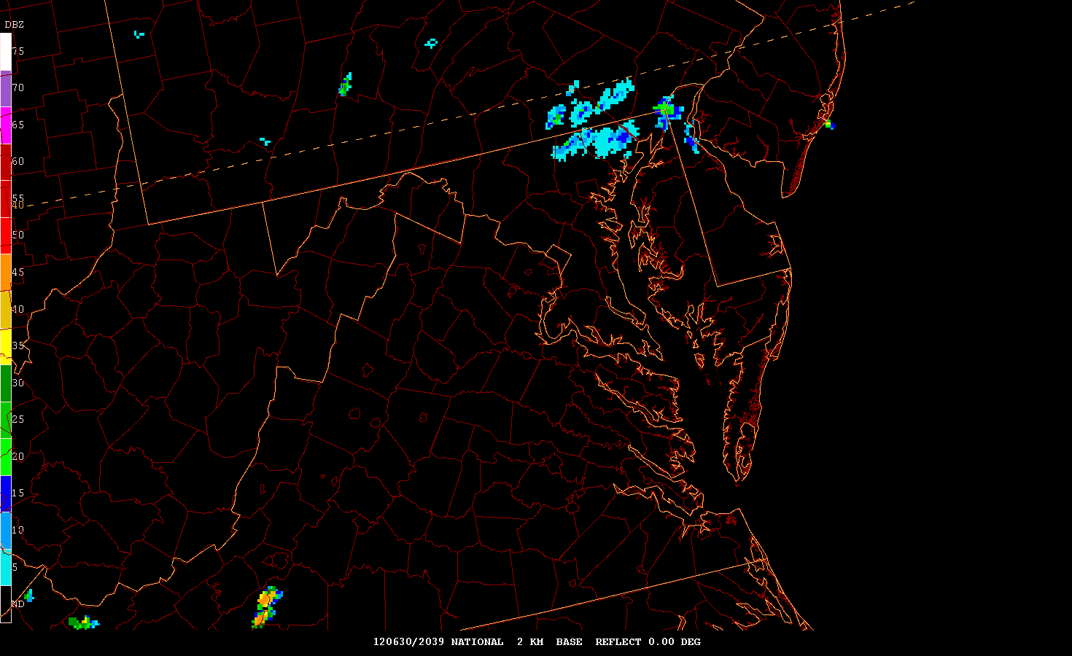

Slide 17
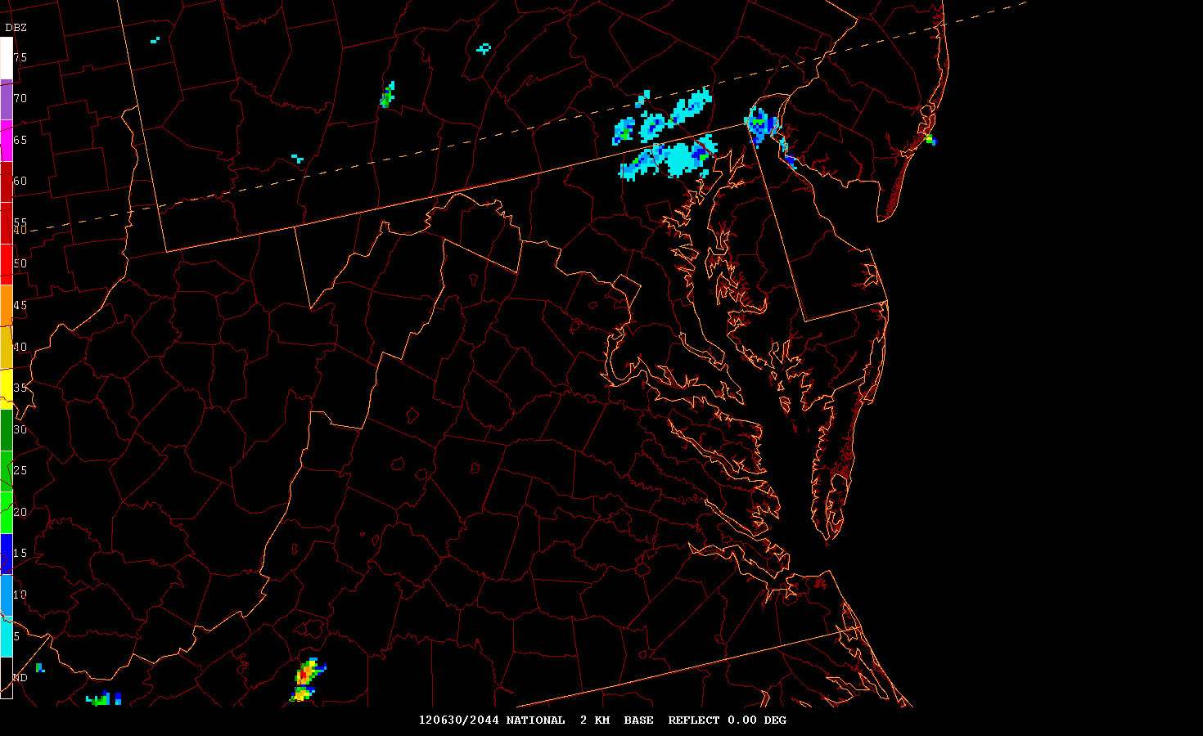

Slide 18
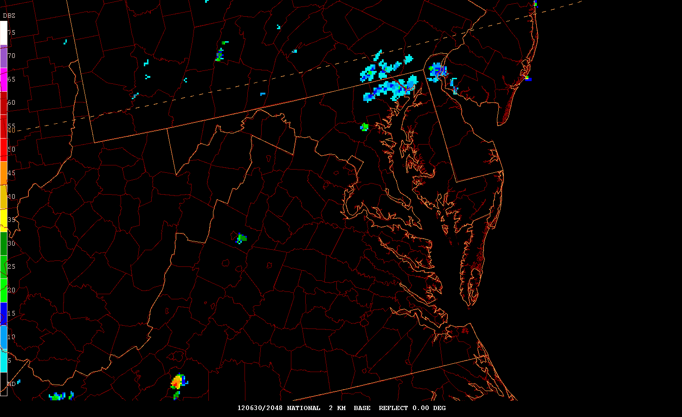

Slide 19
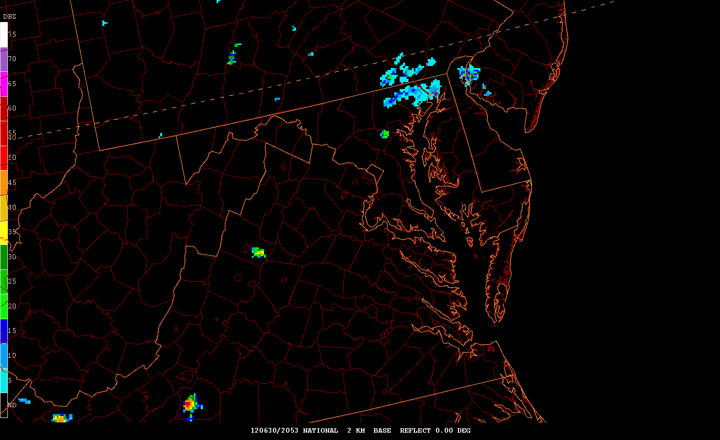

Slide 20
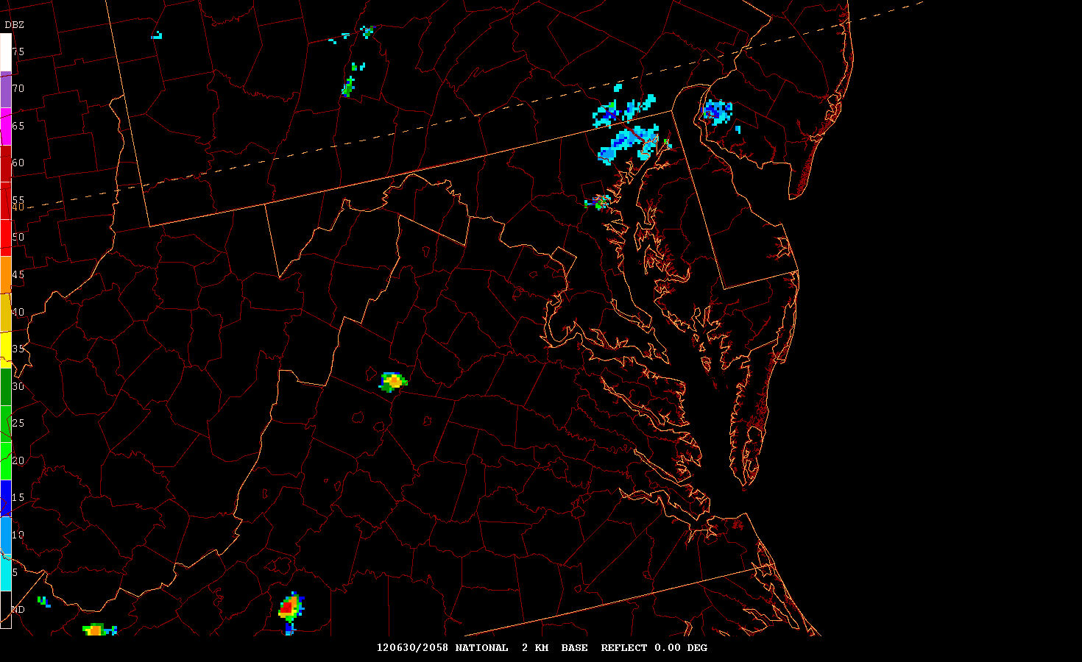

Slide 21
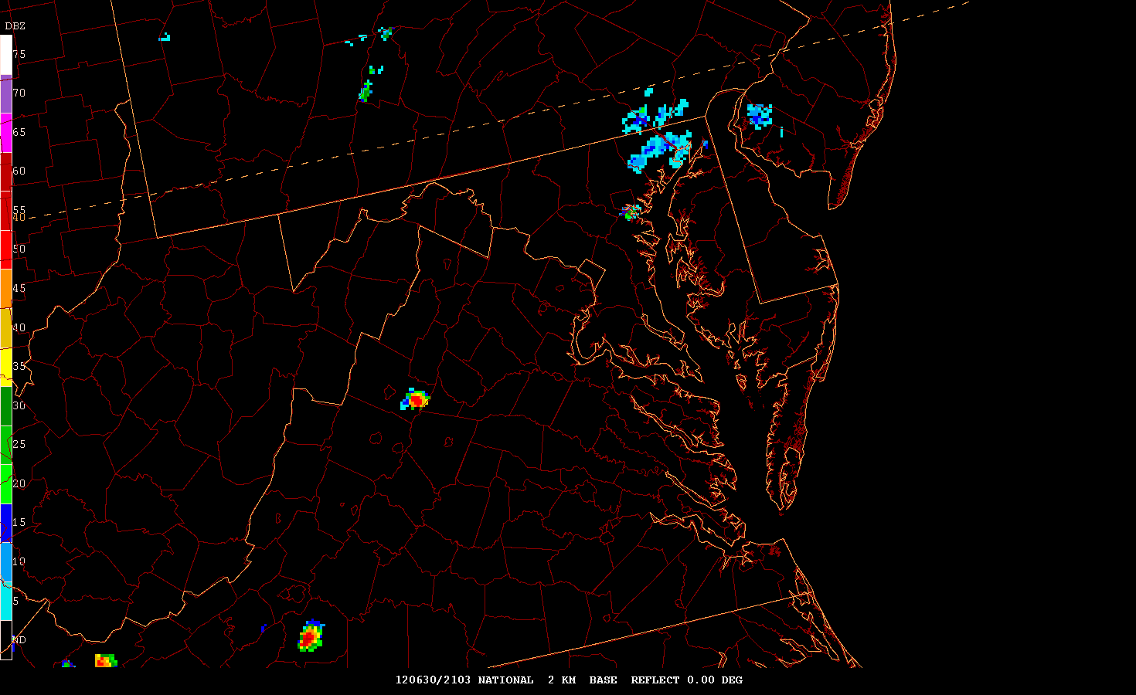

Slide 22
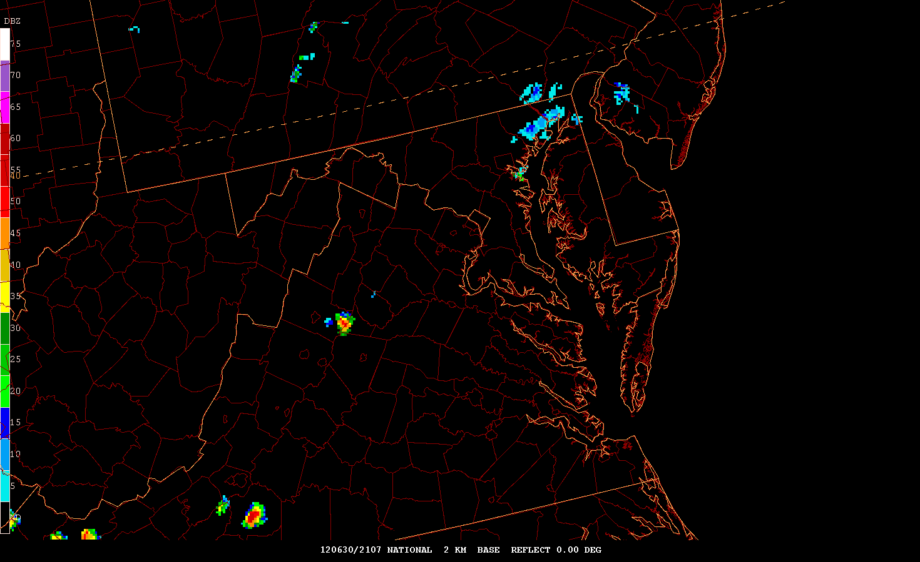

Slide 23
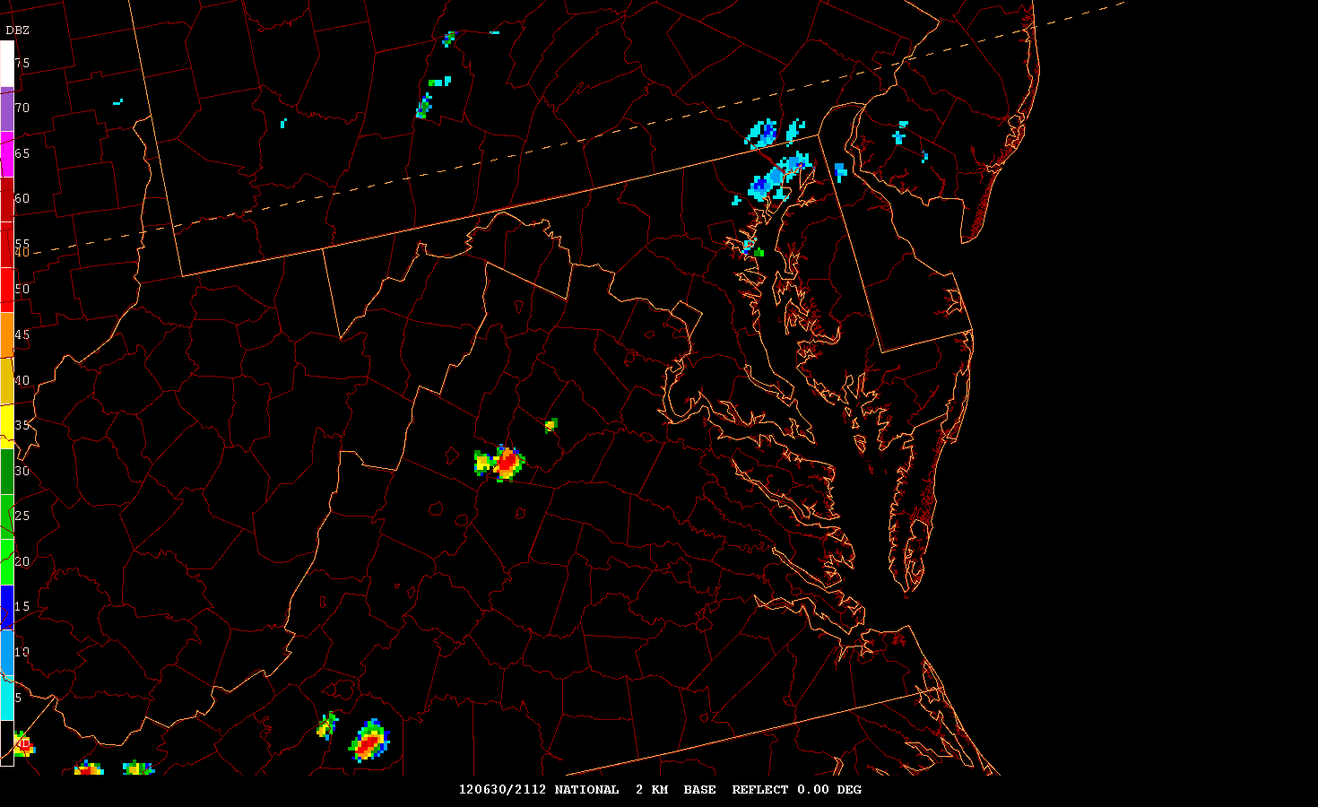

Slide 24
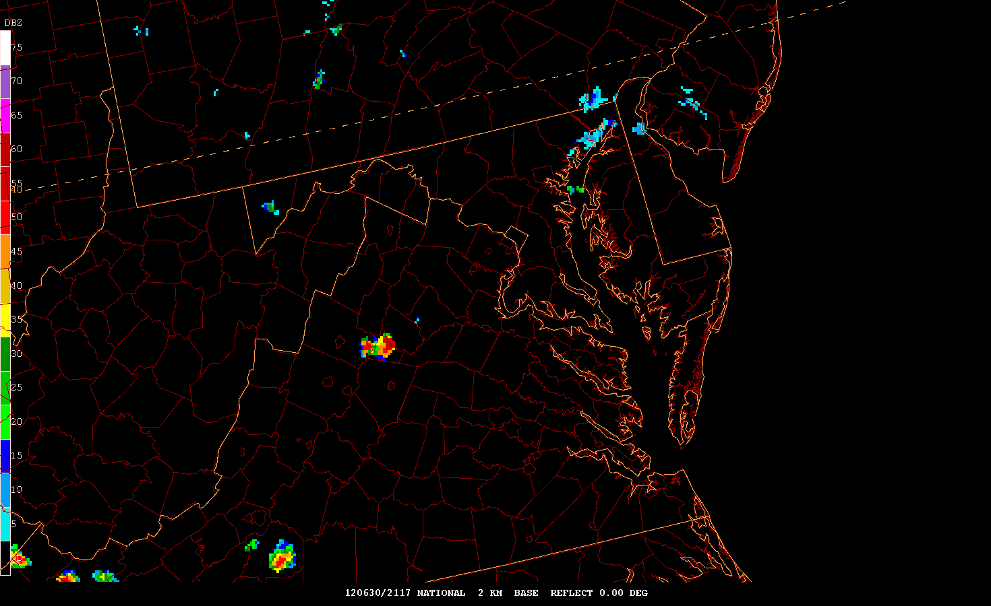

Slide 25
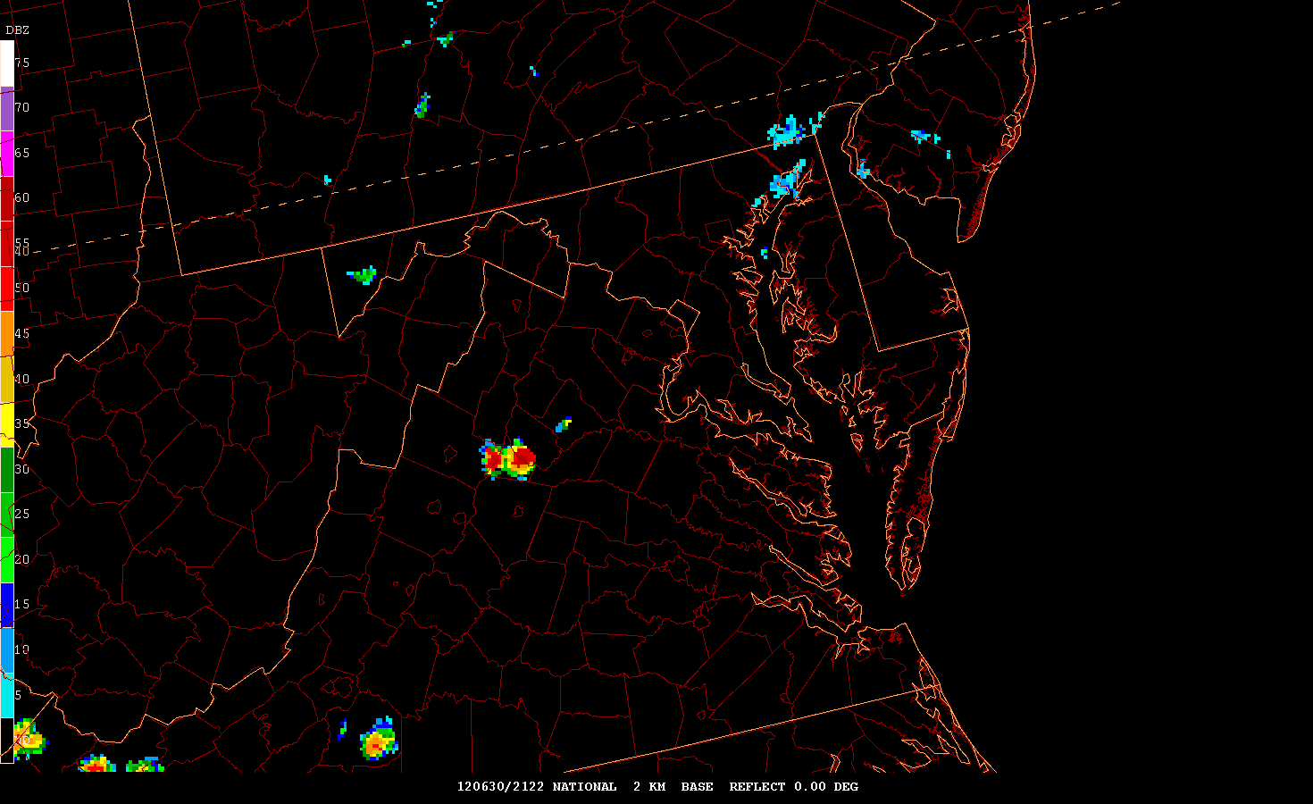

Slide 26
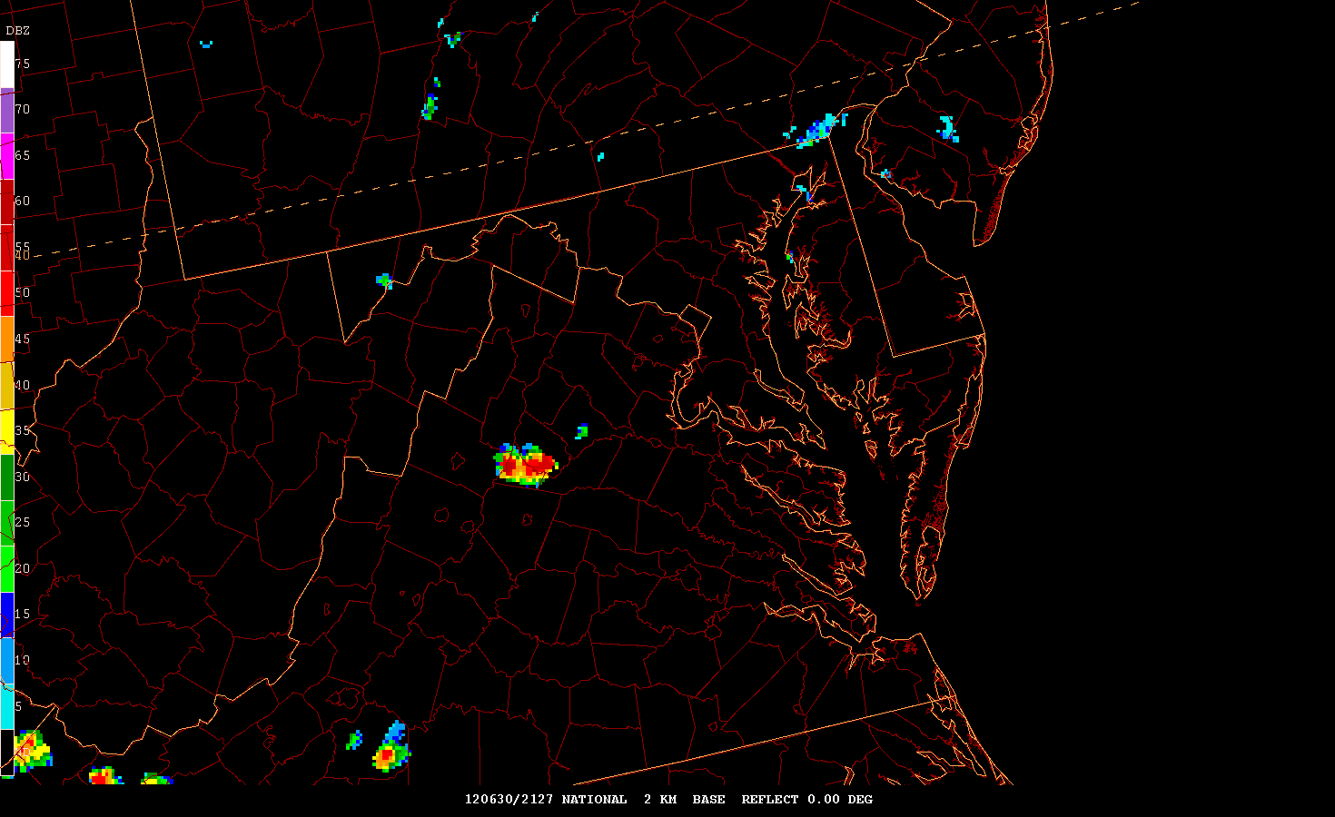

Slide 27
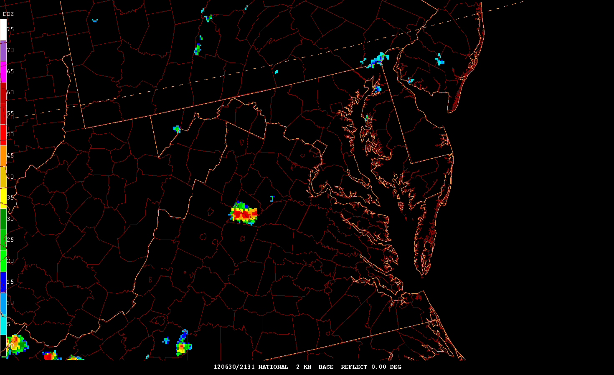

Slide 28
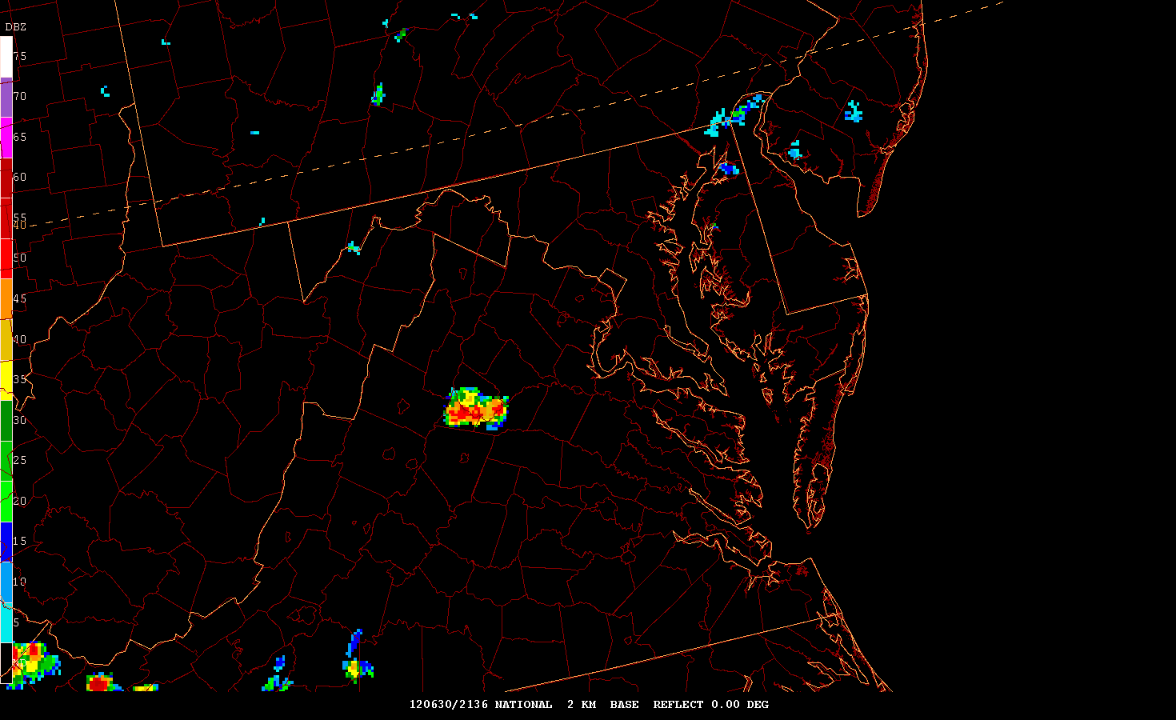

Slide 29
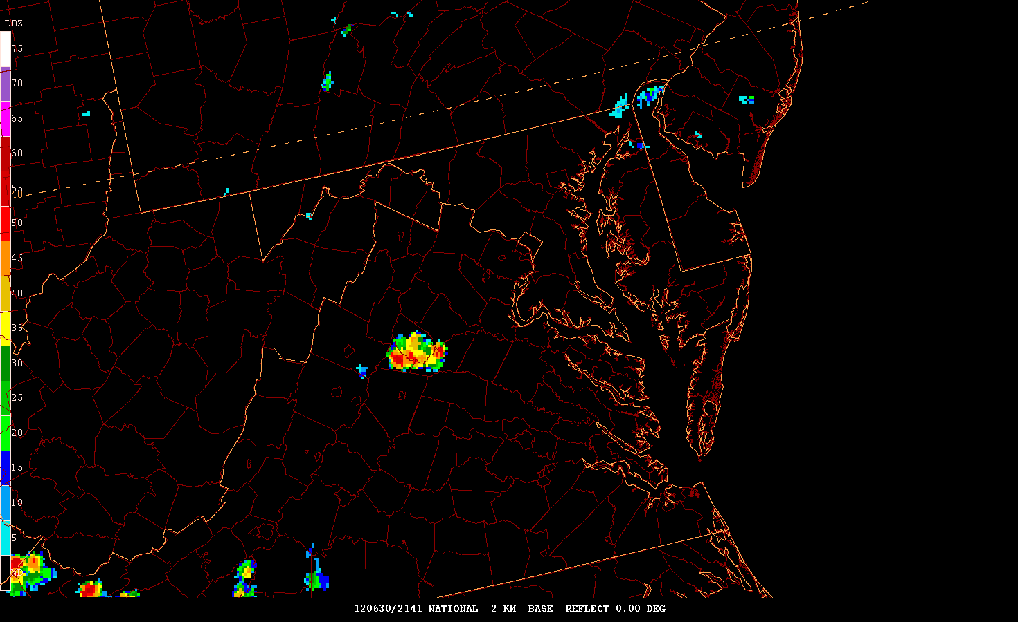

Slide 30
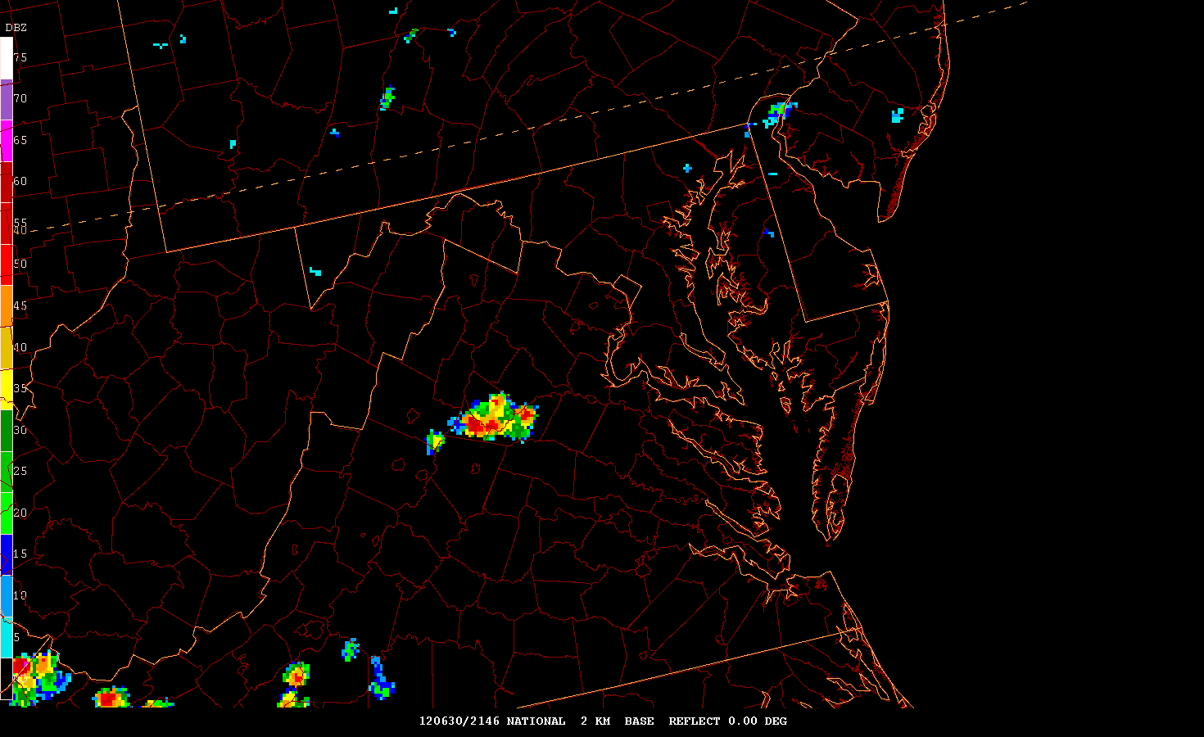

Slide 31
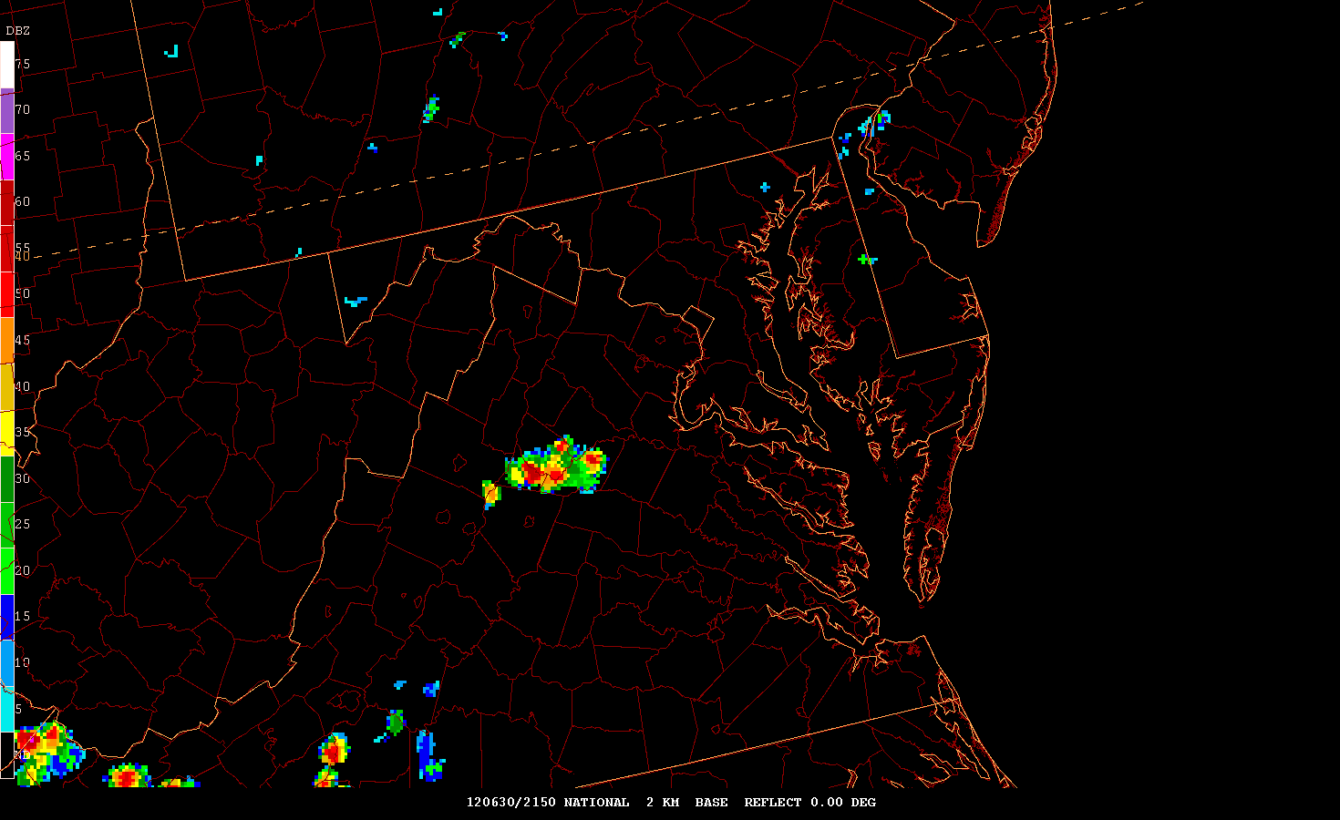

Slide 32
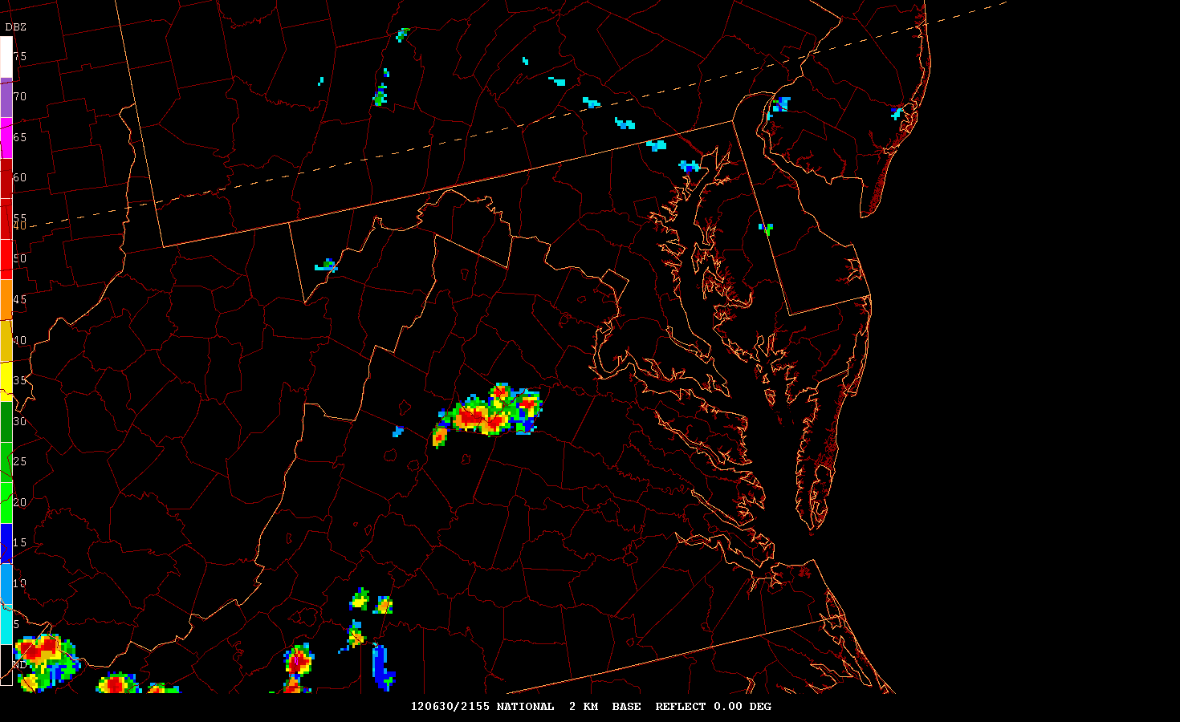

Slide 34
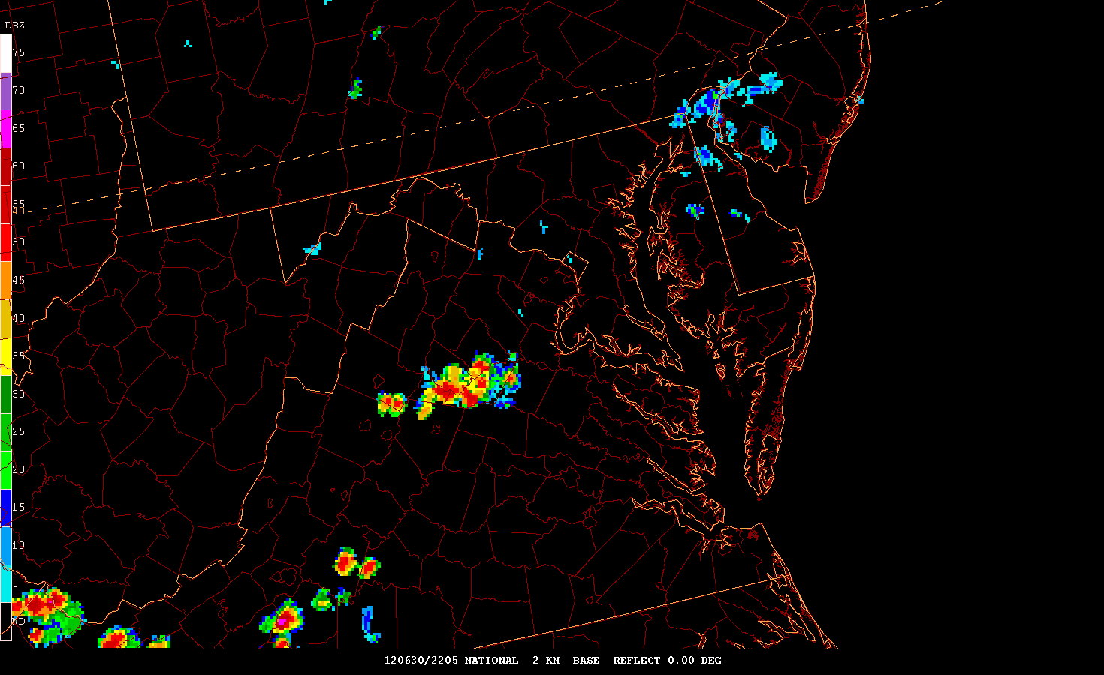

Slide 35
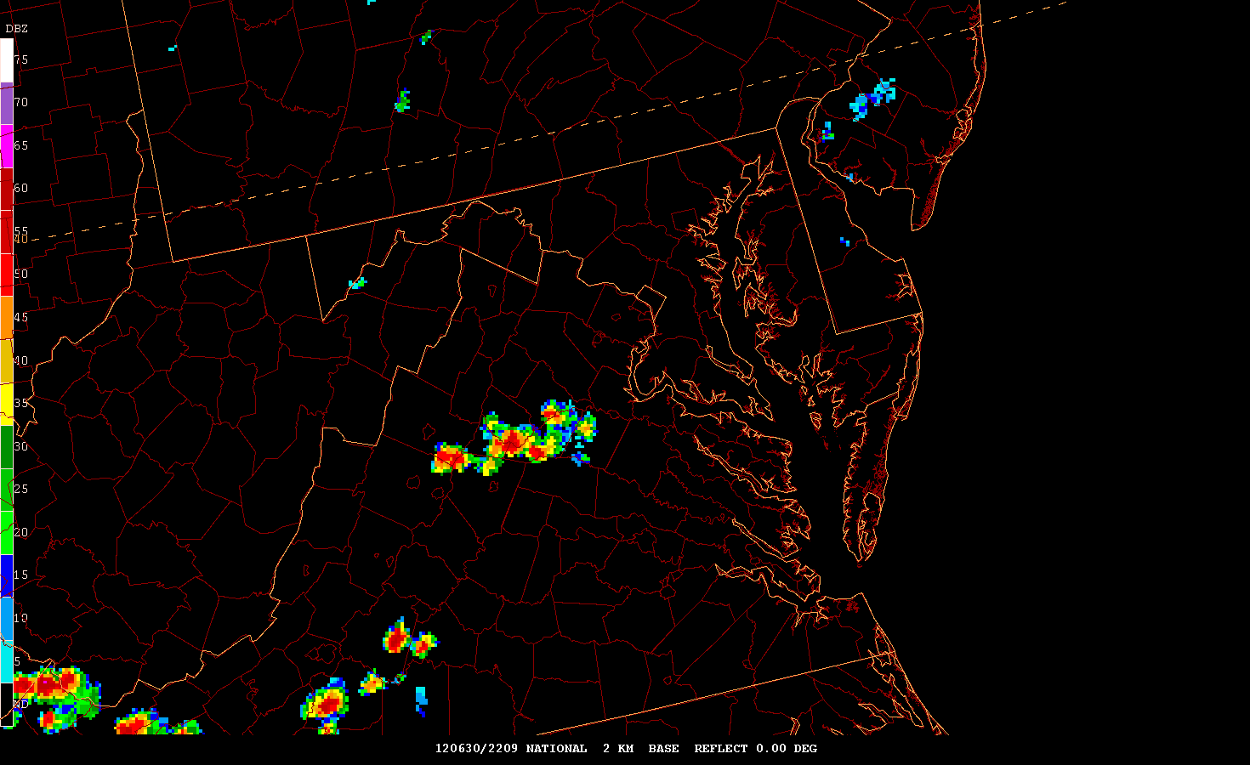

Slide 36
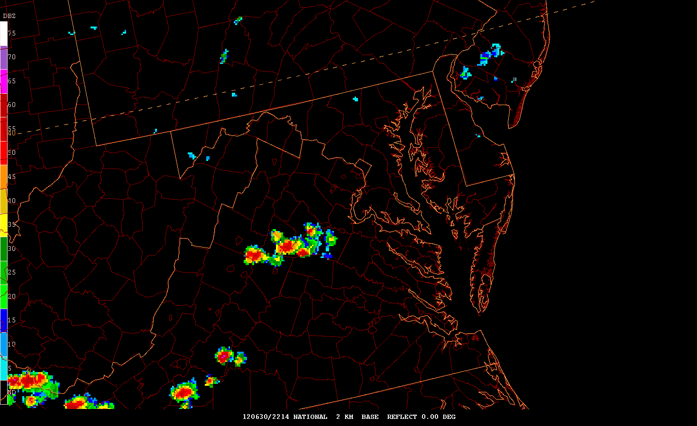

Slide 39
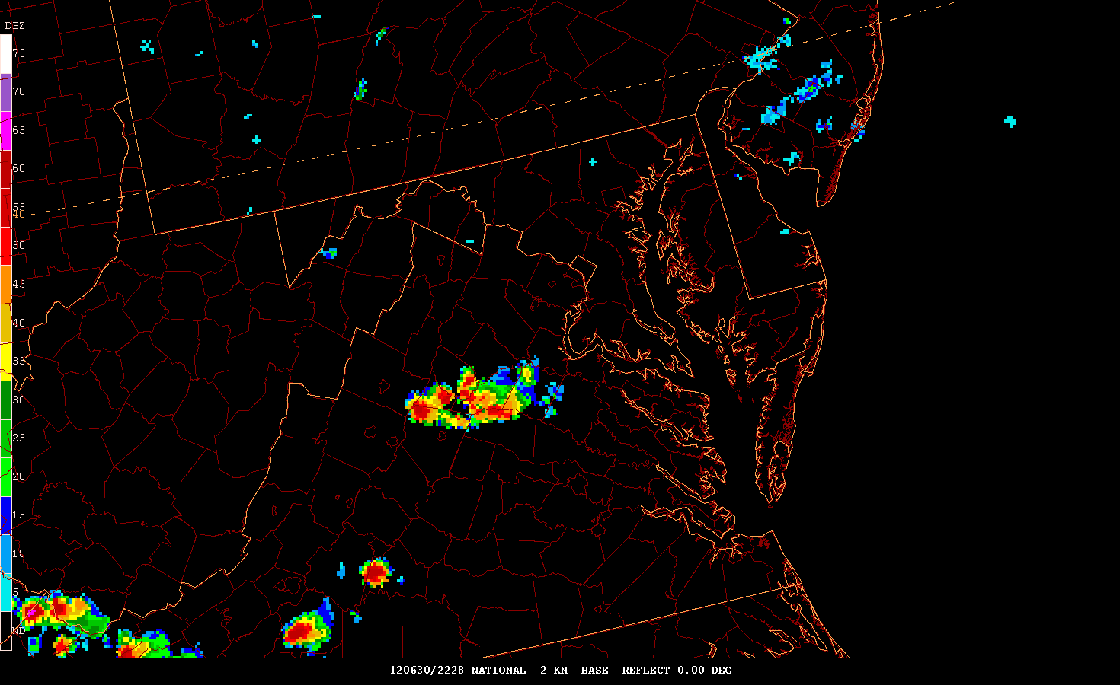

Slide 42
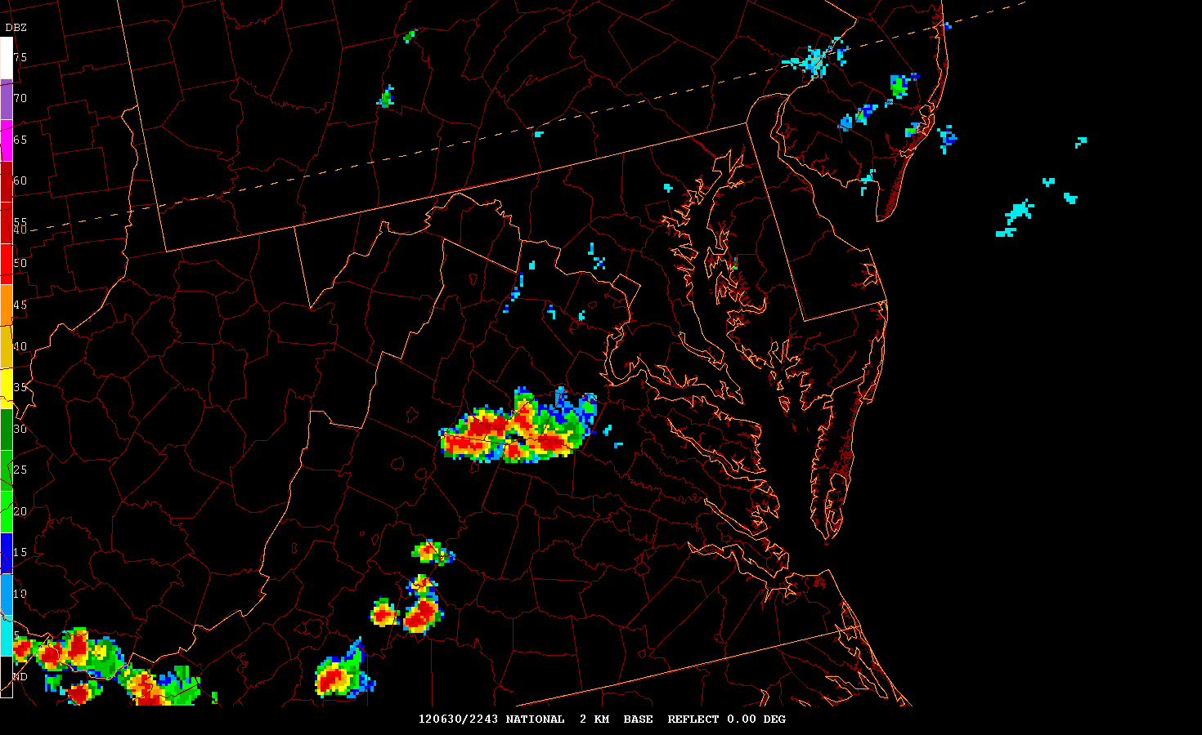

Slide 43
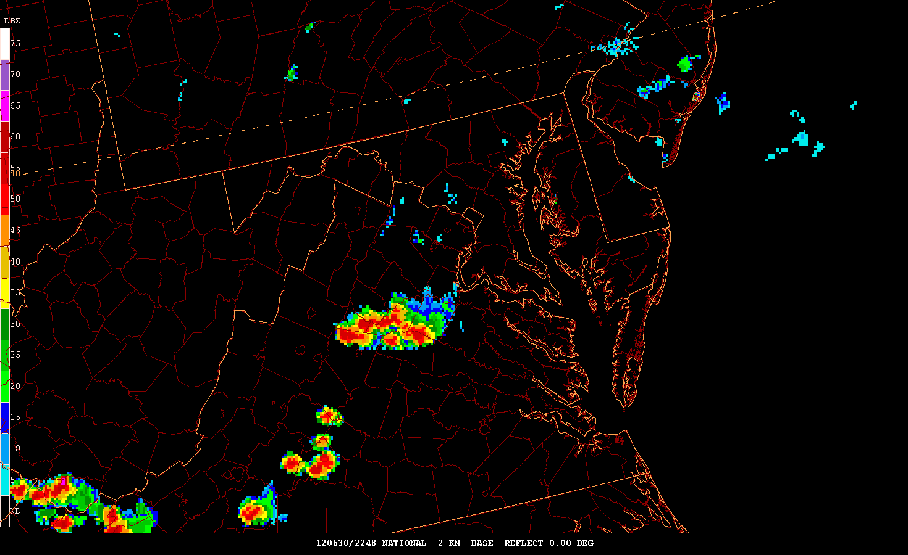

Slide 45
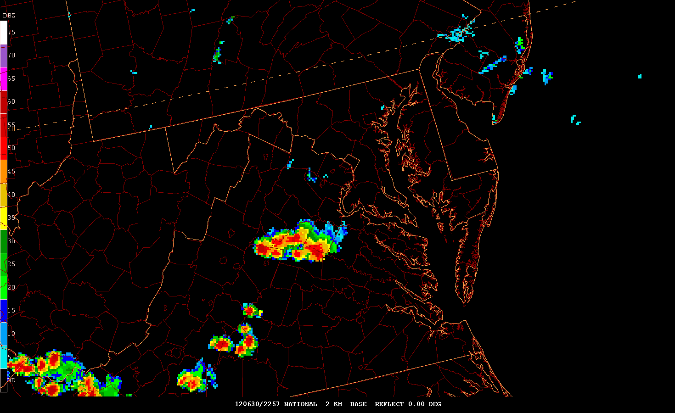

Slide 46
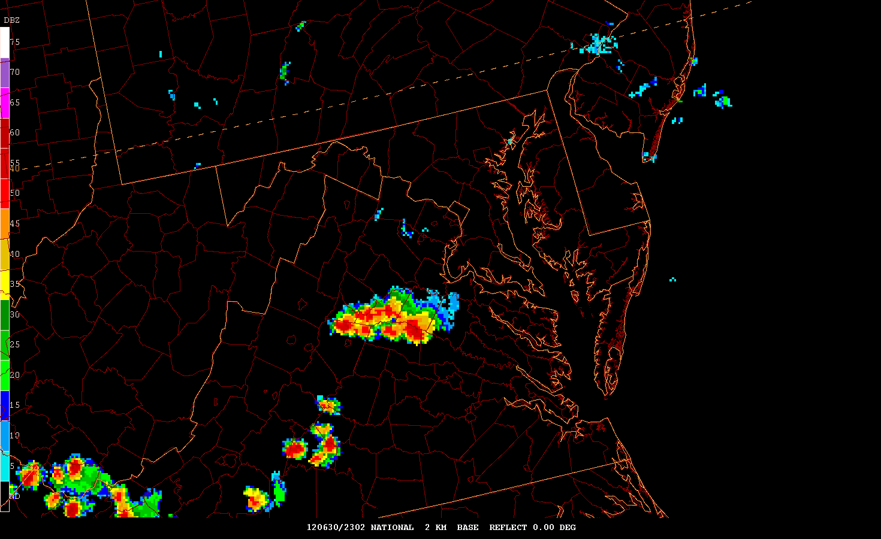

Slide 47
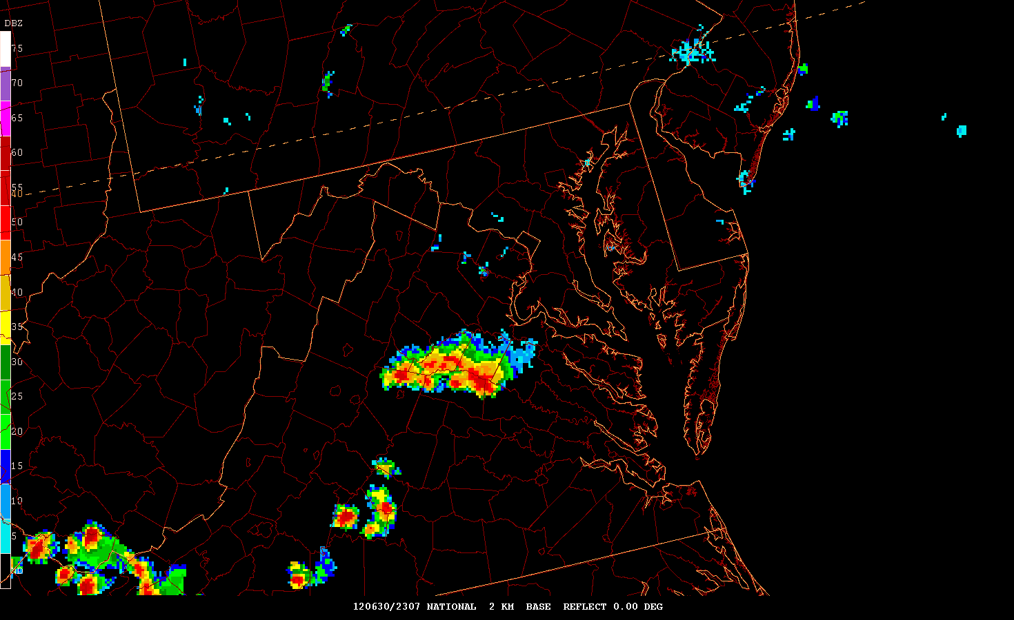

Slide 48
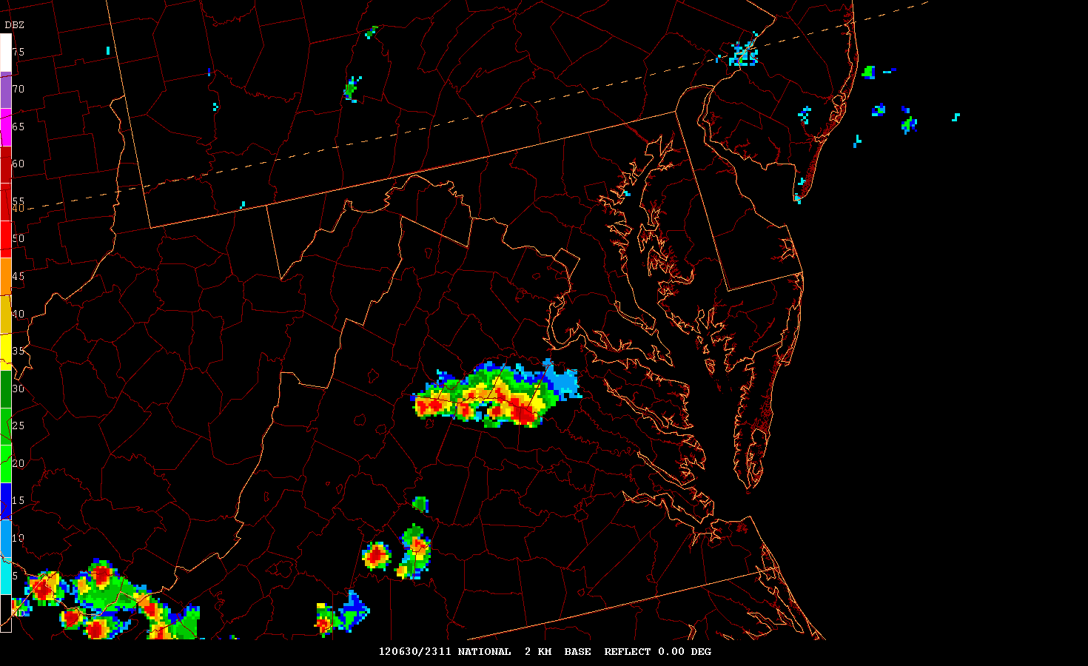

Slide 49
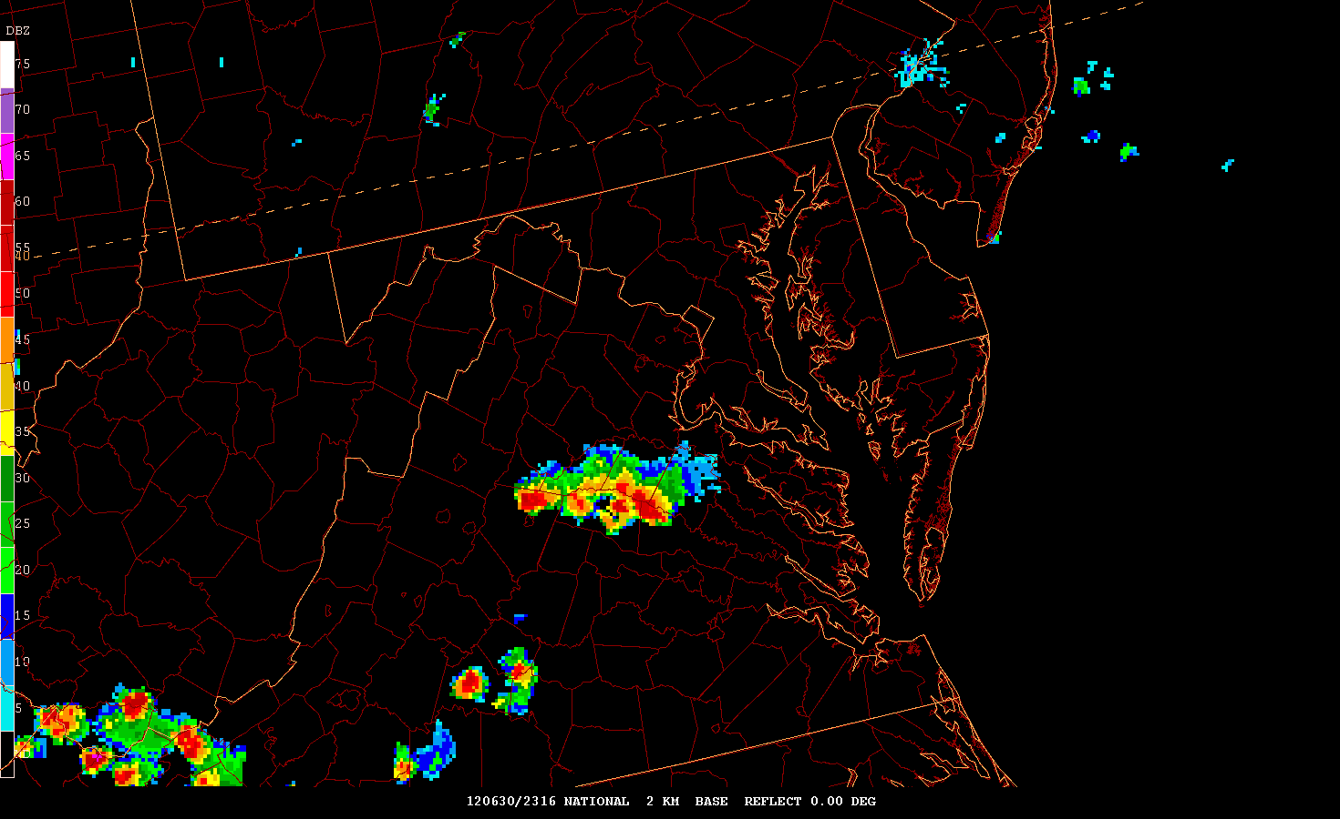

Slide 50
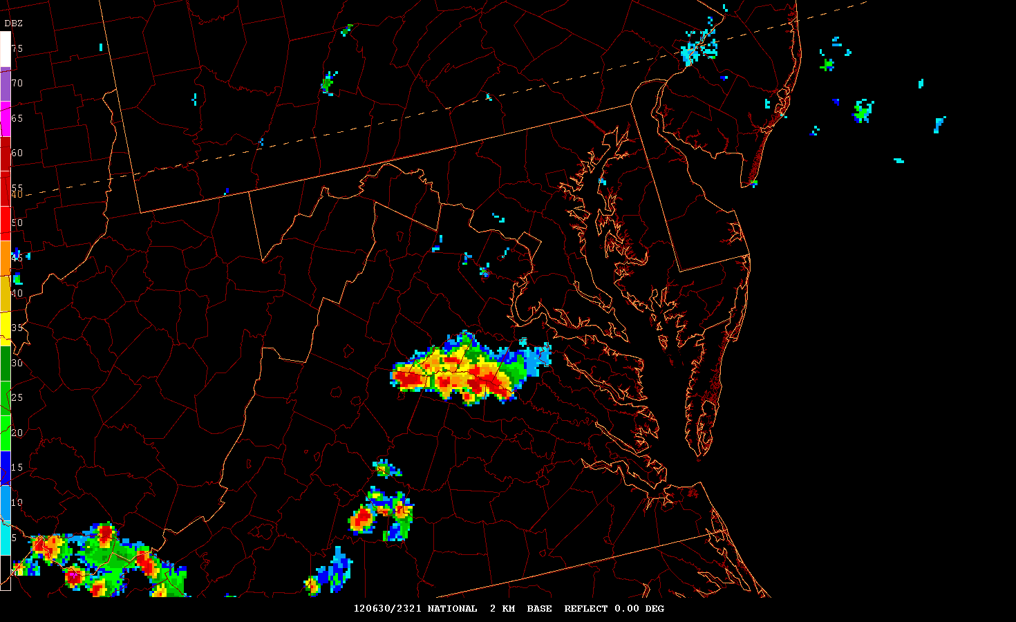

Slide 51
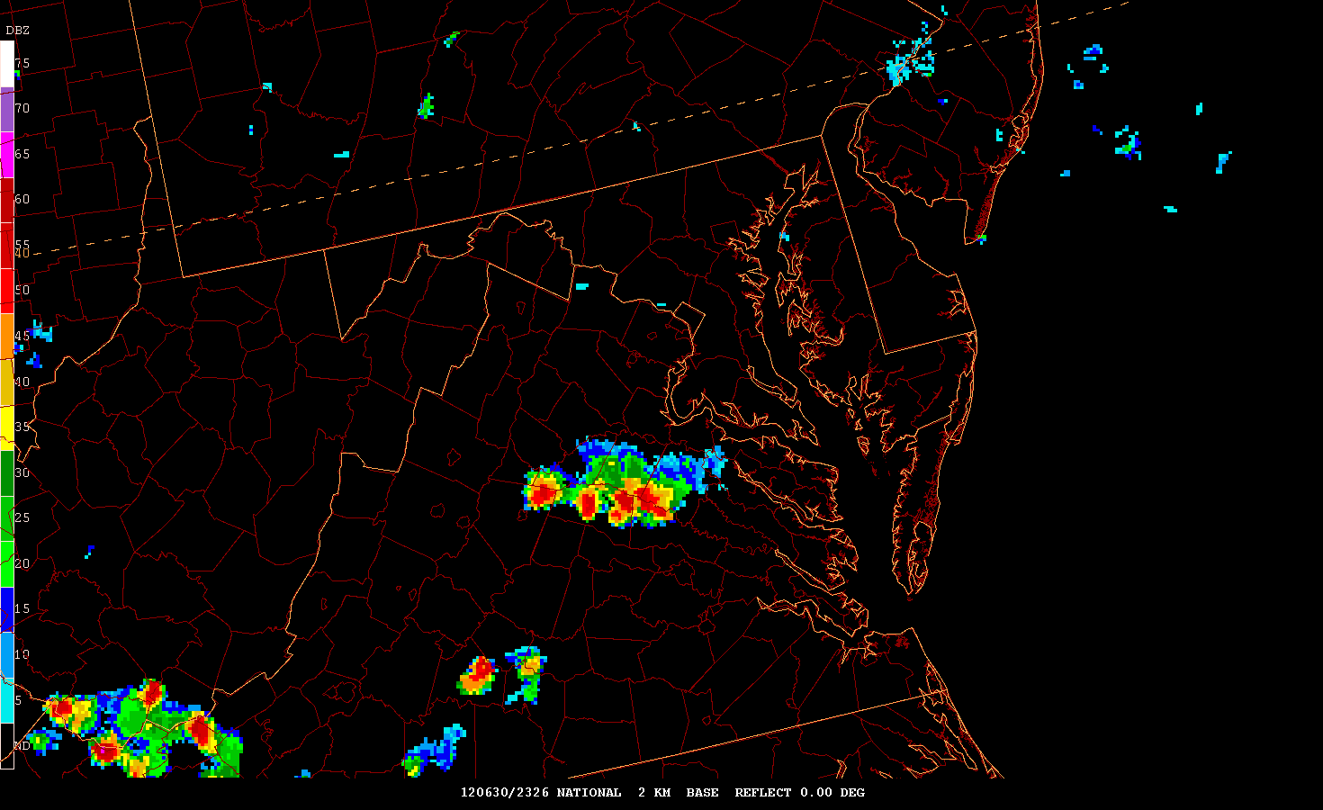

Slide 52
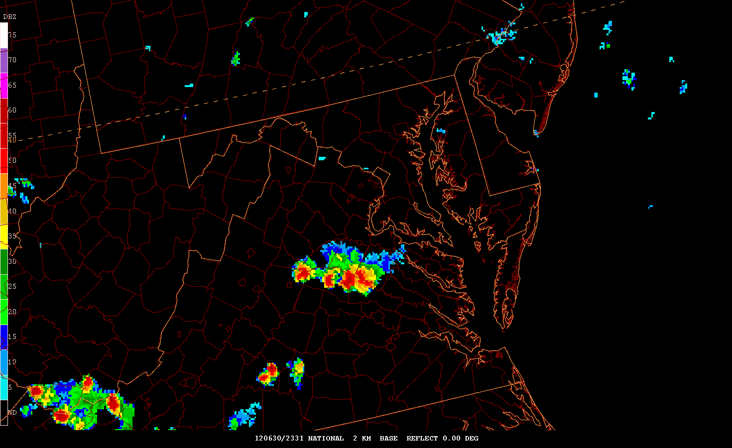

Slide 53
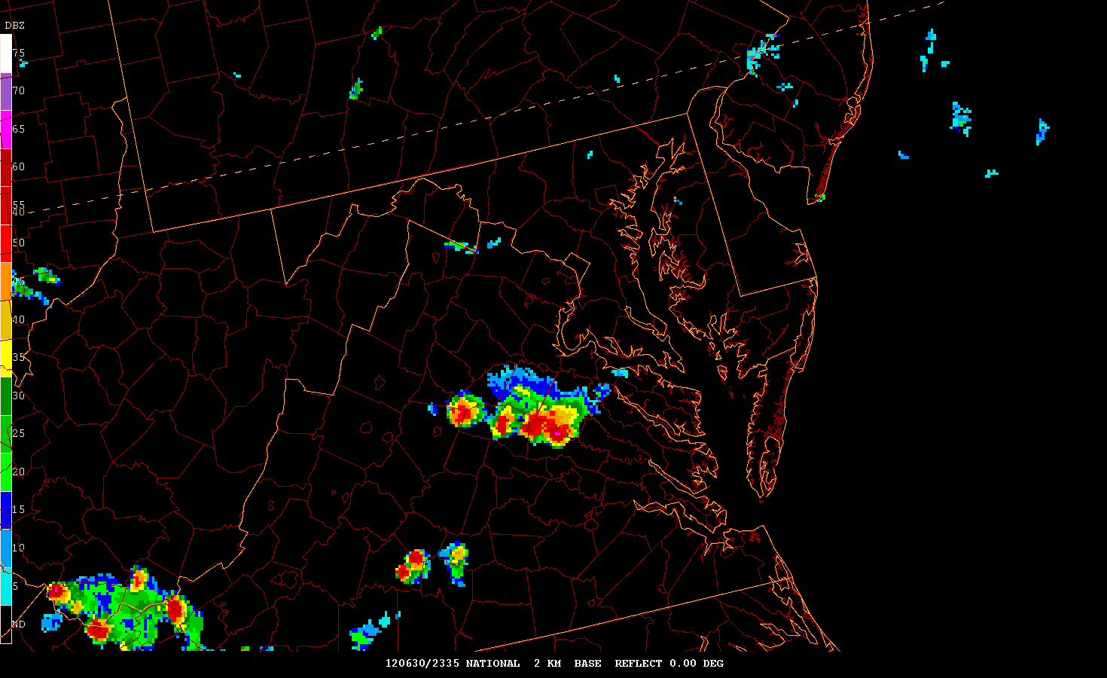

Slide 54
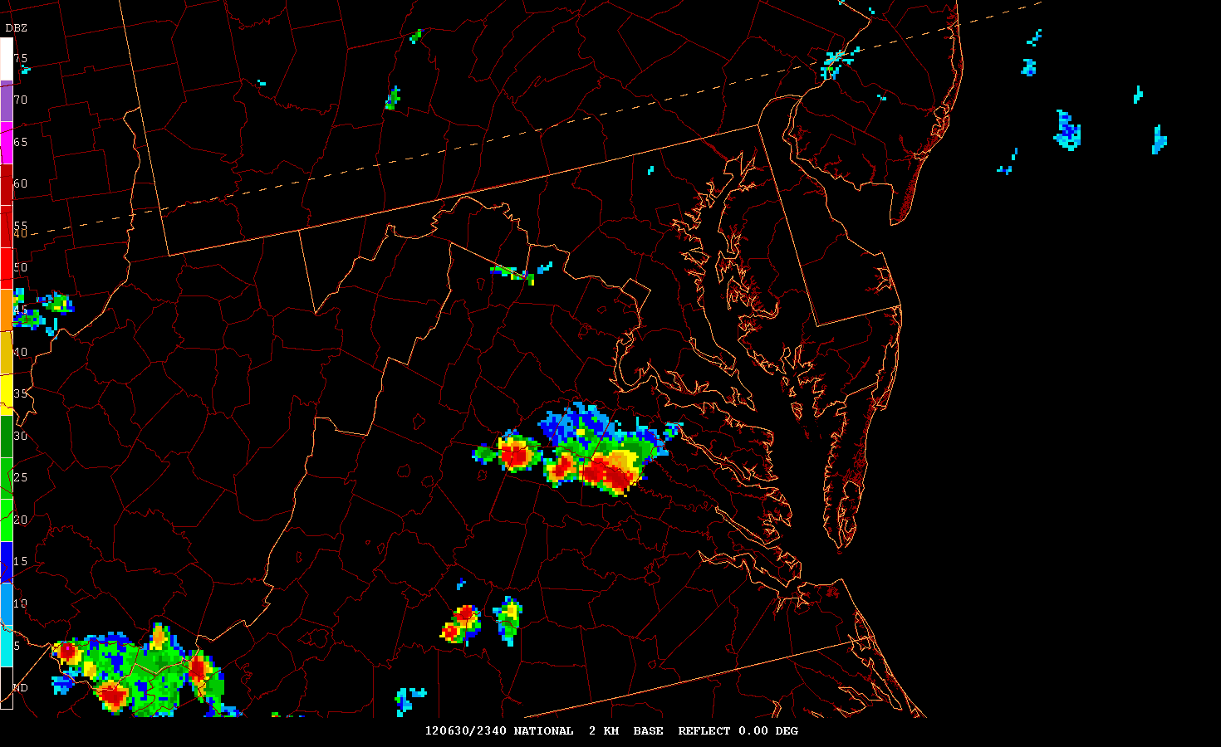

Slide 55
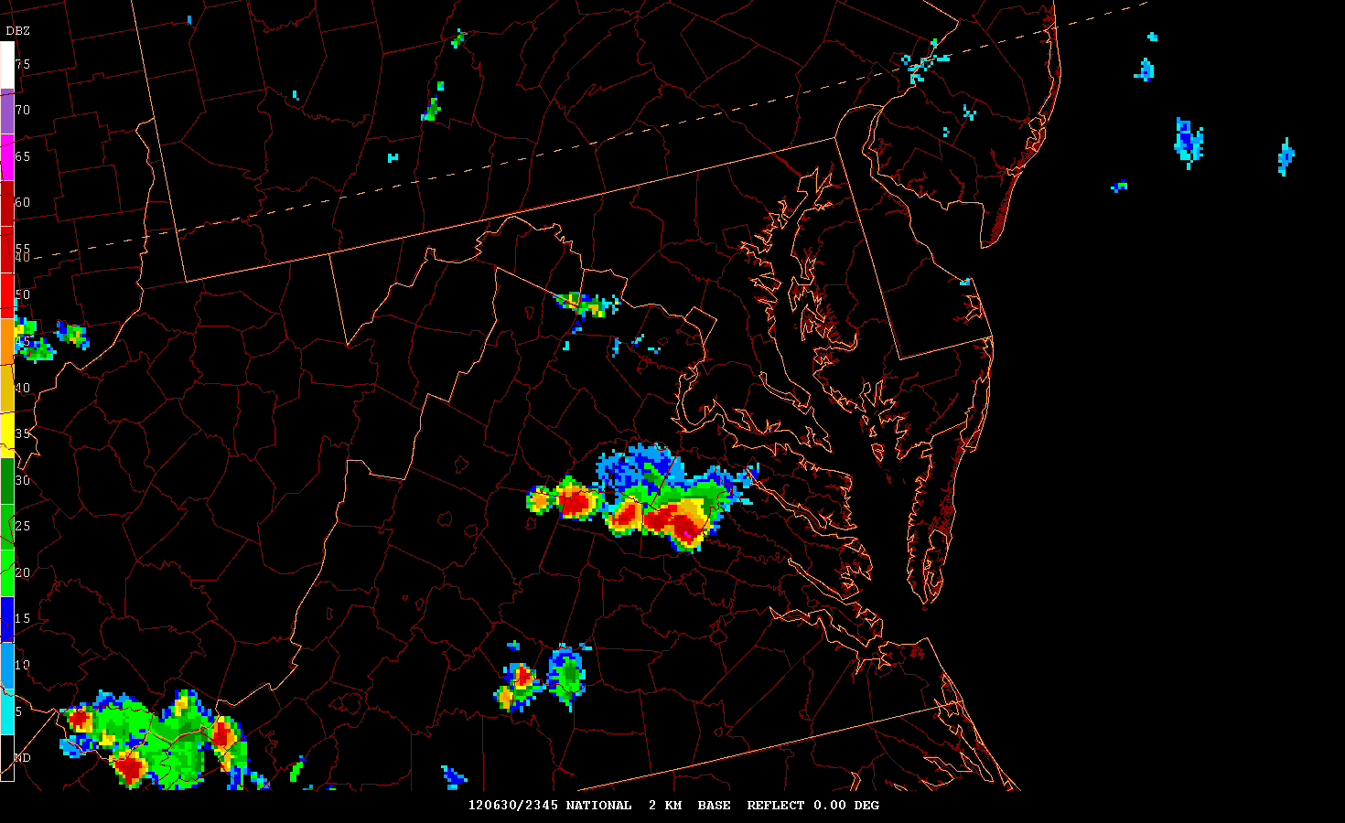

Slide 56
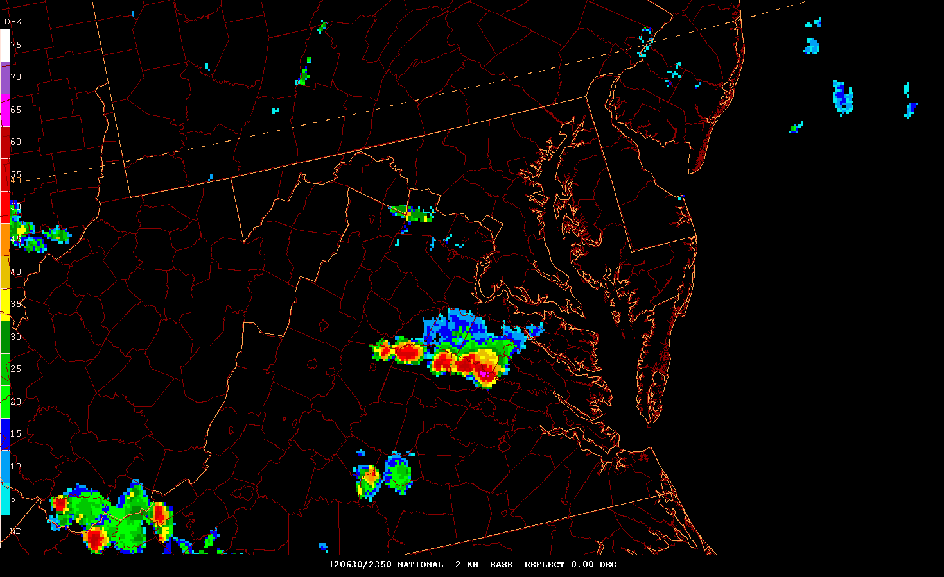

Slide 57
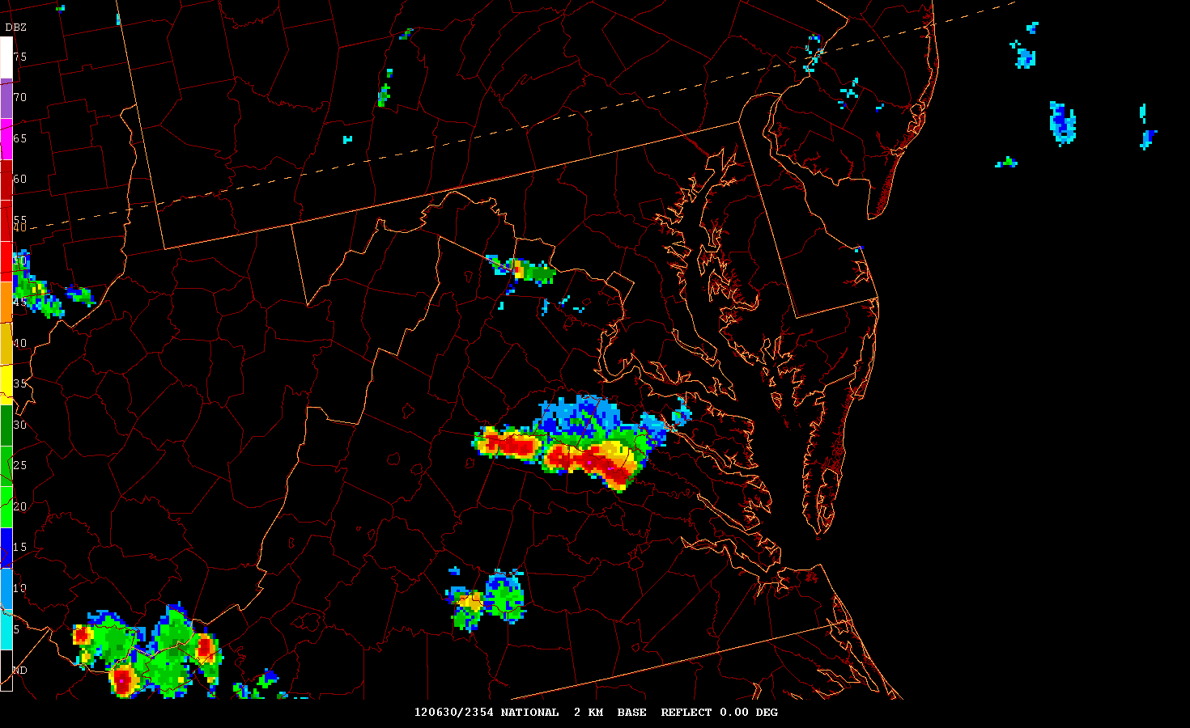

Slide 58
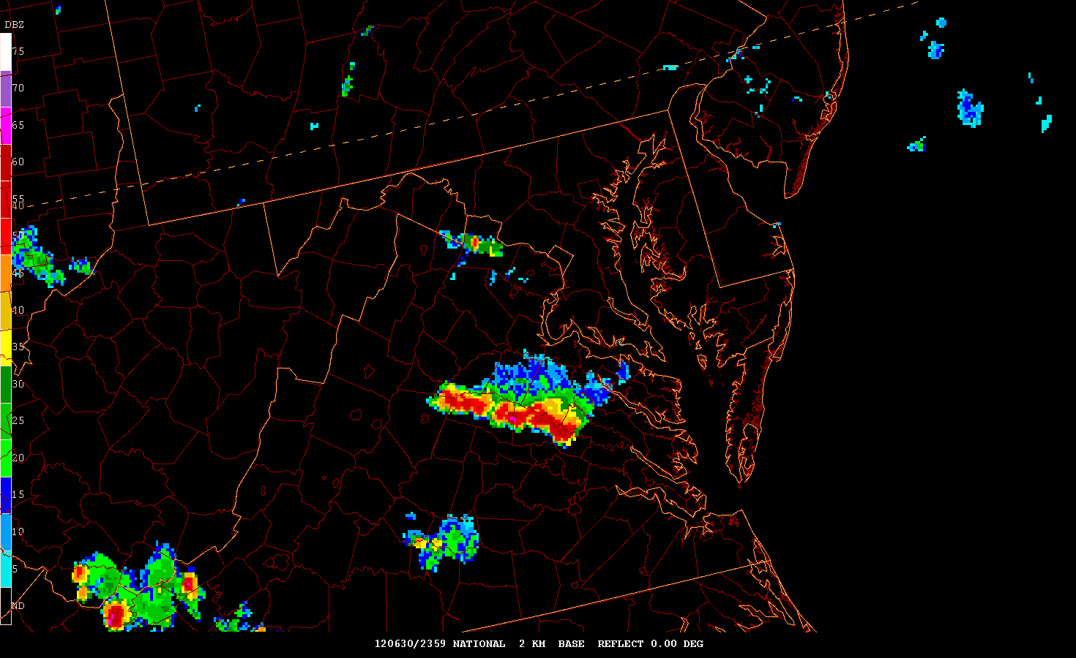

Slide 59
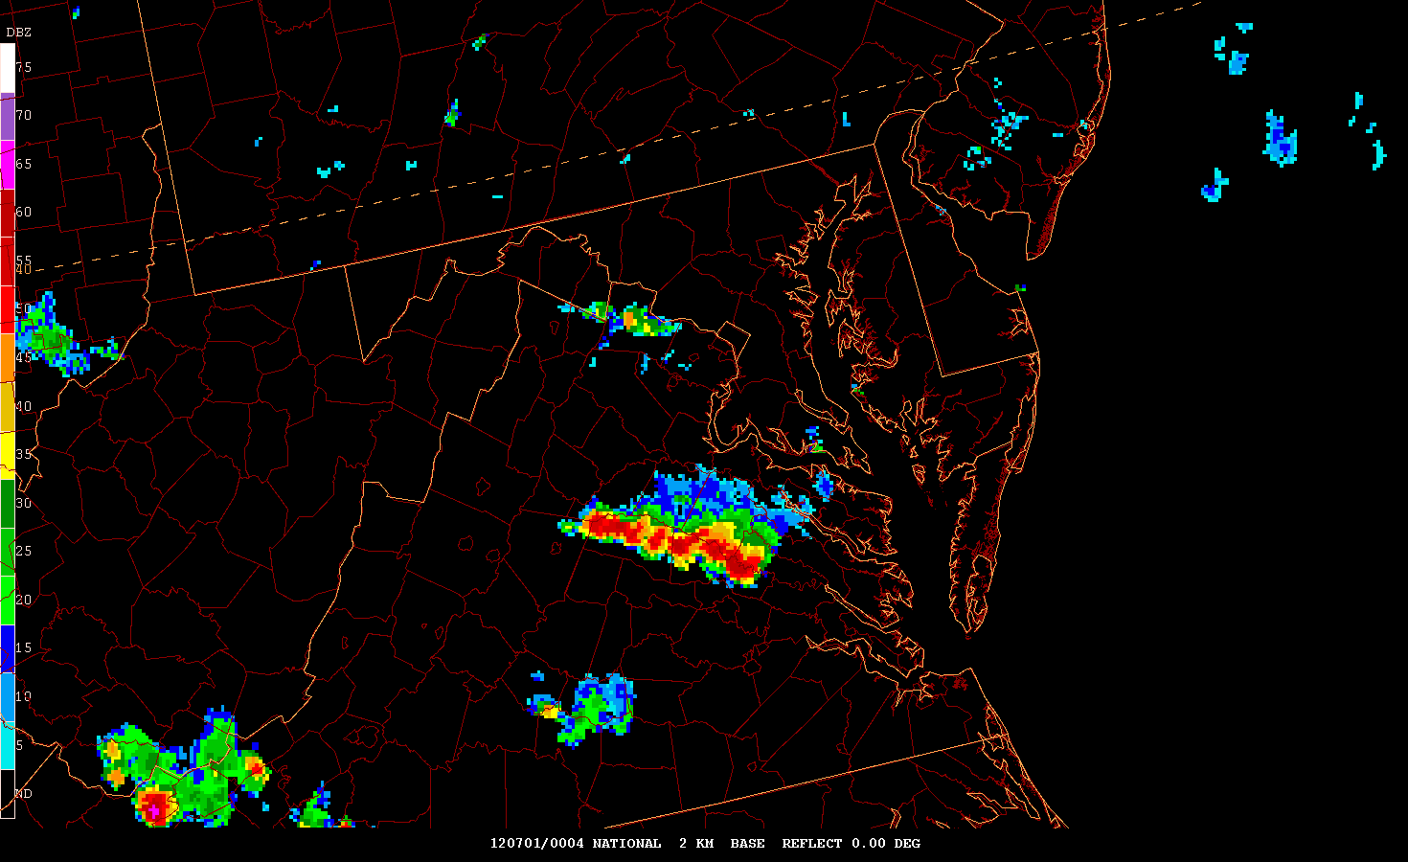

Slide 60
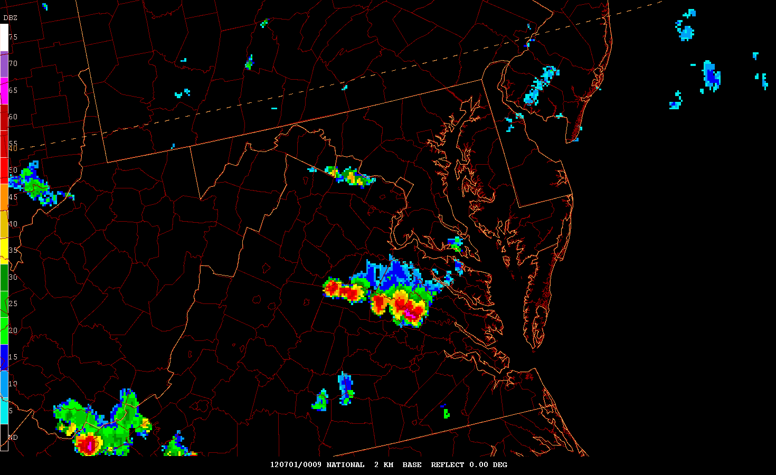

Slide 61
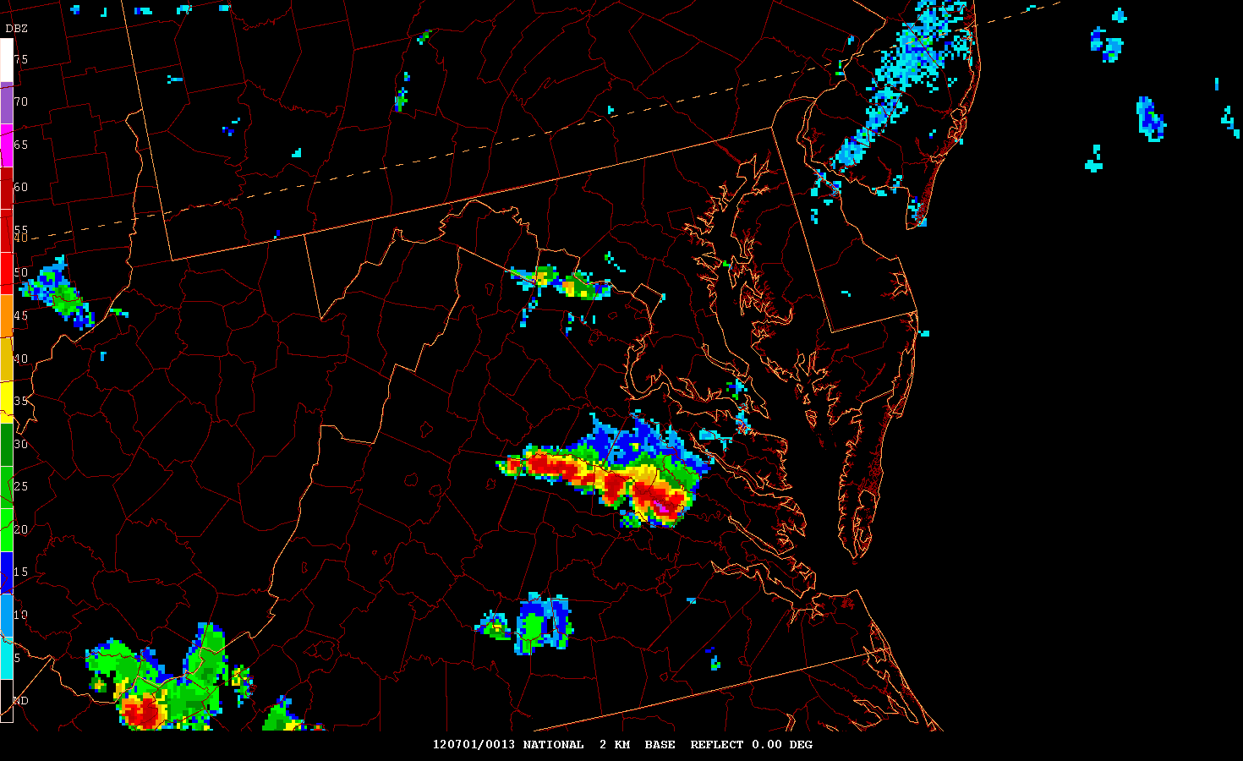

Slide 62
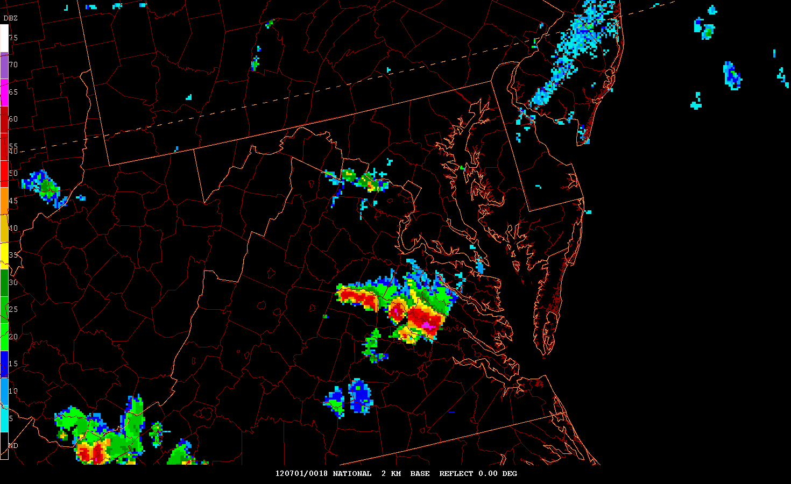

Slide 63
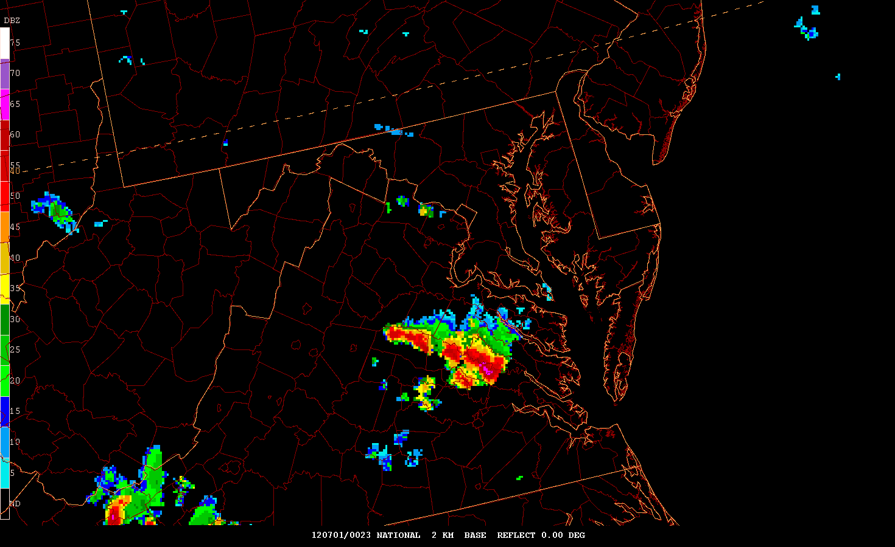

Slide 64
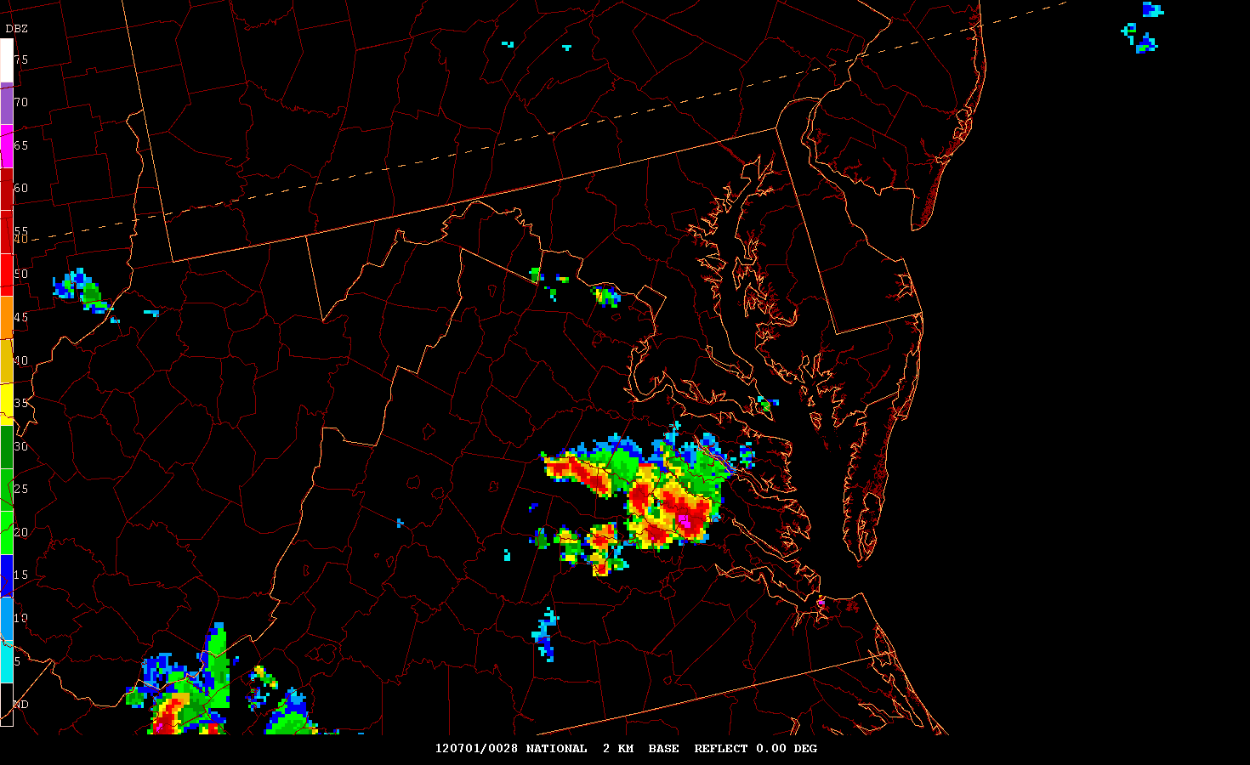

Slide 65
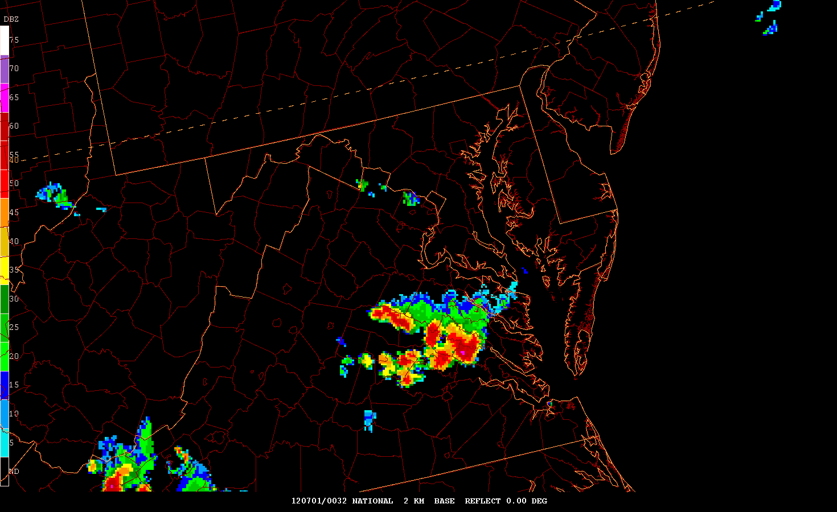

Slide 66
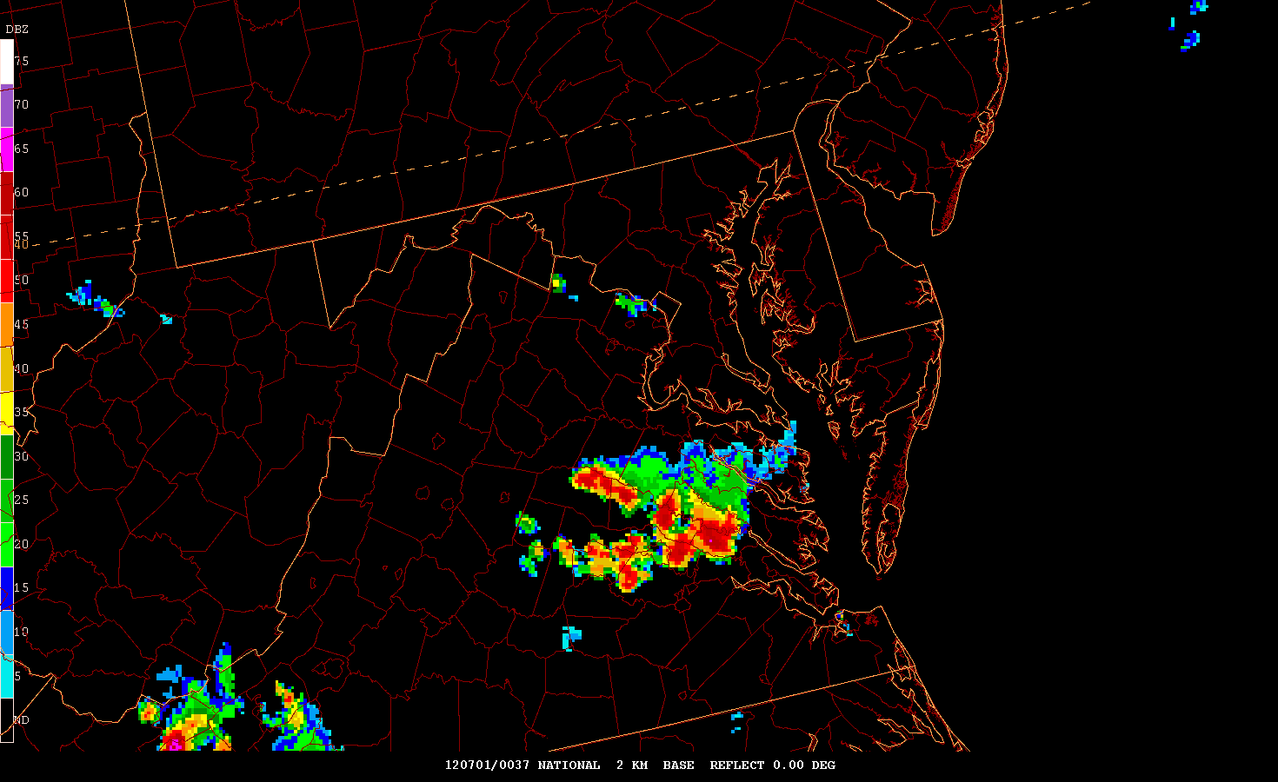

Slide 67
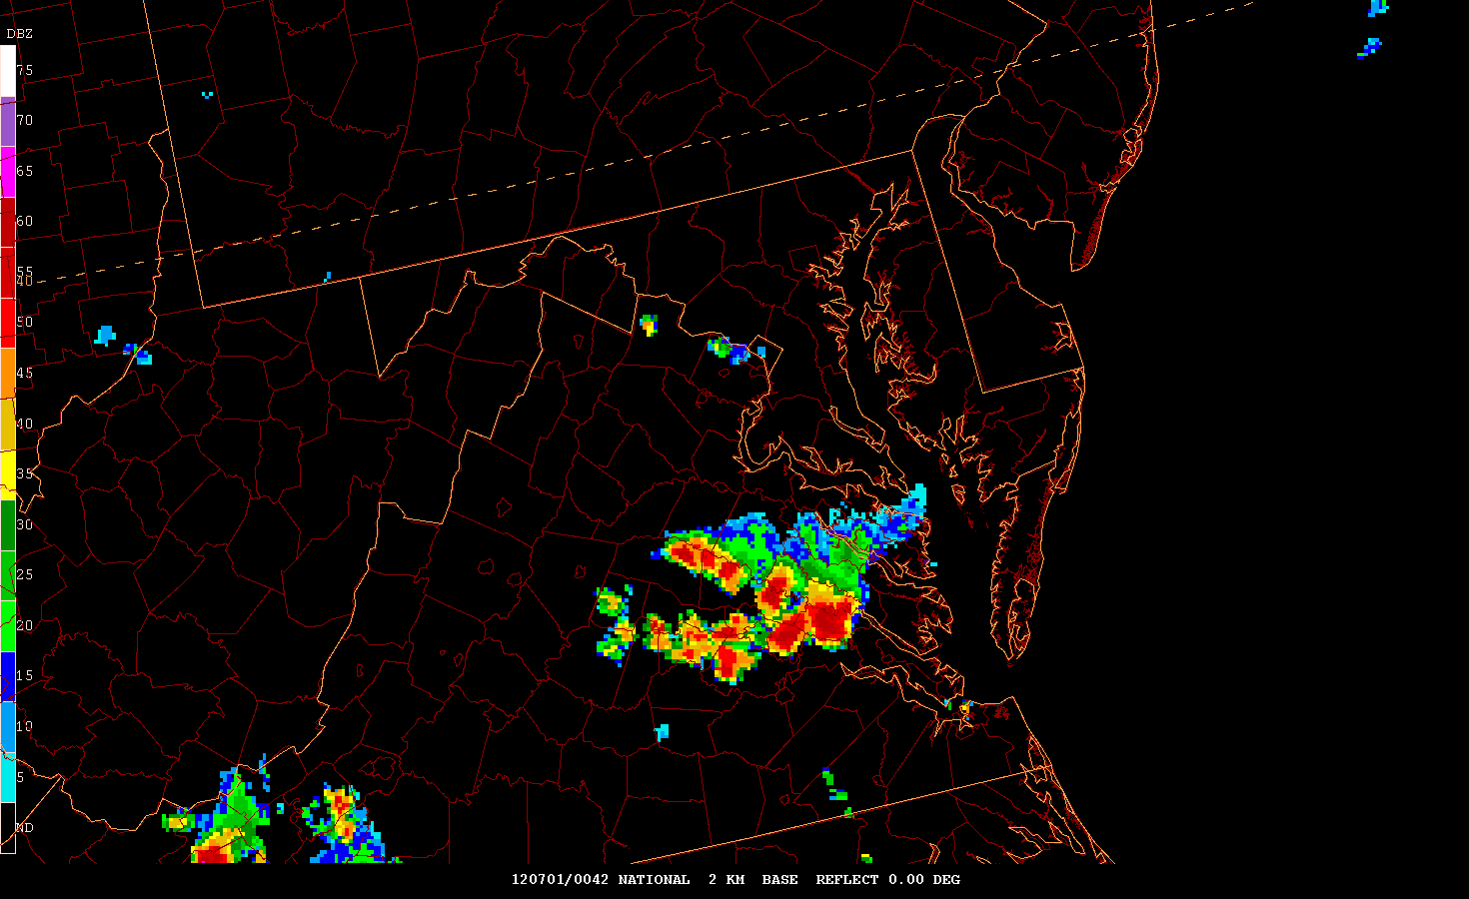

Slide 78
PGLM Data
What is it?

Slide 80
PGLM Flash Density

Slide 81
Green bar means that the PGLM data are being received and there are no issues

Slide 82
Key Features
Co-location of PGLM data and the cloud to ground (CG) lightning data
Movement of the lightning across the region
Location and area coverage of PGLM to N/NE of convection with no CG lightning
Increase taking place in the PGLM flash density

Slide 83
PGLM Data
30 June – 1 July 2012
Two minute imagery

Slide 209
PGLM Data
Tornadic Event

Slide 210
Tornado Information
Hanover County, Virginia
EF0 tornado (6.17 miles long, 100 yards wide)
Numerous downed trees, minor structural damage

Slide 211
Key Features
PGLM flash density increased at 0004 1 July
Tornado at 0011 1 July
dBZ increase from 60 to 70 during event

Slide 212
PGLM
PGLM Increase or “Jump”

Slide 216
Radar Data
Radar Reflectivity
and
Tornado Path

Slide 219
Radar Data
Radar Reflectivity Loop

Slide 228
PGLM Data
PGLM
and
Lightning Data Loop

Slide 248
Aviation
Aviation
Situations

Slide 249
Aviation
MOL-Montebello, VA and GVE –Gordonsville, VA air routes were closed for a period
LDN-Linden, VA had departure limitations

Slide 250
ASDI loop

Slide 251
Aviation
Air routes closed and planes diverted
PGLM data highlights flash densities in stratiform precipitation areas where planes were diverted

Slide 256
Stratiform Rain
In several other case studies, we have observed PGLM data in stratiform rain locations behind a leading line of convection.
In most cases there are no CG observed
PGLM data have been observed almost 75 miles from the leading edge of convection

Slide 257
Aviation
SIGMET forecast were covering the storms

Slide 262
Aviation
CCFP forecast were not consistent for this case
However, since CCFP forecasts are 4,6,8 hour forecasts the data would be of limited to no use for CCFP forecasters

Slide 263
Radar Data
Next Case
September 19 2012

Slide 286
PGLM Data
September 19 2012

Slide 323
Aviation

Slide 324
Aviation
SIGMET forecast were covering the storms

Slide 325
Aviation

Slide 327
Conclusion
Psudo GLM (PGLM) is another aid in observing and forecasting convection
PGLM data can be the first evidence of convection
PGLM flash density "jumps" are a way to detect changes in the strength of the convection (mainly times before other observations, for example radar returns only show increases after the jump)

Slide 328
Conclusion
Stratiform rain locations behind convective lines many times have strong PGLM signals (may even indicate new strong convection within the region)
Convective SIGMET forecasters will be able to utilize this information once the GOES-R Satellite is launched and possibly assist them with issuing their warnings
International Desk will have an additional convective detection tool with GOES-R GLM over areas with limited coverage

Slide 329
Conclusion
The GOES-R GLM may provide aviation forecasters with critical indications of electrification onset in convection
Will enhance forecasters’ ability to improve world airspace system safety

Slide 330
Thank You
Acknowledgements:
COMET
The University of Nebraska
The Aviation Weather Center
NASA SPoRT
CIMSS/SSEC University of Wisconsin
Bob Maxson
Dr. David Bright
Matt Strahan
Debra Blondin
Bruce Entwistle
Jesse Sparks
Ryan Solomon
Ben Schwedler
Dan Vieter
Jeramie Lippman
Dr. Steve Silberberg
Dr. Steven lack

Slide 331
References
Stano, G. T., K. K. Fuell, and G. J. Jedlovec, 2010b: NASA SPoRT GOES-R Proving Ground Activities. 6th Symposium on Future National Operational Environmental Satellite Systems-NPOESS and GOES-R, Amer. Meteor. Soc., Atlanta, GA, 17-21 Jan. 10, 8 pp.
Stano, G. T., and B. Carcione, 2012: Evaluation of NASA SPoRT’s pseudo-Geostationary Lightning Mapper products in the 2011 Spring Program. 8th Symposium on Future Operational Environmental Satellites, Amer. Meteor. Soc., New Orleans, LA, 22-26 Jan 12, 6 pp.
Stano, G. T., J. A. Sparks, S. J. Weiss, and C. W. Siewert, 2013: Fusing total lightning data with Aviation Weather Center and Storm Prediction Center operations during the GOES-R Visiting Scientist Program. 9th Symposium on Future Operational Environmental Satellites, Amer. Meteor. Soc., Austin, TX, 6-10 Jan. 13, 8 pp.

