Slide 1
Colorado Lightning Mapping Array depicts a Lightning Jump Prior to a Non-Supercell Tornado 5 to 10 miles northwest of Cheyenne
By Rob Cox (NWS Cheyenne)

Slide 2
July 29, 2013 @ ~6pm
Photo Courtesy Steve Apfel
Notes:
Photo was taken from our former MIC about 5 to 10 miles northwest of Cheyenne on Horse Creek Road. The tornado was located about 2 miles northwest of his location.

Slide 3
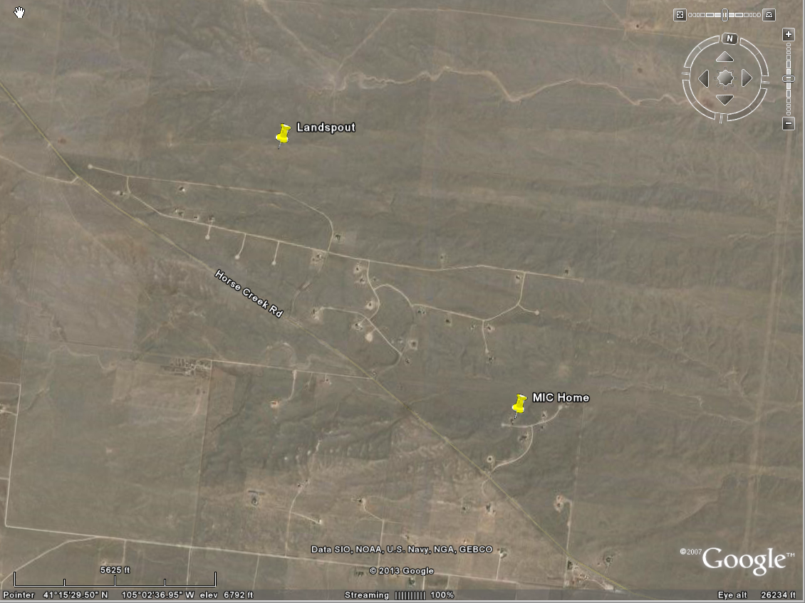
Tornado ~5 to 10 miles Northwest of Cheyenne

Slide 4
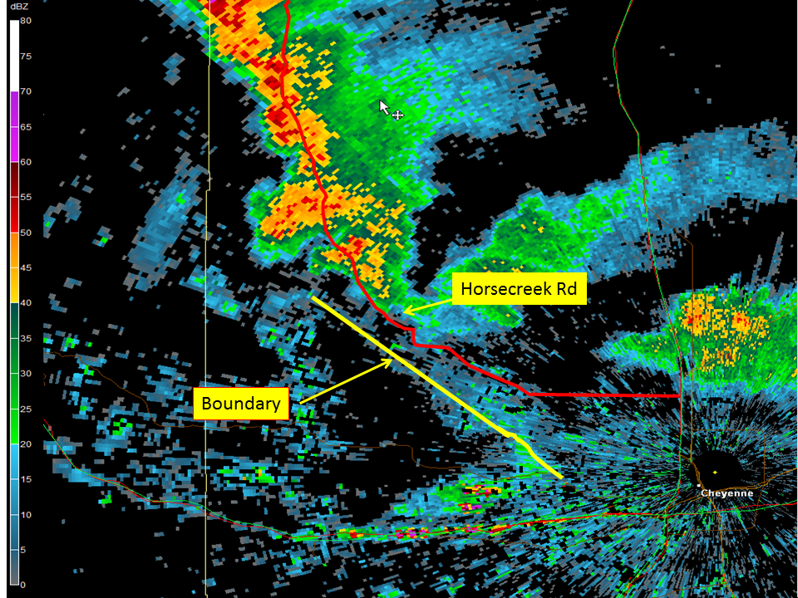
0.5 deg. Z ~15 min prior to Tornado
MIC Home
Notes:
This is the 0. 5 degree slice ~15 min. prior to tornado touchdown. As you can tell, there is very limited reflectivity near the tornado. However, there is a fairly distinct boundary to the southwest of Horse Creek Rd.

Slide 5
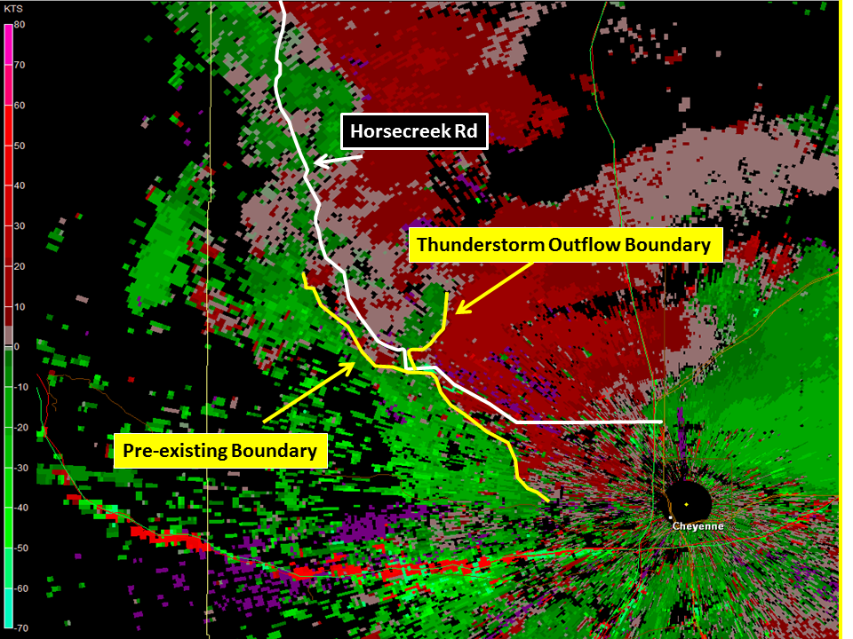
0.5 deg V. ~15 min Prior to Tornado
MIC Home
Notes:
This is the 0.5 degree base velocity image ~ 15 minutes prior to tornado touchdown. This image depicts the surface boundaries fairly well. It appears that these boundaries do intersect about 5 miles northwest of the MIC. These pre-existing converging boundaries could have served as a focus for tornado development.

Slide 6
0 to 3km LAPS Sfc. Based Lapse Rates (23Z)
Notes:
Non-Supercell Tornadoes typically develop in an environment with steep low level lapse rates (sfc-3km), preexisting convergent boundary containing vertical vorticity, slow moving storm motion, which may overlap with the sfc-3km capes greater than 40 j/kg.. Non-Supercell Tornadoes also tend to form on the southern end of a storm where new updrafts develop over the intersection of thunderstorm outflow boundaries. WSR-88D velocity data is usually limited in detecting mesocyclones prior to tornado formation, but it can be helpful at short ranges (60-80km) where you can detect storm-scale/mesocyclone boundaries. This research is based on a paper written by Jon Daviess and James Caruso who studied these small scale features. Here is the link to this study: http://www.nwas.org/ej/cardav/. Our case review, had a number of similarities compared to the Daviess/Caruso study. From the previous images, you can tell there were a couple of boundaries in place. This image depicts 23z Surface Based Lapse Rates on the order of 8.0-9.0 C/km.

Slide 7
0 to 3 km LAPS Surface Based Capes (23Z)
Notes:
This image depicts 0 to 3 km Surface Based Capes at 23z. The highest capes are situated to the east of the tornado. Nevertheless, the values still range from 80 to 100 j/kg which is sufficient enough to provide a good updraft.

Slide 8
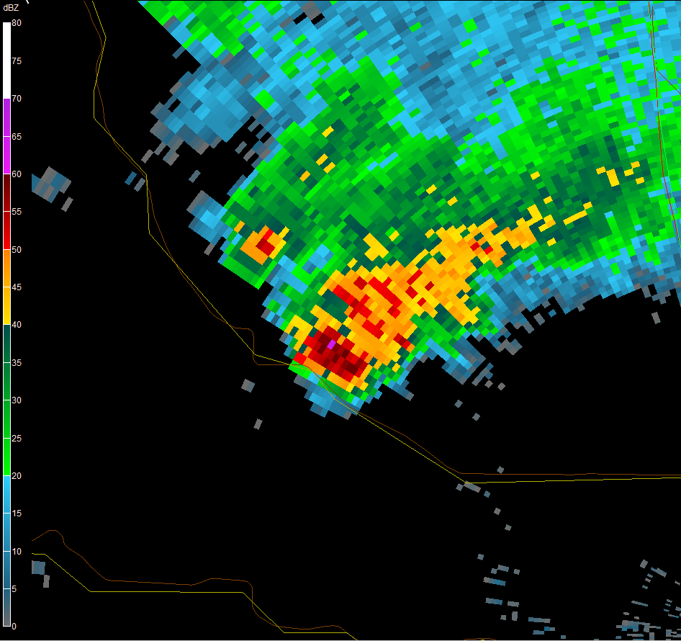
6.4 deg Z. at ~ Time of Tornado (00:05Z)
MIC Home
Notes:
The more interesting aspect of this image is the location of the highest reflectivity at the time of the tornado. It is depicted just above the tornado.

Slide 9
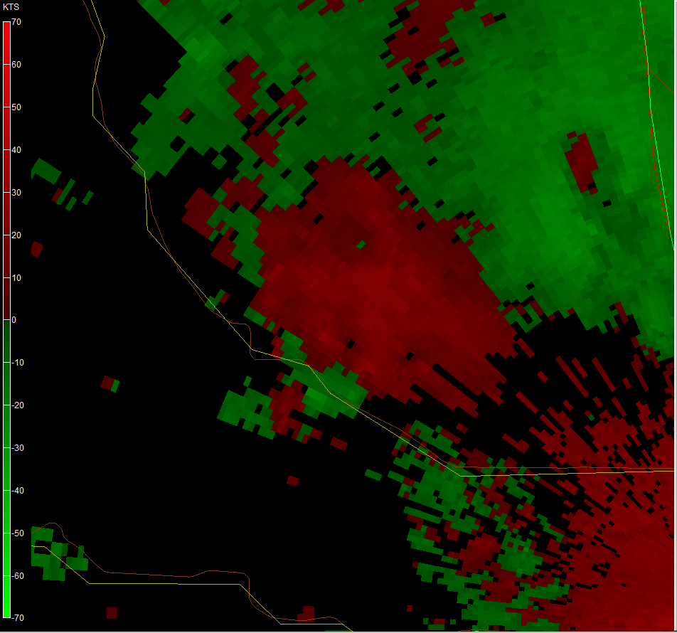
6.4 SRM Slice at ~ time of Tornado (00:05Z)
MIC Home
Notes:
There is some subtle broadscale rotation in the mid levels with this storm, which is depicted just above the tornado.

Slide 10
COLMA 2349Z-00:05Z
Notes:
We made some adjustments to the baseline Source Density Color Scale to account for the lack of lightning in our forecast area. This scale incorporates various colors below 50 which helps us depict more notable lightning jumps. This animation shows the lightning jump occurring just prior to the tornado.

Slide 11
Summary
Look for Pre-Existing Convergent Surface Boundaries
0-3km Capes Greater than 40 j/kg
Steep Low level Lapse Rates
High Reflectivity's Aloft
Mid level Rotation
Lightning Jump ~10 to 15 min prior to Tornado Development
Notes:
Summary of items to look for in Non-Supercell Tornadoes.

