Slide 1
Using MODIS/VIIRS Night-Time Microphysics RGB Imagery with Proximity Soundings to Diagnose Low-Topped Precipitation Events
Paul Nutter
NWS Great Falls, MT
Kevin Fuell
NASA/SPoRT
SPoRT Partners Virtual Workshop
13 February 2014

Slide 2
Low-Topped Precipitation
Heavy rain at Havre, MT
12Z, 25-Sept-2013 (6am MDT)
Still dark; sunrise occurred at 7:09 am MDT
50% forecast 12hr POP
Just a few pixels on radar 0.5° base reflectivity
Could Night-time Microphysics RGB imagery enhance situational awareness?

Slide 3
GOES 11 µm IR Satellite 1215 UCT 25 Sep 2013
Havre
L
ʘ
http://www.mmm.ucar.edu/imagearchive/
Havre is on a transition line; dry slot to west, rain showers to east.

Slide 4
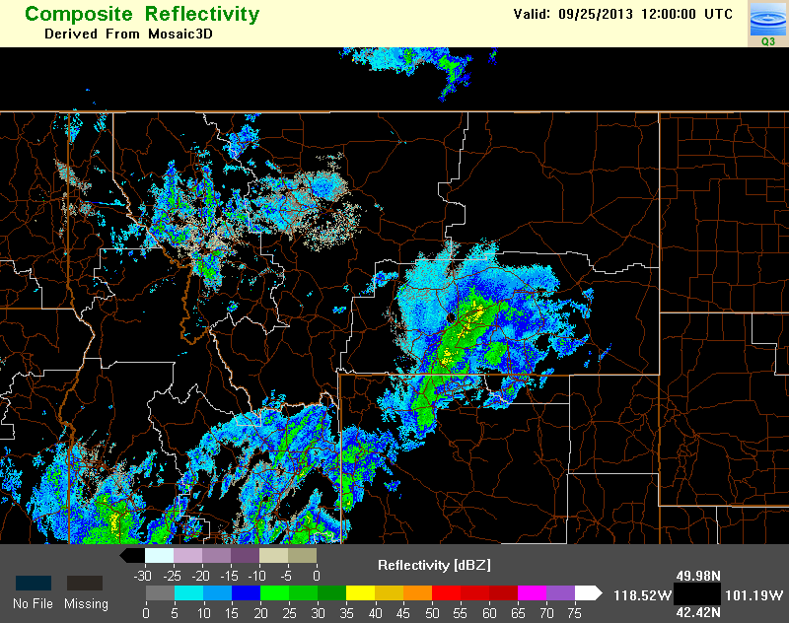
Composite Reflectivity 12 UTC 25-Sep-2013
Havre
ʘ
Orographic showers west of Great Falls on low-level northeasterly flow.
Heavy rain band near BYZ radar, moving northeast.
12-hr forecast included 50% POP at Havre.
http://nmq.ou.edu/applications/qvs_2d_maps.html

Slide 5
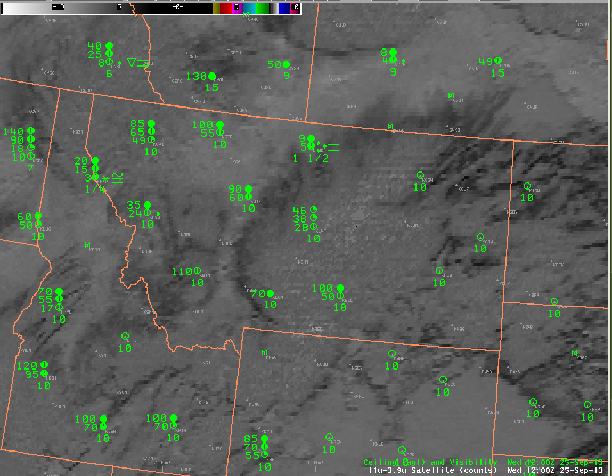
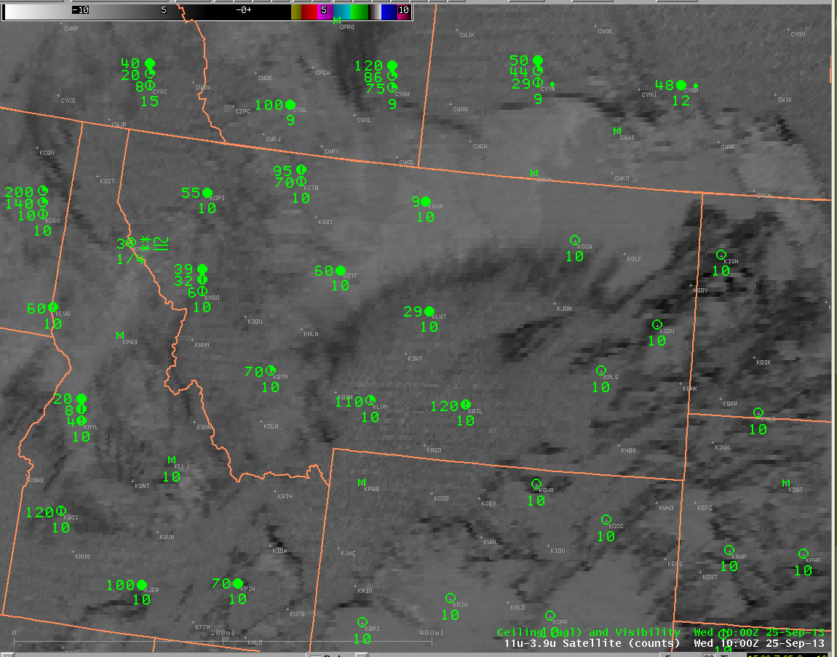
GOES 11-3.9 µm Satellite Ceiling & Visibility Obs
High Clouds
Widespread stratus layer with areas of higher, apparently deeper clouds
KHVR, 1000 UTC:
OVC 900 ft AGL
KHVR, 1200 UTC:
BKN 500 ft AGL
OVC 900 ft AGL
1.5 mi visibility
Heavy rain, fog
Low Clouds
Low Clouds
High Clouds
High Clouds

Slide 6
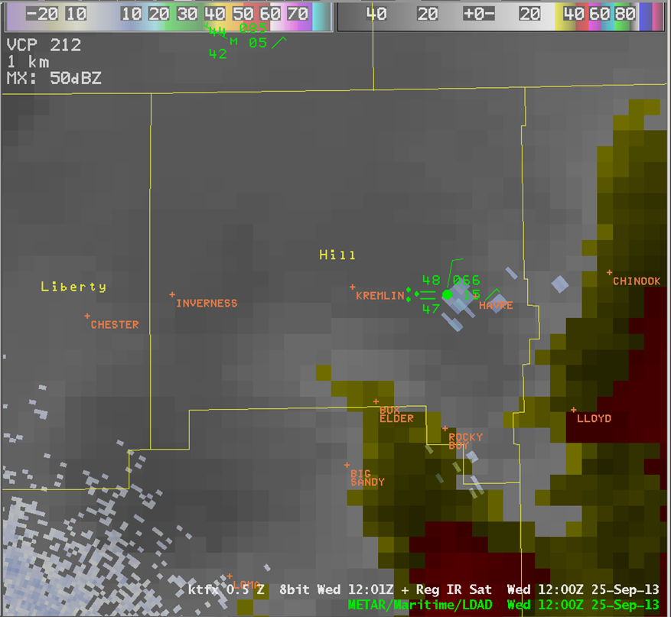
0.5° Base Ref with GOES 11 µm IR 12 UTC 25-Sep-2013
Heavy rain report at Havre was a “surprise” given radar and satellite trends at this time.
12Z KHVR TAF amended to add at TEMPO group for SHRA.
What more can we learn about why these low clouds produced heavy rain?

Slide 7
0.5° Base Ref with GOES 11 µm IR with AWIPS “Pop-up” Skew-T
Image Sampling Shows:
-14 °C brightness temp
15 dBZ reflectivity
93 nm from radar
11,800 ft agl
14,400 ft msl
Notes:
Pop-Up skewT sampling is commonly used with radar in convective situations to measure the height of -10 and -20C levels to assess hail threat. In this case, sampling on a proximity sounding, the 12Z Great Falls raob, shows height and temperature consistent with that of the image sample over HVR, and a deep moist sounding below this level. Let’s take a zoomed in look at the sounding….

Slide 8
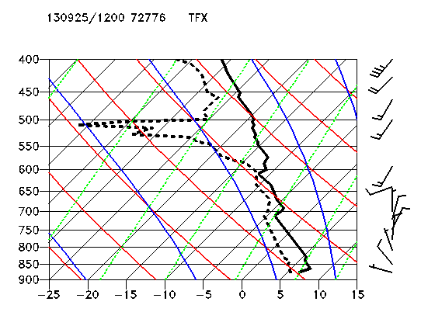
Great Falls 12Z Sounding
Most unstable parcel lifts from 867 mb, with 17 J/kg CAPE.
Convective temp is 52F; parcel likely needs mechanical lift.
Mid-level dry, stable layer; limits cloud height.
Saturated layer from around -5 to -12C. Ice or water?
●
Notes:
Green dot shows level indicated on Pop-Up SkewT over HVR. Orange line is the approximate path of the most unstable parcel. Sounding is saturated below this altitude with unstable layers. Note northerly low level flow, which would be upslope onto Bears Paw mountains south of Havre.

Slide 9
Nighttime Microphysics RGB
VIIRS, 0924 UTC 25 Sept 2013
AQUA MODIS, 1010 UTC 25 Sept 2013
Delineation of high cloud, low cloud, and clear skies now obvious compared to GOES imagery.
Possible delineation of fog vs. stratus, and orographic showers over northern Rocky Mountains.
Note enhanced spatial resolution in VIIRS image.
Notes:
The available RGB images do not correspond in time to rain report at Havre. However, we do see lower cloud features over central MT that are representative of conditions seen on GOES imagery at 12Z. Next consider color interpretation on MODIS image (closest in time to rain at KHVR), noting that these lower cloud features will become representative of those over Havre at 12Z. Indeed, this image would have been available before 12Z, perhaps enhancing situational awareness of the possibility for locally heavy rain as described next.

Slide 10
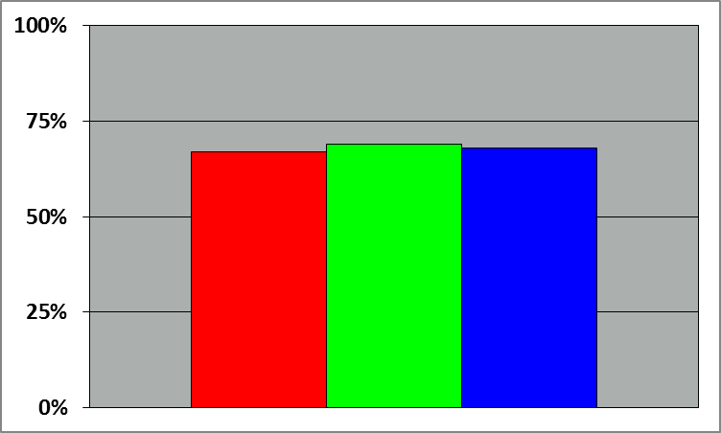
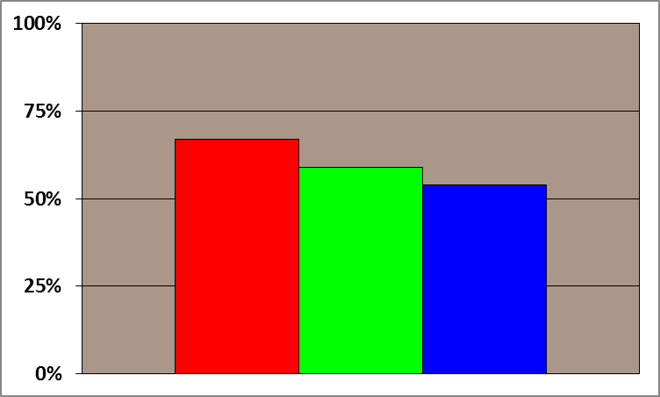
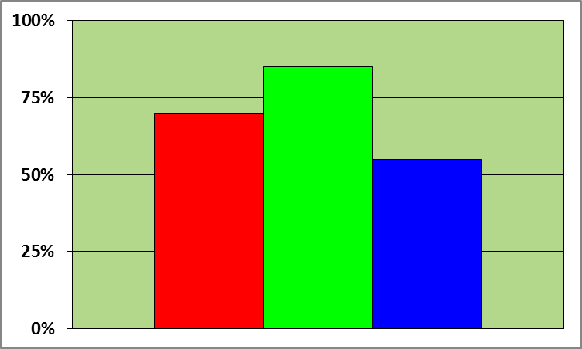
RGB Pixel Saturation
Fog or thick low stratus
Thick stratus, mid-level tops, small water droplets
Havre
ʘ
As above, but more small water droplets
AQUA MODIS, 1010 UTC 25 Sept 2013
Red: [12-10.8 µm] Optical depth (cloud thickness)
Green: [10.8-3.9 µm] Particle phase; presence of water
Blue: [10.8 µm] Temperature…but inverted. Warmer is more blue.

Slide 11
Havre Event Summary
Low-topped +RA not seen on Radar
GOES imagery of limited additional value
Radar Pop-up Skew-T reveals conditionally unstable layers near saturation, -5 to -12 °C.
MODIS/VIIRS Nt Microphysics RGB suggests super-cooled water (strong green).
Development of precipitation is most efficient with mixed ice/water at these temperatures (i.e., Rogers and Yau, A Short Course in Cloud Physics)

Slide 12
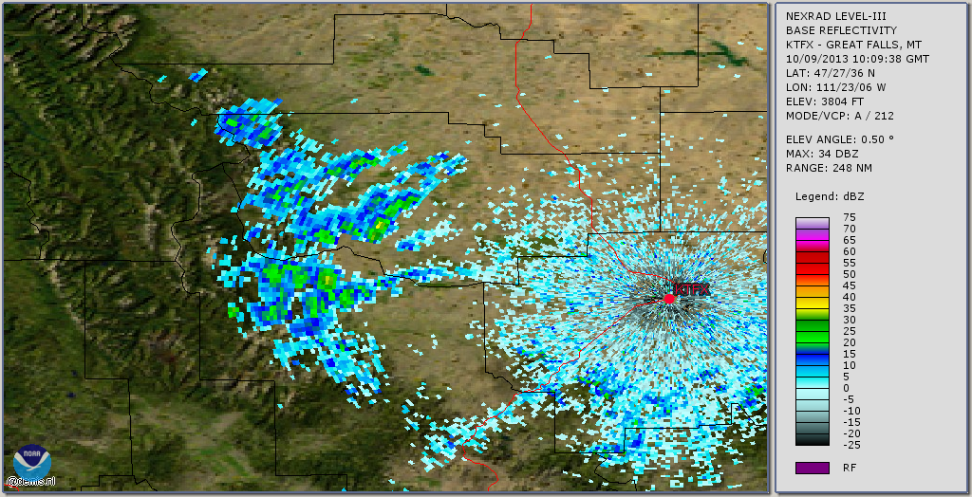
Mixed Phase Precipitation 10:09 UTC, Oct 09 2013
Deep trough over Great Basin.
Weak shortwave ridge over Montana.
Upslope flow; surface high pressure strengthening.
Shallow, weak rain or snow showers.
Notes:
Deep Pacific Trough over Great Basin; Weak shortwave ridge over MT. Shallow Upslop (northeasterly) flow with strengthening surface high pressure.
45 nm downrange, elevation 1.5 kft ARL…~4800 ft MSL
70 nm downrange, elevation 2.25 kft ARL…. ~5600 ft MSL
Right at or, just above fZL on TFX sounding

Slide 13
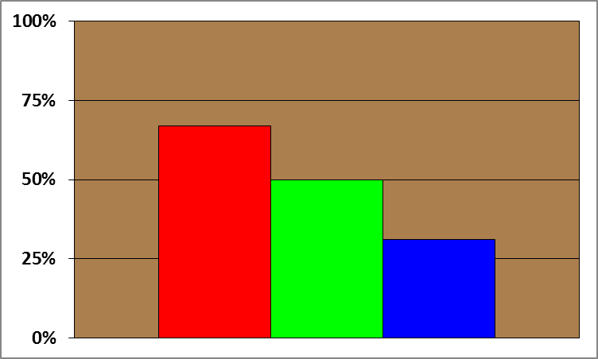
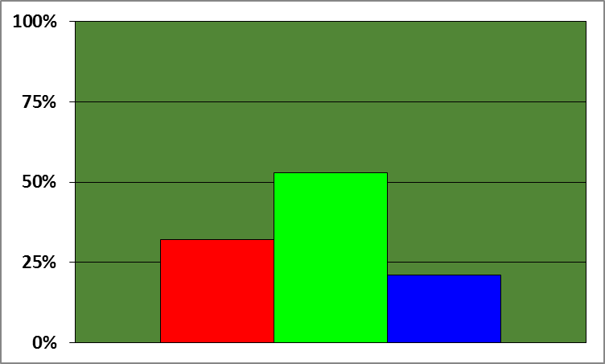
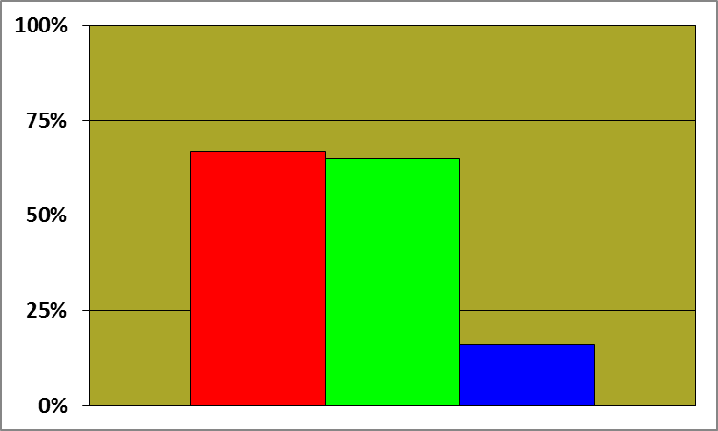
VIIRS Nt Microphysics RGB 10:02 UTC, 09 Oct 2013
Thick mid-level stratus, mostly water
Thick mid-level stratus, ice
Mid-level Stratus, mostly water
Thick, mid-level stratus, mostly water
Less red/blue shows thinner, colder clouds, but still a large contribution from small water particles (bright green)

Slide 14
Dual-Pol Hydrometeor Class. 10:09 UTC, Oct 09 2013
Mix of dry snow and ice crystals.
Recall that melting layer algorithm relies on RUC analysis.
Green in Nt Microphysics RGB initially suggests large water particles.
What does sounding suggest?
Notes:
Deep Pacific Trough over Great Basin; Weak shortwave ridge over MT. Shallow Upslop (northeasterly) flow with strengthening surface high pressure.
45 nm downrange, elevation 1.5 kft ARL…~4800 ft MSL
70 nm downrange, elevation 2.25 kft ARL…. ~5600 ft MSL
Right at or, just above fZL on TFX sounding

Slide 15
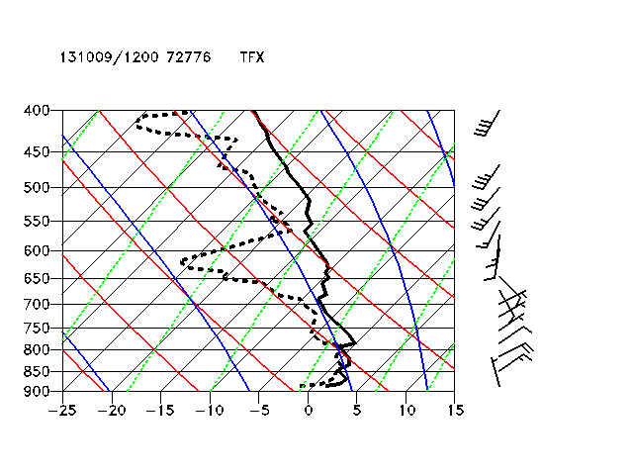
12Z TFX Sounding, 09-Oct-2013
Stable, saturated layer capped by inversion just above FZL.
Also saturated near 700 mb; possible source of ice crystal precipitation?
Mid-level clouds possible around 560 mb.
Radar shows ice/dry snow, but VIIRS Nt micro and sounding together suggest elevation dependent rain or snow.
Orange line is approx height of radar beam over showers

Slide 16
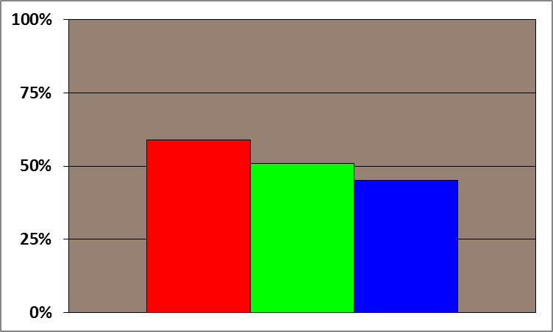
Low-Topped RA in N. Mexico VIIRS Nt Micro, 07:53 UTC, 17 July 2013
Brian Guyer, NWS ABQ. Post to SPoRT Blog.
ABQ Radar 0.5° scan is at 15 kft AGL near rain report at Farmington, so no coverage at 135 nm from radar.
00Z ABQ sounding reveals temp at this level near -10 C, becoming saturated by 12Z.
Super cooled or mixed species in cloud to generate efficient rainfall?
Tan/light green shading suggests cold thicker cloud / small water droplets

Slide 17
Summary
Tan with green channel color saturation of 50% or more suggest mixed or warm rain microphysical process.
Nt Micro RGB can enhance situational awareness:
Improved spatial detail for cloud coverage in radar gaps, including vertical layers
Use proximity soundings (Raob or Model Analyses) to identify temperature of cloud feature seen in RGB
Limitations:
High clouds may obscure lower level water signature
Temporal coverage
Nighttime use only

