Slide 1
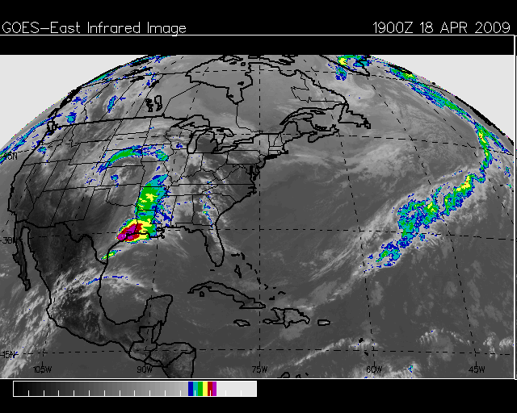
Using the SPoRT MET Scripts to Assess the WRF EMS for a Southeast Texas Heavy Rainfall Event
Patrick Blood and Lance Wood
19 Z

Slide 2
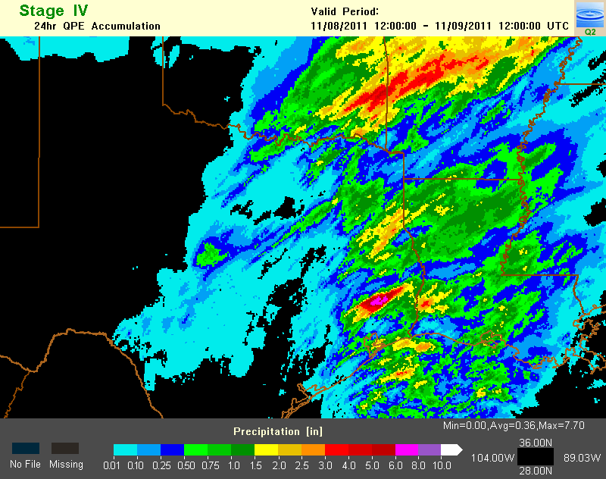
SPoRT Model Simulation Matrix Cold Season Heavy Rainfall - WFO Houston Case Study November 8-9, 2011 Andrew Molthan
Notes:
Radar imagery from the NSSL Q2 mosaics – composite reflectivity over the region for the model simulation time period, 24 hours beginning at 1200 UTC on November 8, 2011.

Slide 3
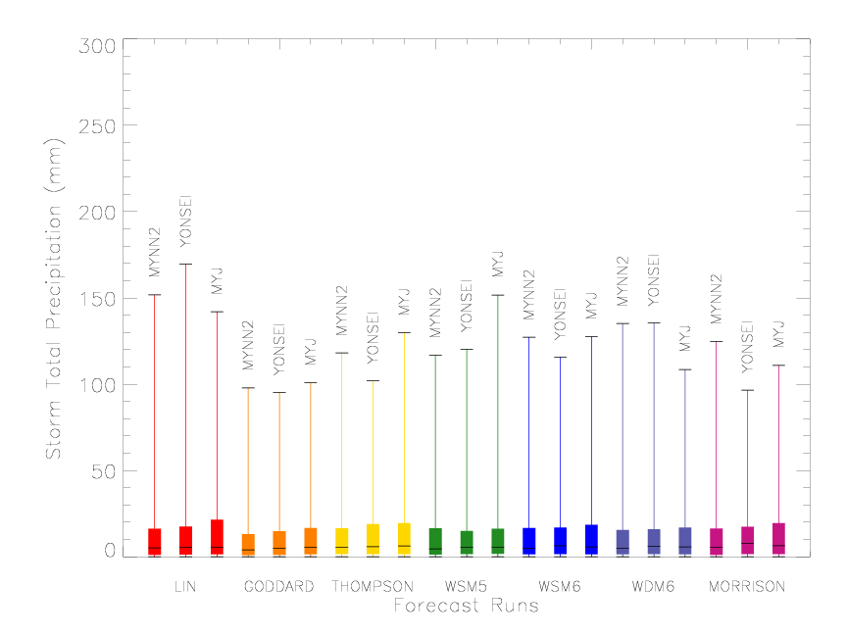
Variability in Storm Total Precipitation – All Points, All Hours
We learned that selecting the appropriate PBL and Microphysics is important
Notes:
Analysis of storm total precipitation includes all points and all forecast hours. Extreme values from Stage IV of 6 in. or greater (150 mm) were achieved by the Lin scheme (graupel), and certain configurations of the WSM5 scheme (no graupel). In general, the Lin scheme produced some of the heaviest amounts of precipitation (likely due to graupel), while other schemes produced lesser amounts. An examination of the Q3 and median values for some microphysics schemes suggests a possible increase in QPF related to PBL selection the Lin scheme, Goddard scheme, WSM6, WDM6, and Morrison schemes all have a slight increase with PBL scheme (although their maximum values do not mimic the trend). Domain-wide coverage of precipitation may be affected by other items noted and related to PBL selection: greater PBL height, increases in updraft, downdraft, and mean vertical velocity. In this particular case, the selection of a no-graupel scheme (WSM5) did not produce significantly lesser precipitation amounts. Nor were there significant differences in domain-wide precipitation statistics between double-moment representations of all species (Morrison) and more traditional single-moment representations (Lin, Goddard, etc.). However, statistics and verification scores may differ significantly when examining individual forecast periods or specific storms.

Slide 4
18 April 2009 Synoptic Overview
Upper divergence apparent at 300 mb level with SE Texas between two diverging jet streaks.
500 mb low moving over the southern plains with a shortwave trough moving across SE Texas.
Deep layer moisture in the lower levels noticed at the 850 and 700 mb levels (PWATS : ~1.55” (25th percentile)).
Pre-existing surface trough over the Houston area with a dry line and cold front approaching from the west.

Slide 5
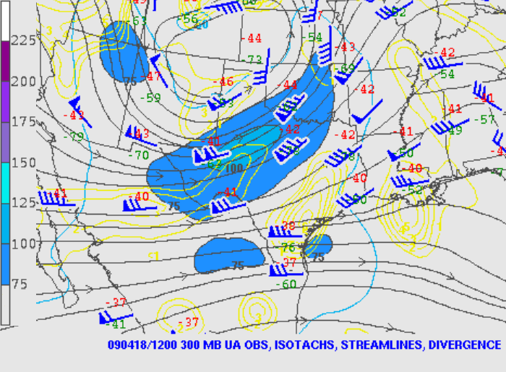
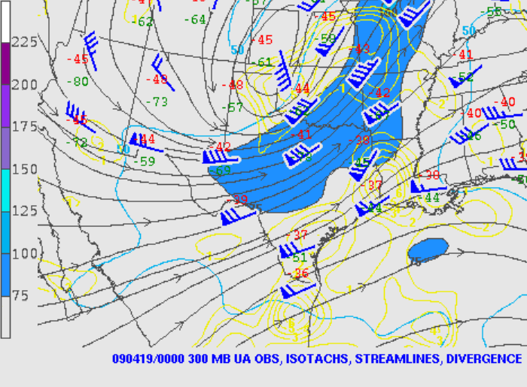
18 April 2009 Synoptic Overview courtesy of http://www.spc.noaa.gov/obswx/maps/
12 UTC 18 April 2009 00 UTC 19 April 2009
300 mb

Slide 6
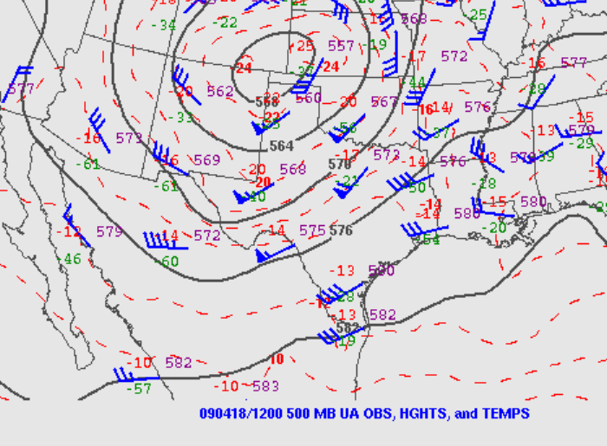
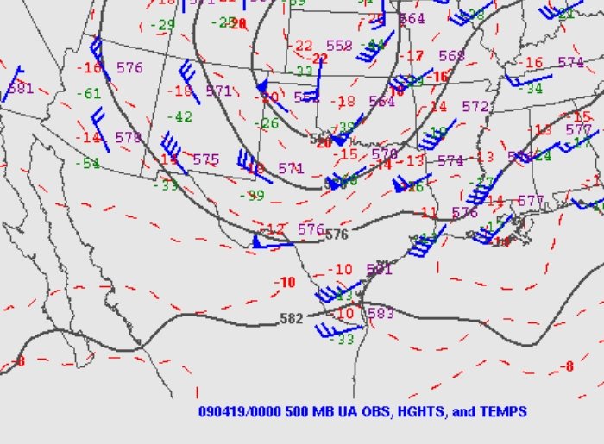
18 April 2009 Synoptic Overview courtesy of http://www.spc.noaa.gov/obswx/maps/
12 UTC 18 April 2009 00 UTC 19 April 2009
500 mb

Slide 7
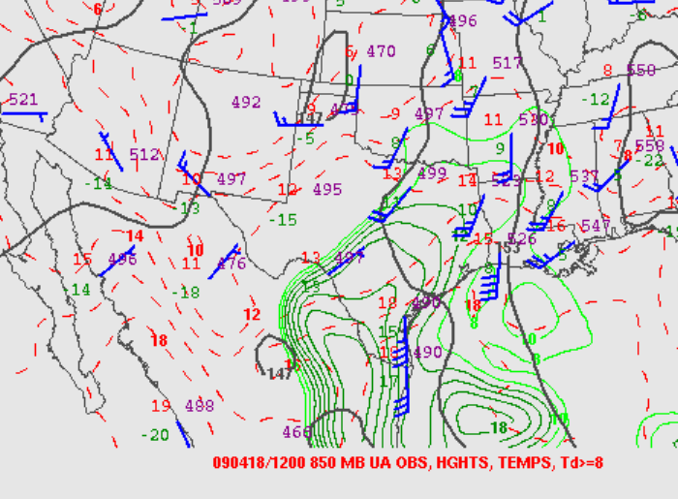
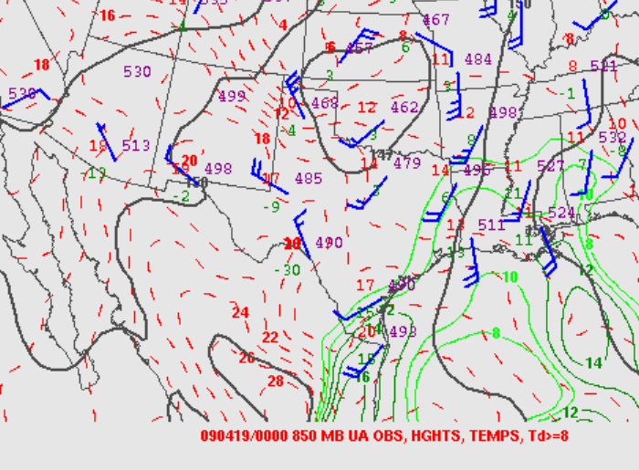
18 April 2009 Synoptic Overview courtesy of http://www.spc.noaa.gov/obswx/maps/
12 UTC 18 April 2009 00 UTC 19 April 2009
850 mb

Slide 8
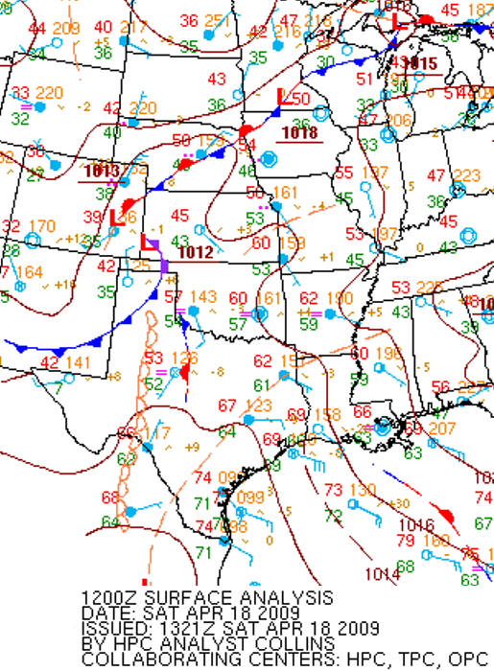
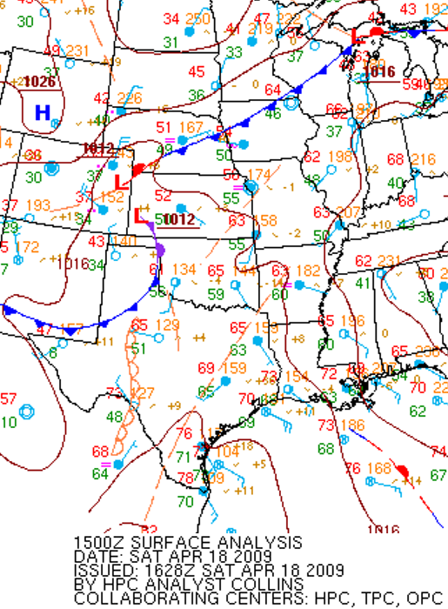
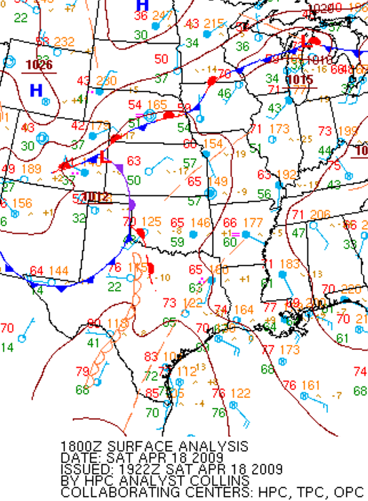
18 April 2009 Synoptic Overview courtesy of http://www.hpc.ncep.noaa.gov/html/sfc_archive.shtml
12 UTC 18 Apr 2009 15 UTC 18 Apr 2009 18 UTC 19 Apr 2009
Surface plot/fronts/pressure

Slide 9
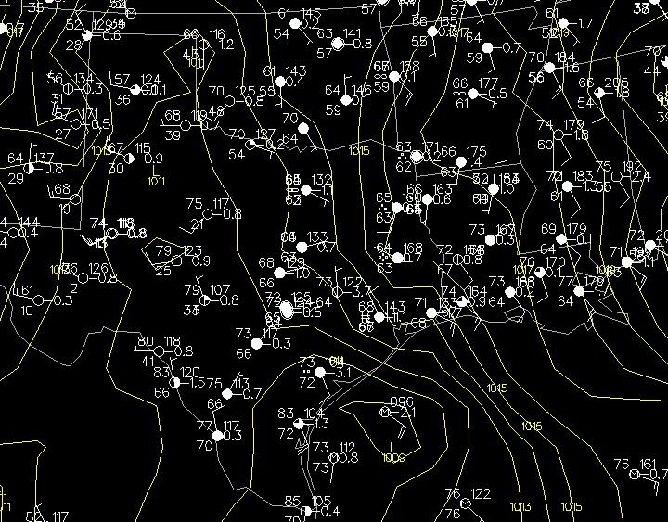
The April 18th 2009 Extreme Rain Event
18Z Surface Analysis
Inland trough provided the convergence / ample inflow (1014.3 mb at IAH)

Slide 10
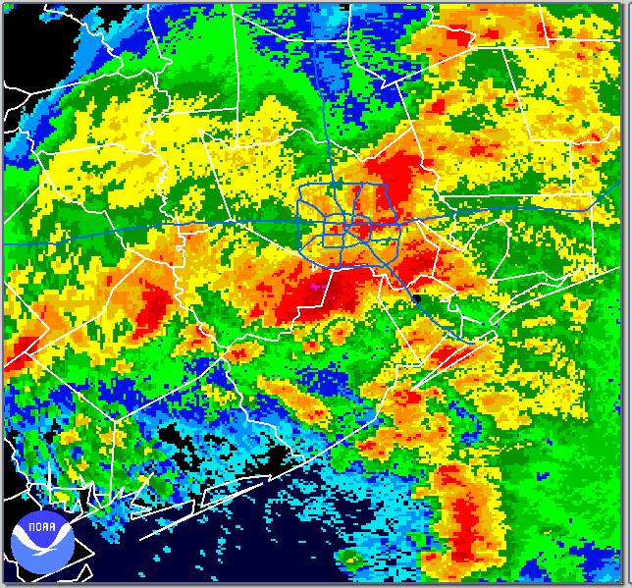
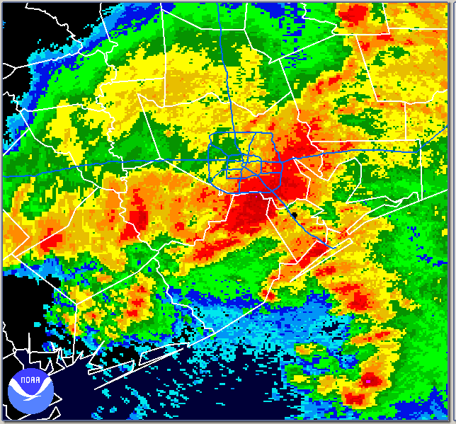
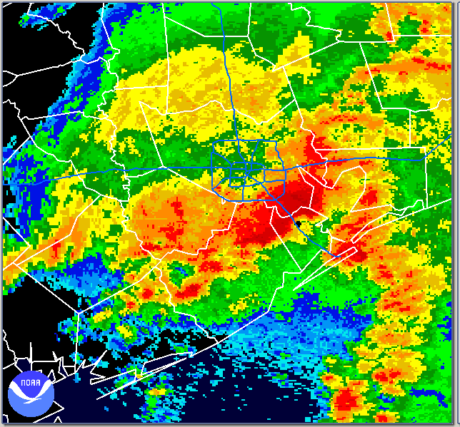
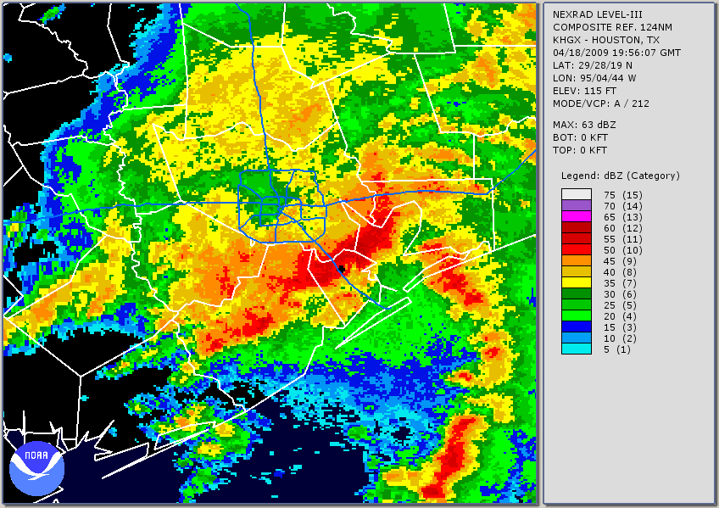
Meso-Low forms and enhances inflow
L
L
1829Z
1902Z
L
L
1930Z
1956Z

Slide 11
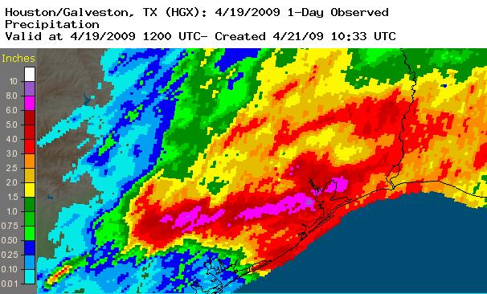
24 Hour Precipitation Estimate from KHGX

Slide 12
Rainfall Rate Comparisons / Impacts
Return Period: | 10year | 25year | 50year | 100year | 500year
The 18 April event had 9.9 of its 11 inch max of rainfall fall in 6 hours with 6.9 inches in one hour.

Slide 13
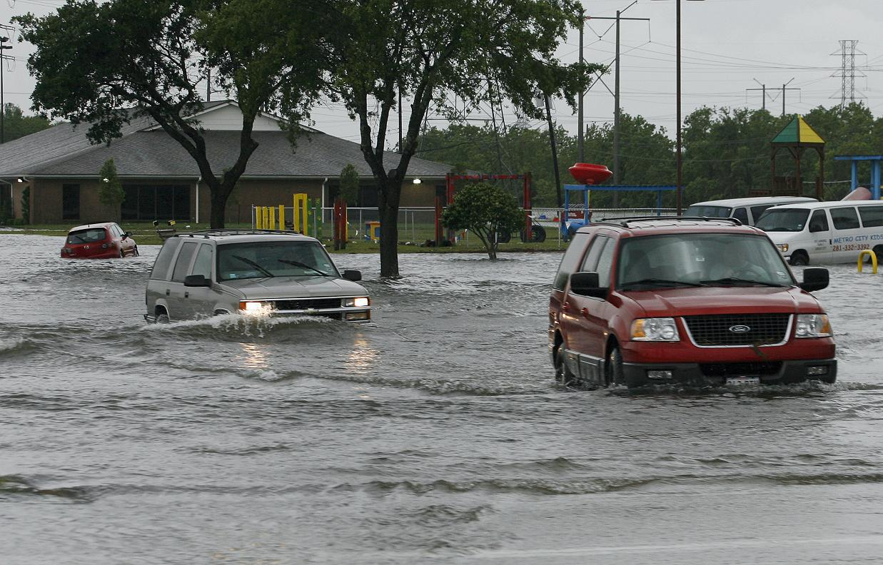
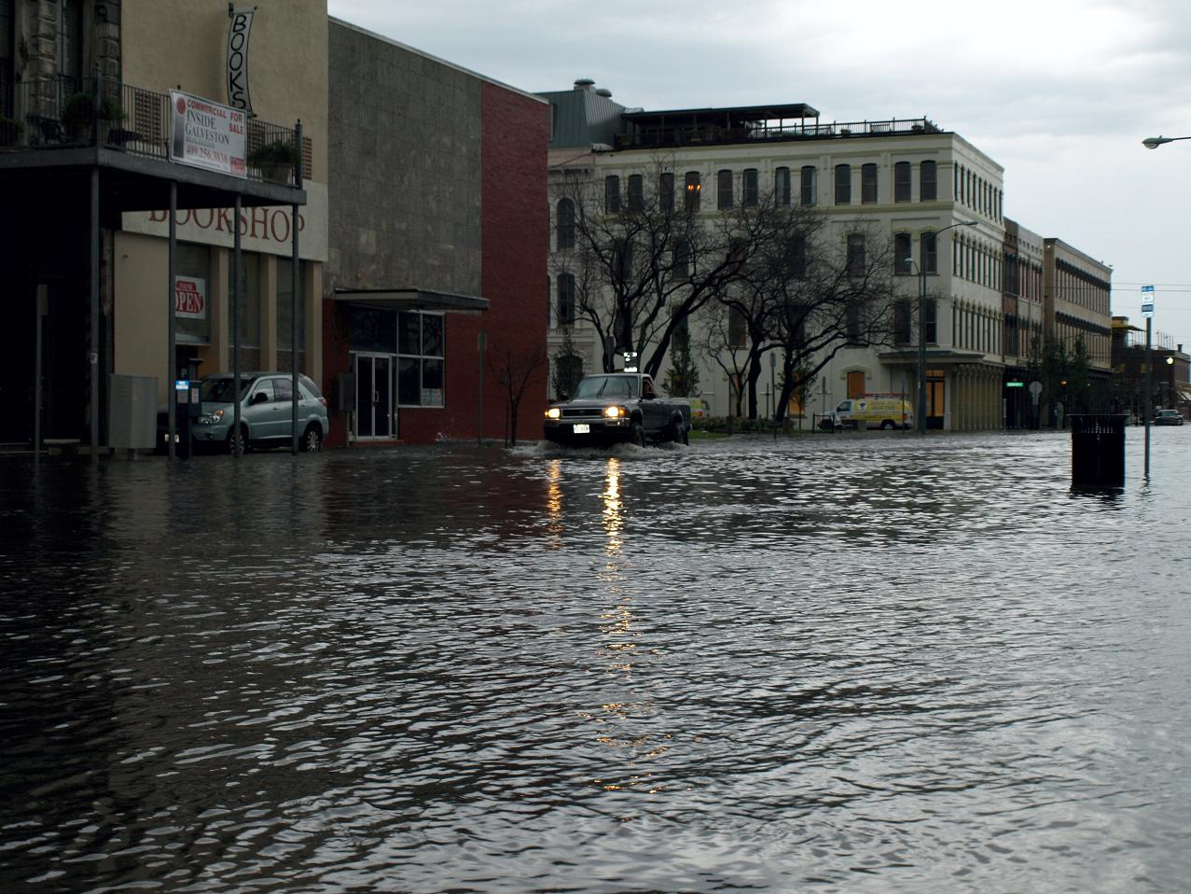
The April 18th 2009 Extreme Rain Event
Friendswood
The Strand
Image Courtesy: Galveston Daily News
Image Courtesy: Galveston Daily News

Slide 14
Historical WRF EMS Runs and Assessing with the Model Evaluation Tools (MET)
Forecaster Patrick Blood has utilized 3 different model initialization datasets, 6 PBLs, and 8 microphysical schemes to produce 144 model runs to analyze - using v3.4 of the WRF EMS.
Using the SPoRT MET scripts v4.1 and the new grib2 capability (courtesy of Brad Zavodsky) to objectively assess the precipitation forecasts.
This work is part of Mr. Blood’s MS Thesis work at the University of Houston. He is in the early stages of data analysis.

Slide 15
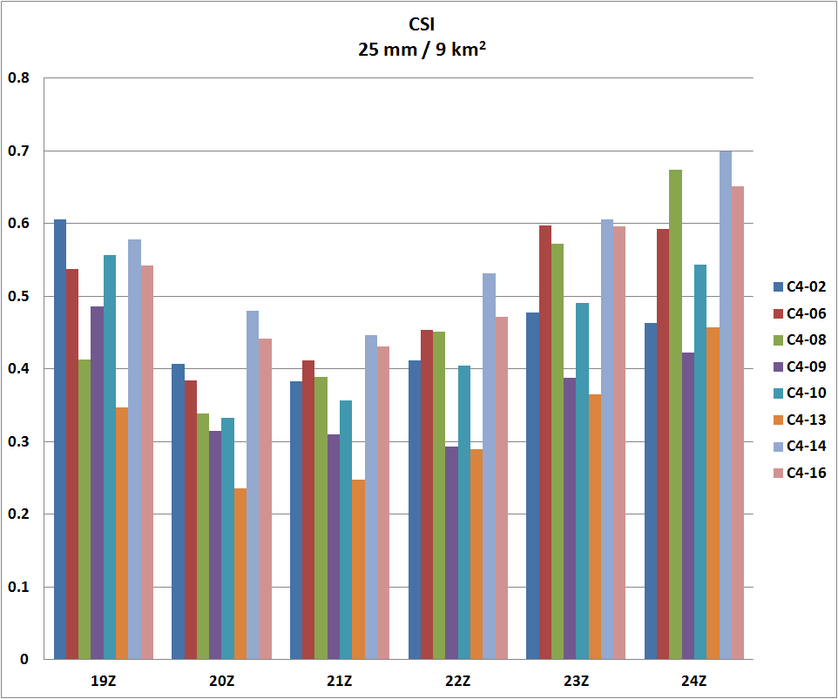
Re-Analysis Initialization:
C : CFSR
PBL Schemes:
1: Yonsei
4: QNSE
Microphysical Schemes:
02: Lin
06: WSM 6 Class
08: Thompson
09: Milbrandt-Yau
10: Morrison
13: Stony Brook University
14: WDM 5-Class
16: WDM 6-Class
24 km x 24 km

Slide 16
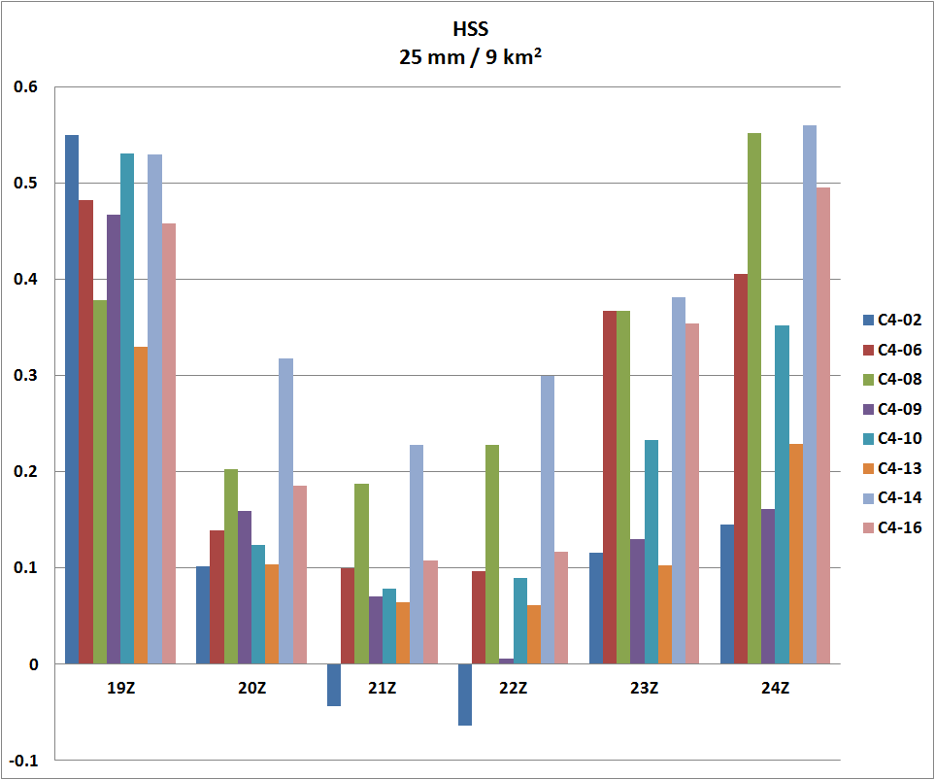
Re-Analysis Initialization:
C : CFSR
PBL Schemes:
1: Yonsei
4: QNSE
Microphysical Schemes:
02: Lin
06: WSM 6 Class
08: Thompson
09: Milbrandt-Yau
10: Morrison
13: Stony Brook University
14: WDM 5-Class
16: WDM 6-Class
24 km x 24 km

Slide 17
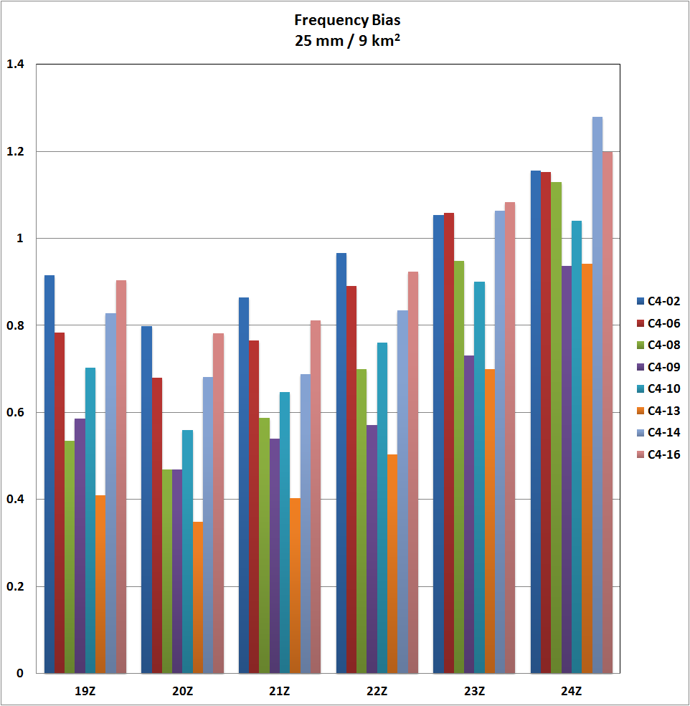
24 km x 24 km
Re-Analysis Initialization:
C : CFSR
PBL Schemes:
1: Yonsei
4: QNSE
Microphysical Schemes:
02: Lin
06: WSM 6 Class
08: Thompson
09: Milbrandt-Yau
10: Morrison
13: Stony Brook University
14: WDM 5-Class
16: WDM 6-Class

Slide 18
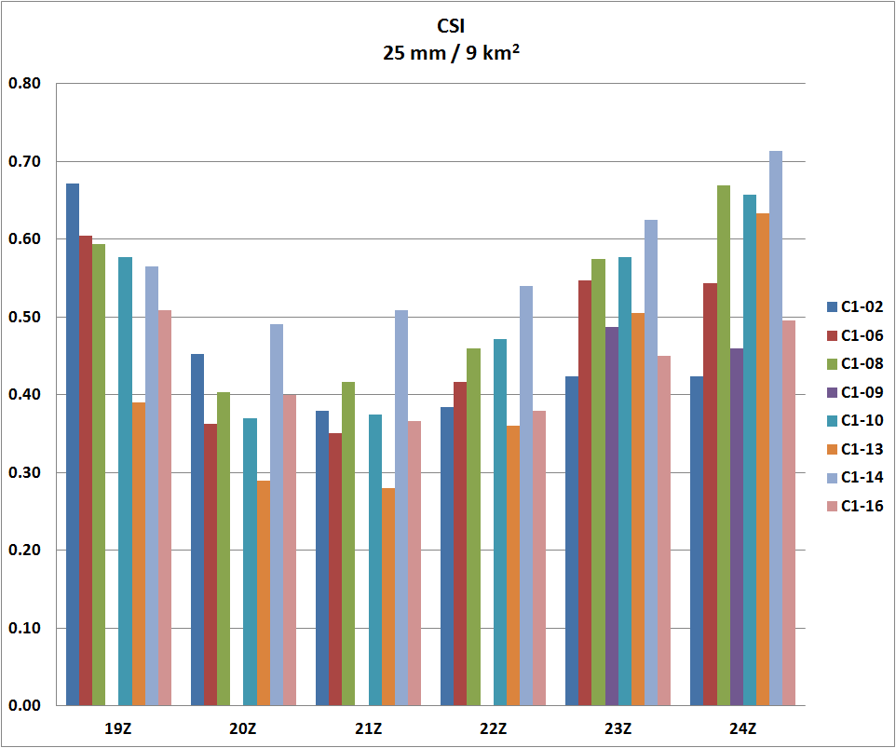
Re-Analysis Initialization:
C : CFSR
PBL Schemes:
1: Yonsei
4: QNSE
Microphysical Schemes:
02: Lin
06: WSM 6 Class
08: Thompson
09: Milbrandt-Yau
10: Morrison
13: Stony Brook University
14: WDM 5-Class
16: WDM 6-Class
24 km x 24 km

Slide 19
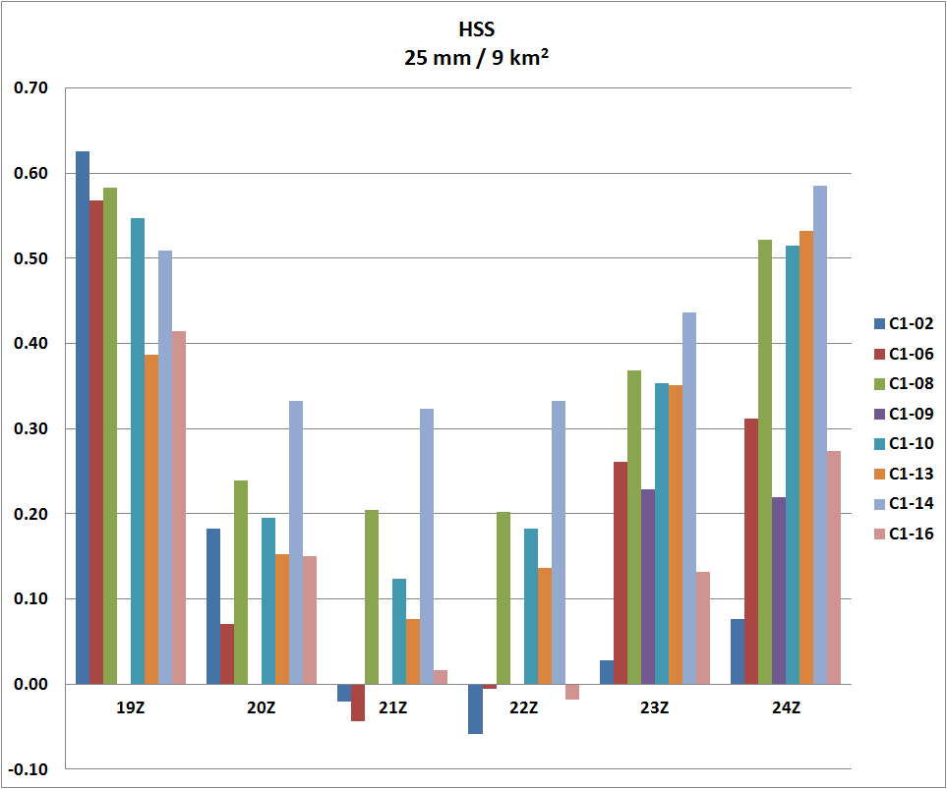
Re-Analysis Initialization:
C : CFSR
PBL Schemes:
1: Yonsei
4: QNSE
Microphysical Schemes:
02: Lin
06: WSM 6 Class
08: Thompson
09: Milbrandt-Yau
10: Morrison
13: Stony Brook University
14: WDM 5-Class
16: WDM 6-Class
24 km x 24 km

Slide 20
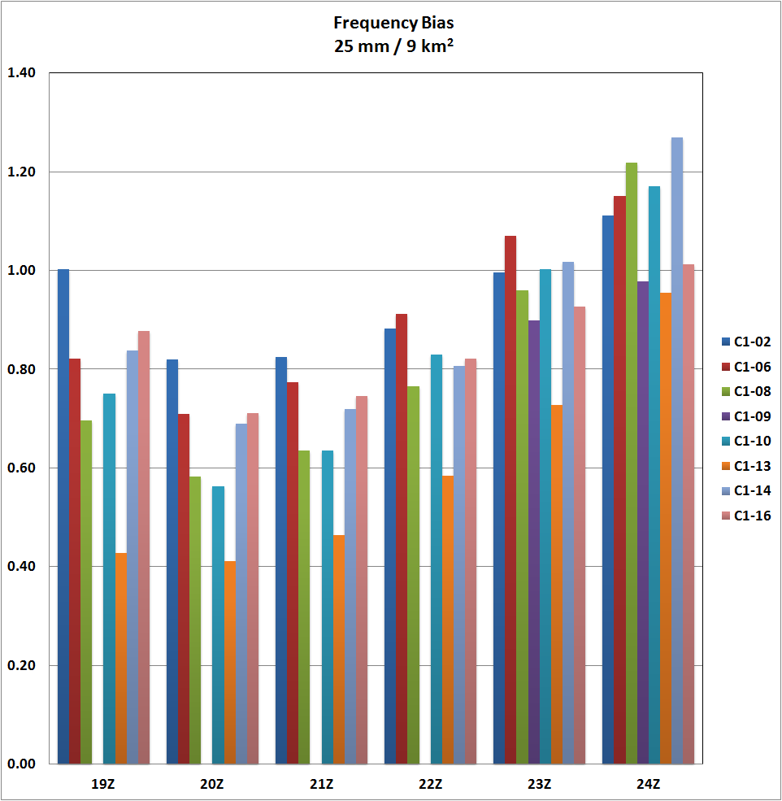
24 km x 24 km
Re-Analysis Initialization:
C : CFSR
PBL Schemes:
1: Yonsei
4: QNSE
Microphysical Schemes:
02: Lin
06: WSM 6 Class
08: Thompson
09: Milbrandt-Yau
10: Morrison
13: Stony Brook University
14: WDM 5-Class
16: WDM 6-Class

Slide 21
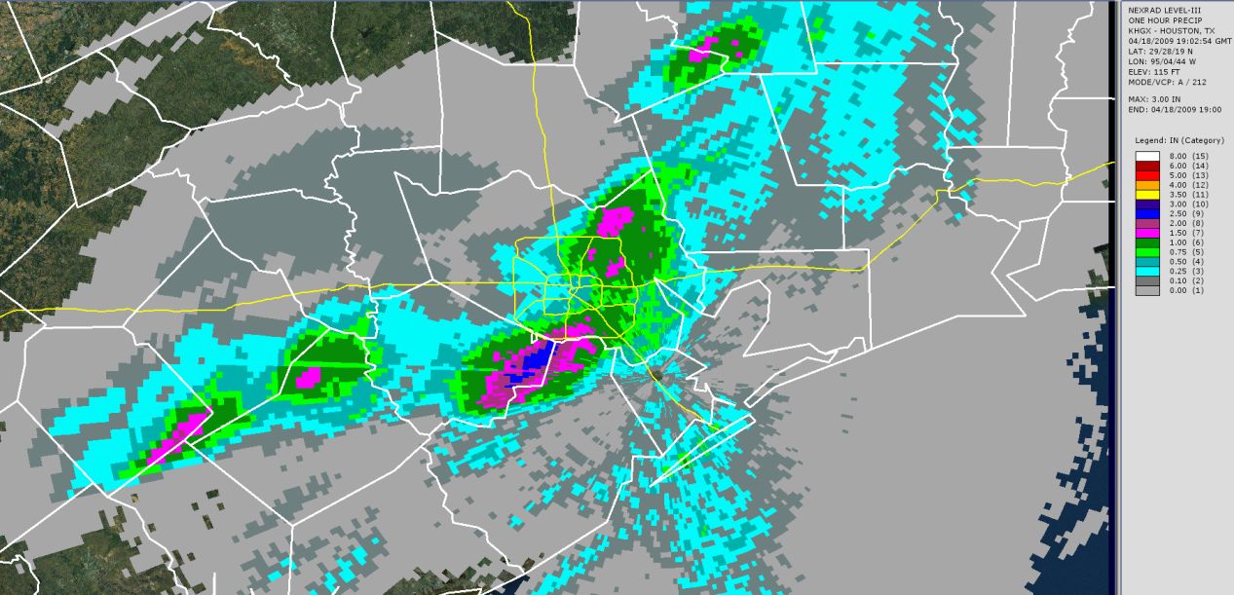
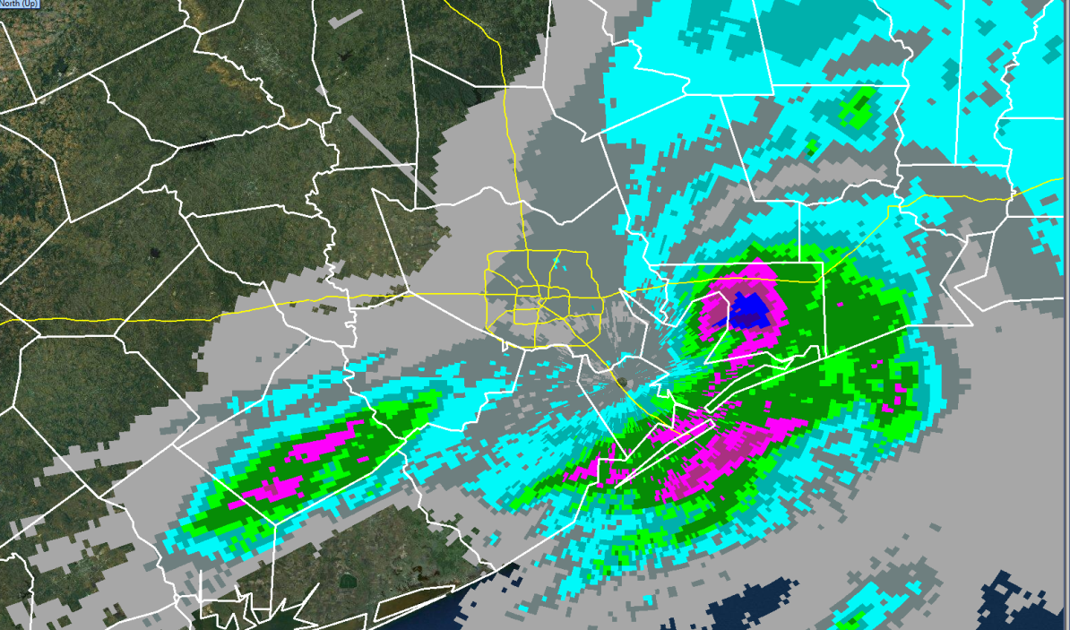
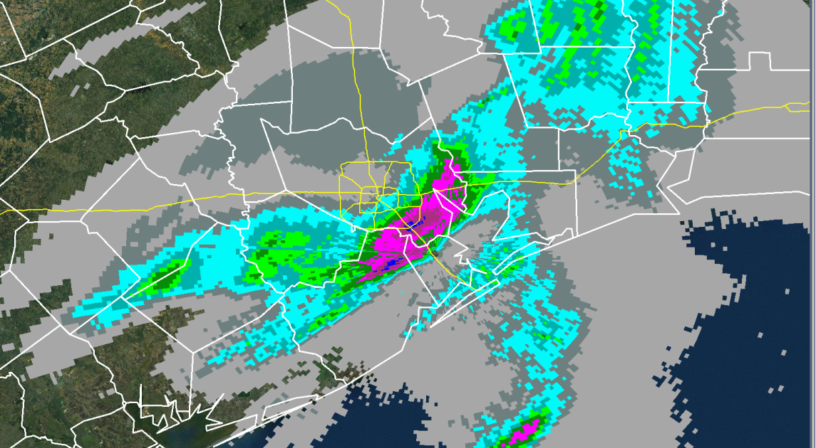
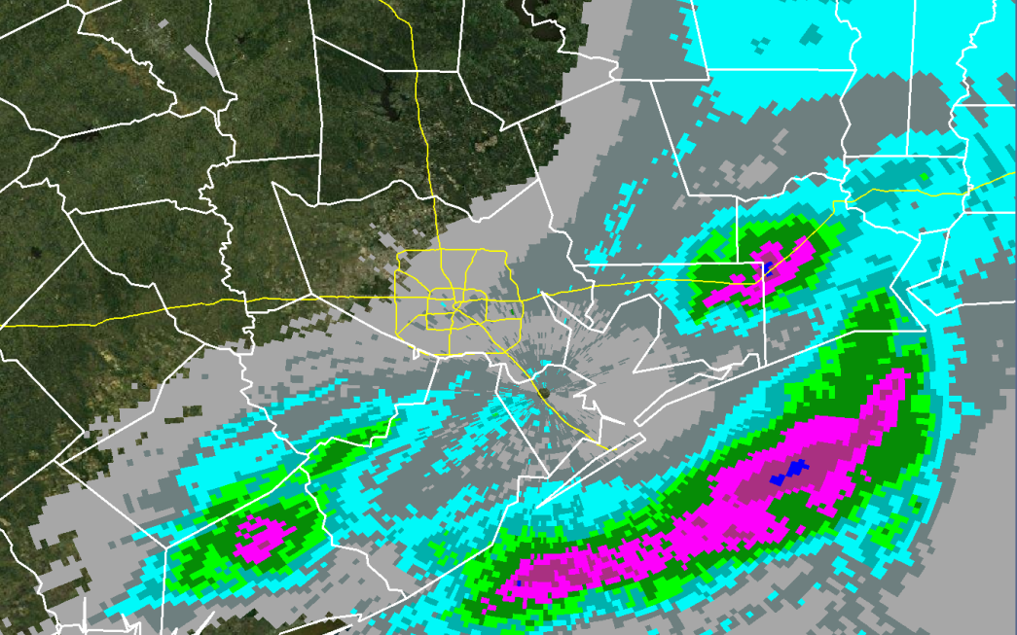
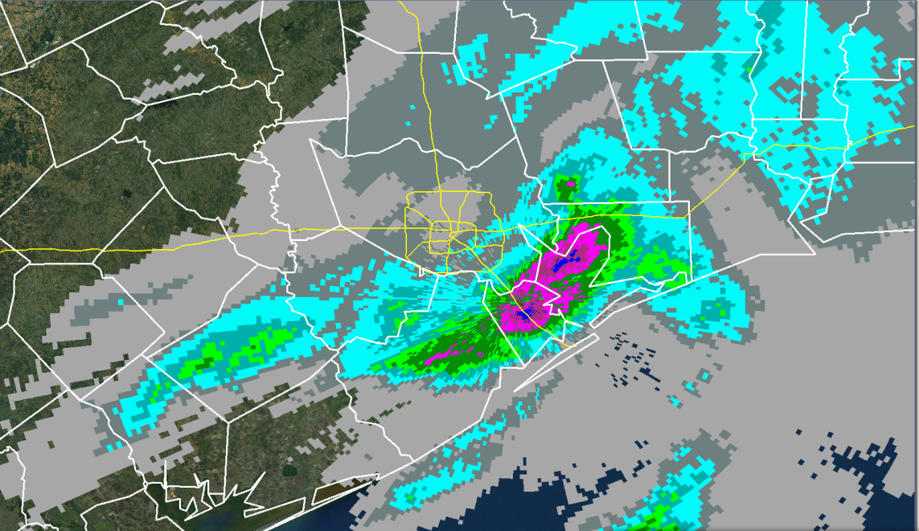
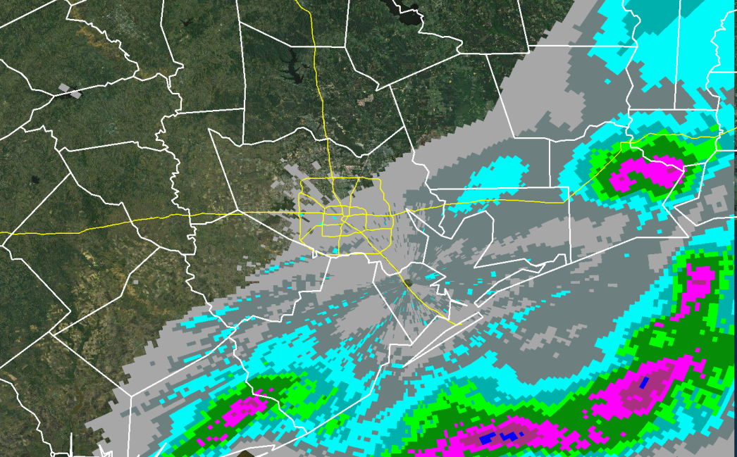
Stage III Precipitation
18-19 Z
21-22 Z
19-20 Z
22-23 Z
20-21 Z
23-24 Z

Slide 22
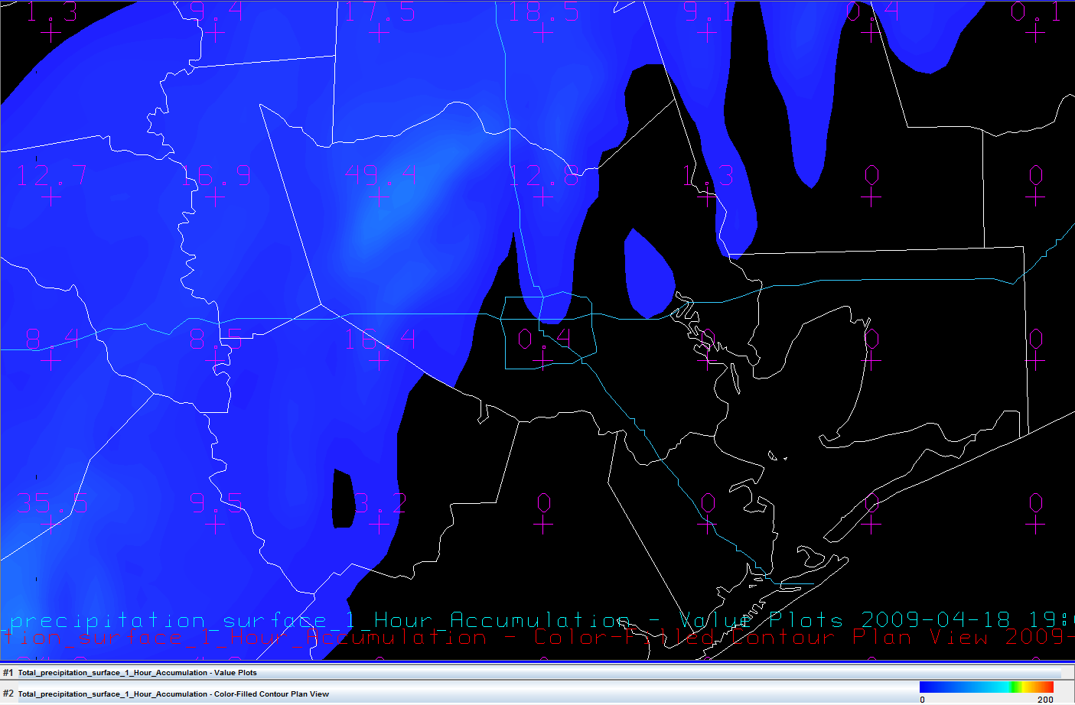
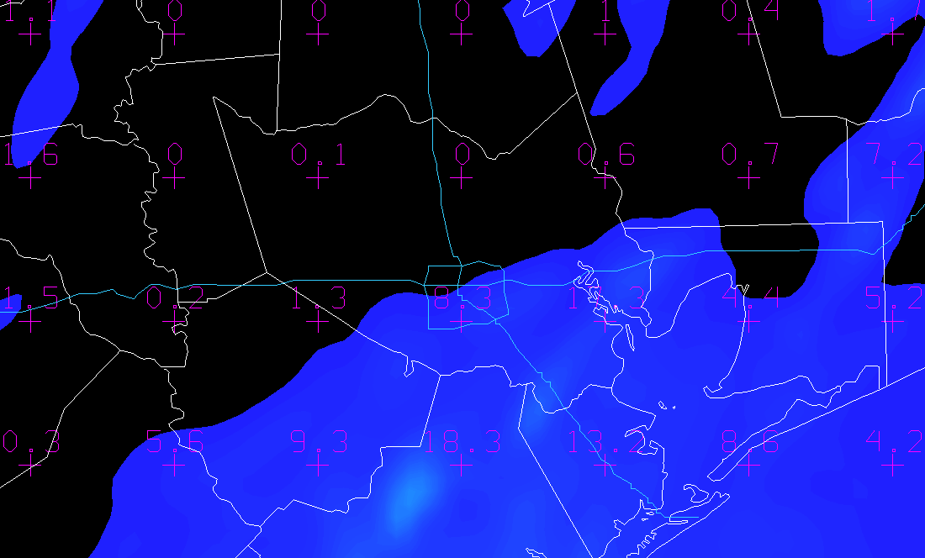
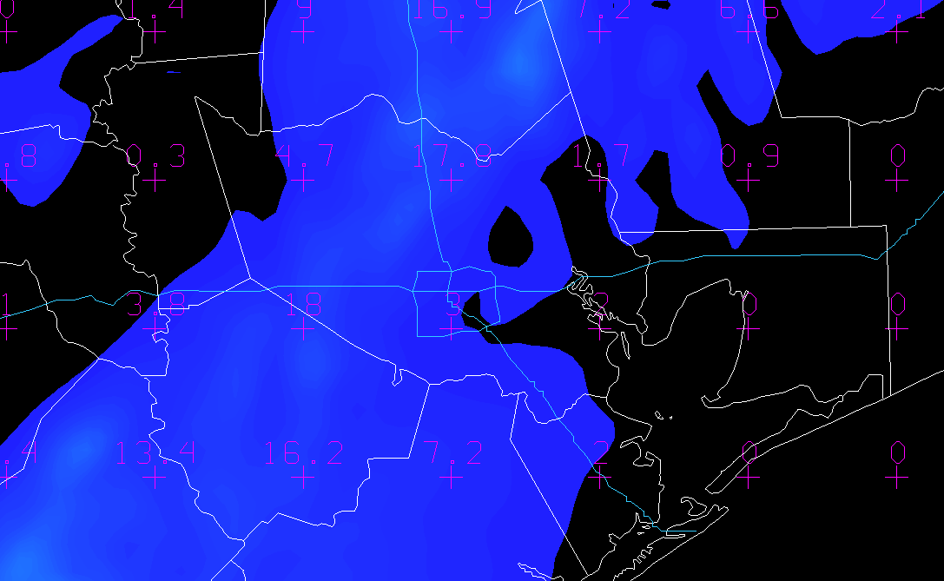
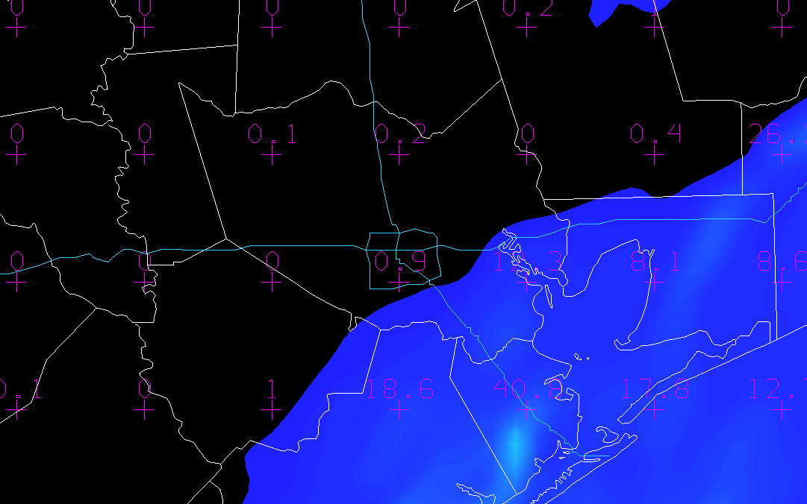
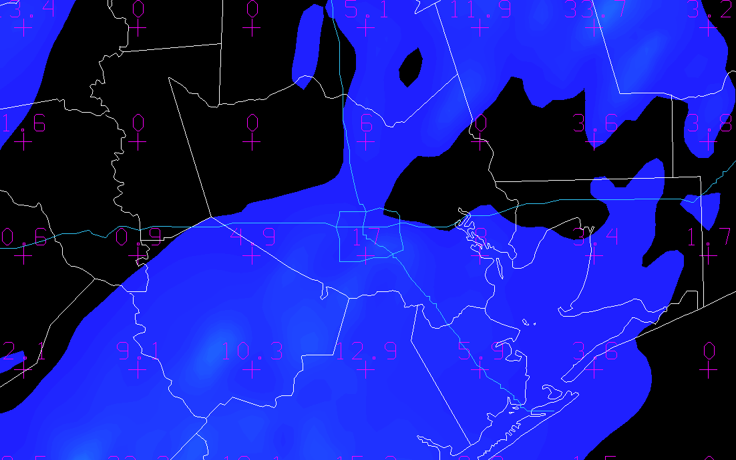
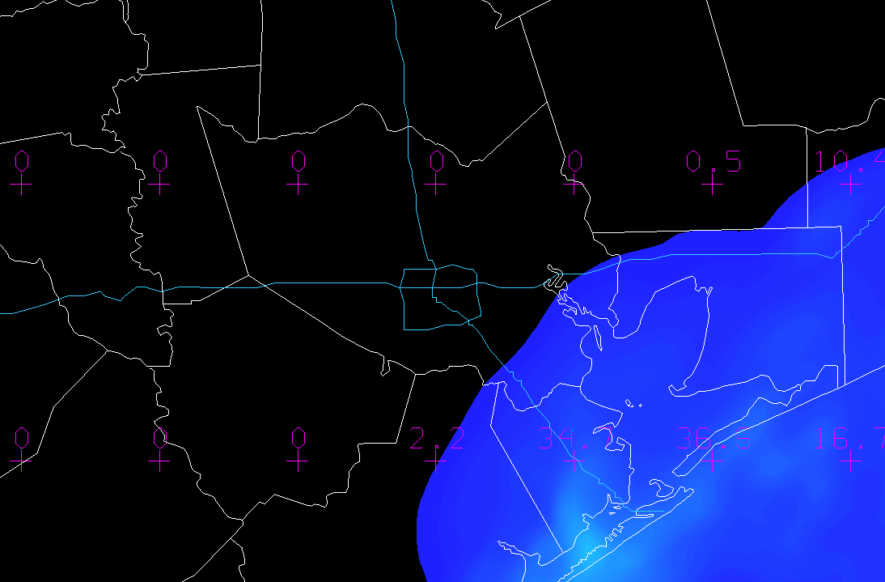
18-19 Z
Example of 6 consecutive 1 hour precip. totals from a WRF-EMS run
During the critical afternoon period
PBL: BouLac
Microphysics:
WDM 5-class
21-22 Z
19-20 Z
22-23 Z
20-21 Z
> 3 inches
23-24 Z
mm

Slide 23
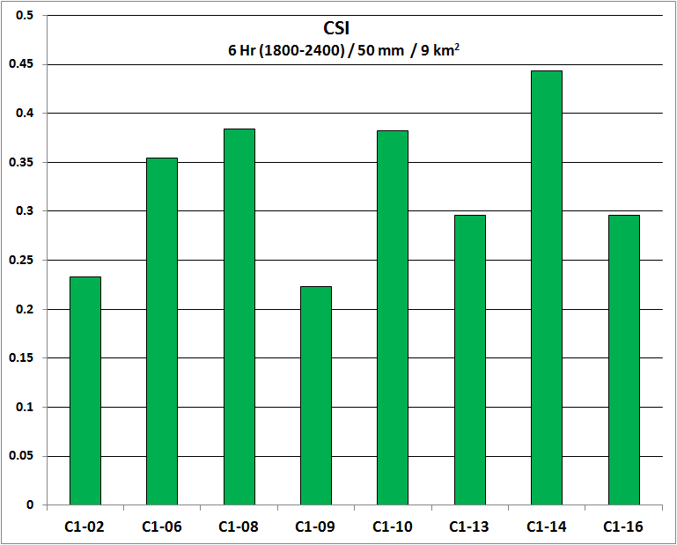
Re-Analysis Initialization:
C : CFSR
PBL Schemes:
1: Yonsei
4: QNSE
Microphysical Schemes:
02: Lin
06: WSM 6 Class
08: Thompson
09: Milbrandt-Yau
10: Morrison
13: Stony Brook University
14: WDM 5-Class
16: WDM 6-Class
24 km x 24 km
Notes:
PBL: Yonsei

Slide 24
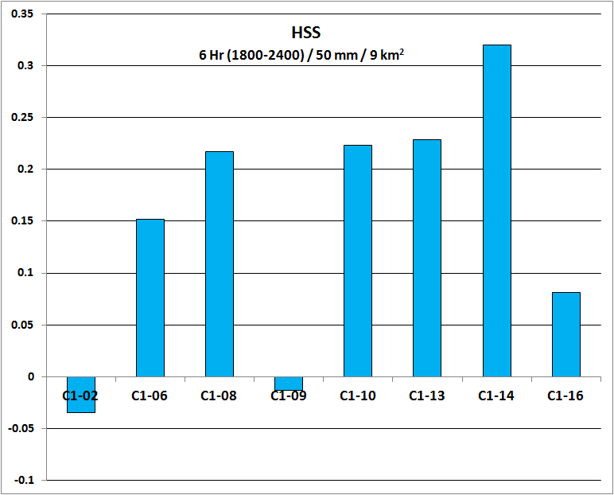
Re-Analysis Initialization:
C : CFSR
PBL Schemes:
1: Yonsei
4: QNSE
Microphysical Schemes:
02: Lin
06: WSM 6 Class
08: Thompson
09: Milbrandt-Yau
10: Morrison
13: Stony Brook University
14: WDM 5-Class
16: WDM 6-Class
24 km x 24 km
Notes:
PBL: Yonsei

Slide 25
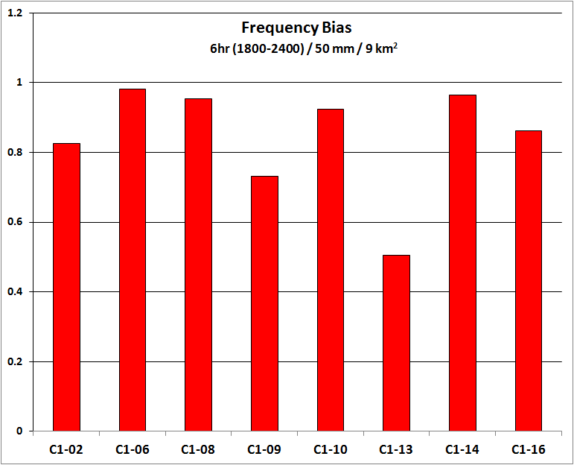
Re-Analysis Initialization:
C : CFSR
PBL Schemes:
1: Yonsei
4: QNSE
Microphysical Schemes:
02: Lin
06: WSM 6 Class
08: Thompson
09: Milbrandt-Yau
10: Morrison
13: Stony Brook University
14: WDM 5-Class
16: WDM 6-Class
24 km x 24 km
Notes:
PBL: QNSE

Slide 26
Early Observations
The strongest performers across the three PBLs/spatial-temporal schemes were the Lin, Thompson, WRF Single Moment (WSM) 6 class, and both WRF Double Moment (WDM) 5 and 6 classes.
There was a trend to over-forecast 1 inch rainfall amounts (Frequency Bias) in the last couple of hours (Yonsei, QNSE) and under-forecast during the early-mid afternoon heavy rainfall period.
The BouLac-WDM 5 class simulation performed well. It placed a 2 to 3 inch bulls-eye over central and southern Galveston County (22 - 24Z) a couple of hours behind where 2 to 3 inches were sensed by the radar (20 – 22Z).
Acknowledgements: Brad Zavodsky, Jon Case, Jayanthi Srikishen

