Slide 1
Leveraging Total Lightning and Convective Initiation Data for Impact-Based Decision Support Services
Brian Carcione
WFO Huntsville, AL

Slide 2
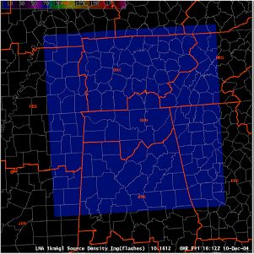
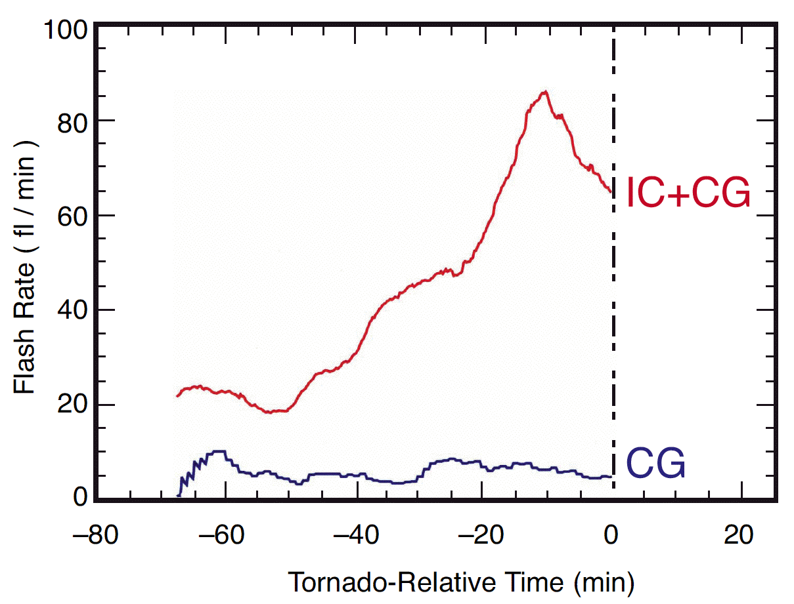
Background – Total Lightning
WFO HUN has a long history (~11 yrs) with SPoRT and Total Lightning from North Alabama Lightning Mapping Array
Convective Initiation from UAHuntsville off and on for ~8 years
Traditionally used for severe weather detection
Huntsville
Courtesy Dr. Steve Goodman

Slide 3
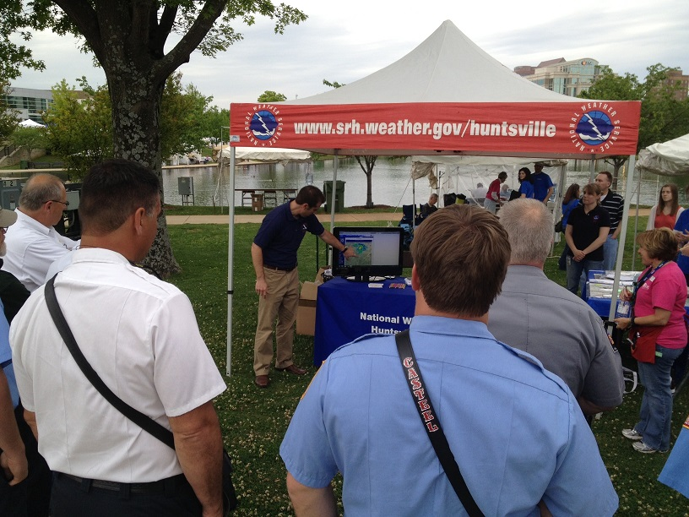
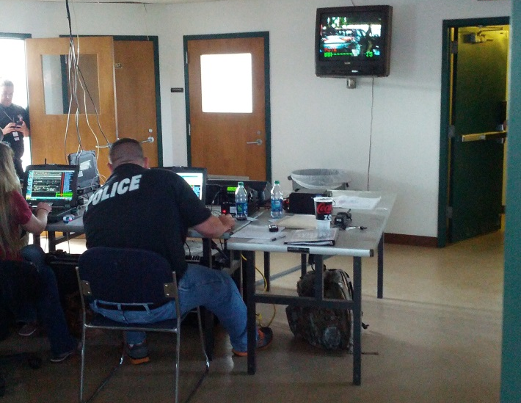
Background – Decision Support
HUN has a long history here too, but it has ramped up markedly in the last 2-3 years
27 April 2011 event, recovery, anniversaries
Work with EMA for protection of life & property

Slide 4
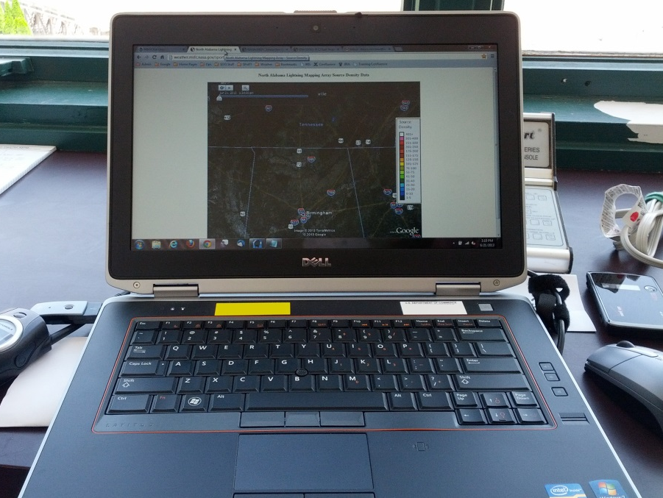
On-Site IDSS with Unique Data
AWIPS importance has changed due to IDSS
SPoRT & UAH have been great about presenting their data in a (mostly) easily-accessible, web-friendly format
GOES-R CI – SPoRT Web Page
NALMA – Google Earth Browser Plugin

Slide 5
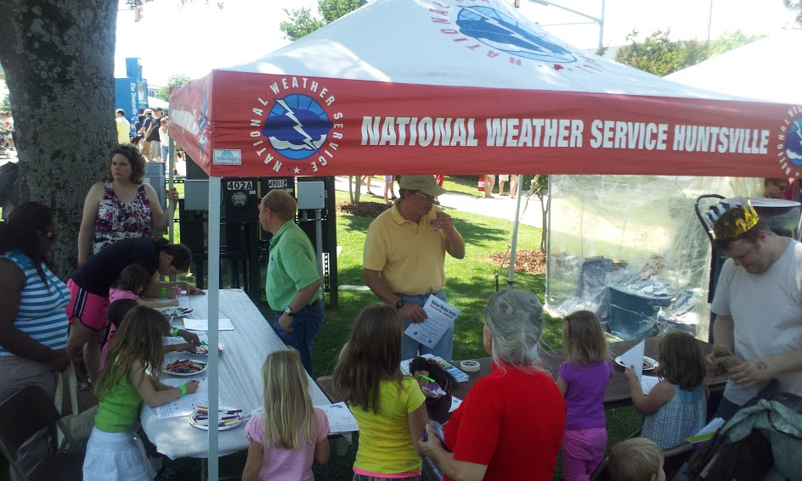
Panoply
Outdoor arts festival in downtown Huntsville, AL, late April
Draws ~300,000 people over 2 ½ days
Strong weather sensitivity
History of bad weather
One day shut down for tornadoes in 2010; completely shut down in 2011 (4/27 effects)

Slide 6
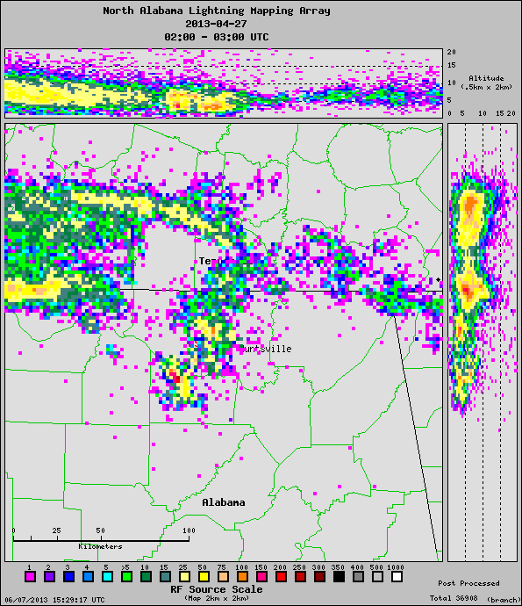
Panoply 2013
First night – scattered showers/storms threatened
NALMA data leveraged at WFO and on-site to determine threats
Organizers accelerated closing fireworks show, but last few fireworks still coincided with lightning

Slide 7
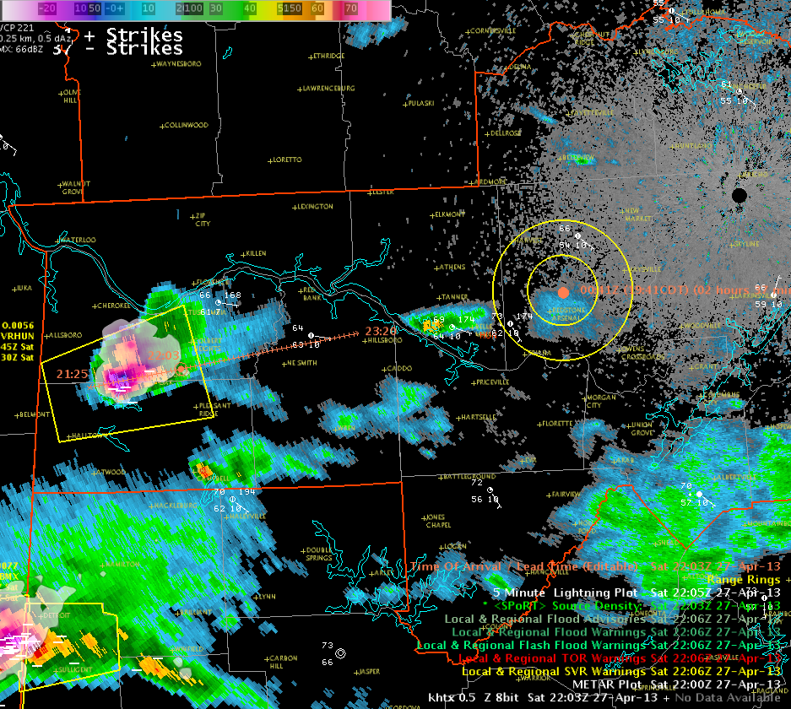
Panoply 2013
New challenges Saturday (tornado watch, scattered storms) but no direct impacts aside from rain
Extended anvils created a “long flash” risk in the evening
DSS met. at WFO conveyed to on-site staff

Slide 8
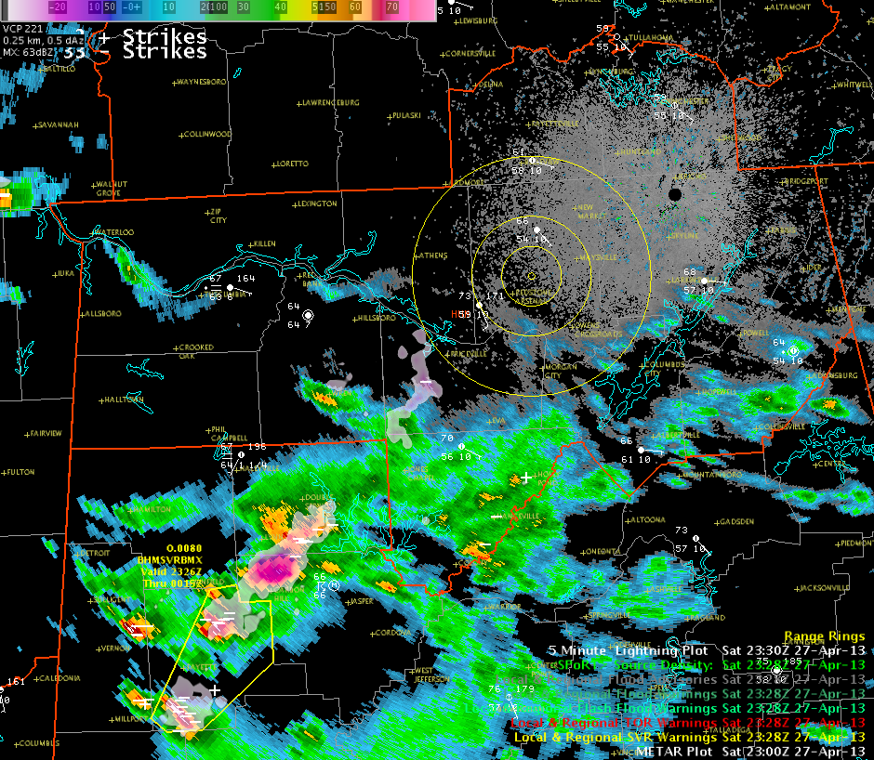
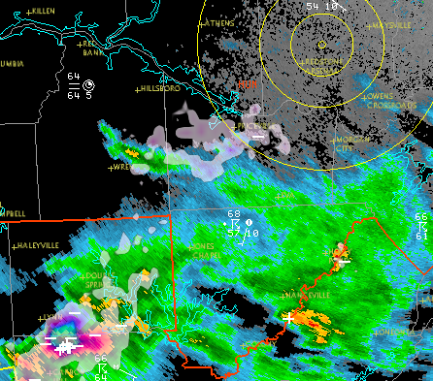
AWIPS II LMA Source Density
2328 UTC 27 April
Panoply Site
(Downtown Huntsville)
5
10
20
Single flash perspective from “XLMA” software

Slide 9
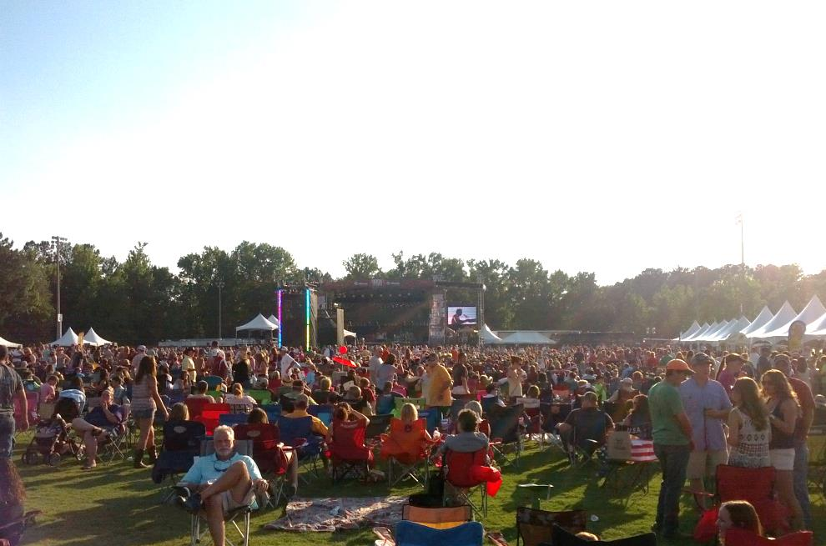
Rock the South Concert
Outdoor concert in Cullman, AL
Originally designed to support victims of April 27 outbreak; now set in June (active convective season)
~40,000 attendees over 2 days
Heightened sensitivity after Indiana State Fair

Slide 10
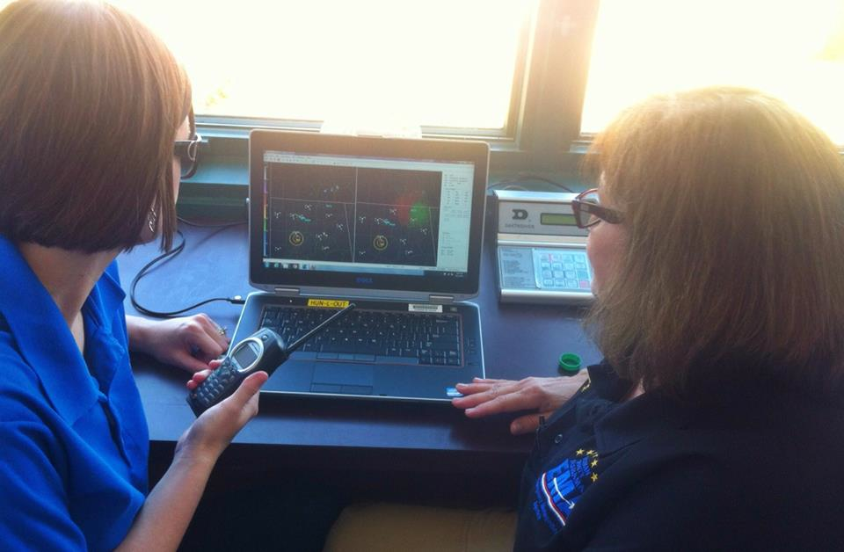
Rock the South Concert
CI permitted anticipation
Important to realize CI goals (35 dBZ, NOT CGs)
Looked for any total lightning signals, not just the jump
Fortunately, activity was very isolated

Slide 11
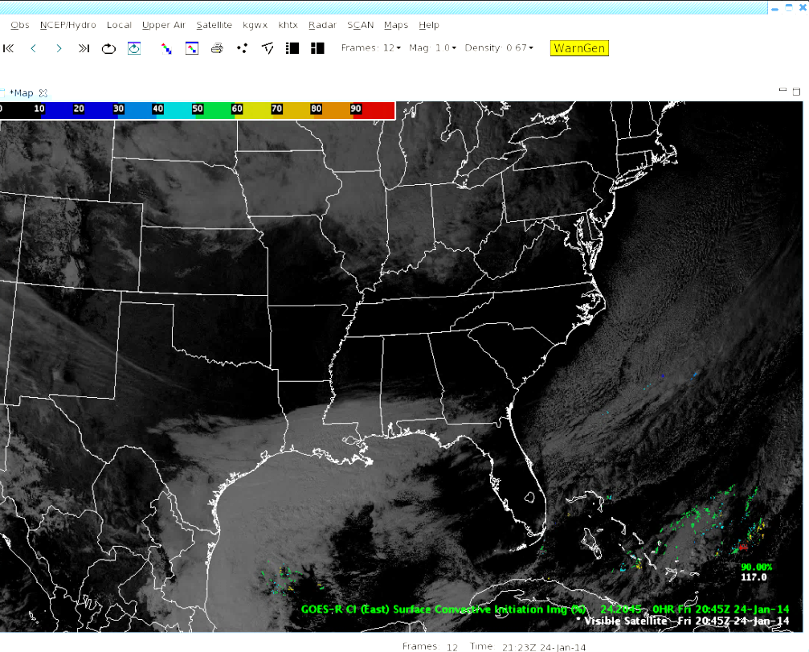
The Next Step?
AWIPS II “Thin Client” could be a game-changer for DSS
HUN testing on a “low-grade” level inside the WFO
GOES-R CI easily available (Grib2), Total Lightning not quite yet
Hasn’t been a top priority yet due to prolonged OT&E, but will increase in importance with increased IDSS

Slide 12
Questions?
Brian.Carcione@noaa.gov
Web Sites:
NALMA Google Earth Plugin (also for DCLMA)
http://weather.msfc.nasa.gov/sport/lma/nalmaSourceDensity.html
GOES-R CI:
UAH: http://nsstc.uah.edu/SATCAST/
SPoRT: http://weather.msfc.nasa.gov/cgi-bin/sportPublishData.pl?dataset=goesrcieast

