Slide 1
Update on LIS activities LIS in AWIPS II Training Development -and- Operational Utility at NWS Huntsville
Kristopher White – NWS Huntsville / NASA SPoRT
Jonathan Case – NASA SPoRT / ENSCO

Slide 2
SPoRT LIS in AWIPS II
Grib2 files, so ingest is relatively easy (instructions available)
LIS Data Include:
AVSFT: Average Surface Skin Temperature (C)
TSOIL: Soil Temperature
0.0-0.1: 0-1 cm depth
0.1-0.4: 1-4 cm depth
0.4-1.0: 4 cm to 1 m depth
1.0-2.0: 1-2 m depth
MSTAV: Moisture Availability (Relative Soil Moisture, %)
0.0: 0-200 cm depth
0.0-0.1: 0-1 cm depth
0.1-0.4: 1-4 cm depth
0.4-1.0: 4 cm to 1 m depth
1.0-2.0: 1-2 m depth
SOILW: Volumetric Soil Moisture Content (%)
0.0-0.1: 0-1 cm depth
0.1-0.4: 1-4 cm depth
0.4-1.0: 4 cm to 1 m depth
1.0-2.0: 1-2 m depth
Precipitation: LIS Surface Precipitation (GFS precipitation, inches)
LHF: Latent Heat Flux (W/m²)
SHF: Sensible Heat Flux (W/m²)
SSRUN: Surface Storm Runoff (mm)
GVF: Green Vegetation Fraction (%)
SPoRT LIS “Skin” Temperature
SPoRT LIS 0-10 cm Relative Soil Moisture

Slide 3
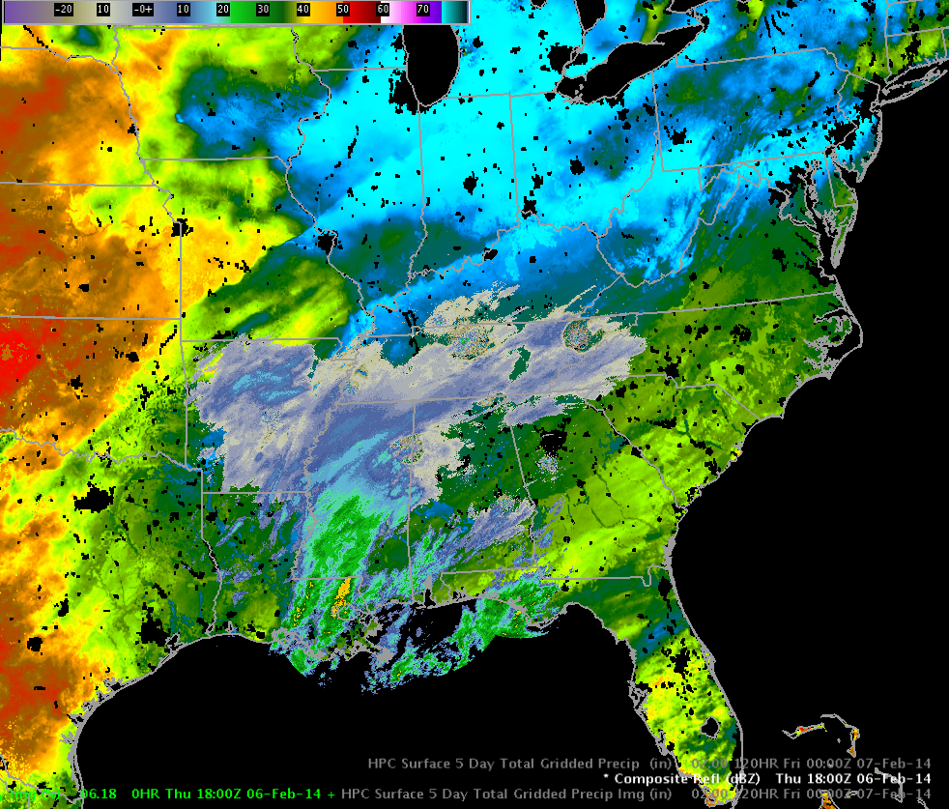
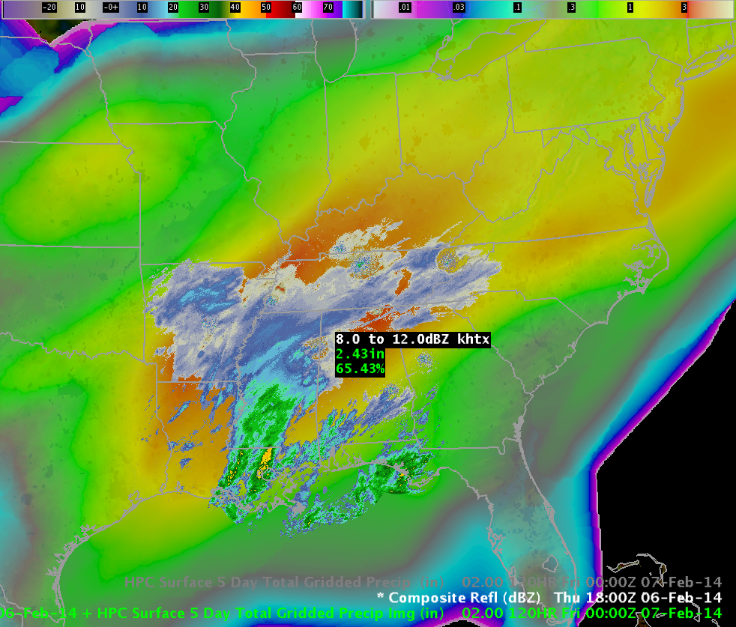
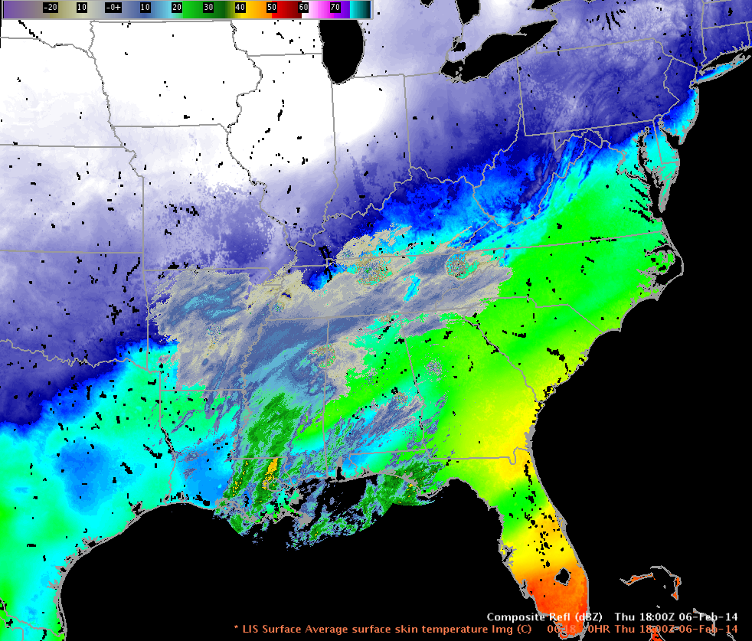
SPoRT LIS in AWIPS II
Advantages
Can now display sub-surface values
Easier editing of menus for the Volume Browser
Can overlay multiple data/image files
Radar imagery and/or precipitation forecasts over soil moisture values can provide improved confidence and better forecasts of flood potential (more on this later)
Radar imagery over skin temperatures can provide a better assessment of the potential for freezing precipitation accumulation
SPoRT LIS 0-10 cm Relative Soil Moisture
SPoRT LIS “Skin” Temperature

Slide 4
SPoRT LIS in AWIPS II
Instructions available for…
ingest into AWIPS II
configuring Volume Browser
VbSources.xml
planesMenuPlanView.xml
LevelMappingFile.xml
gridImageryStyleRules.xml
fieldsMenus.xml
d2dContourStyleRules.x
New colormaps also included
I have created these, but I’m open to suggestions…
SPoRT LIS 0-10 cm Relative Soil Moisture
Any takers to try out the new instructions and colormaps??
SPoRT LIS “Skin” Temperature

Slide 5
SPoRT LIS Training
Under development…but coming soon!
Planned for release by spring
Currently ~40 slides
Overview of LIS
Configuration
Domain/resolution
Output
Example utility at NWS Huntsville, AL
Drought monitoring
Flood forecasting
Winter weather applications
Sample Training Slides

Slide 6
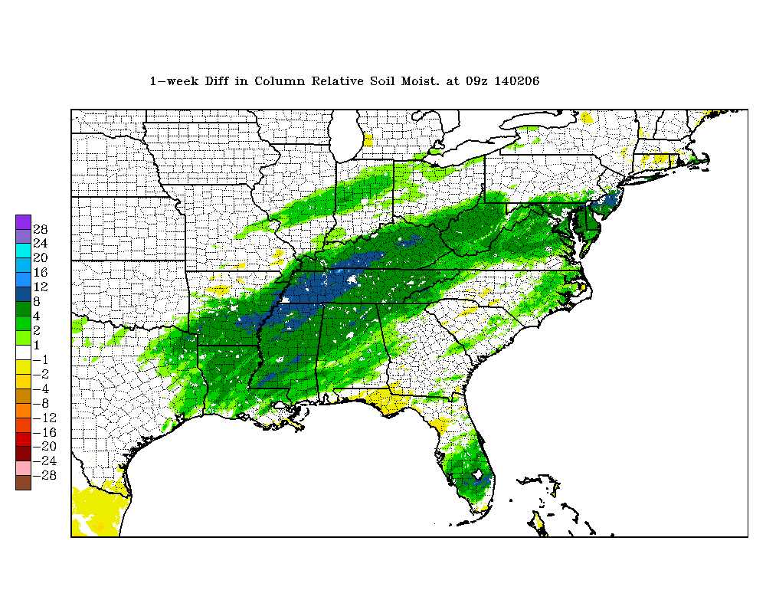
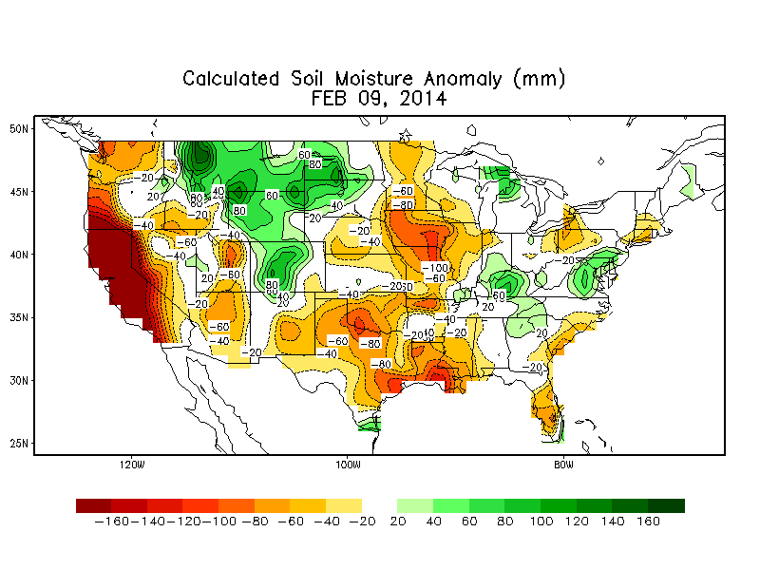
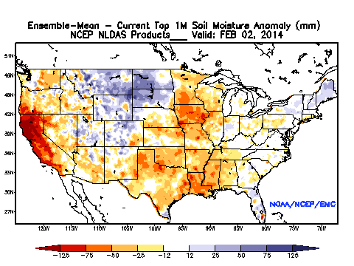
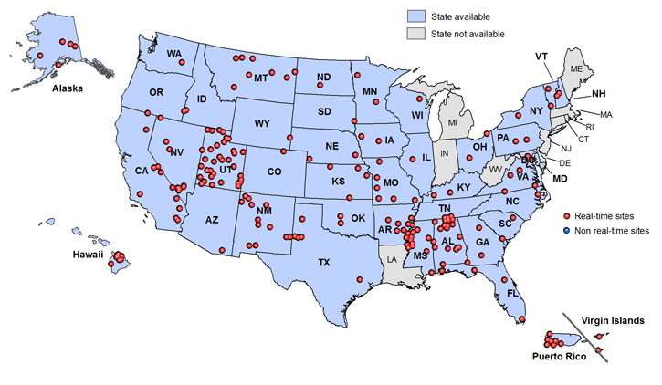
SPoRT LIS
Operational Examples
-Drought Monitoring
SPoRT LIS soil moisture data have been used for input to the U.S. Drought Monitor since 2011
These data help to answer the relevant question…how are soils responding to inputs of precipitation?
3km resolution allow for assessments of soil moisture on sub-county scales
Weekly difference plots also available (online only)
In-situ networks such as SCAN can be useful, but consist of sparse point observations
In most cases, states with intensive agriculture have few sites
Conventional data of soil moisture percentages and anomalies can be very useful, but the imagery is of coarse spatial resolution
SPoRT LIS 0-200 cm Relative Soil Moisture Weekly Difference
SPoRT LIS 0-10 cm Relative Soil Moisture

Slide 7
SPoRT LIS
Operational Examples
-Drought Monitoring
Forecasters may have reasonable estimations of rainfall amounts, but determining how soils are responding to these inputs can be difficult to gauge.
Likewise, different soils respond in different ways, complicating the issue
The SPoRT LIS helps to resolve these issues

Slide 8
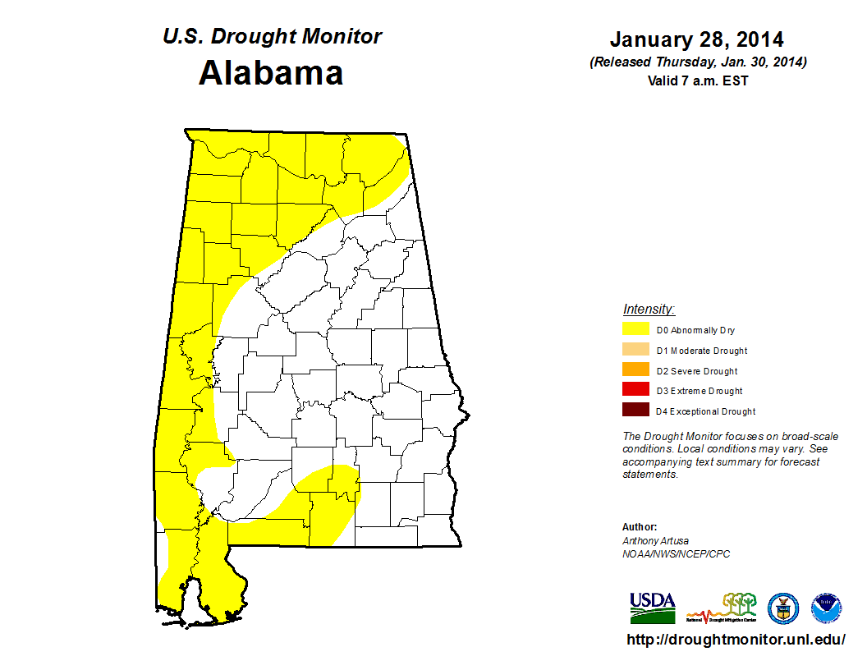
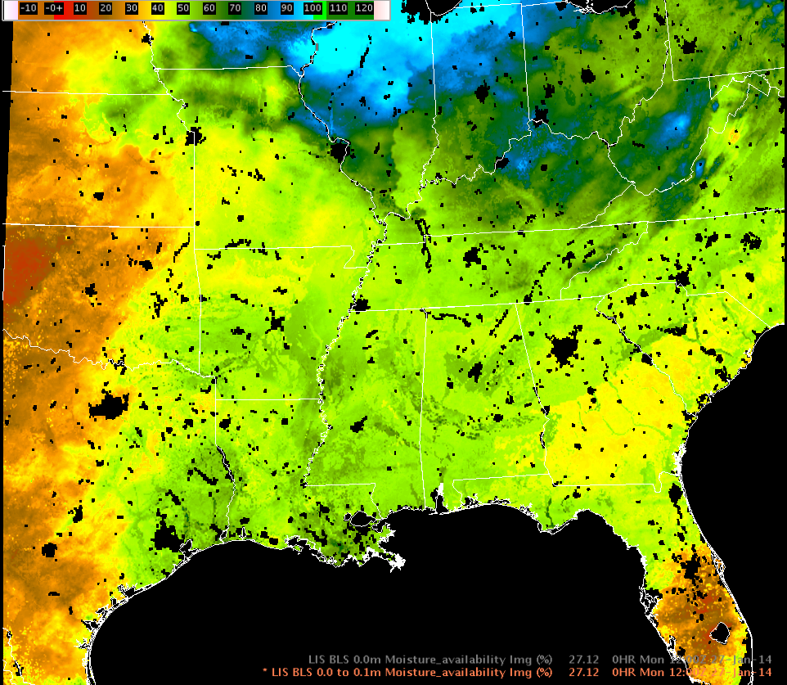
SPoRT LIS
Operational Examples
-Drought Monitoring
Case Example – late January 2014
Alabama free of any drought designations as of the January 21st USDM update
However, lack of precipitation and very dry air with low RH/dew points (<0-20F) persisted for much of January, leading to rapid drying and desiccation of vegetation especially during the 4th week
Initial response was to draw D0 lines cutting across NW Alabama as shown
However, a close look at SPoRT LIS soil moisture data revealed the sub-surface conditions were likely just as dry or drier in some areas to the SE of this initial line
What happened?...input about these soil conditions indicated a need to draw the D0 line through the areas with dry soil conditions
Small county changes/additions can be significant when taking drought declarations into account
New D0
New D0
SPoRT LIS 0-10 cm Relative Soil Moisture
SPoRT LIS 0-200 cm Relative Soil Moisture

Slide 9
SPoRT LIS Operational Examples -Monitoring Flood Potential
0-200 cm Relative Soil Moisture – 3/4/2011
0-200 cm Relative Soil Moisture – 9/4/2011
Contrasting antecedent soil moisture conditions (as shown above)
Relatively heavy rainfall in each event, but greater rainfall in the September case
Very different outcomes
Notes:
Now, let’s take a look at an entirely different use of the LIS. Here we’ll focus on its potential as an effective situational awareness tool for monitoring flood potential. We’ll compare and contrast cases from early March and early September 2011 in northern Alabama. These two cases began with very different antecedent soil moisture conditions. Heavy rain on the following days led to very different outcomes in the hydrologic response.

Slide 10
SPoRT LIS Operational Examples -Monitoring Flood Potential
Early March 2011 Case…
0-200 cm Relative Soil Moisture – 3/4/2011
Antecedent deep-layer soil moisture values were around 45-55% before heavy rains moved into the area over the next week.
Notes:
At the beginning of March 2011, deep layer soil moisture, consisting of the layer from the surface to 200 cm, was around 45% to 50% across much of northern Alabama.

Slide 11
SPoRT LIS Operational Examples -Monitoring Flood Potential
Early March 2011 Case…
Stage IV 2-Day Precipitation
ending 1200 UTC 3/6/2011
0-200 cm Relative Soil Moisture
0900 UTC 3/7/2011
Precipitation totaled ~1-3 inches across northern Alabama and adjacent areas
In response to the rainfall, deep layer relative soil moisture values rose about 10 percent
Notes:
After the 4th, however, heavy rains moved into the Southeast U.S. During the 2-day period ending 1200 UTC on March 6, 2011….(mouse click) precipitation had totaled around 1 to 3 inches across the area. By 0900 UTC on March 7, 2011, due to the rainfall, (mouse click) column integrated soil moisture had risen to around 55% to 65% across much of northern and central Alabama and adjacent areas.

Slide 12
SPoRT LIS Operational Examples -Monitoring Flood Potential
Early March 2011 Case…
Stage IV 1-Day Precipitation
ending 1200 UTC 3/9/2011
0-200 cm Relative Soil Moisture
0900 UTC 3/9/2011
Precipitation totaled ~1-4 inches across northern Alabama and adjacent areas
In response to the rainfall, deep layer relative soil moisture values rose another 10 percent
Notes:
Another bout of rainfall moved across portions of the region on March 8th and 9th. Rainfall totaled around one to four inches. Per the SPoRT LIS, column integrated soil moisture responded by increasing to around 65% to 75% in a swath across northwest and north central portions of Alabama. So, how did rivers and streams respond to all of this rainfall?

Slide 13
SPoRT LIS Operational Examples -Monitoring Flood Potential
Early March 2011 Case…
0-200 cm Relative Soil Moisture 0900 UTC 3/9/2011 (stars indicate locations of flooding)
During and after the 2nd round of heavy rainfall, flooding occurred in numerous locations, with many road closures.
23 Flood warning products resulted across the Huntsville County Warning Forecast Area.
Moderate flooding occurred along the Tennessee, the Big Nance and the Flint Rivers
Notes:
During and after the 2nd round of heavy rainfall on the 8th and the 9th and after soil moisture had increased due to previous heavy rains, flooding and flash flooding occurred in numerous locations, with many road closures. 23 flood warning products resulted across the Huntsville County Warning Forecast area. Moderate flooding occurred along the Tennessee River [click], the Flint River [click] and the Big Nance River [click]. In this case, widespread one to four inch rainfall totals on top of relatively moist soils led to sufficient runoff to generate numerous instances of minor to moderate flooding.

Slide 14
SPoRT LIS Operational Examples -Monitoring Flood Potential
Early September 2011 Case…
0-200 cm Relative Soil Moisture
0900 UTC 9/4/2011
Antecedent relative soil moisture values were around 25-40% before heavy rains in association with the remnants of Tropical Storm Lee moved into the area over the next week.
Notes:
Now, let’s look at a much different case. At the beginning of September 2011, column integrated, or 0-200 cm sub-surface soil moisture, was much drier than that in early March, with values generally around 25% to 40% across much of northern Alabama.

Slide 15
SPoRT LIS Operational Examples -Monitoring Flood Potential
Early September 2011 Case…
Stage IV 2-Day Precipitation
ending 1200 UTC 9/6/2011
0-200 cm Relative Soil Moisture
0900 UTC 9/7/2011
Precipitation totaled ~4-10 inches across northern Alabama and adjacent areas
In response to the rainfall, deep layer relative soil moisture only increased about 15%
Notes:
Rainfall amounts for the two-day period, from the morning of September 4th through the 6th ranged from around 4 to 10 inches (mouse click). Huntsville received it’s largest calendar day rainfall in over 10 years, when 4.42 inches were recorded on the 5th. Some locations in north central and northeast Alabama received over 10 inches of rain during the two day period! However, notice the SPoRT LIS soil moisture graphic on the right. Deep layer Relative Soil Moisture had only increased to around 40% to 55% across the area (mouse click). So, with this kind of rainfall…what kind of flooding occurred?

Slide 16
SPoRT LIS Operational Examples -Monitoring Flood Potential
Early September 2011 Case…
Stage IV 2-Day Precipitation
ending 1200 UTC 9/6/2011
Flood warnings issued for several rivers, including the Big Nance, Flint, Paint Rock and Tennessee River
None of the flood warnings verified
Moderate flooding forecast for the Flint River was overestimated by 10 feet!
Notes:
Flood warnings were issued for several river locations, including the Big Nance River [click]…
The Flint River [click]
The Paint Rock River [click]…
and the Tennessee River [click]. Amazingly, none of these warnings verified.
Moderate flooding was actually forecast for the Flint and the Paint Rock Rivers [click]. The forecast river stage for the Flint was overestimated by 10 feet!

Slide 17
SPoRT LIS Operational Examples -Monitoring Flood Potential
Early September 2011 Case…
Stage IV 2-Day Precipitation
ending 1200 UTC 9/6/2011
0-200 cm Relative Soil Moisture
0900 UTC 9/7/2011
Minor flooding did occur along the Big Wills Creek in Ft Payne, where rainfall amounts were around 10 inches.
Other minor, short-lived flooding occurred in parts of north central and northeastern Alabama
Notes:
Minor Flooding did occur along the Big Wills Creek [click] in Ft Payne in Dekalb County, Alabama[click].
Other minor flooding reports [click] occurred in parts of north central and northeastern Alabama, along the swath of heavy rainfall and where resulting soil moisture values finally climbed to around 50% to 60%. [click]
However, for a rainfall event of this magnitude, more flooding was expected, but did not materialize. Dry antecedent soil moisture conditions likely played a large role in reducing the overall flooding potential with this event.

Slide 18
SPoRT LIS Operational Examples -Monitoring Flood Potential
March Event
Moderate river flooding and numerous flooding reports
High antecedent soil moisture
Moderate-heavy precipitation
September Event
Low antecedent soil moisture
Heavy precipitation
Isolated minor flooding
Very contrasting antecedent soil moisture conditions likely played a strong role in the different outcomes
Local, subjective analysis of several events suggests typical moderate-heavy synoptic rainfall events (>2-3 inches) over deep-layer relative soil moisture values exceeding 55-60% will lead to at least minor flooding events along secondary streams/rivers
Notes:
So, to recap…in the March event, by the time of the 2nd bout of precipitation, 0-200 cm relative soil moisture values exceeded 55-60% across much of northern Alabama. Widespread rainfall of one to four inches, on top of the wet soils, produced moderate river flooding and numerous flooding reports across the Huntsville County Warning Forecast Area. Contrast that with the September event, where antecedent 0-200 cm relative soil moisture values were quite low, around 25-40%. Heavier widespread precipitation amounts on top of the low soil moisture, totaling four to ten inches, and even higher amounts in some cases, produced only isolated, minor flooding. True, precipitation rates during these events was fairly different, with the March event containing more convective rainfall and generally higher rainfall rates. So, precipitation rates also likely played an important role. Nevertheless, the degree of slower-evolving flooding along area rivers, including the Tennessee River, suggests that more factors were at play. The very contrasting antecedent soil moisture conditions also likely played a strong role in the different outcomes observed in these events. Local, subjective analysis of several moderate to heavy rainfall events in the Huntsville County Warning Area over the last few years suggests that more substantial moderate or heavier flooding will result when deep layer relative soil moisture values exceed about 60%. This threshold has become a powerful situational awareness tool for forecasters when attempting to quanitfy threats for flooding in forecasts and hydrologic outlook products. Further attempts at the local Huntsville office level will focus on quantifying these thresholds using objective analysis studies.

Slide 19
SPoRT LIS
Operational Examples
-Winter Applications
Relatively recent usage
Radar can be used to overlay Skin Temperatures to help assess likelihood for freezing precipitation accumulation (left above)
Skin Temperature progs can be used to assess freezing potential. In the graphic to the right, I’ve loaded NAM 6-hour simulated 0.5 reflectivity over the LIS 6-hour Skin Temperature forecast
SPoRT LIS Skin Temperature w/ Regional Composite 0.5 Reflectivity
SPoRT LIS Skin Temperature w/ WPC 6-Hour Precipitation

Slide 20
That’s all from me!
If you have any questions, please feel free to contact me:
kris.white@noaa.gov
256-890-8503 ext 232

