Slide 1


Promoting User Readiness through the GOES-R Proving Ground
Steven J Goodman
Program Chief Scientist
NOAA/NESDIS/GOES-R Program Office
(http://www.goes-r.gov)
SPoRT SSD Chiefs Workshop
Huntsville, AL
March 2, 2010

Slide 2
Contributors
Jim Gurka
NOAA/NESDIS/GOES-R Program Office, Greenbelt, MD 20771
Timothy Schmit
NOAA/NESDIS/Center for Satellite Applications and Research, Madison, WI
Mark DeMaria and Daniel Lindsey
NOAA/NESDIS/Center for Satellite Applications and Research, Fort Collins, CO
Wayne Feltz, Scott Bachmeier and Kris Bedka
Cooperative Institute for Meteorological Satellite Studies, University of Wisconsin, Madison, WI
Steven Miller
Cooperative Institute for Research in the Atmosphere, Colorado State University, Fort Collins, CO
Anthony Mostek
National Weather Service/OCWWS, Training Division
Gary Jedlovec and Richard Blakeslee
NASA/MSFC Short-term Prediction Research and Transition (SPoRT) Center, Huntsville, AL
Russell Schneider and Chris Siewert
Cooperative Institute for Mesoscale Meteorological Studies, NOAA/NWS/Storm Prediction Center, Norman, OK
Dick Reynolds
Short and Associates, Annapolis MD
Etc.

Slide 3
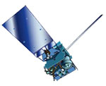
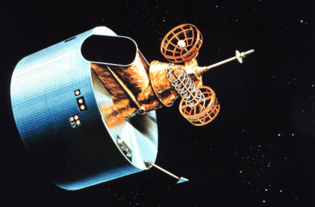
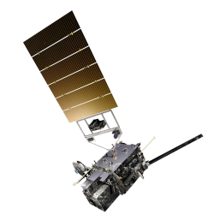

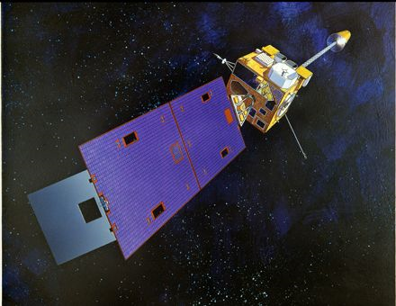
NOAA Geostationary Operational Environmental Satellites (GOES)
GOES 13,14,P
Simultaneous, independent imaging, sounding
GOES 4-7
Vertical profiling
1975 1980 1994 2006 2015
GOES-R series
Improved spectral, spatial and temporal resolution in imaging
Lightning mapping
Improved space weather monitoring
GOES 8-12
3-axis stabilized
Simultaneous imaging, sounding 100% of time
GOES 1-3
NOAA’s First GOES
Spin-stabilized

Slide 4
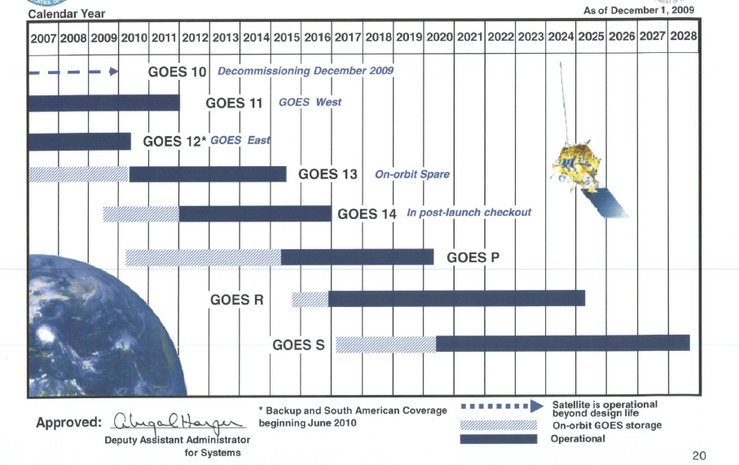
Launch Schedule

Slide 5
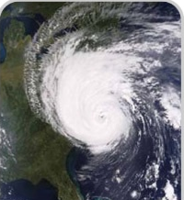
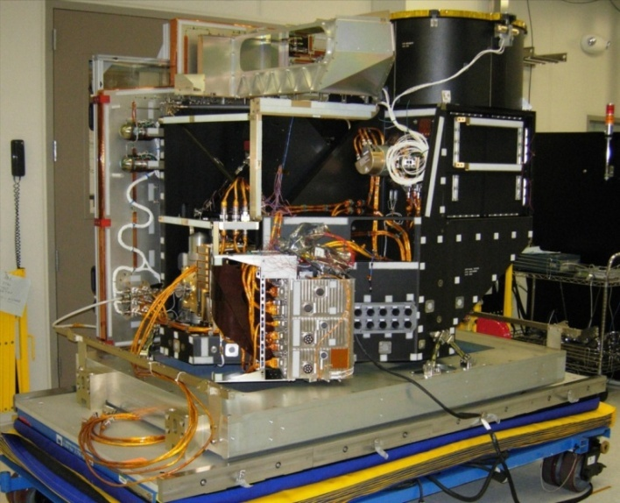
Advanced Baseline Imager (ABI)
16 channel imager
Improves upon current capabilities in spectral information (3X), spatial coverage (4X), and temporal resolution (5X)
Continues current products and allows for new products for severe weather forecasting, fire and smoke monitoring, volcanic ash advisories, and more
Current Status
Prototype Model (PTM) sensor unit complete
PTM Instrument bench testing underway
Coming Soon:
PTM Environmental tests in Spring 2010
Delta Critical Design Review (CDR) in late FY2010
Notes:
Posters: Fire detection and characterization, Sea surface temperatures, proxy datasets for radiance, weather event simulator

Slide 6
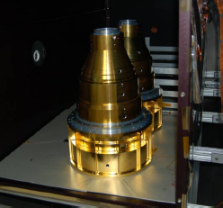
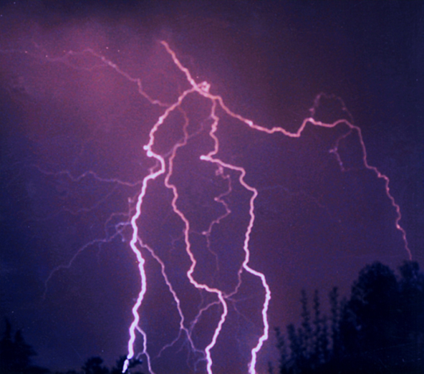
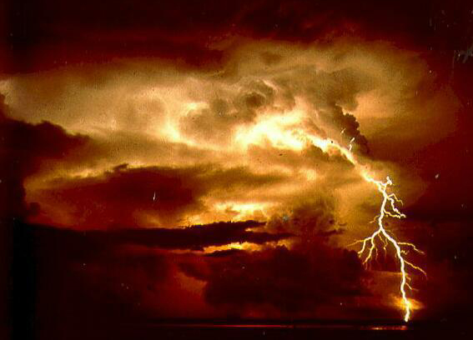
Geostationary Lightning Mapper (GLM)
Detects total lightning: in cloud, cloud to cloud, and cloud to ground
  Improves warning lead-time for severe storms and high impact weather
  Improves aviation safety and efficiency due to avoidance of thunderstorms
Near-uniform storm-scale coverage over oceans and land
EDU rear lens housing
Current Status
Successfully conducted Preliminary Design Review (PDR)
Engineering Test Units and Engineering Demonstration Unit in fabrication
Coming Soon:
CDR in summer 2010
Photo credit: Shane Lear, NOAA
Notes:
Poster on novel lightning detection

Slide 7
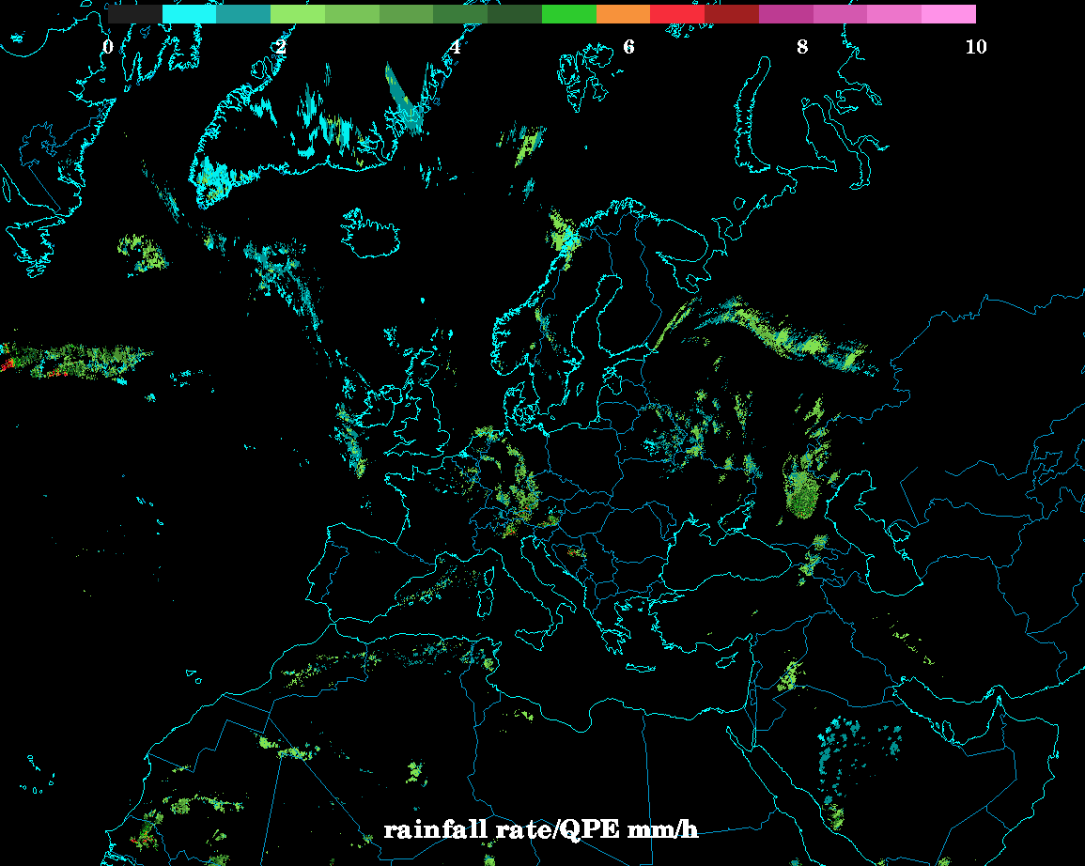
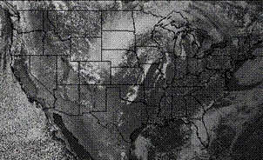
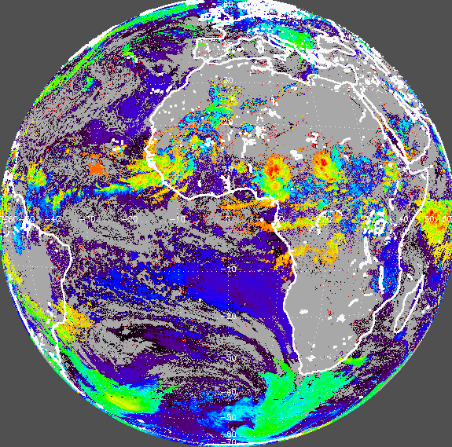
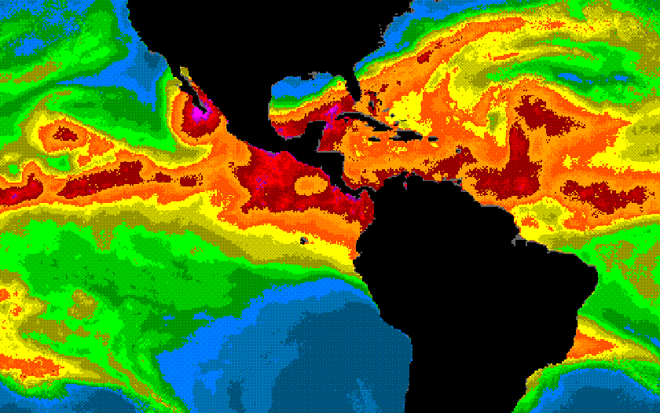
Algorithm Working Group
Algorithm Development
Calibration, Validation, and Verification
Algorithm Sustainment and Product Tailoring
Current Status:
80% Algorithm Packages for Baseline Products completed Sept 2009
Coming Soon:
100% Algorithm Packages for Baseline Products due Sept 2010
80% Algorithm Packages for Option 2 Products due Sept 2010
Notes:
Algorithm Development Session – Tuesday 3:30
Topics include: AWG update, proxy data sets, GRAFIIIR, Risk reduction program
CAL/VAL plans session – Wed. afternoon and Thurs afternoon
Topics include: SDR Cal/Val plan, AWG level-2 products

Slide 8
GOES Product Heritage
(Yellow = current GOES and GOES-R, Blue = GOES-R only)
+ indicates Option 2 products

Slide 9
GOES-R Warning Product Set
The following list is of products offers opportunity for near-real time Warning Related utility.
Baseline Products:
Volcanic Ash: detection & Height
Cloud and Moisture Imagery
Hurricane Intensity
Lightning Detection: Events, Groups & Flashes
Rainfall Rate / QPE
Total Precipitable Water
Fire/Hot Spot Characterization
Option 2 Products:
Aircraft Icing Threat
Convective Initiation
Enhanced “V” / Overshooting Top Detection
Low Cloud and Fog
SO₂ Detection

Slide 10
GOES-R Data Assimilation Investment Portfolio FY2010
CIRA/ESRL GSD Visiting Scientist (Stan Benjamin) - (near storm environment and cloud properties from GEO assimilated into the HRRR/WRF)- new start
CIRA/Dusanka and Milja Zupanski- (Data Assimilation: Extracting Maximum Information from the GOES-R Data)- GOES-R Risk Reduction continuation
CIMSS/Jun Li (Tim Schmit)- (advanced-hyperspectral IRS sounder near-storm environment impacts for severe storms and tropical cyclones- WRF/HWRF)- continuation
CIMSS/Jun Li, Alan Huang-(GOES-R Sounding Algorithm Development and Risk Reduction) GOES-R Risk Reduction continuation
CIMSS/Jason Otkin, Allen Huang- (Study of the Efficient and Effective Assimilation of GOES-R Temporal/Spatial Measurement Information) GOES-R Risk Reduction continuation
CIMSS/Matt Lazzara (Dave Santek, Chris Velden, Jeff Key, Jaime Daniels)-(Combined Geo/Leo High Latitude Atmospheric Motion Vectors with EMC NWP impact assessment)- new start
NSSL/SPC Visiting Scientist (Kevin Kelleher)- Warn on Forecast impact studies- new start
EMC/Stephen Lord- (4D Var model development- 3 FTEs)- continuation
NESDIS/STAR/Shobha Kondragunta- (An IDEA product for GOES-R data) GOES-R Risk Reduction continuation
NESDIS/STAR (CIMSS)/Brad Pierce- (ABI Proxy Data Studies: Regional Assimilation of SEVIRI Total Column Ozone) GOES-R Risk Reduction continuation
JCSDA-STAR/Fuzhong Weng (Xiaolei Zou), Stephen Lord- (JCSDA Preparation for Uses of GOES-R Data in NWP Models)- GOES-R Risk Reduction continuation
JCSDA-ESRL/Stan Benjamin, Steve Weygandt, W. Hu, John Derber- (GOES imager assimilation in GSI cloud analysis for Rapid Refresh)- GOES-R Risk Reduction continuation
JCSDA FFO 2010-(for ABI/GLM instruments; Impact studies on the forecast of severe weather events (hurricanes, flash flooding, etc) at both global and regional scales

Slide 11
GOES-R Proving Ground
  What is the GOES-R Proving Ground?
    Collaborative effort between the GOES-R Program Office, selected NOAA/ NASA Cooperative Institutes, NWS forecast offices, NCEP National Centers, and NOAA Testbeds.
    Where proxy and simulated GOES-R products are tested, evaluated and integrated into operations before the GOES-R launch
    A key element of GOES-R User Readiness (Risk Mitigation)

Slide 12
Proving Ground Mission Statement
The GOES-R Proving Ground engages NWS in pre-operational demonstrations of selected capabilities of next generation GOES
Objective is to bridge the gap between research and operations by:
  Utilizing current systems (satellite, terrestrial, or model/synthetic) to emulate future GOES-R capabilities
  Infusing GOES-R products and techniques into NWS operations with emphasis on AWIPS and transitioning to AWIPS-II.
  Engaging in a dialogue to provide feedback to developers from users
The Proving Ground accomplishes its mission through:
  Sustained interaction between developers and end users for training, product evaluation, and solicitation of user feedback.
  Close coordination with GOES-R Algorithm Working Group (AWG) and Risk Reduction programs as sources of demonstration products, promoting a smooth transition to operations
Intended outcomes are Day-1 readiness and maximum utilization for both the developers and users of GOES-R products, and an effective transition to operations

Slide 13
GOES-R Proving Ground
  Place where technologies and ideas are tested and proven before being fielded in operations
  Evaluates how infusion of technology or process in forecast environment impacts operations
  Integrates technology or process with other available tools
  User readiness risk mitigation
  Key component: operational testing by those independent of the development process
  Key Benefit: users more accepting of fielded technology
    They have had a say in the design
    Design better fits an identified need

Slide 14
Capacity Building and Outreach
    GOES Users Conferences, Meetings, Symposia
      Southern Thunder Lightning Workshop July 28-30, 2009 at Cocoa Beach, FL
      GOES Users Conference (GUC VI) November 3-5, 2009 at Madison, WI
      Space Weather Workshop April 27-30, 2010 at Boulder, CO
      NOAA USWRP Testbed Workshop May 3-5, 2010 at Boulder, CO
      Proving Ground (PG) Annual Meeting May 17-19, 2010 at Boulder, CO
      AWG/R3 Annual Meeting, Jun 7-11, 2010 at Madison, WI
      OCONUS PG Pacific Regional Meeting, July 28-30, 2010 at Honolulu, HI (post- IGARSS)
    Outreach Materials
      Fact Sheets for Proving Ground and Products in development
      Web site improvements underway
      Tri-fold updated with spacecraft, 10K bookmarks for distribution
      Training modules (COMET, VISIT, SHyMet)- GOES-R 101 completed, RGB in production
    NOAA Testbeds
      Satellite champion at NOAA Hazardous Weather Testbed in Norman, OK
      Intensive Observation Period (IOP-1) held spring 2009, IOP-2 planned in conjunction with VORTEX-2 for spring 2010
      Intensive Observation Period planning for 2010 hurricane season (NOAA HFIP, NASA GRIP, NSF PREDICT)
    Data Assimilation visiting scientist at GSD/ESRL in Boulder, CO to develop HRRR/WRF capability- job announcement closes March 2

Slide 15
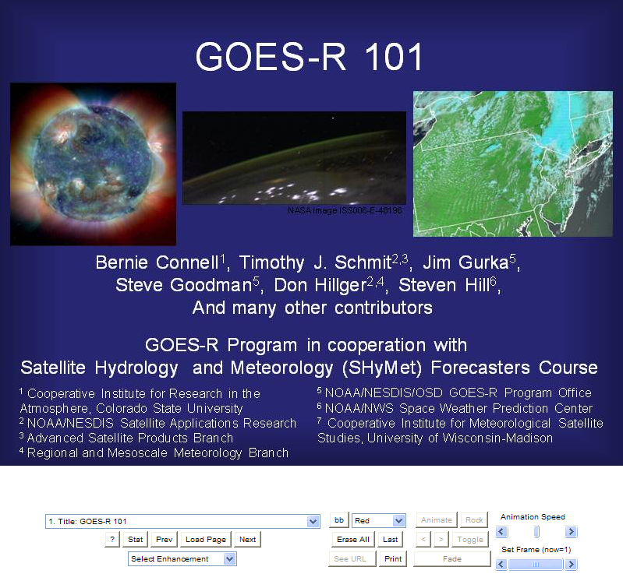
SHyMet for Forecasters: GOES-R 101 http://rammb.cira.colostate.edu/training/shymet/forecaster_GOESR101.asp
Went live in January
Available training options
  A.) Web-based Video training session (90 min duration)
  B.) Audio playback
  C.) Web-based VISITview training session with notes
Part of SHyMet Forecaster training series
Announced to SOOs
Planned link to GPO goes-r.gov web page
Sponsored by GOES-R Risk Reduction
GOES-14 Science Test, 1 min RSO

Slide 16
Lessons Learned at SPC
Convective Initiation (CI)/Cloud Top Cooling (CTC)
  CTC is valuable product in itself
  Diagnostic tool rather than prognostic over SE warm sector environments
  Masked where thick cirrus present
  Thin cirrus over land/water/water clouds and expanding edge false alarms
  Avg. lead time ~15 minutes over radar (for successful nowcasts)
  Full disk 30 min. scan limitations (false alarms/missed nowcasts)
  Cloud detection limitations due to poor spatial/spectral resolution
  Instantaneous fields more useful to forecasters than accumulated fields
  Overlay on visible/IR essential to forecasters
  Continue CTC after CI occurs (storm severity) interest from forecasters
  Effective for terrain/dryline convection
  CI misses some CTC signals
  Works well in rapid scan operations

Slide 17





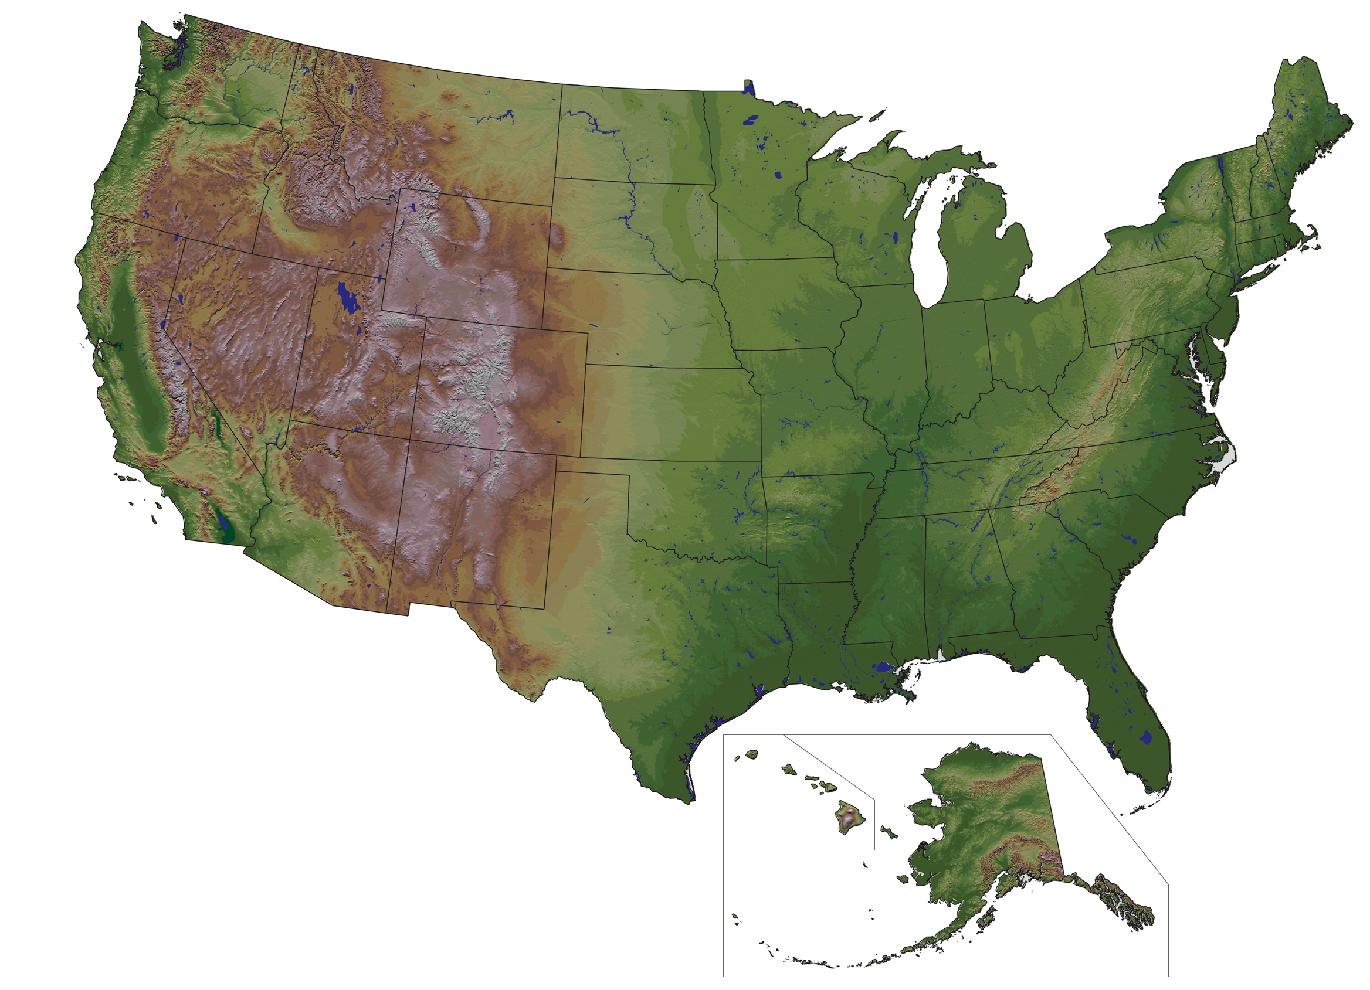
GOES-R Proving Ground Partners
75 Total Partners Preparing
Current as of December 2009
OTX
GGW
TFX
BPA
PDT
FGF
DLH
BYZ
MQT
BTV
MFR
ABR
MPX
GRB
EKA
RIW
UNR
ARX
BGM
CIMSS
MKX
CTP
ERH
REV
WRH
CYS
DMX
DVN
PBZ
UMBC
CIRA
LOT
IWX
CICS
NOAA/NWS Headquarters
(Silver Spring, MD); Center for Satellite Applications and Research; Office of Satellite Data Processing and Distribution.
GOES-R Program Office (Greenbelt, MD).
BOU
AWC/CRH
EAX
IND
LWX
EPA
MTR
AKQ
VEF
JKL
RNK
ICT
SGF
MRX
RAH
ABQ
AMA
TSA
OHX
GSP
SPC OUN
SPoRT
HUN
CAE
CHS
SRH
FWD
BMX
FFC
EPZ
MAF
MOB
3 Weather Service Offices served by
the Cooperative Institute for Research
in the Atmosphere (CIRA)
4 Weather Service Offices served by the Cooperative Institute for Climate and Satellites (CICS) via SPoRT
11 National/Regional
15 Weather Service Offices served by the NASA Short-term Prediction Research and Transition Center (SPoRT)
46 Weather Service Offices served by the Cooperative Institute for Meteorological Satellite Studies (CIMSS)
TAE
HGX SMG
MLB
CRP
NHC
PRH
NWS Pacific Region HQ
MFL
AFG
KEY
AFC
AJK
ARH
NWS Alaska Region HQ
Notes:
Last updated November 16, 2009; Jordan Gerth (CIMSS/SSEC)

Slide 18


GOES-R Proving Ground Partners
75 Total Partners Preparing
Current as of December 2009
Weather Service Offices served by the
NASA Short-term Prediction Research
and Transition Center (SPoRT)
15
• Albuquerque, New Mexico (ABQ)
• Birmingham, Alabama (BMX)
• Corpus Christi, Texas (CRP)
• Great Falls, Montana (TFX)
• Houston, Texas (HGX)
• Huntsville, Alabama (HUN)
• Key West WFO (KEY)
• Melbourne, Florida (MLB)
• Miami, Florida (MFL)
• Mobile, Alabama (MOB)
• Morristown, Tennessee (MRX)
• Nashville, Tennessee (OHX)
• Peachtree City WFO (FFC)
• Spaceflight Meteorology Group (SMG)
• Tallahassee, Florida (TAE)
46
Weather Service Offices served by the Cooperative Institute
for Meteorological Satellite Studies (CIMSS)
OTX
• Aberdeen, South Dakota (ABR)
• Amarillo, Texas (AMA)
• Billings, Montana (BYZ)
• Binghamton, New York (BGM)
• Boulder, Colorado (BOU)
• Burlington, Vermont (BTV)
• Charleston, South Carolina (CHS)
• Chicago, Illinois (LOT)
• Columbia, South Carolina (CAE)
• Dallas/Fort Worth, Texas (FWD)
• Davenport, Iowa (DVN)
• Des Moines, Iowa (DMX)
• Duluth, Minnesota (DLH)
• El Paso, Texas (EPZ)
• Fargo, North Dakota (FGF)
• Glasgow, Montana (GGW)
• Green Bay, Wisconsin (GRB)
• Greenville, South Carolina (GSP)
• Indianapolis, Indiana (IND)
• Jackson, Kentucky (JKL)
• Juneau, Alaska (AJK)
• Kansas City, Missouri (EAX)
• La Crosse, Wisconsin (ARX)
• Las Vegas, Nevada (VEF)
• Marquette, Michigan (MQT)
• Medford, Oregon (MFR)
• Midland, Texas (MAF)
• Milwaukee, Wisconsin (MKX)
• Minneapolis, Minnesota (MPX)
• Monterey, California (MTR)
• Nashville, Tennessee (OHX)
• Norman, Oklahoma (OUN)
• Northern Indiana (IWX)
• Pendleton, Oregon (PDT)
• Pittsburgh, Pennsylvania (PBZ)
• Raleigh, North Carolina (RAH)
• Rapid City, South Dakota (UNR)
• Reno, Nevada (REV)
• Riverton, Wyoming (RIW)
• Spokane, Washington (OTX)
• Springfield, Missouri (SGF)
• State College, Pennsylvania (CTP)
• Sterling, Virginia (LWX)
• Tulsa, Oklahoma (TSA)
• Wichita, Kansas (ICT)
• Spaceflight Meteorology Group (SMG)
4
Weather Service Offices served by the
Cooperative Institute for Climate
and Satellites (CICS) via SPoRT
• Blacksburg Virginia (RNK)
• Raleigh, North Carolina (RAH)
• Sterling, Virginia (LWX)
• Wakefield, Virginia (AKQ)
11
National and Regional
Centers
• Alaska, Anchorage (ARH)
• Anchorage and Fairbanks
• Eastern, Bohemia, New York (ERH)
• Central, Kansas City, Missouri (CRH)
• Pacific, Honolulu, Hawaii (PRH)
• Southern, Fort Worth, Texas (SRH)
• Western, Salt Lake City, Utah (WRH)
• Aviation Weather, Kansas City (AWC)
• Bonneville Power Administration (BPA)
• Environmental Protection Agency (EPA)
• National Hurricane Center, Miami (NHC)
• Storm Prediction Center, Norman (SPC)
Univ. of Maryland, Baltimore, Co.
Weather Service Offices served by the Cooperative Institute for Research in the Atmosphere (CIRA)
3
• State/Local/Tribal Air Quality
Forecast Offices (non-NOAA)
• Boulder, Colorado (BOU)
• Cheyenne, Wyoming (CYS)
• Eureka, California (EKA)
Notes:
Last updated November 16, 2009; Jordan Gerth (CIMSS/SSEC)

Slide 19


NHC Proving Ground
AWG hurricane products very limited
  Hurricane Intensity Estimate
Focus on Day 2, new applications
  Air mass product from MSG
  Dust/Aerosol products
  Lightning applications from ground-based WWLLN
  Anvil thickness product
  Additional products from CIMSS
Developing methods for product display and forecaster feedback
Coordination with Hurricane Forecast Improvement Project (HFIP)
  May collect special rapid scan datasets
19

Slide 20
Summary
    The GOES-R Proving Ground is critical to mission success
    Program Plan under development
    Phase I spin-up at CIMSS, CIRA (2008)
    Phase II added SPoRT, AQ, Alaska, Pacific
      HWT IOP with VORTEX-2 (2010)
    Need real time and archived events (AWIPS2, WES)
    PG is the ultimate tool for user interaction
    Must maintain focus on clear path to operations
    Ensuring pathway into operations by developing GOES-R proxy products for the AWIPS2 environment
    Existing and Planned collaborations with NOAA Testbeds- HWT, JHT, DTC, HMT, SATB, JCSDA

Slide 21
Back-up

Slide 22


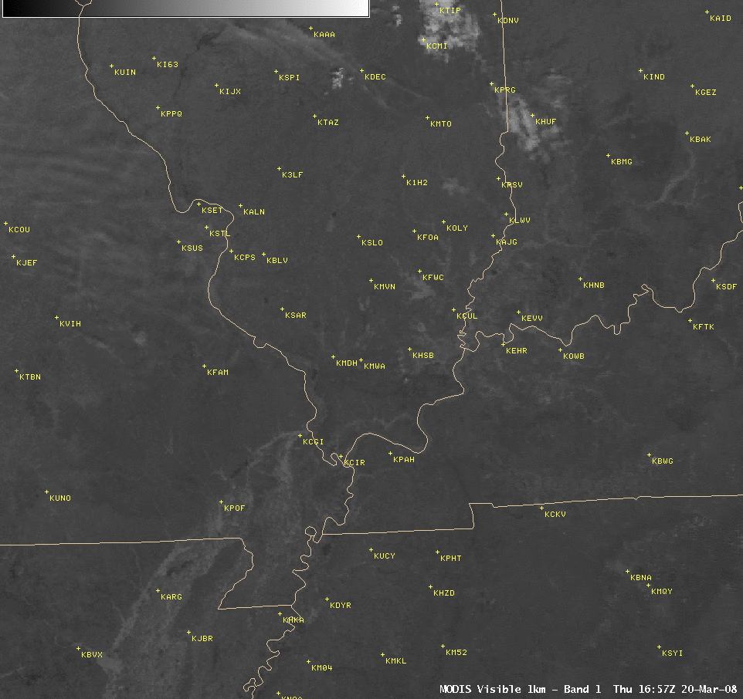
CIMSS “Satellite Proving Ground”:
NOAA’s Cooperative Institute for Meteorological Satellite Studies (CIMSS) is engaging in activities that serve as a “Satellite Proving Ground” for new satellite products that are not yet operationally available in the National Weather Service AWIPS environment.
AWIPS images of the MODIS visible channel and near-IR “snow/ice channel”, highlighting the extent of river flooding across the central Mississippi River and Ohio River valley regions on 20 March 2008.
22
Notes:
22

Slide 23
CIRA / RAMMB Roles
Coordination with CIMSS, SPoRT, GPO, other PG components
  Product documentation, distribution methods, AWIPS development, web page, feedback methods
WFO Interaction
  Direct interaction with Boulder and Cheyenne WFOs
  Remote interaction with additional WFOs
NCEP Interaction
  Coordination of 2010 PG with National Hurricane Center
  Participation in SPC PG
Leveraging Ongoing CIRA/RAMMB Activities
  NexSat for NPOESS, CloudSat, Joint Hurricane Testbed , GOES-R Risk Reduction, VISIT, SHyMet
23

Slide 24
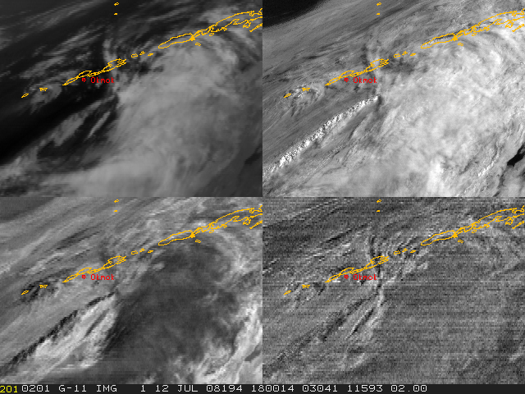
Principal Component Image (PCI) Analysis:
Volcanic Ash Enhancement
Analysis of Initial Okmok Eruption: Imagery for the Okmok (Alaska Aleutian) volcano eruption from 12/13 July 2008 has been analyzed thru Principal Component Image (PCI) analysis. PCIs extract dominant image combinations from the available GOES bands.
24
Notes:
24
The Volcanic Ash Principal Component Image product is computed from all 5 bands of GOES imagery with updates available every 30 minutes.
It is heavily weighted by the two longwave infrared window bands available on older operational geostationary satellites (up through GOES-11). (On GOES-12 and beyond, the less-transparent longwave band was replaced by a 13.3 um band used to better detect the levels of clouds. This does not prevent the product from being generated, but results in an altered interpretation).
The key to the image differencing is the use of Principal Component Analysis on the multi-spectral GOES (or other) imagery. This analysis sorts out the image content according to explained variance, with the first component containing the most variance, and with decreasing variance in successive components. This process relegates most of the redundant image content to the first component and image difference information into the other components. And, because the volcanic ash signal is often best detected by an image difference, the split-window difference in particular, that difference appears as one of the higher-order Principal Components. Image differences seen in other components may show other features, such as cloud type: water vs. ice, etc...
Size and Frequency of product: the size of one Volcanic Ash Principal Component Image product is less than 0.5 MB, with updates available every 30 minutes.

Slide 25
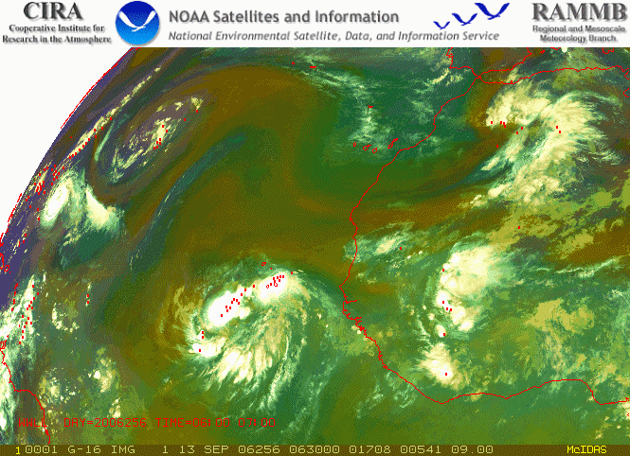
RGB Air Mass Product with Lightning
27 April 2009
Mike Kalb
25
25
Notes:
25
This is an example of the ABI-based AIR MASS product again patterned after similar products available from MSG. The green areas are tropical air masses characterized by low ozone levels, the red colors are associated with dryer regions and the blue colors indicate the temperature associated with the air.
This ABI – based product is created by
Red – shows the difference between Channel 8 (6.2um) and Channel 10 (7.3um) scaled from -29C to -4C
Green – shows the difference between channel 11 (9.7um) and channel 15 (12.2um)
Blue – is the channel 8 scaled from 243 K to 208 K
Hourly lightning from WWLLN is show in red.
25

Slide 26

SPoRT GOES-R Proving Ground Activities
Collaborate with Algorithm Working Groups (AWGs) and Proving Ground (PG) teams to prepare forecasters for unique data and products coming from GOES-R sensors by:
  transitioning proxy and simulated products to the operational environment linking products to forecast problems
  develop appropriate product training for end user education
  conduct assessments of utility of products on improved forecast capabilities
  SPoRT emphasis on:
  high resolution proxy ABI products and multichannel combinations of image data – situational awareness
  pseudo GLM products – lightning warning and severe weather
  WRF-based lightning forecasts – lightning threat forecasts
  Examples presented in following charts
transitioning unique NASA data and research technologies to operations
Notes:
26

Slide 27
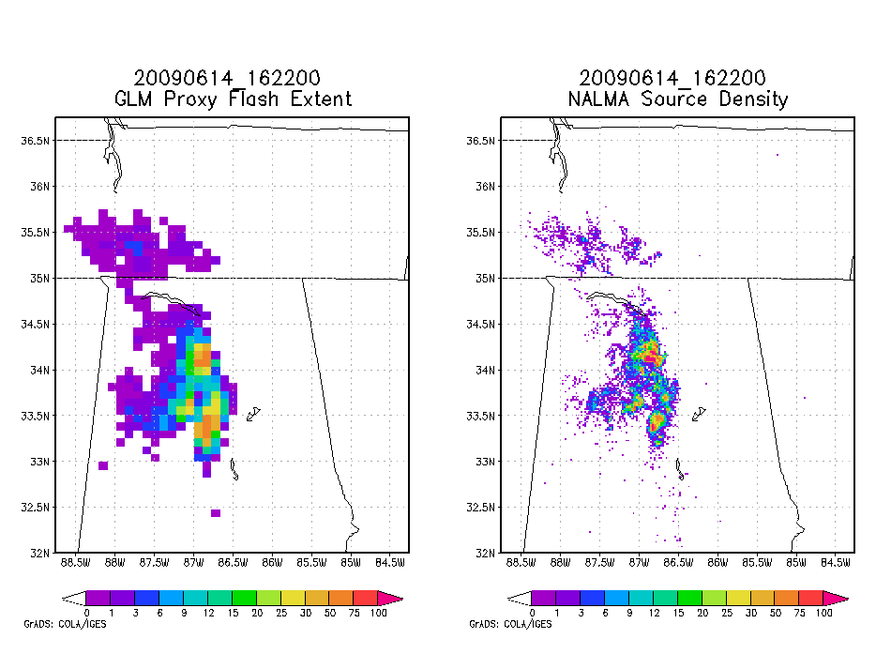
SPoRT Pseudo GLM Product
Provide forecaster exposure to GLM data, differences from LMA, applicability to severe weather forecasting – benefits transition of full AWG proxy when available
Pseudo GLM Flash Extent
LMA Source Densities
Flash Extent Density derived from LMA data at GLM resolution
different from AWG proxy - no optical data
forecaster demonstration and education
applicable to other total lightning networks
focus on AWIPS II development with user feedback
transitioning unique NASA data and research technologies to operations
Notes:
27

Slide 28
SPoRT Center
SPoRT is working collaboratively with AWGs and PG teams to prepare forecasters for unique data and products coming from GOES-R sensors
  ABI proxy imagery and products and pseudo GLM data will be disseminated to selected WFOs (early 2010) and to the PG testbed as part of the Hazardous Weather Testbed (HWT) and 2010 NSSL Spring Program
  focus on displays in AWIPS II where products can be better displayed
  preliminary product list focuses on current forecast problems
Forecast Problem | Proxy Data | Product(s)
Diagnosing changing weather | ABI | High resolution imagery and derived products
Diagnosing low clouds and fog | ABI | Enhanced channel difference imagery
Local temperature forecasts | ABI | Land surface temperature
Visibility reductions due to smoke and fire weather support | ABI | Color composites, active fires and burn areas
Lead time for severe weather | GLM | Total lightning products, WRF lightning threat
Sea breeze impact | ABI | Local model forecasts initialized with surface parameters and SSTs
transitioning unique NASA data and research technologies to operations
Notes:
28

