Slide 1
Recent Accomplishments from the NASA SPoRT Center
Andrew Molthan
transitioning unique NASA data and research technologies to operations

Slide 2
Outline
Efforts in SPoRT focus on three main areas:
Situational Awareness
Satellite products, lightning data, and visualizations.
Modeling for Short-term Forecasts
Components related to the WRF model
Data Assimilation
Adapting unique NASA data sets to improve analyses
Each area consists of several projects of value to forecasters within the National Weather Service.
Each project will be discussed in terms of forecaster benefit, NASA/SPoRT contributions, and future plans.
transitioning unique NASA data and research technologies to operations

Slide 3
Situational Awareness
Situational awareness projects encompass unique NASA data sets applicable to:
Near real-time analysis of current conditions
Short-term forecasts on a WFO scale
To ensure that SPoRT/NASA observations are useful to forecasters, they must be:
Available in their visualization system (AWIPS)
As timely and reliable as possible, even though these products are experimental
transitioning unique NASA data and research technologies to operations

Slide 4
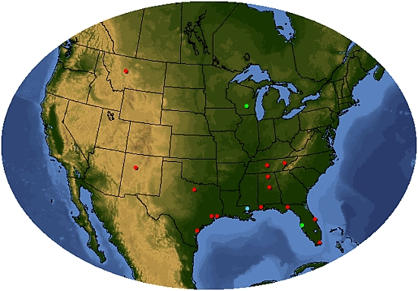
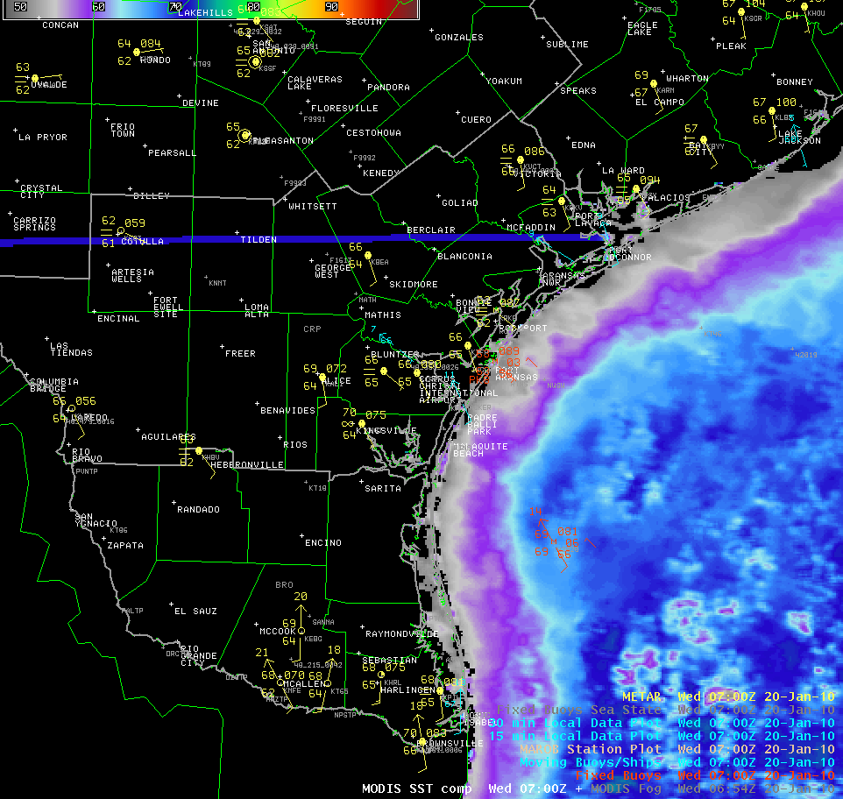
Distribution of SPoRT Products to End Users
Kevin Fuell, Geoffrey Stano, Matt Smith, Frank LaFontaine, Jason Burks (NWS)
Relevance to NWS Forecasters
SPoRT distributes NASA or partner data sets for visualization in the AWIPS system, with planned transition to AWIPS II.
This allows for a collocation with other AWIPS data sets and forecaster interfaces
Rather than an “over the fence approach”, we provide training and seek feedback from the end user
Mechanism
Obtain data through Direct Broadcast sites
We use a local data manager (LDM) to provide a single conduit between SPoRT and NWS Regional Headquarters.
Future Work
Continued expansion of data feeds to regional HQs and integration of products within the AWIPS 2 system.
Partners Receiving Data
SPoRT Partner WFOs
NWS Regional HQs
Direct Broadcast sites
transitioning unique NASA data and research technologies to operations

Slide 5
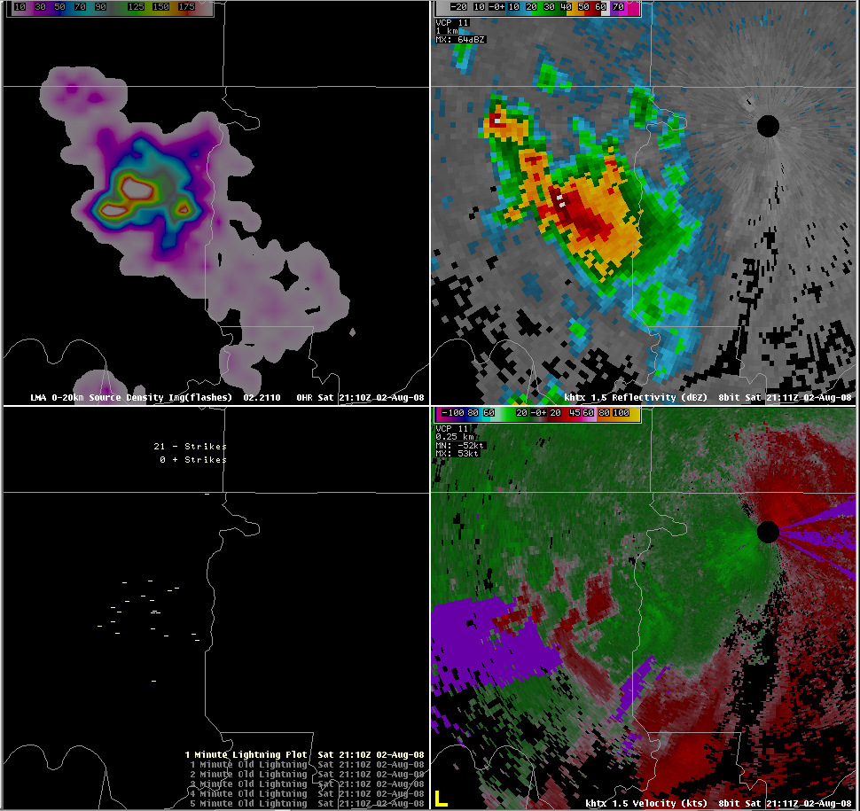
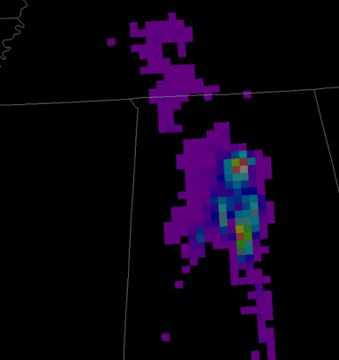
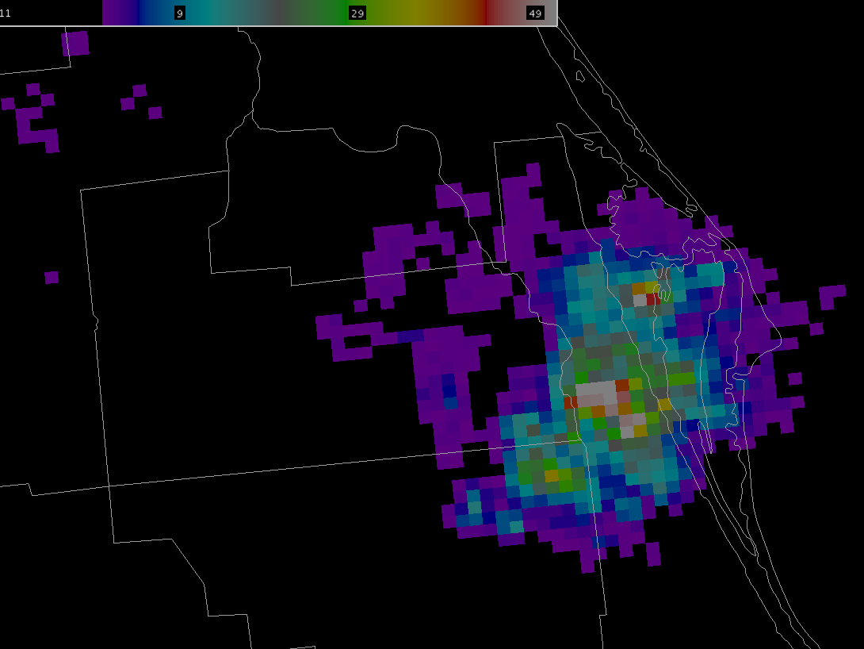
Operational Uses of Lightning Mapping Array Data Geoffrey Stano, Dennis Buechler, Chris Darden (NWS)
Relevance to NWS Forecasters
Some NWS WFOs have access to lightning mapping array data, others will have future access through the GLM on GOES-R.
SPoRT and NASA collaborators are producing proxy data sets in preparation for GOES-R/GLM.
Unique NASA/SPoRT Contributions
Working to obtain total lightning data from a variety of CONUS sources (Alabama, DC, Florida, New Mexico, Oklahoma)
Incorporation of total lightning data within AWIPS/AWIPS 2 for overlay with traditional radar and other analyses
Translate total lightning trends into severe weather precursors
Future Work
Exploring new tools available within AWIPS or AWIPS 2 that permit tracking of flash rates by cells for use with lightning trend algorithms
4-panel display
Pseudo GLM
AWIPS II
transitioning unique NASA data and research technologies to operations

Slide 6
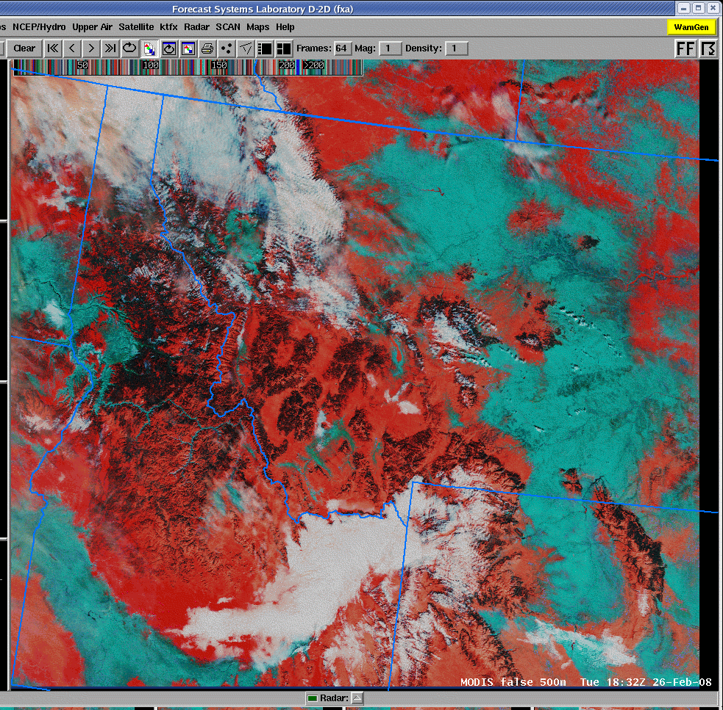
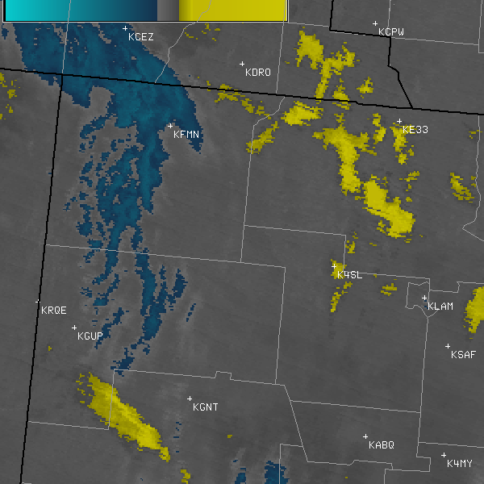
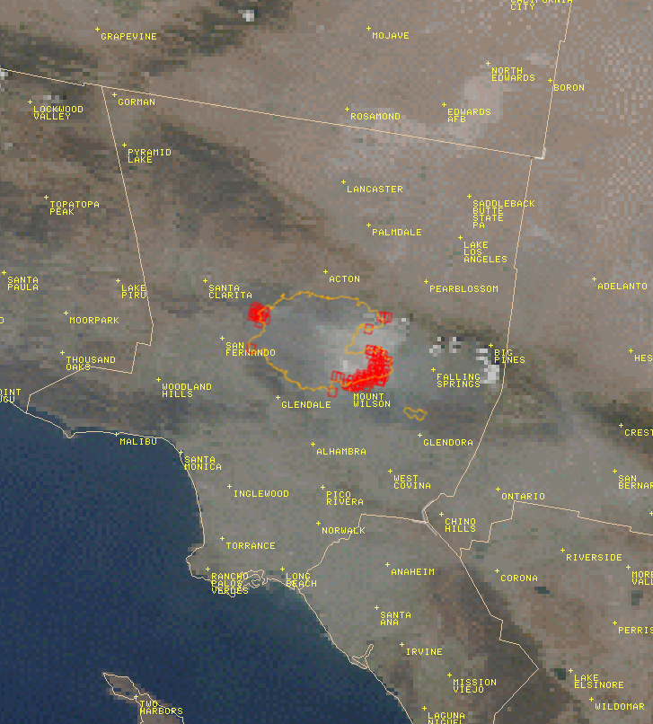
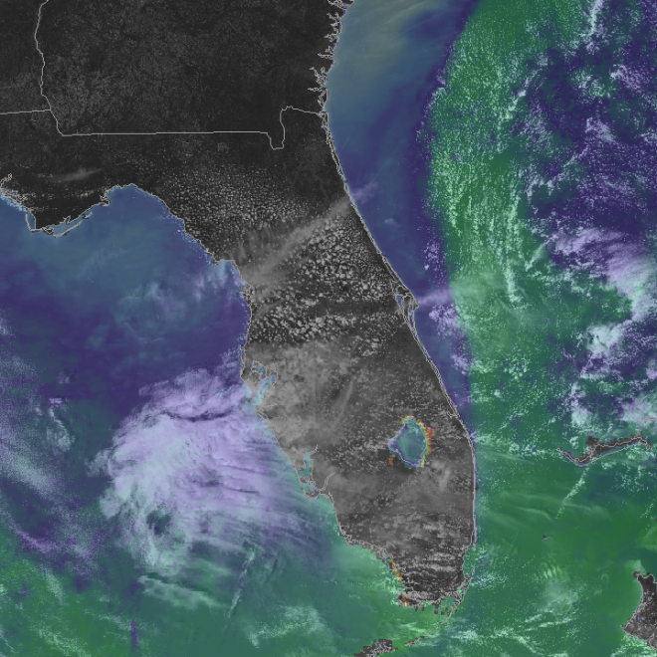
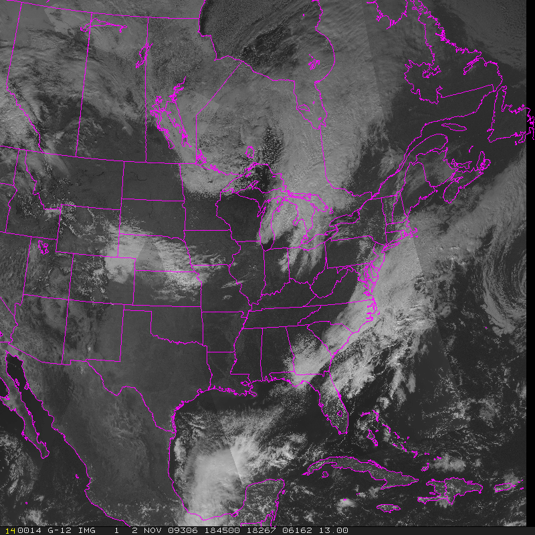
MODIS Applications Kevin Fuell, Geoffrey Stano, Gary Jedlovec
Relevance to NWS Forecasters
Infuses NASA EOS data into the short-term forecast process.
Serves as an introduction to future polar and geostationary products
Unique SPoRT/NASA Contribution
High resolution visible imagery, false color products, detection of fog in small terrain features, and hot spot detection.
Future Work
Blend MODIS and GOES imagery as MODIS becomes available, allowing for a “hybrid” product that demonstrates the value of polar orbiting data.
Allows for looping of geostationary data but with insertion of higher resolution product when available.
MODIS False Color snow/ice cover (red) monitoring
MODIS True Color with burn areas, hot spots, and smoke
MODIS fog/low clouds between obs. sites and topo.
MODIS SST composite with visible channel used to support Shuttle missions.
In the hybrid product, MODIS data replace GOES when available.
MODIS
MODIS
transitioning unique NASA data and research technologies to operations

Slide 7
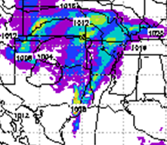
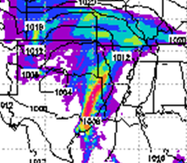
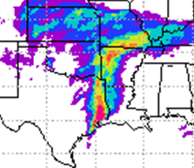
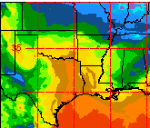
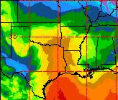
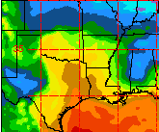
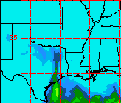
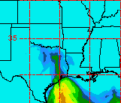
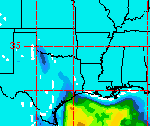
3D Analysis Product Using Hyperspectral Sounder Profiles Bradley Zavodsky, Shih-Hung Chou
Relevance to NWS Forecasters
Profiles from hyperspectral sounders (e.g. AIRS and IASI) provide rawinsonde-quality observations to fill spatial and temporal data voids
Temperature and moisture profiles can be used to improve CAPE, atmospheric river, and moisture return forecasts
WFOs can use NASA-enhanced initial conditions for nowcasting or initializing model runs
Unique SPoRT/NASA Contribution
Configured WRF-Var analysis system to assimilate AIRS thermodynamic profiles
Rigorous testing of analysis system on 37 case study days from winter 2007
Future Work
Incorporate IASI profiles into analysis
Collaborate with Corpus Christi WFO on impact of AIRS profile assimilation for moisture return cases
Generate and distribute real-time product to WFOs
Improved 6-hr cumulative precipitation from improved CAPE and 1000 hPa dew point
24-h forecast valid 00Z 2/13/07
Control
Control + AIRS
Analysis “Truth”
50.80
6-hr precip.
38.10
25.40
19.05
12.70
6.35
2.54
0.25
1000 hPa T_{d}
CAPE
transitioning unique NASA data and research technologies to operations

Slide 8
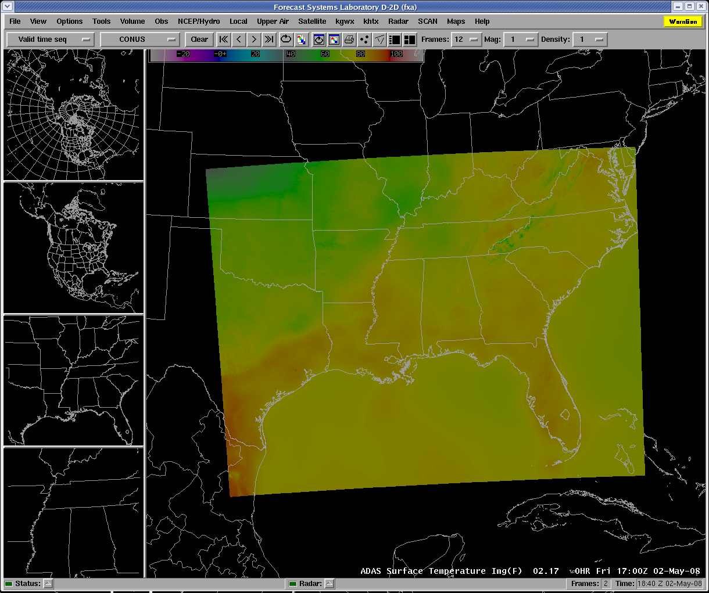
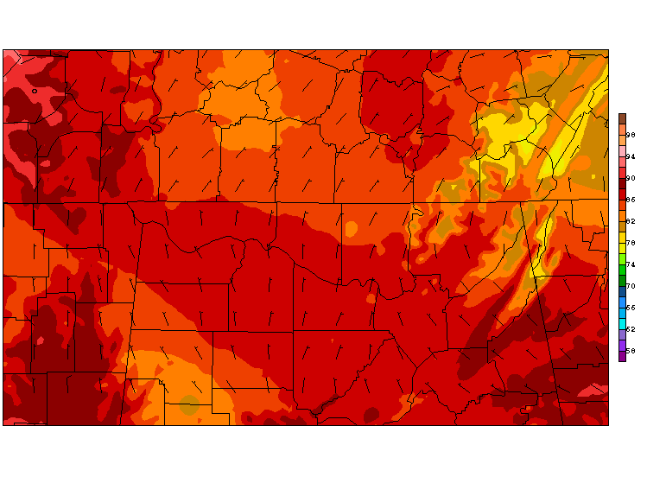
SPoRT ADAS: An Hourly Surface Analysis Product Bradley Zavodsky
Relevance to NWS Forecasters
2-km surface analysis product blending 13-km, 2-hr RUC forecast with MADIS surface observations
Higher resolution and better quality control than other surface analyses currently available in AWIPS
Aids temperature forecasts in elevation gradients
Can be used to initialize GFEs
Unique SPoRT/NASA Contribution
Provide AWIPS-formatted product every hour
Worked with forecasters at Huntsville WFO to target questionable observations to blacklist
Future Work
Develop full training module
Expand domain to cover all of CONUS
Incorporate non-MADIS data (e.g. local mesonets)
Transition to short-term NSSL WRF forecast as first-guess field to include impact of SPoRT SSTs
Use SPoRT ADAS to verify gridded forecasts
Sample surface temperature analysis displayed in AWIPS
Superior resolution over elevated terrain
transitioning unique NASA data and research technologies to operations

Slide 9
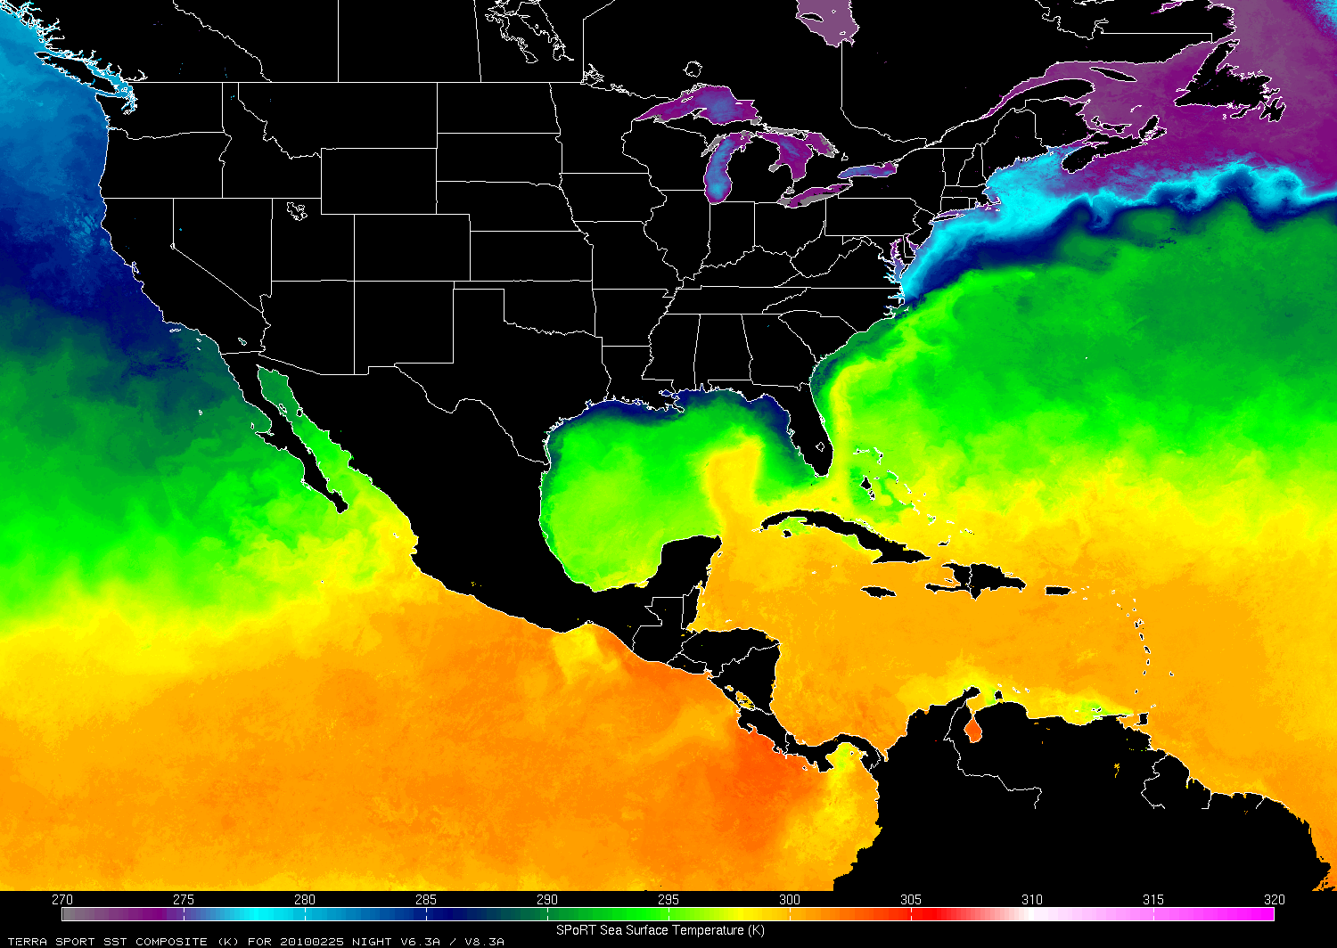
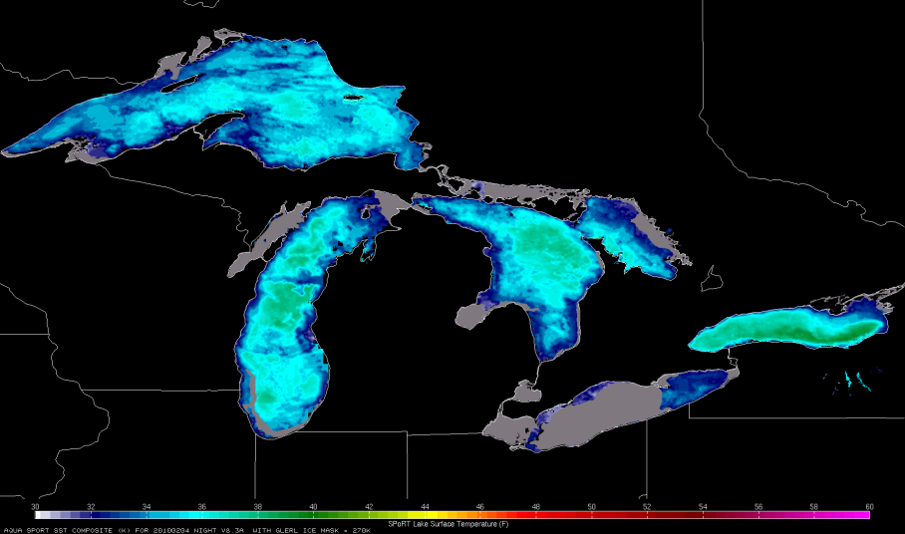
Sea and Great Lake Surface Temperature Composites Frank LaFontaine, Gary Jedlovec, Jackie Shafer, Matt Rigney
Relevance to NWS Forecasters
Observations of sea and lake surface temperatures provide high resolution detail for coastal and marine forecasts
Unique SPoRT/NASA Contributions
Partnering with JPL to develop a high resolution composite from MODIS, AMSR-E and other thermal data
Provides coverage throughout North America and the tropics, depicts coastal and Gulf Stream gradients
Developed a unique application over the Great Lakes that includes lake ice analyses from the NOAA Great Lakes Environmental Research Laboratory (GLERL)
Future Work
Examine sensitivities of WRF-EMS forecasts to initialization with SPoRT SSTs and Great Lakes temperature composites.
NOAA/GLERL Ice Mask
transitioning unique NASA data and research technologies to operations

Slide 10
Modeling
SPoRT supports the short-term forecasting efforts of the NWS by contributing to the research and development of the WRF model.
Benefits to the community include:
Adaptation of NASA data for use in WRF
Contribution of new code and bug fixes to the WRF-EMS, the local model for individual WFOs
The use of NASA instruments to evaluate the simulation of clouds and precipitation
transitioning unique NASA data and research technologies to operations

Slide 11
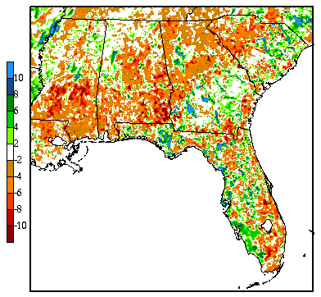
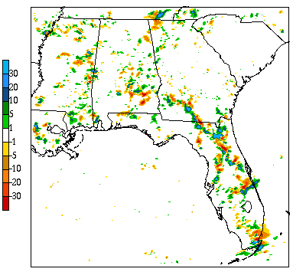
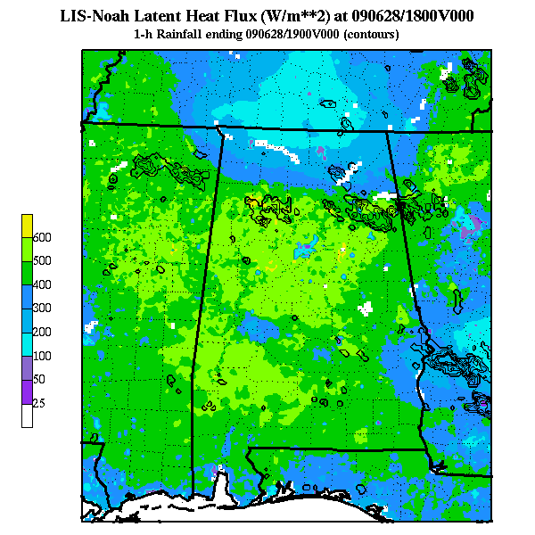
Applications of the Land Information System (LIS) Jonathan Case
Relevance to NWS Forecasters
NASA land surface modeling and assimilation system provides high-resolution soil data for NWP
Reduces the diurnal 2-m temperature bias in model forecasts and improves QPF for convective events
Unique SPoRT/NASA Contributions
SPoRT maintains a near real-time run of the NASA LIS, providing output over the southeastern U.S.
High resolution (3 km) output available for WRF-EMS initialization, currently used by NWS Miami, FL
NWS Birmingham, AL is planning to use LIS fields to identify local soil moisture boundaries with a goal of improving convective initiation
Future Work
Incorporate MODIS vegetation data to improve representation of the land surface
Provide output LIS fields in AWIPS/2 for diagnostic evaluation at partner WFOs
10 June 2008 WRF run:
0-10 cm soil moisture diff (LIS – CNTRL, %)
1-h forecast precip
diff (LIS – CNTRL, mm)
transitioning unique NASA data and research technologies to operations

Slide 12
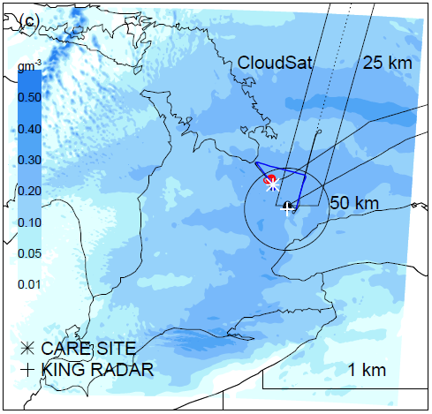
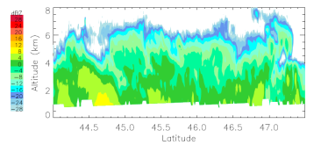
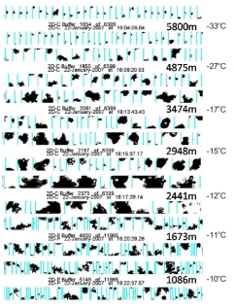
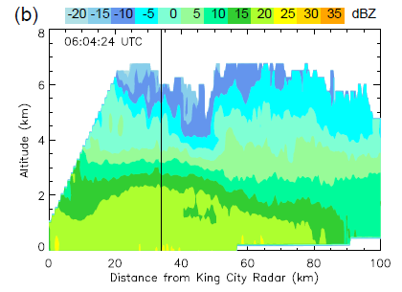
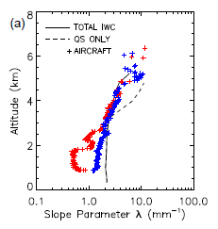
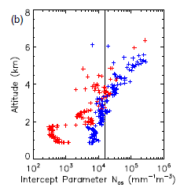
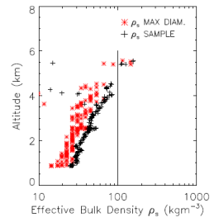
Evaluating Cloud Microphysics Schemes in the WRF Model Andrew Molthan
Relevance to NWS Forecasters
Evaluating the performance of assumptions during synoptic-scale and lake-effect snowfall events
Unique SPoRT/NASA Contributions
Identify the physical realism of microphysics schemes available within the WRF-EMS system
Partner with the research community to obtain schemes with additional processes, evaluate against traditional and remotely sensed observations
Future Work
Obtained schemes with additional prediction of crystal habit and parameterizations of riming processes
Revisit field campaign data for new schemes, ensure representation of physical processes and evaluate sensitivities in QPF and predicted snow density
WRF + NASA Goddard Scheme
CloudSat
King City C-Band Radar
Aircraft Measurements
λ
N_{os}
ρ_{s}
Snow Crystal Size Distributions and Bulk Density vs. Assumptions
Evaluating the snow crystal assumptions currently made within the NASA Goddard scheme.
transitioning unique NASA data and research technologies to operations

Slide 13
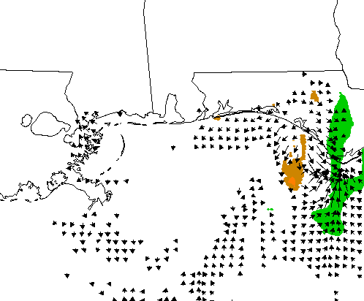
Contributions to the WRF Environmental Modeling System Jonathan Case
Relevance to NWS Forecasters
The WRF-EMS is used within several NWS WFOs to provide local, high resolution forecasts for prediction and training.
Unique SPoRT/NASA Contributions
The SPoRT SST product is the current default within the WRF-EMS, effective V3.1, and real-time composites are distributed four times daily in GRIB format.
Jon Case contributed a bug fix in the upcoming release that allows for the use of Great Lakes temperatures and the NOAA GLERL ice mask.
SPoRT provides LIS initialization fields for the WRF-EMS, currently available over the southeastern United States.
Future Work
Examine impact of Great Lakes temperatures on lake effect weather.
Broaden the LIS domain to include a broader sample of the United States.
Enhanced cyclonic flow associated with SST gradient
T.S. Claudette, 03z 17 Aug 09
4-h forecast, 10-m wind & MSLP diff
transitioning unique NASA data and research technologies to operations

Slide 14
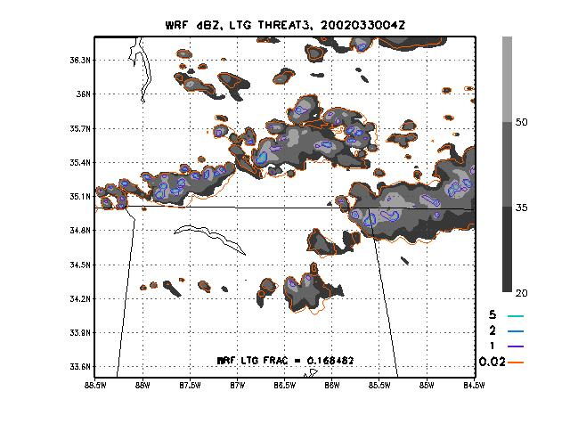
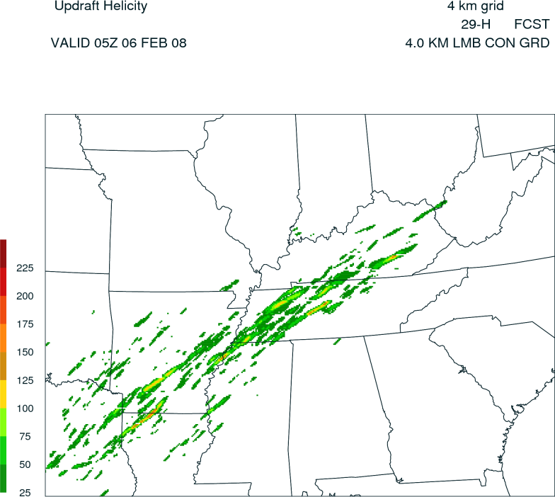
Contributions to Experimental High Resolution Forecasts
Jonathan Case, Eugene McCaul, Scott Dembek
Relevance to NWS Forecasters
Allows for the testbed utilization of unique output fields obtained within the WRF model, based upon cloud microphysics and dynamics output.
Lightning threat -- uses ice flux rates from the WRF six-moment scheme to predict lightning flash rates.
Hourly maximum fields – interpret the relative strength of storms between WRF output times.
Unique SPoRT/NASA Contributions
Algorithm details published (McCaul et al. 2009) and integrated within the NSSL WRF model for use in their Spring Experiment.
Output available online as part of the NSSL daily 4-km experimental forecasts produced over CONUS.
Future Work
Evaluate product during the upcoming Spring Experiment, identify strengths and weaknesses, and improve upon performance by calibrating against new cases.
transitioning unique NASA data and research technologies to operations

Slide 15
Conclusion
NWS forecasters and WFOs benefit from SPoRT efforts in the areas of:
Situational Awareness
Satellite products, lightning data, and visualizations.
Modeling for Short-term Forecasts
Components related to the WRF model
Data Assimilation
Adapting unique NASA data sets to improve analyses
Future goals continue to support short-term forecasting efforts.
transitioning unique NASA data and research technologies to operations

Slide 16
Questions?
transitioning unique NASA data and research technologies to operations

