Slide 1


Other Research Data and Products
Relevance
External collaborators
Products
Examples
Future opportunities
transitioning unique NASA data and research technologies to operations

Slide 2
Relevance to SPoRT
Non-NASA data and products can provide improved situational awareness and short-term forecasting issues
  match forecast challenge to data and products
  end users ask for products to be brought into decision support systems
Research community has wealth of expertise and experience with non-NASA satellite data
  developing collaborations with these providers is critical to success of transition products – access, training materials, etc.
  collaborations can lead to joint funding for new work
Use SPoRT knowledge of end users and AWIPS/NAWIPS/AWIPS II to transition products
  similar distribution as NASA SPoRT products
  implement training and assessments

Slide 3
External Collaborators
UW / SSEC / CIMSS
  wealth of expertise and data sources
  in-house products – POES, GOES, GOES-R Proving Ground
CSU / CIRA
  wealth of expertise and data sources – passive microwave, POES, GOES-R PG
NOAA / NESDIS – various groups
  GOES products, GOES-R proxy products, and SEVIRI data
  significant research and development activity feeding operations - formal R2O activity
  not all products slated for transition to AWIPS
  desire for early feedback from WFOs
Naval Research Lab (NRL) – Monterey
  unique passive microwave expertise, special sensors
  access to global data (GOES, NOAA, DOD)
  unique products to address DOD nowcasting and short-term weather forecasting around the world, training products

Slide 4
Products to End Users
NASA
OTHER
INSTRUMENT / PRODUCT | RESOLUTION | END USER | FORECAST PROBLEM
MODIS
Imagery (vis, 3.9, 6.7, 11 µm) | 4 km, 1 km, 500 m (state), 250 m (WFO scale) | WFOs | Situational awareness
RGB products (true, false color) | 4 km (CONUS), 1km (reg.), 500m (state) | WFOs, NC | Obstructions to visibility, snow cover
Derived image products
clouds (mask, CTP, phase) | 4 km (CONUS) | WFOs | Situational awareness
fog / low cloud (11 – 3.9 µm ) | 4 km (CONUS), 1 km (reg.) | WFOs | Visibility, hazards
LST, SST, LI, TPW | 4 km (CONUS), 1 km (reg.) | WFOs | Atmospheric stability, surface forcing
Temporal composite images
SST w and w/o ice mask | 2 km | WFOs | Coastal processes, lake effect precipitation
Non-image data
HMS/FIRMS fire/ burn areas¹ | CONUS | WFOs | Smoke, visibility, flooding
AMSR-E²
Rain rate, cloud water | 5 km (CONUS); 21 km | WFOs | Coastal weather, data voids
SSTs | 38 km (CONUS) | WFOs | Coastal weather
Total lightning data
LMAs (4) – total lightning | 2 km(2min) / 1 km(1min) | WFOs | Severe weather, safety
new
Available in AWIPS II only 2. Products no longer available
transitioning unique NASA data and research technologies to operations

Slide 5
Products to End Users
NASA
OTHER
INSTRUMENT / PRODUCT | RESOLUTION | END USER | FORECAST PROBLEM
Combined Instrument products
Multi-sensor SST composite | 2 km (NA coastal regions) | WFOs | Short-term forecasts
Blended TPW (from CIRA)* | 16 km (NH) | WFOs | Atmos. Rivers, precip.
GOES
NESDIS Aviation products* | 4 km (CONUS) | WFOs | Situational awareness
GOES-R
pGLM product suite | 10 km / 2 minutes | HWT | Severe weather, lightning
GOES-MODIS hybrid | 500 m, 1 km | WFOs | Situational awareness
GOES-MODIS RGB hybrid | 500 m, 1 km | WFOs | Situational awareness
Proxy QPE (NESDIS) | 4km | WFOs | Precipitation
RGB products – SEVIRI, MODIS, GOES Sounder | 1 – 10 km | Nat. Ctrs. | Situational awareness
UAH Convective Initiation | 1 km | WFOs / NC | Convection, rain
Passive Microwave
TRMM 37 (V/H), 85 (V/H), comp. | 12.5 – 25 km | NC, WFOs | Precip., atmos. dynamics
SSMI(S) 37 (V/H), 85 (V/H), 91V | 12.5 – 25 km | NC, WFOs | Precip., atmos. dynamics
SSMI(S) RGBs – 37/85, 37PCT | 12.5 – 25 km | NC, WFOs | Precip., atmos. dynamics
new
new
new
new
NESDIS version of products now available in AWIPS via SBN.
Red text indicates a future near-term product
transitioning unique NASA data and research technologies to operations

Slide 6
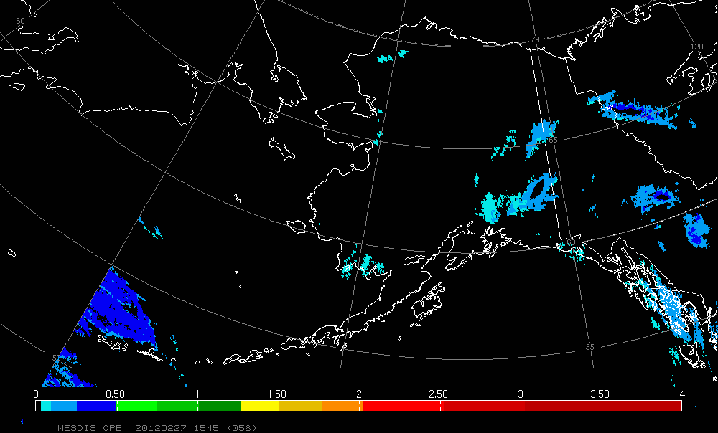
NESDIS GOES-R ABI Proxy QPE
GOES-R ABI AWG for precipitation (Bob Kuligowski)
  develop and demonstrate future QPE capabilities over North America
  version of SCaMPR used in near real-time applications
  demonstrate in challenging area like Alaska

Slide 7
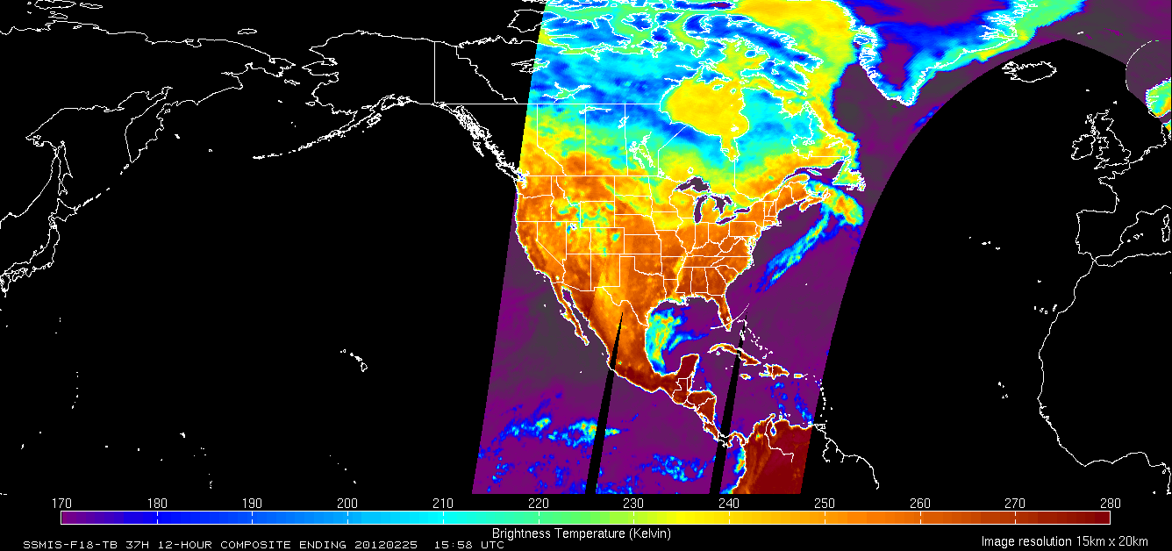
Passive Microwave Imagery / Products
National Hurricane Center (NHC) request for SSM/I products
  current access from NRL tropical web-site – desire data in NAWIPS
    SPoRT look at feasibility for TRMM, SSM/I, SSMIS
    Pave way for other SPoRT products
    utility to OCONUS as well
  developed collaborative partnership with NRL for access to digital data
  discussed desired products / format with NHC forecaster / SOO
  products ready to go – waiting for NHC IT integration
SSM/I / TMI 12-Hour Combined Composites
  37H, 37V, 85H, 85V, RR
SSMIS 12-Hour Combined Composites
  37H, 37V, 91H, 91V, RR
Anticipate full hemispherical coverage in near future

Slide 8
Products to End Users
NASA
OTHER
INSTRUMENT / PRODUCT | RESOLUTION | END USER | FORECAST PROBLEM
MISCELLANEOUS
LIS hourly products | 1-3 km | WFOs | CI, drought / hydrology
WindSat OSWV | 25 km | WFOs | Situational awareness
ASTER imagery³ | 15 m | WFOs | Tornado damage tracks
3D analysis fields from GSI | 12 km | WFOs | Weather forecasting
OMI
NESDIS SO₂⁴ | Native resolution in NAWIPS | W. VAAC | Volcanic ash monitoring
AIRS
Carbon monoxide | 15 km | WFOs | Fires, air quality
VIIRS
Imagery (vis, 3.9, 6.7, 11 µm) | 750 m (state), 375 m (WFO) | WFOs | Situational awareness
RGB products (SEVIRI suite) | 750 m (state) | WFOs | Obstructions to visibility, snow cover, fog, smoke
DNB (low light) | 375 m | WFOs | Situational awareness
Derived image products
EDRs | various | WFOs | Situational awareness
new
new
new
new
Not real-time data Red text indicates a future near-term product
Full transition of software
transitioning unique NASA data and research technologies to operations

Slide 9
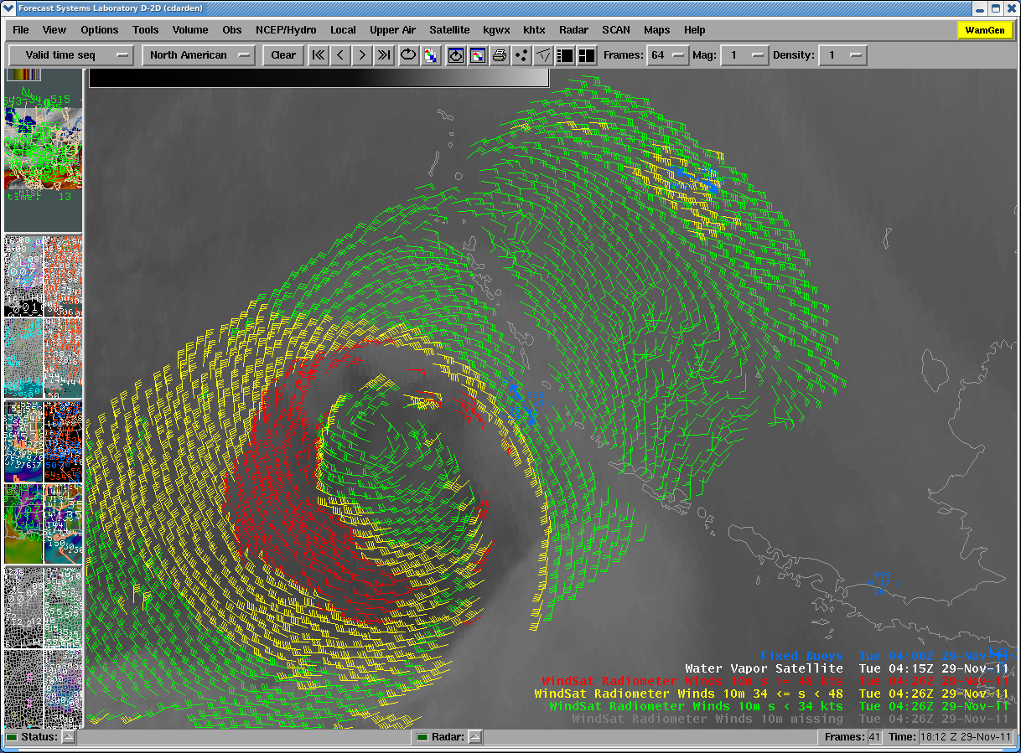
Ocean Surface Vector Winds - WindSat
WindSat (Coriolis) improved retrieval algorithm (NRL)
Global data, near real-time from NRL
emulate QuikSat data structure for AWIPS
retained only highest quality winds
Recent conference papers, blog posts on usage
    Alaska WFOs
    Western Region
      Monterey
      Eureka
      Medford
    Interest from other users including OPC

Slide 10
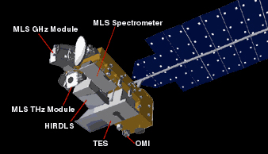
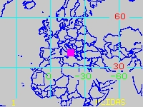
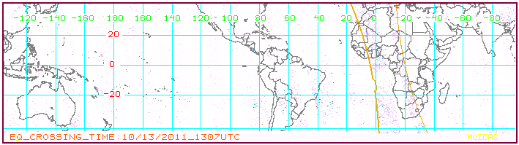
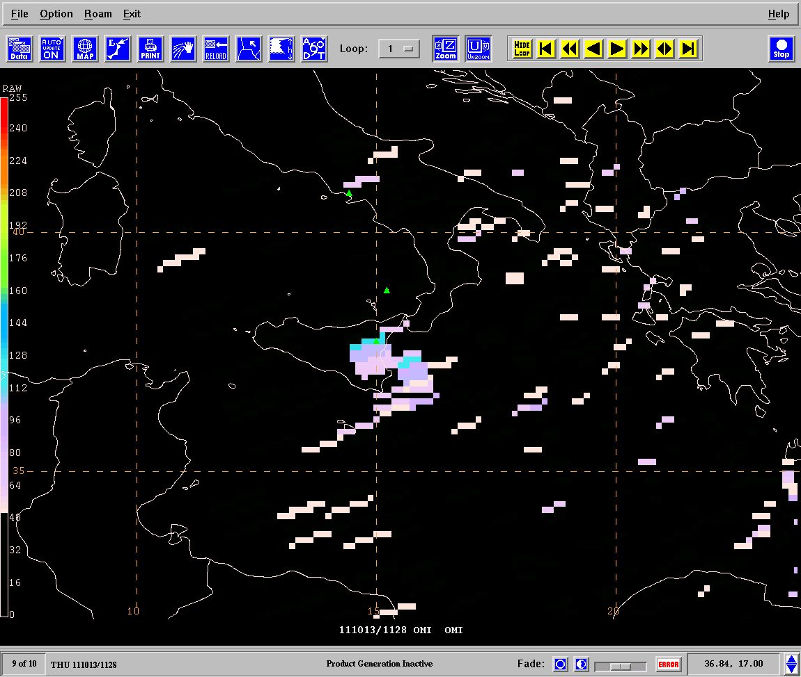
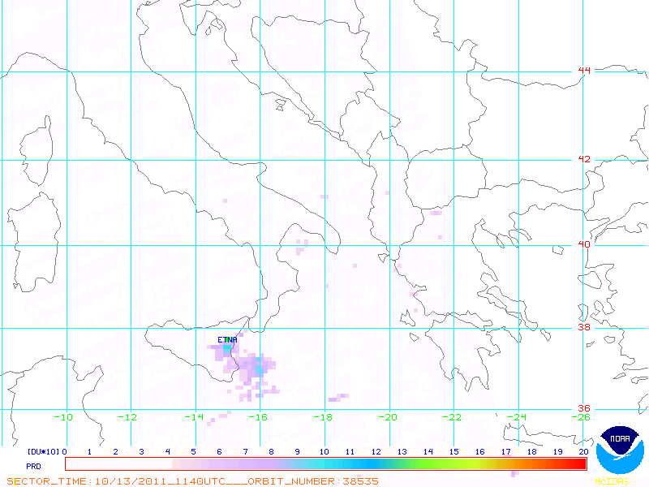

OMI /AURA SO₂ Transitioned to VAAC
NESDIS asked for help transitioning OMI column SO₂ into NAWIPS for the Washington VAAC (VAAC) to improve decision support. SPoRT:
  accessed OMI data from NESDIS secure site
  developed technique to ingest product and display in NAWIPS – formatting , units, enhancements, etc.
  then transitioned code to NESDIS for operational processing
SPoRT no longer involved in processing / distributing data
AURA launched in 2004
OMI used to monitor SO2 from volcanoes
OMI Column SO2 - Mt Etna in Sicily Oct 13, 2011 @ 1500UTC
Legacy web-display
NAWIPS Display

Slide 11
Looking to the Future
Continue transition of non-NASA products to AWIPS II
  training and impact studies
Ensure successful transitions of pending data
  AIRS Carbon monoxide - fire tracer, air quality
  3D analysis from GSI (AIRS, IASI, CrIS profiles) – diagnostic analysis in data void regions
  passive microwave measurements – storm structure, water vapor, precipitation products
  Consider new satellite data that addresses forecast issues
  GCOM (AMSR2)
Expand collaborations with providers when appropriate
  CSU / CIRA, NRL, UAF / GINA
Continue collaborative participation in Satellite Proving Ground
Make products more readily available via ftp, KML, etc.

