Slide 1
Assessment and Transition of AWG Products: GOES-R QPE and CI
Science Advisory Committee Meeting
26 – 28 August, 2014
National Space Science and Technology Center, Huntsville, AL

Slide 2
NOAA PG Intro – AWG Support
1
Where we’ve been …..
What we’re doing ….
Co-located with UAH developers of official GOES-R Convective Initiation product
Support transition (training) of product and user DSS integration
Conducted assessment and provided feedback to developers
Collaborated with QPE AWG to transition and assess product
West Coast, Alaska, and Puerto Rico
Continuing to make Convective Initiation product available to WFOs and NCs
Collaborating with Pacific Region for QPE Assessment in Fall 2014
Planning with QPE developers for eventual use of Himawari version of product
Participating in Air Quality AWG transition planning

Slide 3
Why NASA-SPoRT Transitions and Assesses AWG Products
2
Is a leader in transitioning experimental products to operations
Has a proven paradigm for training, transitioning, and assessing experimental products
Recall SPoRT Assessment Paradigm aims to:
Provide efficient and effective forum for forecasters’ feedback
Gather detailed, actionable information for product developers, program managers, etc.
Assessment Characteristics
Does not take the place of AWG-led validation studies
5-point Likert scales
Use of/confidence in training, confidence in product, product utility in meeting forecast challenge
NESDIS GOES-R QPE: Bob Kulgowski
UAH GOES-R CI: John Mecikalski
Can work with other AWGs through the PG to transition and assess

Slide 4
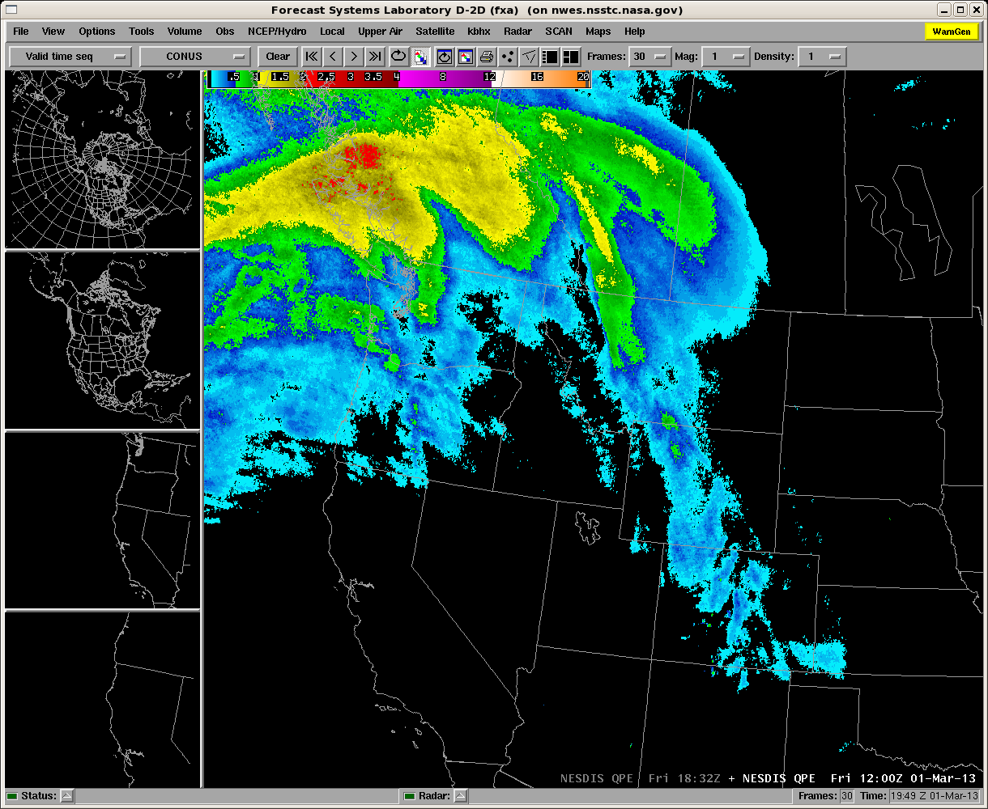
QPE Product and Purpose
3
GOES-R ABI baseline product
Satellite-based rain rate estimates
based on IR data
calibrated using microwave rain rates
Input data:
IR channels from GOES
Microwave from TRMM TMI, MHS on NOAA 18/19 and METOP-A
Current GOES:
4km spatial resolution
15 minute temporal resolution
Domains: GOES-East, GOES-West (including AK, HI, and SJU)
Forecast challenge: high impact rain events in data-sparse regions (AK, SJU, WC)
90 surveys from a variety of operational cases/conditions
NESDIS GOES-R QPE

Slide 5
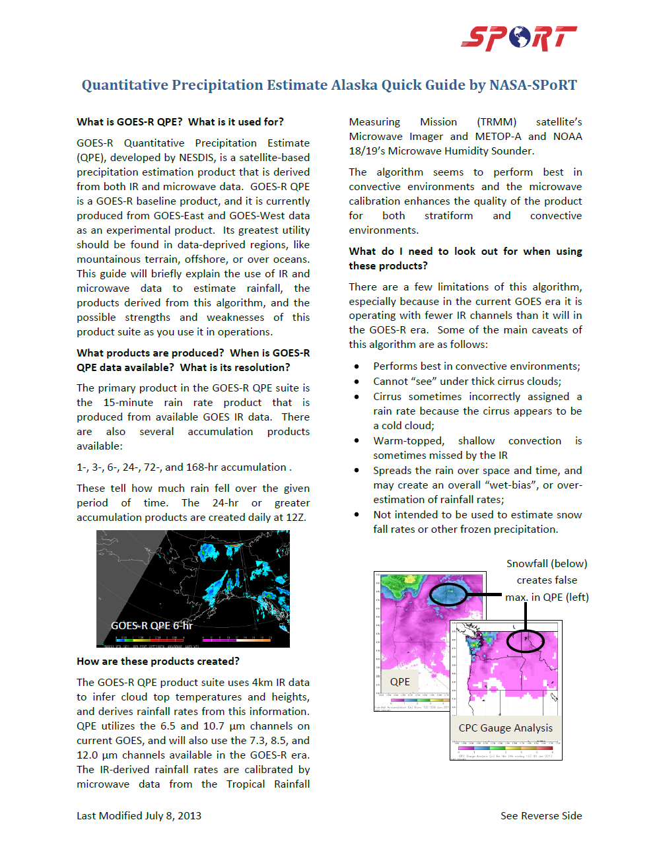
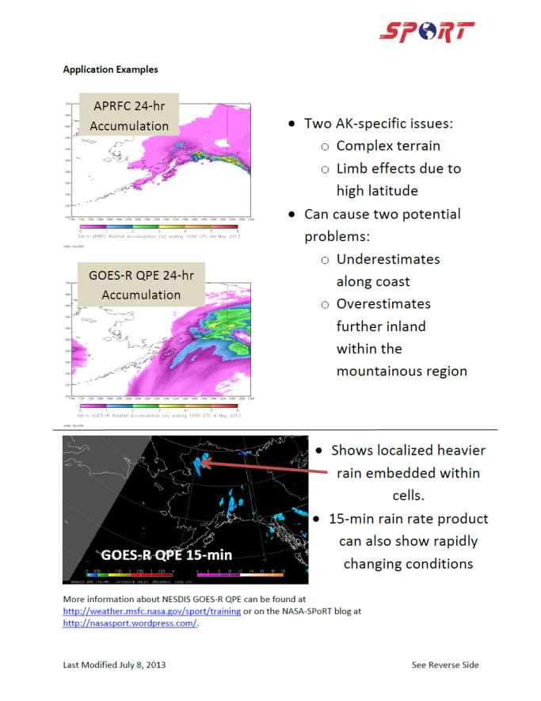
GOES-R QPE Training
4
Teletraining Sessions March 6th 2013 and July 9th and 11th, 2013 for WFO SOOs and staff with product developer Bob Kuligowski
Region-Specific Quick Guides: CONUS, AK, and SJU/HI
Site Visits to AFC, AFG, and AJK in July 2013

Slide 6
GOES-R QPE Quantitative Results
5
GOES-R QPE:
Underestimates in SJU
Overestimates rainfall on the coast and underestimates in the mountains along the WC
Performed inconsistently in AK
http://weather.msfc.nasa.gov/sport/evaluations/
Notes:
Final Assessment Reports available on our website.

Slide 7
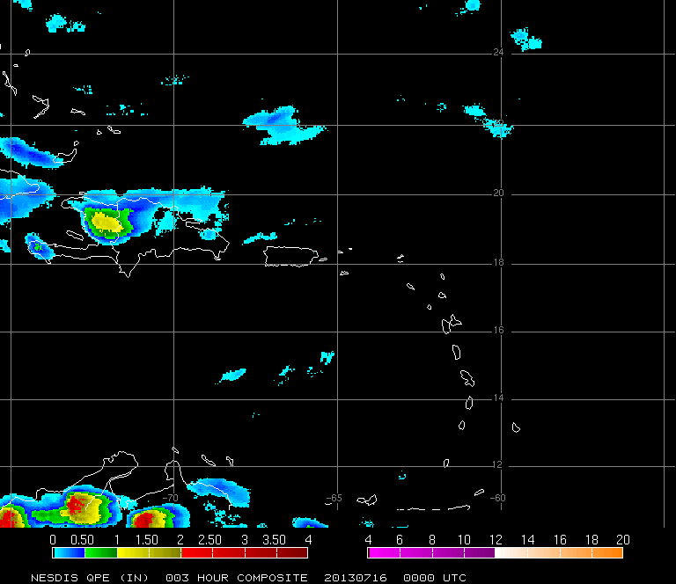
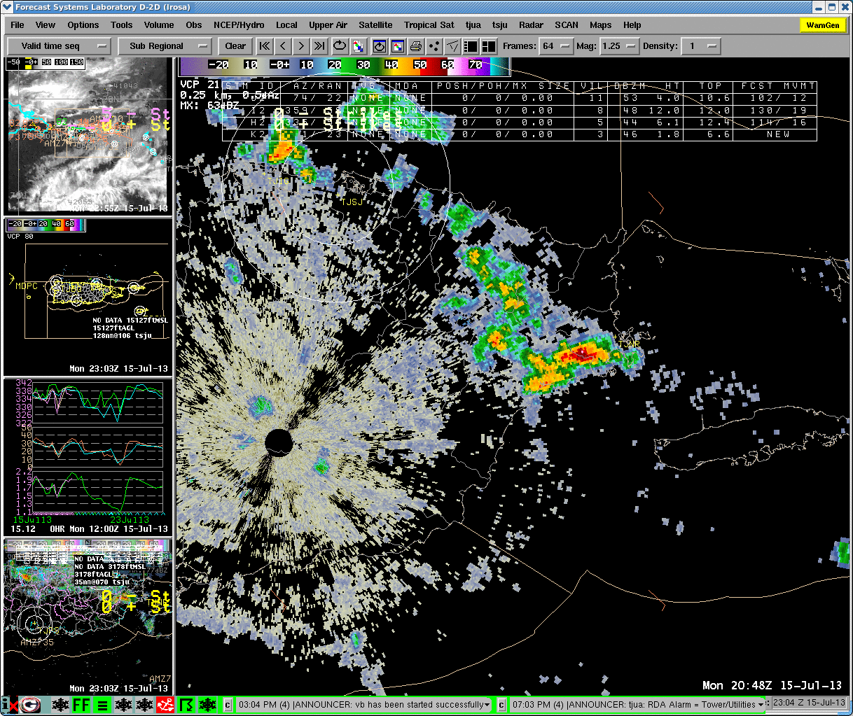
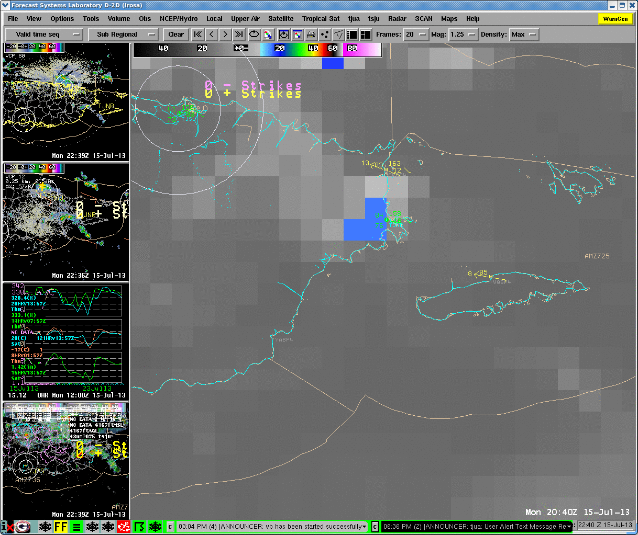
GOES-R QPE Forecaster Feedback
6
Tstorms over NE PR 15 July 2013 producing moderate flooding
Dual-Pol shows ~1in/hr
GOES-13 2040-2145 UTC shows warm cloud tops (-49C offshore min) vs 0.5km res DMSP F-16 OLS IR shows overshooting tops (-80C)
GOES-R QPE reported trace rainfall
“Thanks for putting this case together--this is exactly the kind of thing I need to know about. My validation focuses primarily on large-scale performance and I don't often catch events like these because I'm not looking at everything so close-up.” –Bob Kuligowski
Notes:
Case example from Luis Rosa (WFO-SJU), adapted from the World Wide of SPoRT Blog.
GOES-R QPE, in its proxy form, failed to detect a storm due to current GOES resolution. Likely a common occurrence in SJU and could impact validation studies, etc.

Slide 8
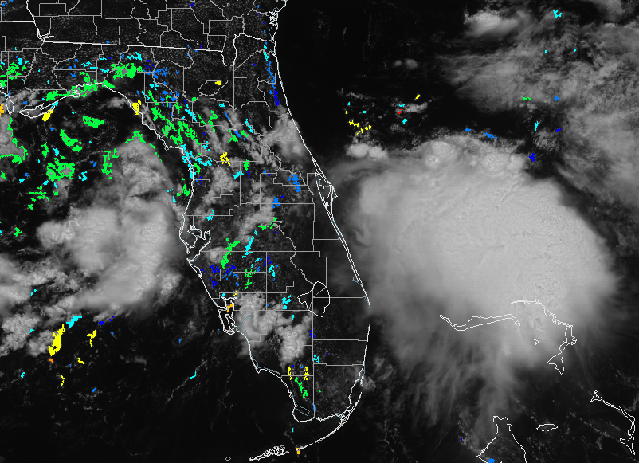
CI Product and Purpose
7
GOES-R ABI Future Capabilities—high priority
Satellite nowcasting for convective initiation
Spatial Resolution: 1km on current GOES (4km at night)
Temporal Resolution: 15 min
Current Domain: GOES-East, GOES-West (CONUS)
Input:
9 interest fields from GOES
15 NWP fields from RAP
Ground snow cover (SNODAS)
Output:
Probability of 0-2hr CI
GOES: Cloud motion, growth, glaciation, and height
+
NWP Model: CAPE, CIN, LI…
=
Logistic Regression
Little bitty old CI image

Slide 9
GOES-R CI Training
8
Teletraining Sessions prior to assessments
Quick Guide updated with product changes
Articulate Module for self-paced training
Site Visits to facilitate collaborations and peer-to-peer training

Slide 10
GOES-R CI Quantitative Results
9
Confidence and Impact suggests
Positive impact on situational awareness
Room for improvement
Generally effective lead times
Error detected in GOES-West algorithm
http://weather.msfc.nasa.gov/sport/evaluations/
Notes:
Final Assessment Reports available on our website.

Slide 11
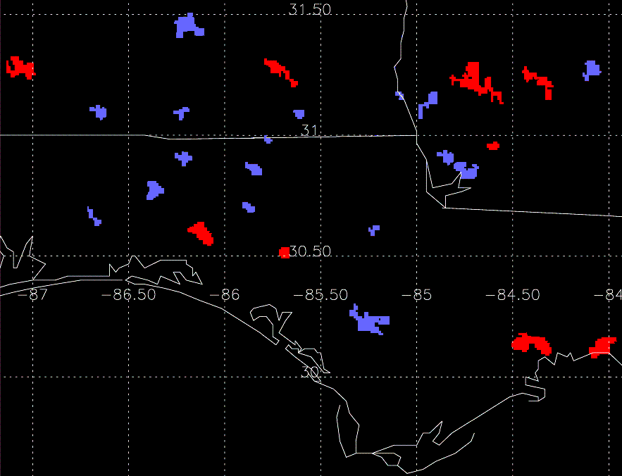
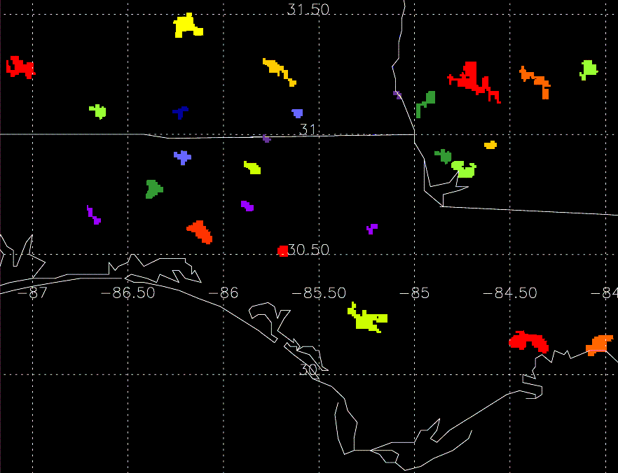
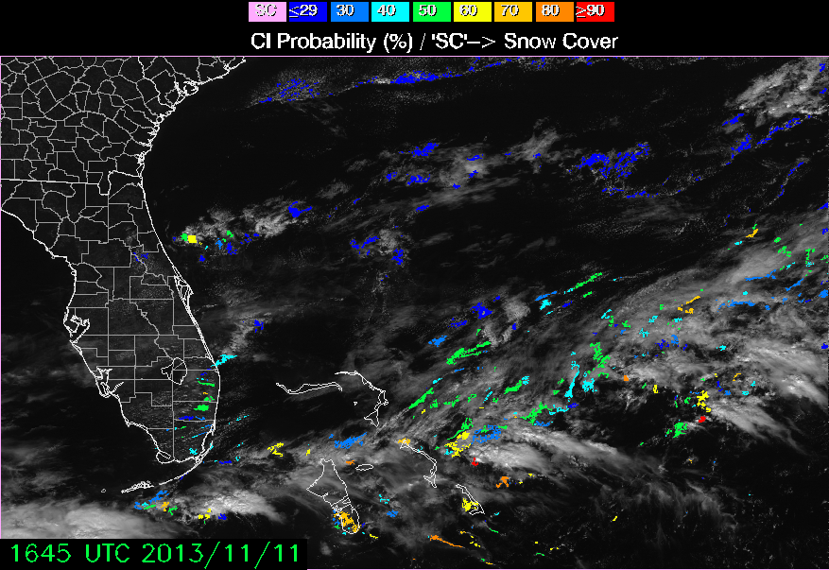
10
GOES-R CI Iterative Development
2010: Yes/No Product
2011/12: SoS Product
2013: Probabilistic Product (sat+model fields)
Transition Problems: Inconsistently available
Forecaster Feedback: Binary output is inaccurate, not very detailed
Product Changes: Product available year-round; “Strength of Signal” Product
Forecaster Feedback: SoS MUCH better; lead times improve; no environment
Product Changes: new transitions dataflow and process; Probabilistic product includes environment via model data
Forecaster Feedback: Better lead times and situational awareness; GOES-West problems
Notes:
SPoRT PARADIGM: John Mecikalski’s team could observe, with the guidance of forecasters, the strengths and weaknesses of each version of the product over numerous operational cases, making improvements in preparation for GOES-R.

Slide 12
In Conclusion
11
SPoRT’s core competencies:
Transitioning experimental products to end-user DSS
Multi-faceted training
Robust quantitative assessments
SPoRT’s role in transitioning and assessing AWGs:
Better understand the utility of AWGs in operations
Gather vital feedback from forecasters for the development of AWGs

