Slide 1
Session 2: Product Development
Science Advisory Committee Meeting
26 – 28 August, 2014
National Space Science and Technology Center, Huntsville, AL

Slide 2
Products Team Objectives
1
Mission: Develop experimental products for satellite missions to assess the impact on forecast needs in operations
Primary role:
Integrate user forecast needs with available SPoRT capabilities
Multiple avenues for information: Assessments, site visits, science sharing, etc.
Relevance to the SPoRT Paradigm
Emphasize SPoRT’s expertise with remote sensing
Products Group takes feedback from partner interactions and assessments to develop means to address forecast concerns
Close interaction with end users and other SPoRT teams

Slide 3
Range of Activities
2
SPoRT has a diverse suite of products
Remote sensing expertise (satellite, lightning)
NASA Missions
SPoRT initially began with and continues support of NASA missions
Examples: MODIS, North Alabama Lightning, GPM, etc.
SPoRT’s Expanded Role
Recent collaborations have greatly expanded the number of platforms from which data are received
Primarily through NOAA Proving Grounds, but also new NASA missions
Recognizes SPoRT’s expertise in remote sensing applications
Activities now incorporate VIIRS, passive microwave, ozone products

Slide 4
Product Suite and Collaborations
3
Through interaction with SPoRT Groups, over 3 dozen collaborators
Weather Forecast Offices
National Centers
Center Weather Service Units
Spaceflight Meteorology Group
Proving Ground (via Hazardous Weather, Aviation, Tropical, and High Latitude Test Beds)
Expanding and flourishing in new regions (e.g., Alaska and Pacific)
Emphasizing SPoRT’s continued efforts to assess solutions to various forecast issues with remote sensing background
Numerous individual product suites

Slide 5
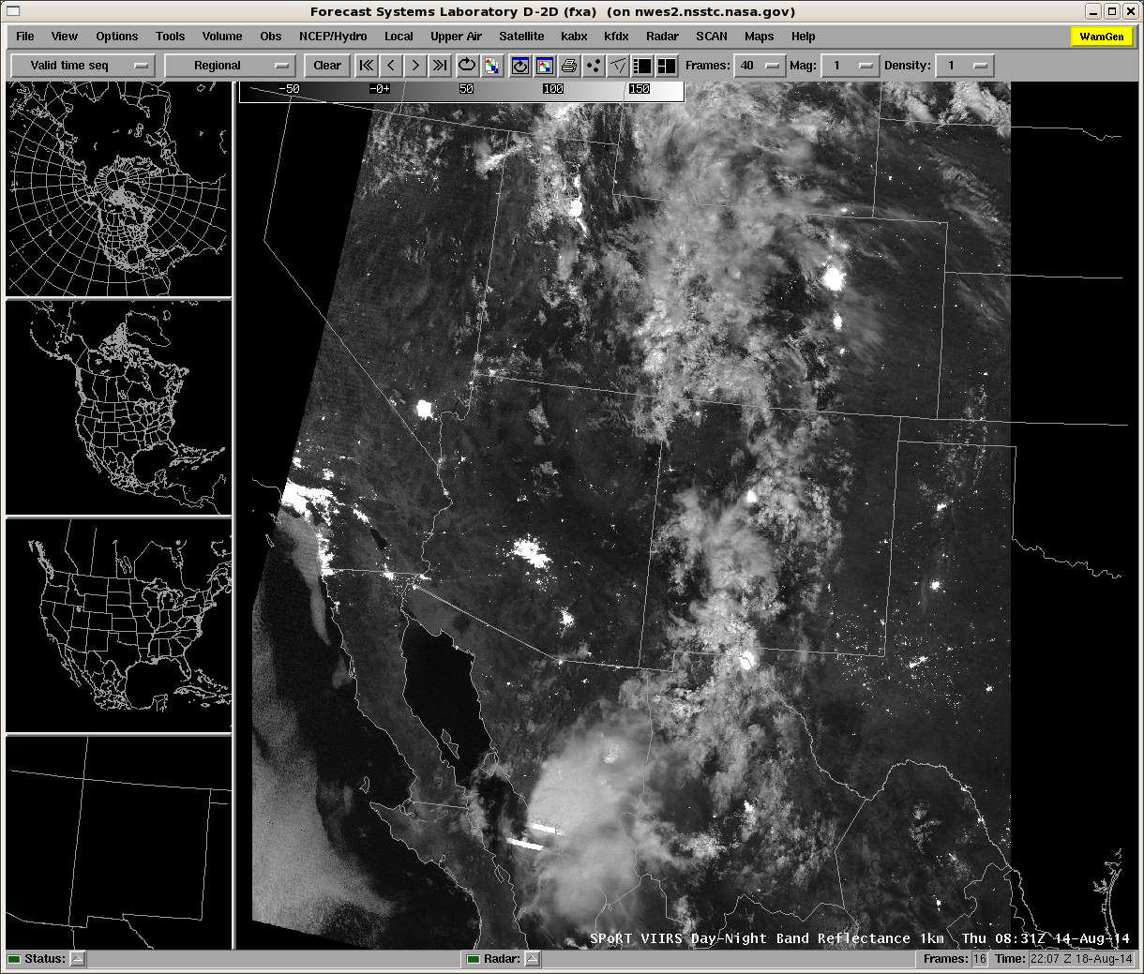
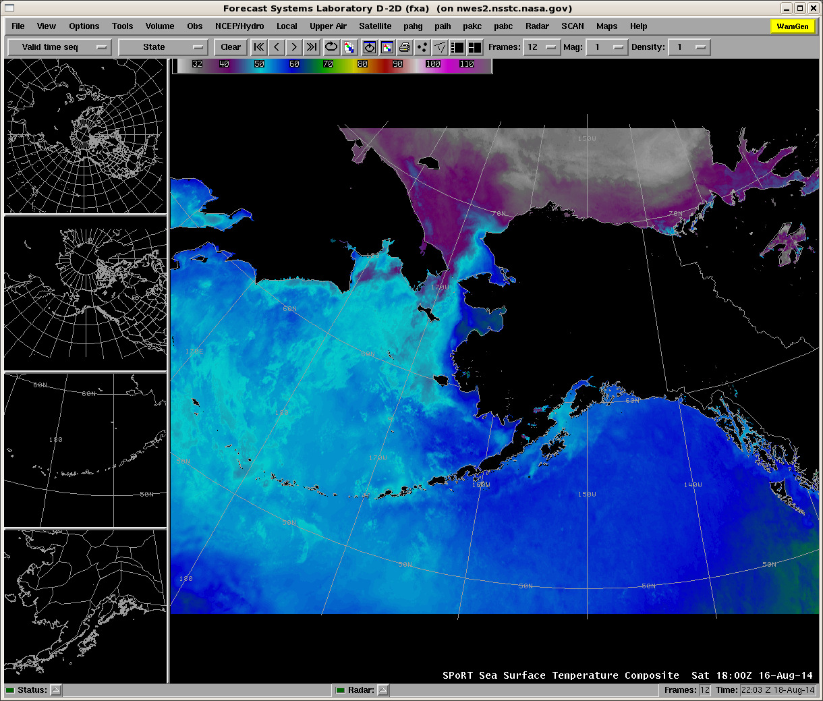
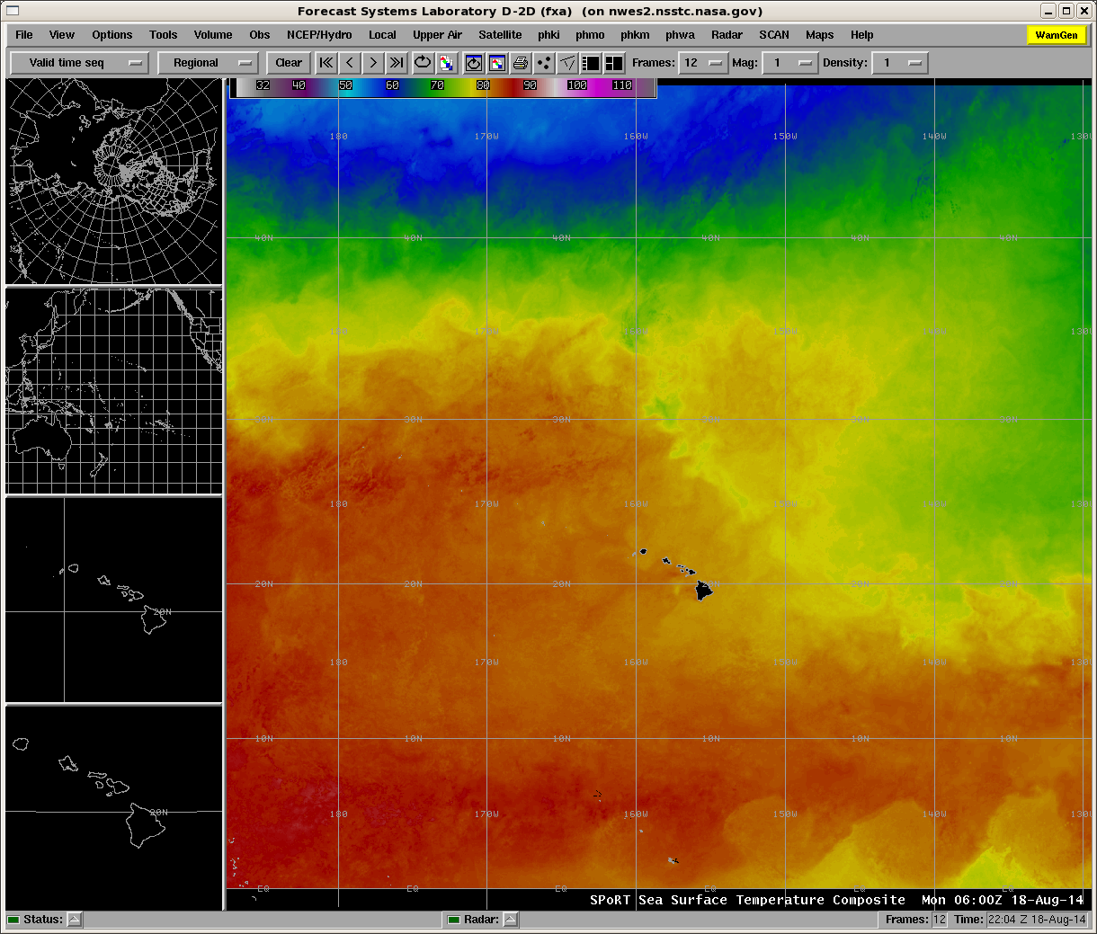
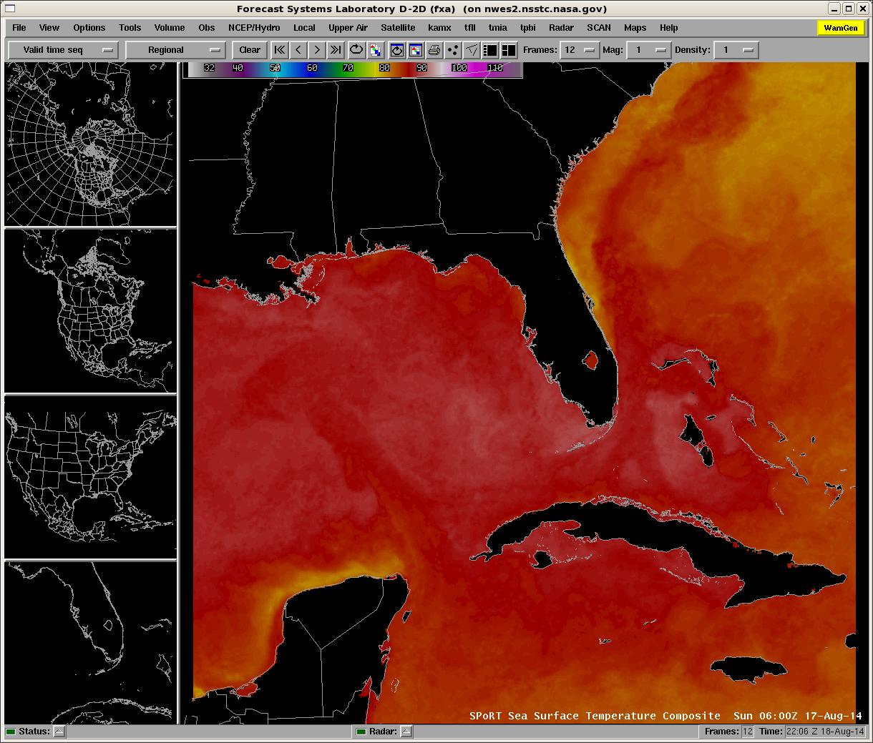
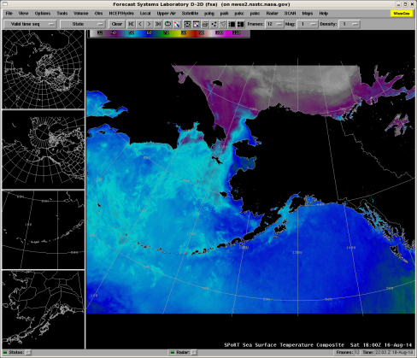
Product Highlights
4
SSTs: Alaska Region
Not every product will be covered during this session
Several highlights of products without formal presentation
VIIRS Day-Night Band Reflectance
Sea Surface Temperature Composite
VIIRS Day-Night Band:
Reflectance
SSTs: Pacific Region
SSTs: Southeast
City Lights
Lightning
0831 UTC

Slide 6
Introduction of Speakers
5
Passive Microwave and Upcoming GPM Activities (Frank LaFontaine)
Red-Green-Blue Composites (Kevin Fuell)
Ozone and Ozone Anomaly Products (Emily Berndt)

