Slide 1
SPoRT Future Lightning Activities
Christopher J. Schultz
Geoffrey T. Stano
Paul Meyer
Kevin McGrath
Kevin Fuell

Slide 2
Overview
Continuation of current activities and partnerships for assessment and training for GOES-R’s GLM.
Vision for future lightning products in SPoRT.
New product development using SPoRT Core resources and other funding sources.

Slide 3
Vision for future Lightning Products and Collaborations in SPoRT
Take advantage of the synergy between NASA, USRA, UAH, NWS Huntsville and other local partners
Work performed here spans from instrument development to basic science and applications of that science for atmospheric electrification to real-time use of data for operational decision making
Ultimately, integrate lightning into algorithm development and forecast processes.
Become the world renown leader for applying lightning measurements to real-world problems.

Slide 4
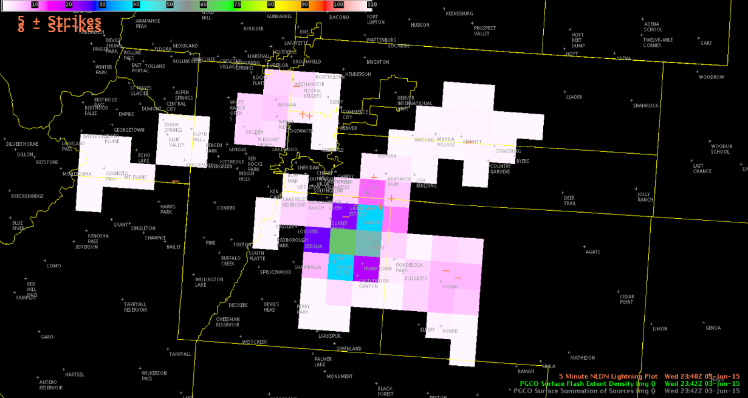
Continuation of GOES-R GLM work
Use GOES-R funding to maintain engagement with forecasters as GOES-R becomes operational in 2017.
Continue to develop training for GLM and utilizing lightning data in the forecast process
Quick guides
STAT training modules
Journal publications
Comparison of PGLM and NLDN in AWIPS2 at HWT highlighting lightning safety applications

Slide 5
Collaboration with National Hurricane Center
Initial effort in discussion between SPoRT and CIRA via satellite liaisons (for GLM and NHC, respectively)
Identify training and applications of GLM over existing ground-based networks
Tropical meteorology limited to primarily cloud-to-ground observations from long-range networks
Project will train on differences and investigate changes to the cyclone Rapid Intensification Index when GLM observations are used.
Example of WWLLN lightning (dots) overlaid on IR observations for Hurricane Earl at 0300 UTC, 29 August 2010. Range rings every 100 km. (Stevenson et al. 2014)

Slide 6
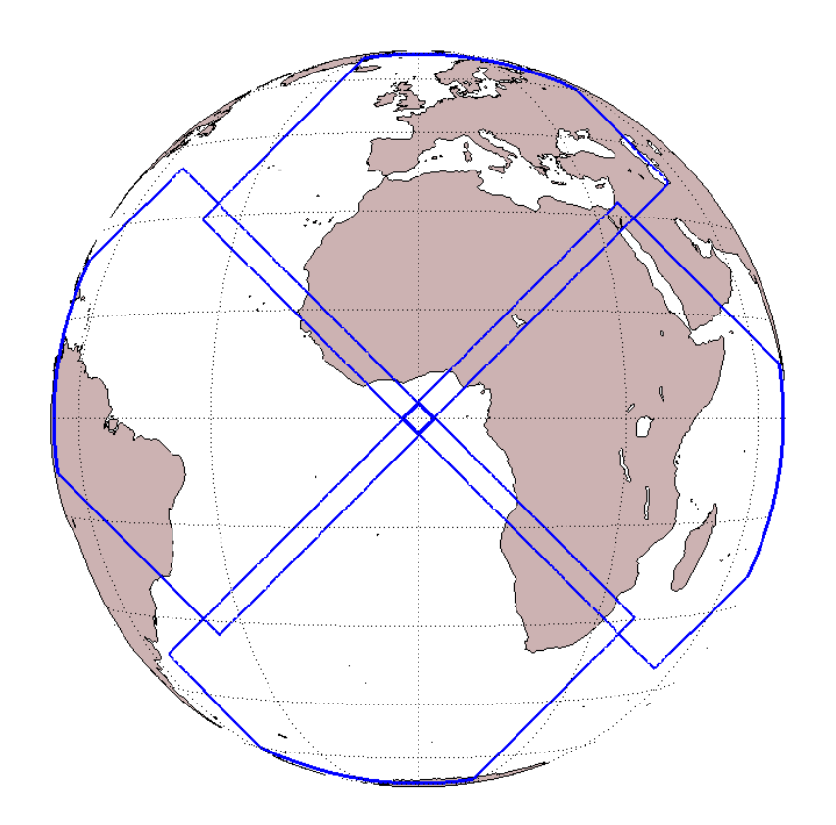
International Applications and Partnerships
In the next 10 years, there should be global coverage of total lightning from space
We can utilize the lightning information for decision support in data sparse areas
Serve as subject matter experts for SEVIR hubs
Extension of current partnerships (e.g., EUMETSAT, University of Toulouse)
Footprints for GLM (above) and MTG-LI (below)

Slide 7
Other future partnerships
Utilize our expertise for FAA applications
Safety criteria for ground crews
Product development for monitoring lightning/turbulence threats along air routes
Engagement with the Day of Launch Working Group
US Forest Service/National Park Service
Photograph of a lightning flash over the Central Pacific from a commercial airline passenger – Image courtesy The Washington Post

Slide 8
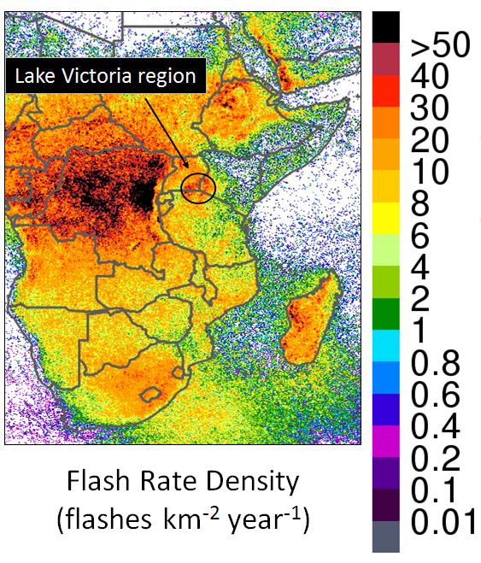
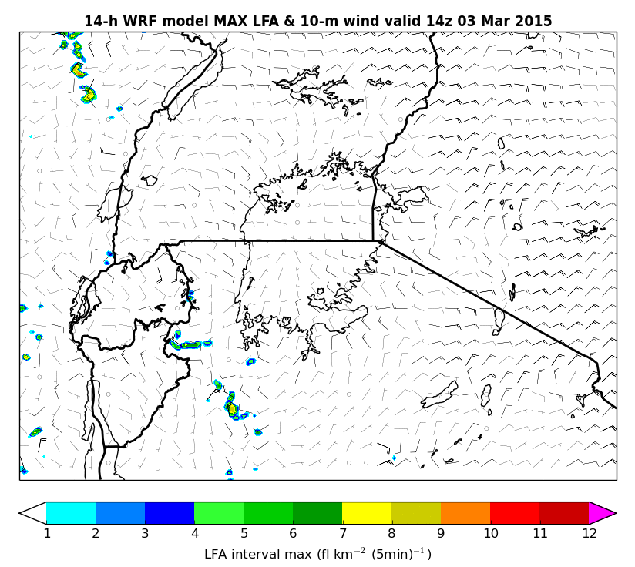
Lightning Safety Proposal with NASA SERVIR
(Left) Flash rate density over eastern and southern Africa from the very high resolution TRMM-LIS climatology from 1998-2013 at 0.1° resolution. (Albrecht et al. 2016)
Proposal for NASA SERVIR’s ROSES applied science call
Coordinate with East Africa hub located in Nairobi, Kenya
Globally: 24,000 killed by lightning with 10 times that injured (conservative estimate)
Kisii, Kenya east of Lake Victoria has 30 deaths per year and Uganda has had 365 from 2012-2014
Integrate NASA Light Forecast Algorithm with WMS from MSFC project over East Africa
Include training and preparation to use EUMETSAT Lightning Imager
Goal to reduce lightning fatalities / injuries in East Africa
(Right) Example of Lightning Forecast Algorithm over Lake Victoria (1400 UTC, 3 March 2015)

Slide 9
New Product Development
Lightning Initiated Wildfire Prediction
Physically Based Lightning Jump Algorithm
Lightning NOx activities for future TEMPO applications
Electrification Modeling

Slide 10
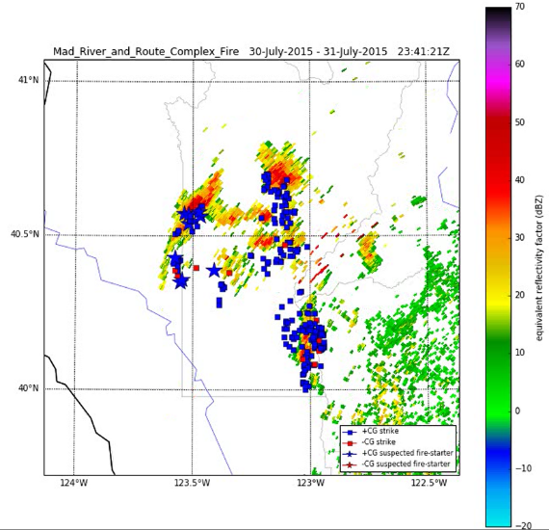
Lightning Initiated Wildfire Potential
Current methods for wildfire detection from lightning have not really changed since the 1990s
http://www.wfas.net/images/firedanger/ltng_pi.png
Combines surface conditions and basic lightning parameters
Empirically driven.
Vision: develop a probabilistic product which utilizes modeling, surface conditions and atmospheric remote sensing (e.g., lightning, radar) to aid forecasters to real-time events.
Extend to sub flash properties (GLM/ISS-LIS events, radiances)
Fire-starting flashes
Example showing the comparison of the Land Information System Model 0-10 cm relative soil moisture and National Lightning Detection Network Data.
Notes:
http://www.wfas.net/index.php/lightning-efficiency-fire-potential--danger-33

Slide 11
Intern Wildfire Project, James Coy
The first look combines NASA Land Information System information with NLDN data to assess lightning flash properties with 4 model output fields: 0-10 cm soil moisture, 0-10 cm relative soil moisture, total column soil moisture, and green vegetation fraction.
Neg. flashes
Pos. flashes
Neg. flashes
Pos. flashes
GVF (%)
0-10 cm Relative soil moisture (%)

Slide 12
Physically based lightning jump algorithm for hazardous storm identification
Flashes are arbitrary definitions of a storms electrical output
Goal: utilize sub flash properties (events, radiances) to estimate storm intensity from GLM and ISS-LIS
Fuse this information with current techniques for severe storm analysis

Slide 13
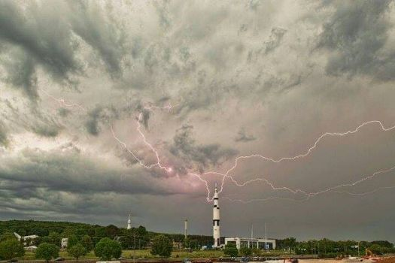
Lightning Initiation/Cessation
Utilize the satellite LI algorithm to develop and implement methods for real-time monitoring of developing thunderstorms
FAA, DOLWG, NASA lightning safety

Slide 14
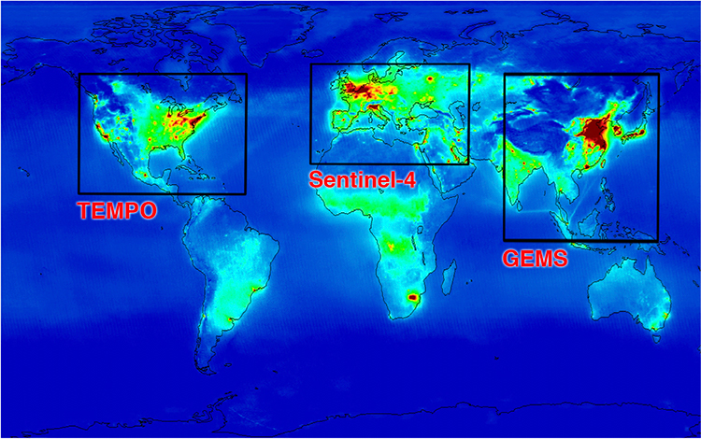
Lightning NOx Production
Future science applications to the TEMPO mission
Flash/radiance NOx Estimation
Regional air quality monitoring
Utilized by EPA and local EMA officials.
Can expand these applications globally.
Estimated increase in ozone due to Lightning Nox, Koshak et al. (2014)
Example output of a combined TEMPO/Sentinel/GMS satellites monitoring air pollution (NASA/SAO)

Slide 15
Electrification Modeling
An emerging field in the modeling community
Currently leveraging efforts through ROSES Calls
A.13 MAP Proposal with Goddard and U. Toulouse (collaborating)
A.23 Weather (September)
Future implementations for short-term lightning prediction.
Simulated radiances from lightning and brightness temperatures for storms over the Congo basin during a 2.5 hour simulation in MesoNH (Courtesy C. Bovalo, U. Toulouse).

Slide 16
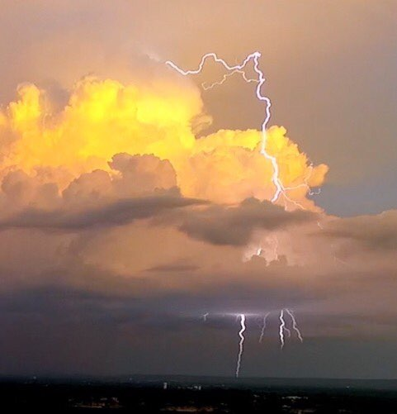
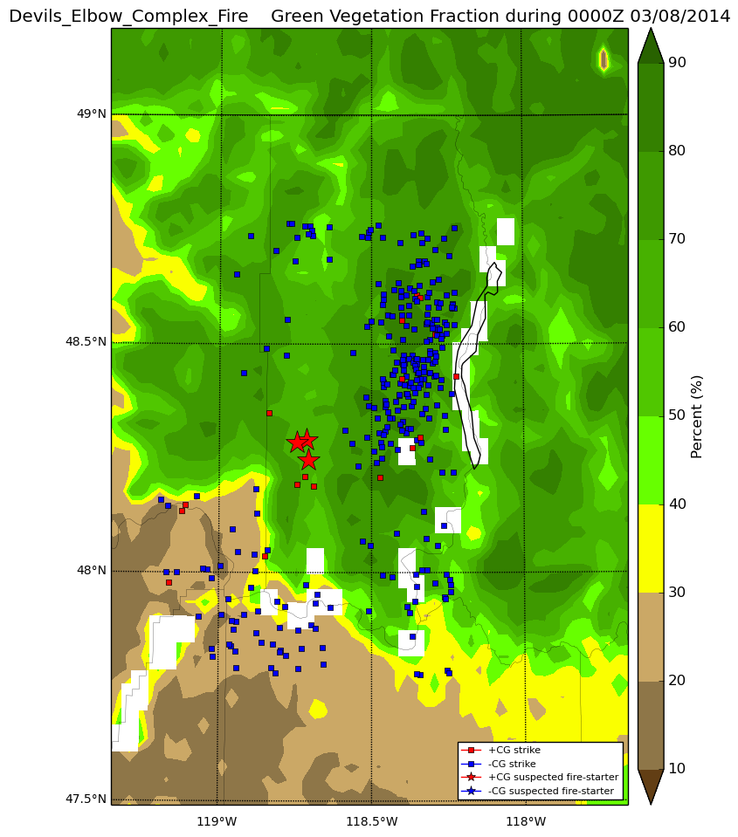
Summary
Continue GOES-R training and assessments.
Engage our international partners.
Develop new relationships with Government partners.
Expand our product development into new areas.
Image courtesy of the Hazardous Weather Testbed
Image courtesy of the Jennifer Smith, Florence, AL

Slide 17
Extra Slides

Slide 18
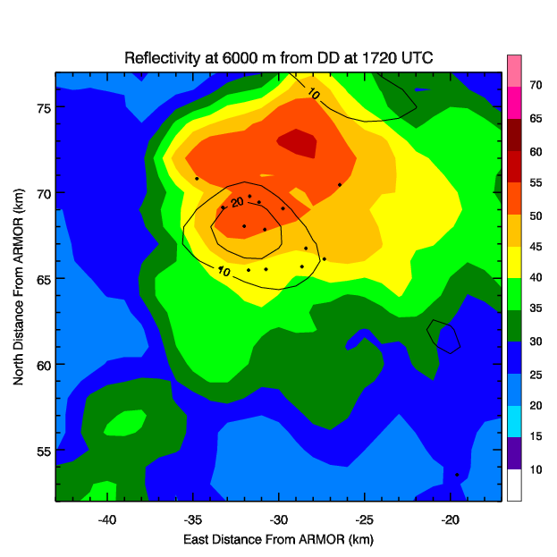
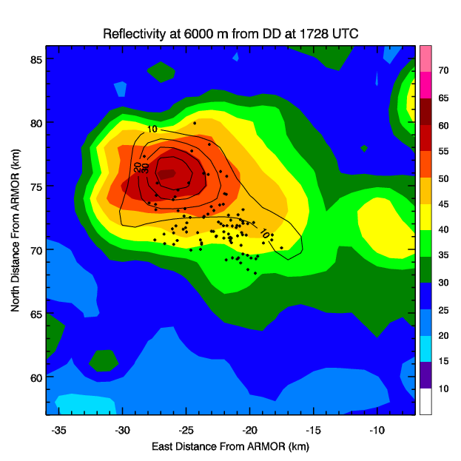
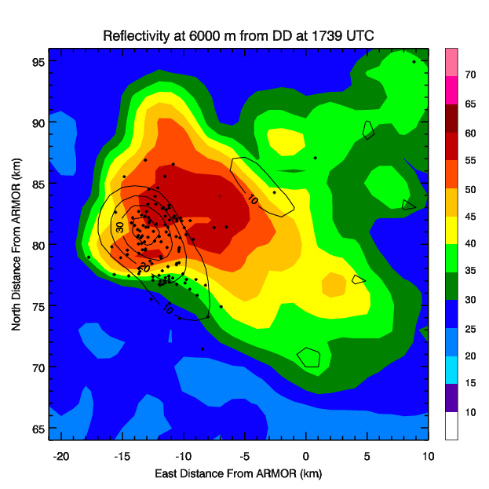
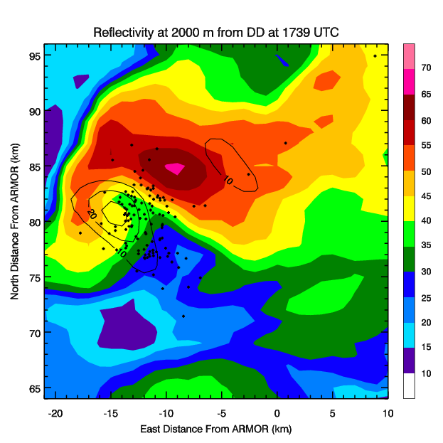
Lightning Jump Conceptual Model
Δt
Jump Time
Δt
A
B
C
LMA flash initiation
W = 10, 20, 30, 40, 50 m s⁻¹
C
A to B – Mixed phase updraft volume, updraft speed and graupel mass increase and a lightning jump occurs
B to C – As flash rates continue to increase, increases in intensity metrics (e.g., MESH, azimuthal shear) are observed resulting in enhanced severe weather potential.
Schultz et al. (2015)

