Slide 1



SPoRT Modeling and Data Assimilation Activities Portfolio:
2014 – 2016
Jonathan Case* (ENSCO, Inc.)
Other SPoRT contributors:
Bradley Zavodsky, Andrew Molthan, Clay Blankenship, Nicholas Elmer, Aaron Naeger, Emily Berndt, Xuanli Li, Jayanthi Srikishen

Slide 2
Outline of Discussion Topics
New SPoRT cluster “sc1”
Land surface modeling applications
Soil moisture data assimilation research
WRF-Hydro/National Water Center
WRF-Chem modeling / cloud microphysics eval
Data assimilation research with GSI
Multi-NASA Center downscaling project
Ensemble modeling / field campaigns
International activities
External collaborations

Slide 3
Outline of Discussion Topics
New SPoRT cluster “sc1”
Land surface modeling applications
Soil moisture data assimilation research
WRF-Hydro/National Water Center
WRF-Chem modeling / cloud microphysics eval
Data assimilation research with GSI
Multi-NASA Center downscaling project
Ensemble modeling / field campaigns
International activities
External collaborations

Slide 4
SPoRT Cluster-1 (sc1) System Components (1)
Stand-alone cluster physically located at NASA/MSFC
  Two login / analysis nodes (256 GB RAM, 20 cores each)
  Twenty-six compute nodes with 28 cores per node
    128 GB RAM each; 728 total compute cores
    Fourteen Data Rate Infiniband high-speed interconnect
  One storage server and one management server
  10 GbE Wide Area Network
    MSFC Building 4663 to NSSTC
  Two raid disk partitions (SAS/JBOD)
    ~210 TB of disk space on /raid1
    ~73 TB of disk space on /raid2
Important complement to “Discover” research cluster
  Near-real-time research and experimental operational support via cron scheduling and direct access to outside servers

Slide 5
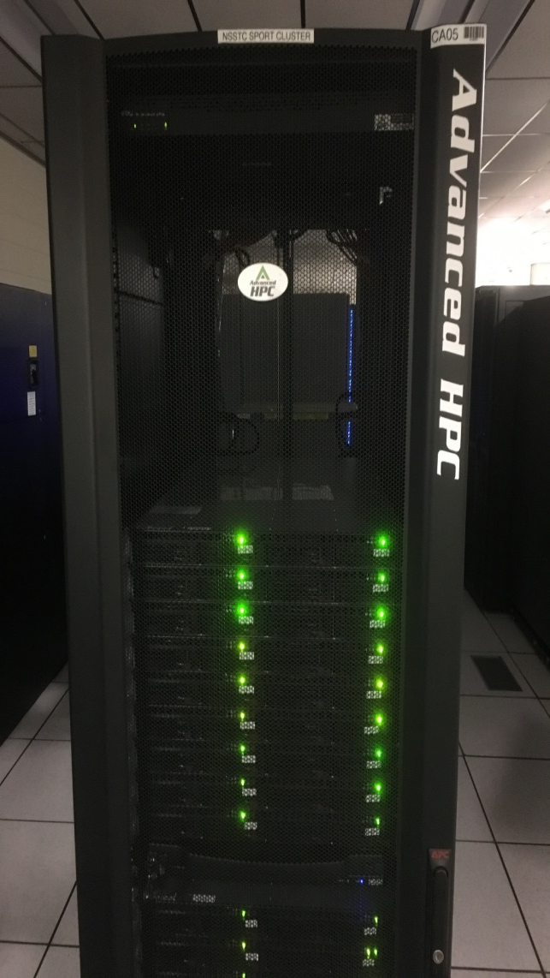
sc1 Notional Architecture (2)
Only Login/Analysis and storage servers have connections to the local area network. Storage server has two connections.
GbE Local Area Network
Login/Analysis Node (1)
Login/Analysis Node (2)
X2
Storage Server
X2
48-port Cu GbE Switch
JBOD
36-port FDR IB Switch
All servers are linked to an internal GbE management network.
All servers connected to the FDR IB switch with storage server having two connections
Mgmt Node
Compute Nodes (1)
Compute Nodes (2)
•
•
•
Compute Nodes (26)

Slide 6
Outline of Discussion Topics
New SPoRT cluster “sc1”
Land surface modeling applications
Soil moisture data assimilation research
WRF-Hydro/National Water Center
WRF-Chem modeling / cloud microphysics eval
Data assimilation research with GSI
Multi-NASA Center downscaling project
Ensemble modeling / field campaigns
International activities
External collaborations

Slide 7
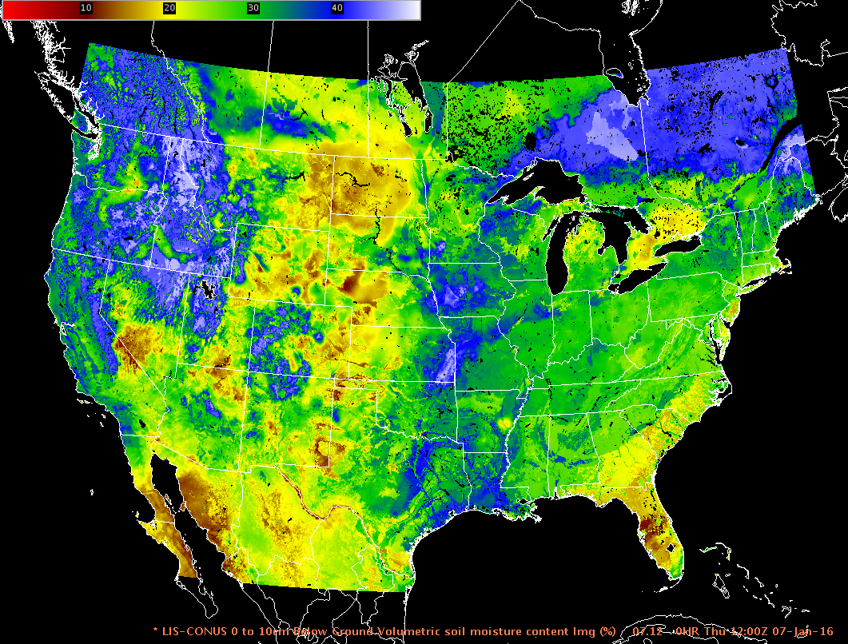
Land Surface Modeling Applications (1):
CONUS upgrade to SPoRT real-time Land Information System (LIS)
Current SPoRT-LIS CONUS domain running Noah LSM, displayed in AWIPS II
Full Continental U.S. (CONUS) domain with 0.03° (lat/lon) grid resolution
Unique characteristics of “SPoRT-LIS”:
  Real-time S-NPP/VIIRS Green Vegetation Fraction
  Albedo scaled to input vegetation
  Restart simulation strategy to produce real-time output (timeline below)
  SPoRT-LIS ingested and displayed in AWIPS II
  at select NOAA/NWS weather forecast offices
  Land surface variables available to initialize modeling applications (WRF and STRC/EMS/UEMS)
NLDAS-2 forcing
GDAS + MRMS forcing
GFS forcing
Jan 1979
t − 4 days
t = current

Slide 8
Land Surface Modeling Applications (2):
SPoRT-LIS Assessments at NWS WFOs (examples in backups)
SPoRT-LIS for improving situational awareness
  2014 assessment: NWS Huntsville, Houston, Raleigh
    Forecasters had high confidence in applying soil moisture to drought monitoring and (to a lesser extent) areal flooding potential
    Recommended expansion to full CONUS, and place in historical context
  2015 evaluation: NWS Tucson, Albuquerque, and Huntsville
    Forecasters at NWS TWC and ABQ applied LIS soil moisture to blowing dust and wildfire cases
  Disseminated select soil moisture grids and change fields
  Forecaster surveys and blog posts to highlight product utility
  Forecasters found value in:
    Assessing drought and USDM drought categories
    Monitoring soil moisture to help evaluate flooding concerns
    Examining soil moisture around wildfires
    Evaluating risk for blowing dust from convective outflows

Slide 9
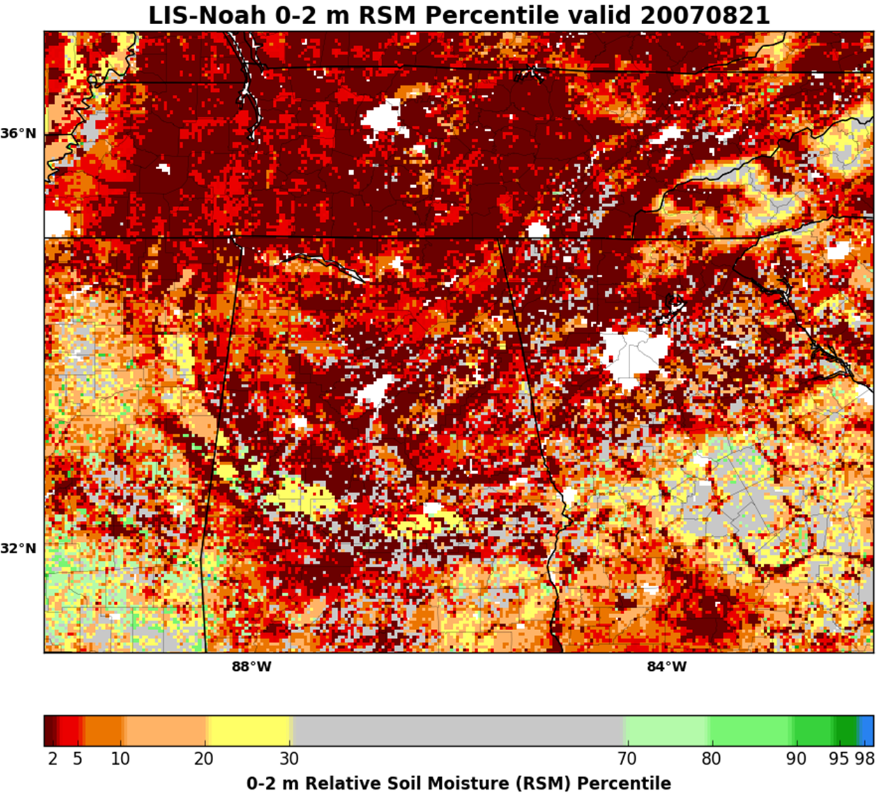
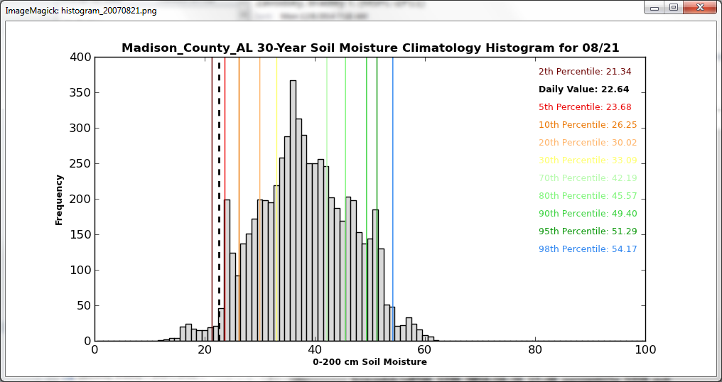
Land Surface Modeling Applications (3):
Daily soil moisture county climatology & percentile product
370
TN
MS
AL
GA
36%
  D4 ≤ 2% D3 ≤ 5% D2 ≤ 10% D1 ≤ 20% D0 ≤ 30%
Uncalibrated total column relative soil moisture (RSM; 0-2 m)
Generate daily county histograms of 0-2 m RSM
County-based climatologies used to compute percentiles at all grid points each day
Proxy percentiles of U.S. Drought Monitor categories (D0 through D4)
  Follows the NLDAS-2 drought index convention used in Xia et al. (2014; J. Hydrometeor.)
  Standard “proxy” percentiles (and mirror analogs) shown below histogram

Slide 10
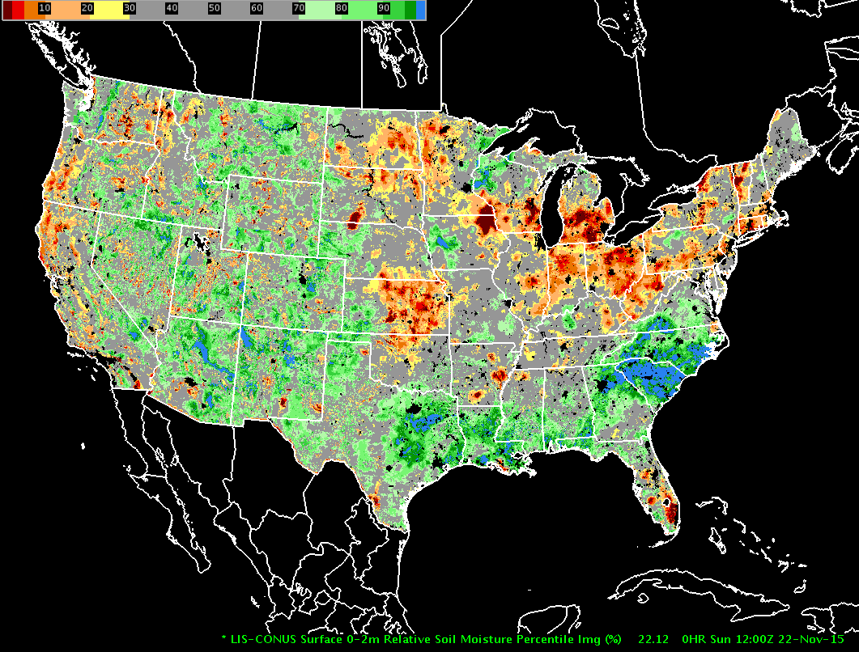
Land Surface Modeling Applications (4):
Soil moisture percentile application
  SPoRT-LIS Percentile Product in NWS AWIPS-II decision support system for 22 November 2015
Near real-time soil moisture percentiles provide proper climatological context and allow for more thorough, accurate operational analysis
Drought diagnosis especially important during times of
“flash drought”
  NWS contributes to the USDM and has made sub-county scale modifications based on
  LIS output
Flood threat analysis
  Flood guidance provided by RFCs
  NWS forecast offices issues flood watches and warnings
  Soil moisture over SC still exceeds 98th percentile over a month after major flooding in early OCT
Notes:
(Here is where we should provide Kris White with percentile GRIB2 files so he can drop them into AWIPS II and generate screen captures for us. We should assemble a brief list of impactful cases that we can show in 2-3 slides. My first suggested case is to show the example of the SC drought to flooding and the corresponding percentile change. Kris – please add other cases you’d like to see – they can be historical and/or recent, although I prefer more recent events with AWIPS II screen captures zoomed into the region of interest. Thanks!)

Slide 11
Outline of Discussion Topics
New SPoRT cluster “sc1”
Land surface modeling applications
Soil moisture data assimilation research
WRF-Hydro/National Water Center
WRF-Chem modeling / cloud microphysics eval
Data assimilation research with GSI
Multi-NASA Center downscaling project
Ensemble modeling / field campaigns
International activities
External collaborations

Slide 12
Soil Moisture Data Assimilation: Summary (1)
Tested and implemented data assimilation of SMOS soil moisture retrievals
  Developed custom bias correction aggregating points by soil type to develop Cumulative Distribution Functions for CDF Matching—does not require multi-year data record.
  Improved correlations and improved dynamic range, relative to station measurements
  Publication: Blankenship et al. 2016, IEEE TGRS, in press
Tested and implemented data assimilation of SMAP soil moisture retrievals
  Beginning near real time SMAP assimilation with soil-type-based bias correction for CONUS domain
  Received ROSES funding to investigate impact SMAP DA on short-term weather forecasts
Notes:
Notes on this bias correction methodology:
Details of bias correction method amount to second-order corrections which are small relative to size of observation errors, errors relative to validation datasets, etc.
Pointwise corrections can never correct for geographic model biases or processes such as irrigation or bad forcing data
Patterned after NWP bias correction which is generally location-agnostic
Jackson et al. (2012) suggested using a single first-order correction globally
Allows implementation of DA without multi-year time series.

Slide 13
SMOS Data Assimilation Validation (2)
1.Prairie SP, MO
3
1
2
2. Stillwater, OK
0-10 cm model soil moisture
Compared open loop run to SMOS DA run
Results validated against soil moisture networks in U.S.
North America Soil Moisture Database
Better correlations
Improved dynamic range
3. Pittsfield, IL
Notes:
Figure 4. Time series of in 5 cm in situ soil moisture (black) and collocated model 0-10 cm soil moisture (open loop in blue, SMOS DA in red) from 1 Mar 2011 to 30 Sep 2011. a) Prairie State Park, Missouri; b) Stillwater, Oklahoma; c) Pittsfield, Illinois.

Slide 14
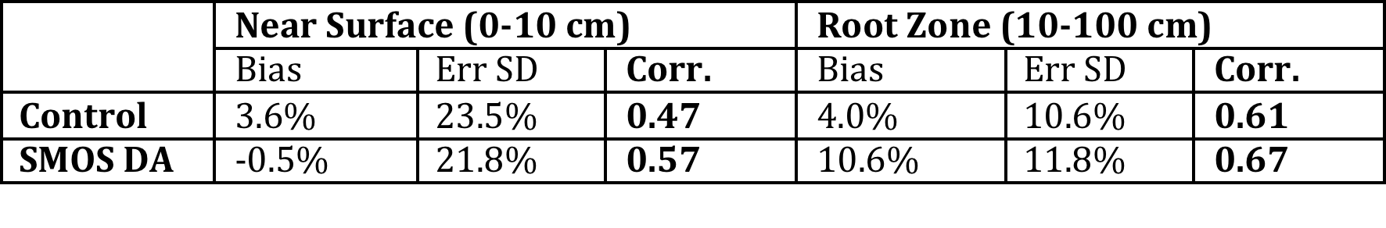
SMOS Data Assimilation Validation (3)
Notes:
Figure 5. Changes in validation statistics (SMOS data assimilation run minus control run) at field stations for 1 Mar 2011 to 30 Sep 2011. a) 0-10 cm correlation; b) root zone correlation; c) 0-10 cm error standard deviation (cm³/cm³); d) root zone error standard deviation (cm³/cm³). In each case, red indicates improvement and blue indicates degradation when compared to the station measurements.

Slide 15
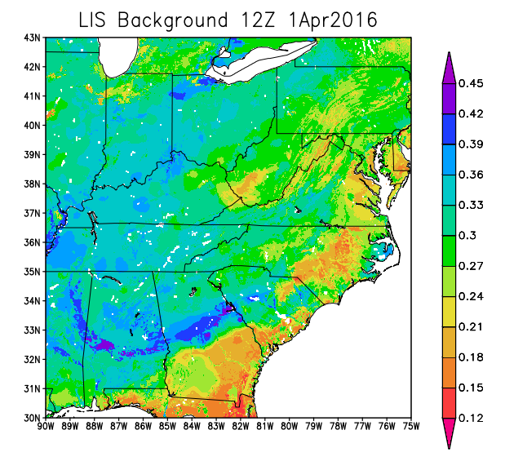
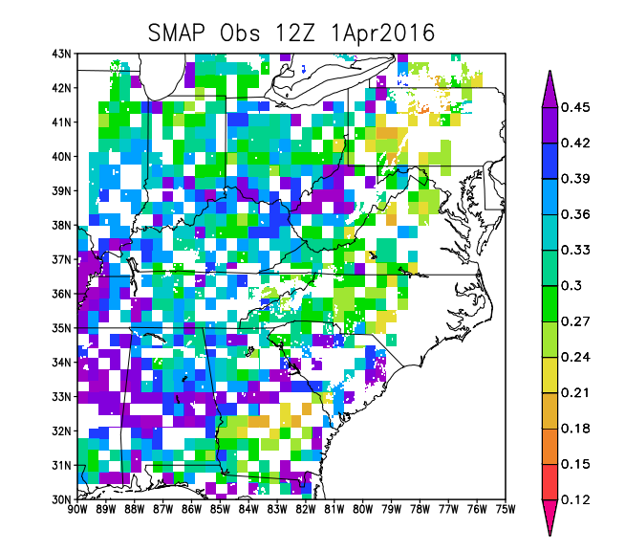
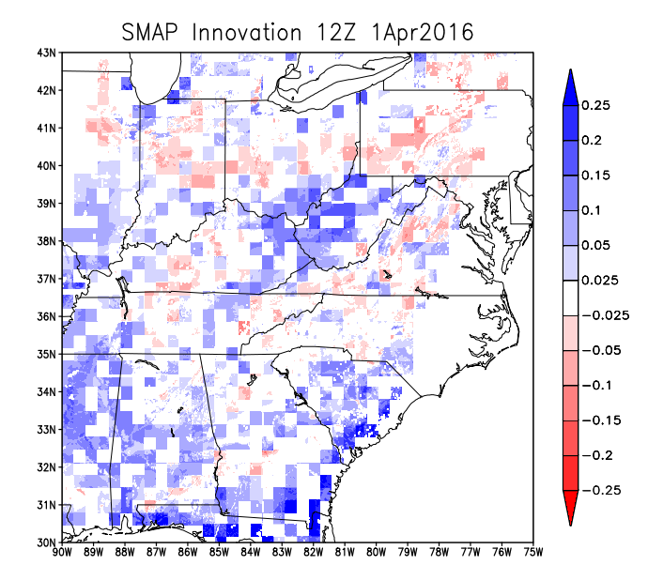
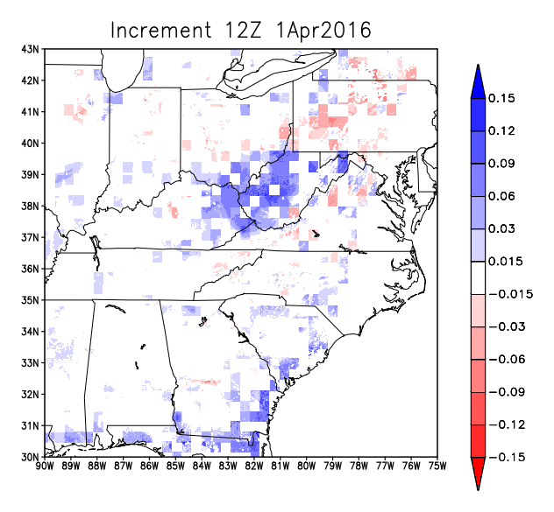
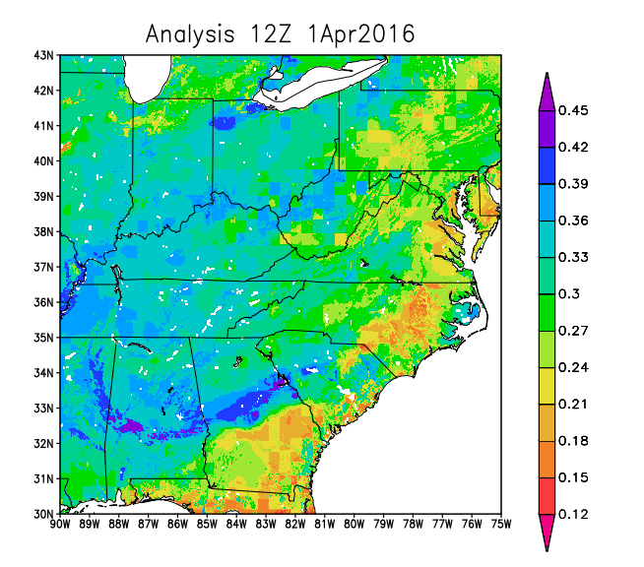
SMAP Data Assimilation in LIS (4)
1.
2.
3.
4.
5.
LIS Background Soil Moisture (0-10 cm)
SMAP Observed SM
(after QC and bias correction)
Innovation (obs minus BG)
Model Increment
Model Analysis
(blending background & obs)
Notes:
Ongoing Work:
*Near-real-time SMAP data assimilation planned this month (July 2016)
*Implementing soil-type-based bias correction as described in Blankenship et al. 2016 (IEEE TGRS in press)
*Plan to investigate use of upcoming higher-resolution soil moisture products from SMAP science team

Slide 16
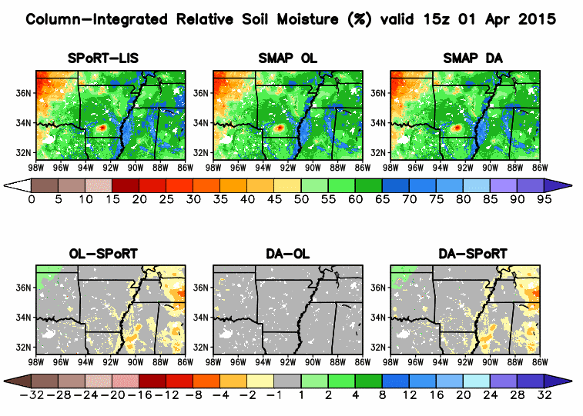
SMAP Data Assimilation Preliminary Result (5):
Positive impact on soil moisture artifacts due to poor forcing
Problem with gauge QC at NCEP/CPC resulted in dry precip “bulls-eyes” in NLDAS-2 forcing input to SPoRT-LIS during 2015
Notable dry bulls-eye in southern AR (left)
Three months of daily assimilation of SMAP retrievals removes artifact
Likely due to soil-texture-based bias correction methodology
Notes:
Ongoing Work:
*Near-real-time SMAP data assimilation planned this month (July 2016)
*Implementing soil-type-based bias correction as described in Blankenship et al. 2016 (IEEE TGRS in press)
*Plan to investigate use of upcoming higher-resolution soil moisture products from SMAP science team

Slide 17
Outline of Discussion Topics
New SPoRT cluster “sc1”
Land surface modeling applications
Soil moisture data assimilation research
WRF-Hydro/National Water Center (NWC)
WRF-Chem modeling / cloud microphysics eval
Data assimilation research with GSI
Multi-NASA Center downscaling project
Ensemble modeling / field campaigns
International activities
External collaborations

Slide 18
Evaluating NASA Data in National Water Model (1)
SPoRT plans to integrate NASA mission datasets into WRF-Hydro and NOAA’s National Water Model (NWM)
  Build upon SPoRT-LIS capabilities and GSFC/NCAR joint project to couple LIS and WRF-Hydro systems
  Utilize LIS EnKF to improve land surface initial conditions
    Soil moisture (SMAP/SMOS)
    Snow cover (MODIS/VIIRS) and snow water equivalent (AMSR2)
    Total terrestrial/ground water (GRACE/GRACE-Follow On)
    Other future NASA missions (ICESat-2, NISAR, Landsat-9)
  Assimilation of hydro-focused NASA missions (e.g., SWOT) directly into channel routing component of WRF-Hydro model
Nicholas Elmer, PhD candidate funded by SPoRT
  Initializing WRF-Hydro/NWM with SPoRT-LIS fields
  Fostering collaborations with National Water Center-Tuscaloosa

Slide 19
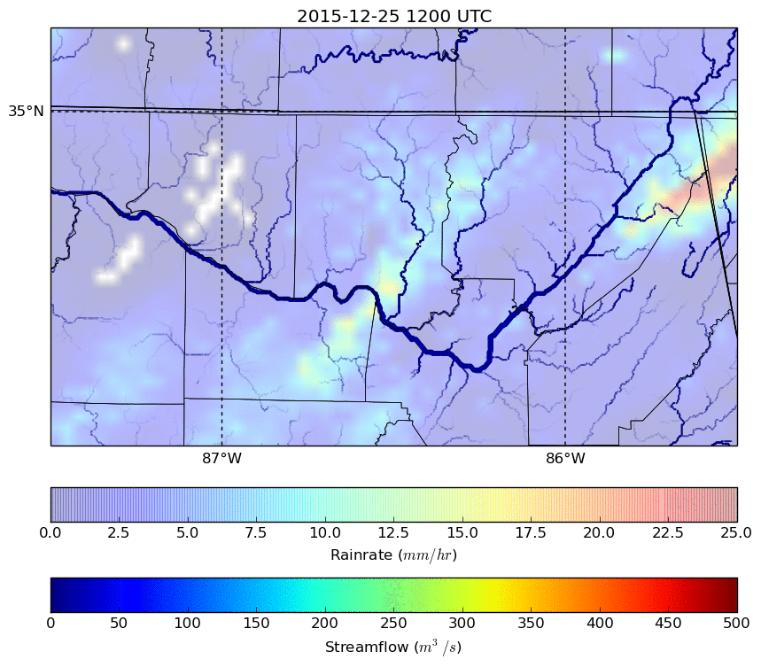
Evaluating NASA Data in National Water Model (2)
Collaborations with the NWC have enabled local SPoRT configuration of NWM
Example at right shows WRF-Hydro simulation of north Alabama Christmas Day flooding event
Initialized with LIS soil moisture, soil temperature, surface skin temperature, and VIIRS green vegetation fraction
MRMS 1-h gauge corrected accumulated precipitation (background field; mm h⁻¹)
Madison County
Indian Creek
Tennessee River
Flint River
“Cold start” of the hydrological model (i.e., streambeds initially dry). Work ongoing to apply NWM cycling strategy
Notes:
This slide presents some details on plans by the Short-term Prediction Research and Transition (SPoRT) Center at NASA/Marshall Space Flight Center to determine ways in which NASA datasets can be integrated into WRF-Hydro and the National Water Model (NWM). In partnership with Christa Peters-Lidard of NASA/Goddard Space Flight Center (GSFC), SPoRT has developed a real-time, daily, 3-km resolution CONUS run of the NASA Land Information System (LIS; hereafter “SPoRT-LIS)). NASA’s Modeling, Analysis, and Prediction (MAP) program has funded a collaborative project between Joe Santanello (NASA/GSFC) and Dave Gochis (NCAR)—the author of WRF-Hydro—to couple LIS and WRF-Hydro in the Earth Science Modeling Framework (ESMF), which will enable operational linking of these two systems. LIS is attractive in this sense because it contains a built in Ensemble Kalman Filter (EnKF) that enables assimilation of satellite-based observations. These observations include soil moisture from ESA’s Soil Moisture Ocean Salinity (SMOS) and NASA’s Soil Moisture Active Passive (SMAP), snow cover from infrared sensors (e.g., Moderate Resolution Spectroradiometer (MODIS) and Visible Infrared Imaging Radiometer Suite (VIIRS)), and snow water equivalent from passive microwave sensors (e.g., Advanced Microwave Scanning Radiometer 2 (AMSR2)) to improve the initial soil moisture and land surface model conditions in both atmospheric and hydrologic models. Currently, the NWM does not have a system or strategy for assimilating land surface satellite observations related to soil moisture; the LIS system is a strong candidate given both the long history of the LIS and its linkage through the ESMF.
Nicholas Elmer, a PhD candidate at the University of Alabama at Huntsville (UAH), is funded by SPoRT to perform some preliminary demonstrations to show impacts of initializing the NWM with LIS fields. Because of the real-time, high spatial resolution of our SPoRT-LIS, we are working with that dataset in an attempt to satisfy 1) the operational needs for real-time data and 2) the aims of the NWM to resolve “street-level” hydrological features. For the example of a significant flooding event in North Alabama on Christmas Day 2015 shown on this slide, a version of WRF-Hydro was configured using the NWM namelist obtained through collaborative visits between SPoRT and the NWM implementers at the National Water Center (NWC) in Tuscaloosa, Alabama. This WRF-Hydro run is performed using the NoahMP Land Surface Model initialized with LIS soil moisture, soil temperature, surface skin temperature, and vegetation fraction. Precipitation comes from the Multi Sensor Multi Radar (MRMS) operational NCEP product; 1-hr gauge corrected accumulated precipitation (mm/hr) are shown as the transparent background field in the animation. All other NoahMP fields were initialized from WRF pre-processing system (WPS) geogrid file. As stated above, the NoahMP parameterization options used for this case match those currently used by NWM in order to provide consistency and ease of transition for any techniques developed at SPoRT into operations. The color and width of the streams indicate streamflow (m³/s). One caveat to this animation is that this WRF-Hydro simulation uses a “cold start” of the hydrological model with no spin-up of the stream characteristics (i.e., the streambeds are initially dry) since this is a demonstration of the ability to link WRF-Hydro to LIS. Work is ongoing to learn more about the NWC strategy for cycling the model to ensure that the initial streambed conditions are brought in from a previous model run. As a result of this cold start (i.e., dry streambed) initialization, the magnitude of the streamflow shown here does not match the magnitude of the highest streamflow during this event. However, the relative impacts of where precipitation fell and then the increased streamflow/routing of the water is apparent in this simulation. This can be noted as bands of heavy precipitation fall across Madison County and responses from Indian Creek and the Flint River swell with that rain and drain into the Tennessee River.
Additional testing is ongoing to evaluate a control simulation that does not include the LIS soil moisture to determine specific impacts from initializing the model with real-time soil moisture from LIS. Near-future work will determine the streamflow impacts on the assimilation of the SMOS and SMAP observations into SPoRT-LIS and initialization of these fields into WRF-Hydro. Additional future work will focus on an attempt to work with NASA to identify ways to assimilate or integrate its fleet of current and near future instruments related to ground and surface water (e.g., Gravity Recovery and Climate Experiment (GRACE), GRACE Follow On (GRACE-FO), Surface Water Ocean Topography (SWOT)) and land use (e.g., Ice, Cloud,and land Elevation Satellite-2 (ICESat-2), NASA-ISRO Synthetic Aperture Radar (SAR) Mission (NISAR), and LandSat-8/9). NASA/SPoRT plans to perform offline simulations that mimic the NWM to determine optimal assimilation strategies and evaluate data impacts to support NWC operations in collaborations with the model implementers at the NWC, model developers at NCAR, and collaborators at GSFC.

Slide 20
Outline of Discussion Topics
New SPoRT cluster “sc1”
Land surface modeling applications
Soil moisture data assimilation research
WRF-Hydro/National Water Center
WRF-Chem modeling / cloud microphysics eval
Data assimilation research with GSI
Multi-NASA Center downscaling project
Ensemble modeling / field campaigns
International activities
External collaborations

Slide 21
WRF-Chem Modeling (1)
CalWater field campaign gathered ideal measurements for studying aerosol-cloud-precipitation interactions
  Intensive CalWater campaigns over N.CA in late winter 2011 and 2015
  Measurements showed that long-range transported (LRT) and local aerosols act as cloud condensation nuclei and ice nuclei within atmospheric rivers (ARs)
Goal: To quantify the impact of individual aerosol species in modifying the cloud microphysical properties and surface precipitation fields of AR events
  Focus on several case studies during CalWater campaigns where LRT and/or local aerosols interacted with ARs
  Used NASA Unified-WRF with chemistry which is capable of predicting the interactions of aerosol species with clouds and precipitation
Notes:
2015: drought year
Aerosols tend to decrease precip efficiency for warm-rain processes through increased CCN; however, CalWater results suggested the increased ice nuclei at higher elev. may *increase* snowfall.

Slide 22
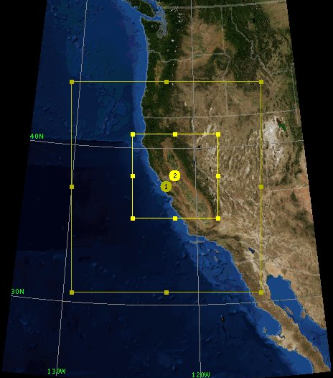
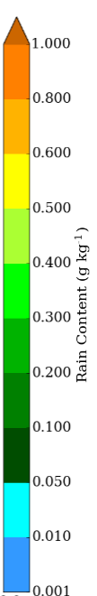
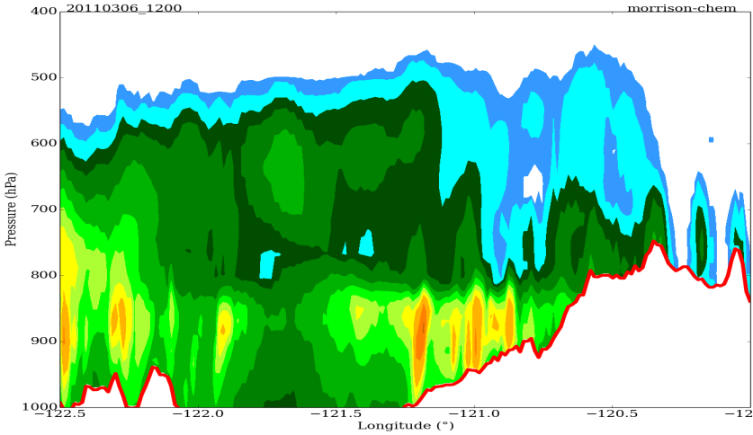
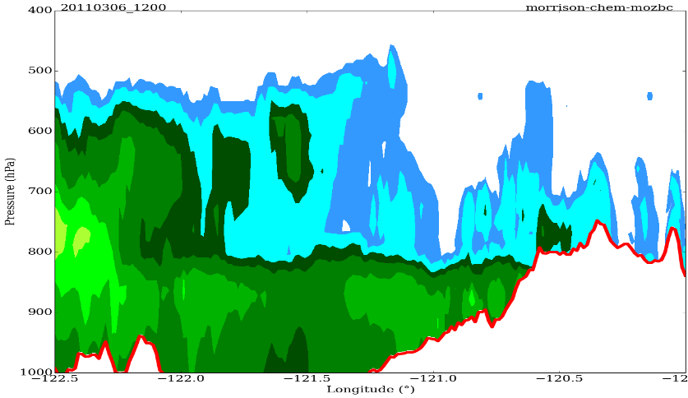
WRF-Chem Modeling (2)
All model runs use model configuration and setup (aerosol chemistry – 8-bin MOSAIC, cloud microphysics – Morrison)
  Only aerosol conditions vary between runs.
Model runs…so far…
  (1) NU-WRF background aerosol (CNTL)
  (2) MOZART aerosol (MOZART)
4 km
1.3 km
CalWater
CNTL
MOZART
Sierra Nevada
Sierra Nevada
W
E
Cross sections across Sierra Nevada: 36 hours into simulation at 1200 UTC 6 March 2011
Notes:
Less rain content and therefore rainfall in MOZART as larger aerosol concentration leads to enhanced CCN and cloud droplet number which delays droplet growth and rainfall.

Slide 23
Outline of Discussion Topics
New SPoRT cluster “sc1”
Land surface modeling applications
Soil moisture data assimilation research
WRF-Hydro/National Water Center
WRF-Chem modeling / cloud microphysics eval
Data assimilation research with GSI
Multi-NASA Center downscaling project
Ensemble modeling / field campaigns
International activities
External collaborations

Slide 24
Data Assimilation Research with GSI (1)
Assimilation of NUCAPS Profiles
Satellite profiles are traditionally assimilated as rawinsonde observations and assigned rawinsonde errors which are unrepresentative for satellite profiles
Experiments to compare model runs:
  No profile assimilation + conventional observations
  Profile assimilation with rawinsonde errors + conventional observations
  Profile assimilation with NUCAPS errors from Nalli et al. (2013) + conventional observations
Analysis increments show how much and where the background fields have been modified by assimilating observations
Profiles warm (cool) temperature analysis by more than 2K (-2K)
Clouds
GSI rejected
850 hPa temperature analysis cooler behind the cold front and warmer in the warm sector
850 hPa moisture analysis drier over potions of the domain

Slide 25
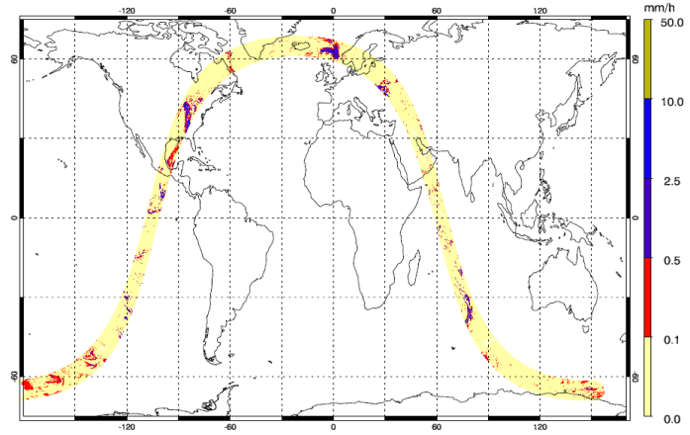
Data Assimilation Research with GSI (2)
NDOA/ROSES Project: GPM Rain Rate Assimilation
Research Team
Xuanli Li (UAHuntsville): modeling and data assimilation
John Mecikalski (UAHuntsville): modeling and data assimilation
Walt Petersen (NASA GSFC): GPM data process and validation
NASA SPoRT: data assimilation evaluation and transition
Research goals
Generate a package in community GSI system to assimilate GPM rainfall products
Evaluate the impact of GPM rainrate data on short-term prediction of convection
Transition the technique into operational forecasts to assimilate GPM rainfall observations
Motivation
GPM is Built upon TRMM legacy for next-generation global observation of rain and snow.
Extended coverage ~70°S to 70°N.
Better retrieval for light rain and snowfall.
Significance of research
Improving understanding of GPM retrieval products
Exploring methods to assimilate GPM products in NWP model
Research plan
Community GSI v3.3; upgrading to v3.4 WRF-ARW
Data assimilation and high-resolution modeling experiments:
Control run – benchmark experiment
Single data tests – test and evaluate the developed package in GSI for GPM rainrate assimilation
Real data for case studies – examine the impact of GPM data on 0-24 h WRF forecast
1-month cycled assimilation run – continuous assimilation of GPM data for 1-month in convective season
Sensitivities: test model and obs error settings
GPROF-GMI Hourly Rainrate

Slide 26
Outline of Discussion Topics
New SPoRT cluster “sc1”
Land surface modeling applications
Soil moisture data assimilation research
WRF-Hydro/National Water Center
WRF-Chem modeling / cloud microphysics eval
Data assimilation research with GSI
Multi-NASA Center downscaling project
Ensemble modeling / field campaigns
International activities
External collaborations

Slide 27
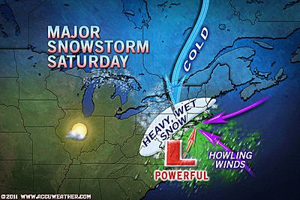
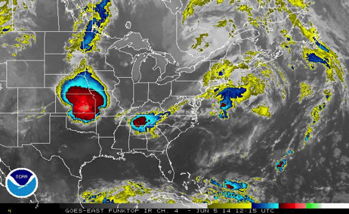
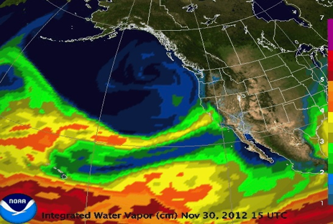
Multi-NASA Center Downscaling Project
Narrow Scope – Focus only on three
Impactful Phenomena
Northeast Wintertime Storms (NESs)
Extreme precipitation/snowfall events
Extreme wind events
Resolution
May Matter
for the Proper Representation of the Impacts
of These
Phenomena
Midcontinent Summertime MCSs
Warm / Dry Climate Model Biases
Extreme weather events
West Coast Wintertime Atmospheric Rivers (ARs)
Crucial for water resources/availability
Associated with most flooding events

Slide 28
Outline of Discussion Topics
New SPoRT cluster “sc1”
Land surface modeling applications
Soil moisture data assimilation research
WRF-Hydro/National Water Center
WRF-Chem modeling / cloud microphysics eval
Data assimilation research with GSI
Multi-NASA Center downscaling project
Ensemble modeling / field campaigns
International activities
External collaborations

Slide 29
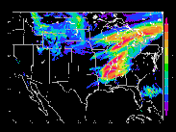
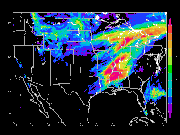
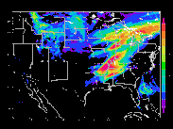
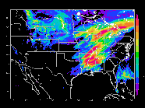
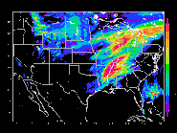
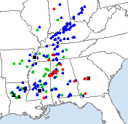
NASA Severe Thunderstorm Observations and Regional Modeling (NSTORM)
CNTL
SPoRT-LIS
LIS w/ GVF
Investigation into the use of NU-WRF and LIS for studying severe weather in the SEUS in parallel to NOAA’s VORTEX-SE fields campaign
Scientific objective to understand role of land surface perturbations on convection and severe weather using ensemble-like approach
31 Mar 2016 benchmark simulations completed
  CONUS domain; 4-km grid spacing; 56 vertical levels
  Tested each member on 252 processors
  Mean 2.4 h wall clock per member for 18-h fcst → scales to ~50 min per member using all 26 sc1 nodes
Eval forthcoming for the well-observed 31 March 2016 Priceville, AL tornado during VORTEX-SE
Future work to include potential NRT support of event investigations for next season’s VORTEX-SE
GEFS m1
GEFS m2
GEFS m3
GEFS m4
GEFS m5
GEFS m6
*All members use Goddard microphysics, radiation physics, MYJ PBL, and Noah LSM
(right) NCEP/SPC Storm
Reports: 31 Mar 2016
Notes:
The first of 3 simulation sets will use 6 out of the 20 randomly perturbed NCEP Global Ensemble Forecast System (GEFS) members with GEFS surface fields
The second set of simulations will use the same 6 GEFS perturbed members with 3-km Land Information System Land Surface Model (LIS LSM) output for the surface fields.
The third set of simulations will use the same 6 GEFS perturbed members with 3-km LIS LSM data and 4-km Visible Infrared Imaging Radiometer Suite (VIIRS) green vegetation fraction (GVF) data to represent the land surface.

Slide 30
Outline of Discussion Topics
New SPoRT cluster “sc1”
Land surface modeling applications
Soil moisture data assimilation research
WRF-Hydro/National Water Center
WRF-Chem modeling / cloud microphysics eval
Data assimilation research with GSI
Multi-NASA Center downscaling project
Ensemble modeling / field campaigns
International activities
External collaborations

Slide 31
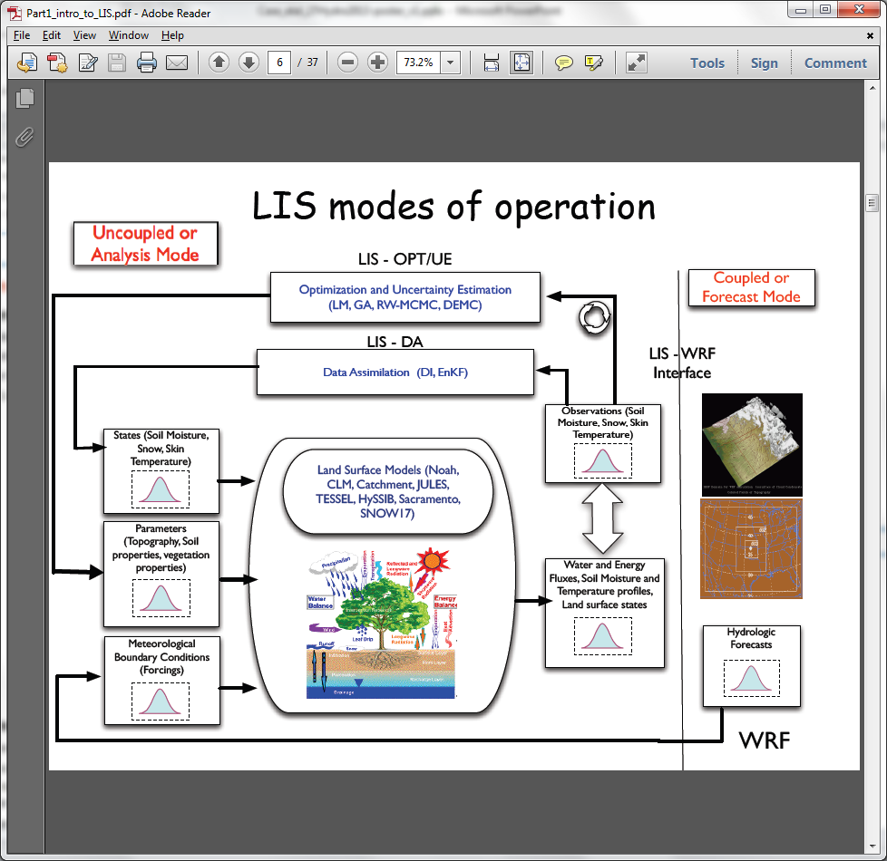
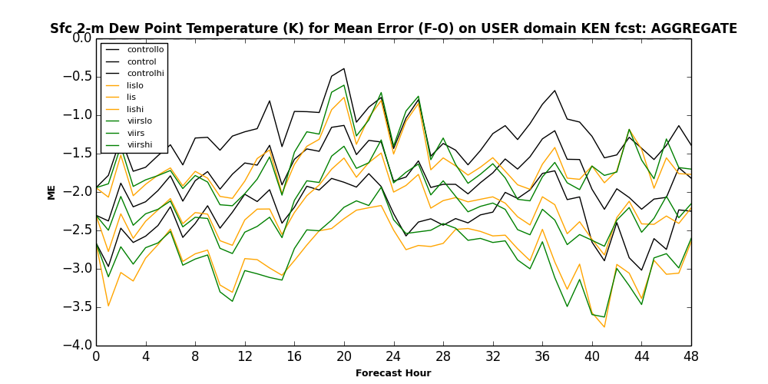
Int’l Applications: LIS, WRF, and NWP Verification over Eastern Africa and beyond
Partnering with NASA/SERVIR
Running LIS in real-time over eastern Africa with GPM/IMERG precip and VIIRS GVF to provide better soil initialization for NWP models
Training to SERVIR end-users,
including upcoming workshop
next month in Nairobi, Kenya
Transitioning SPoRT-MET scripting
package for NWP model verification
Recent proposal win to run NU-WRF
model and develop on-demand
convection-allowing ensemble for intense thunderstorm guidance in south Asia
  Will explore cloud computing solutions

Slide 32
Outline of Discussion Topics
New SPoRT cluster “sc1”
Land surface modeling applications
Soil moisture data assimilation research
WRF-Hydro/National Water Center
WRF-Chem modeling / cloud microphysics eval
Data assimilation research with GSI
Multi-NASA Center downscaling project
Ensemble modeling / field campaigns
International activities
External collaborations

Slide 33
External Collaborations
NOAA/ESRL: VIIRS GVF in Rapid Refresh (RAP)
  NESDIS/VIIRS global GVF transferred to ESRL via NASA SPoRT ftp site
  VIIRS GVF data format is converted for ingest into WRF
  Initial testing in cold-start RAP initialized from the GFS model
  Future plans: implement in the cycled RAP and HRRR
The Weather Company
  Evaluating SPoRT’s 2-km SST and VIIRS GVF on 50 regression cases
  Recently implemented SST into CONUS operations based on improvements in 2-m T, esp. in Western U.S. and Gulf Coast regions
  Still evaluating real-time GVF; presented positive improvements at WRF Users’ workshop on an Upper Midwest summer case
Baron Advanced Meteorological Services:
  Ingesting real-time GVF from SPoRT to support their high-res LIS runs

Slide 34
Open Discussion
Modeling and Data Assimilation Activities Portfolio
Science Advisory Committee Meeting
26 – 28 July 2016

Slide 35
Backup Slides
Modeling and Data Assimilation Activities Portfolio
Science Advisory Committee Meeting
26 – 28 July 2016

Slide 36
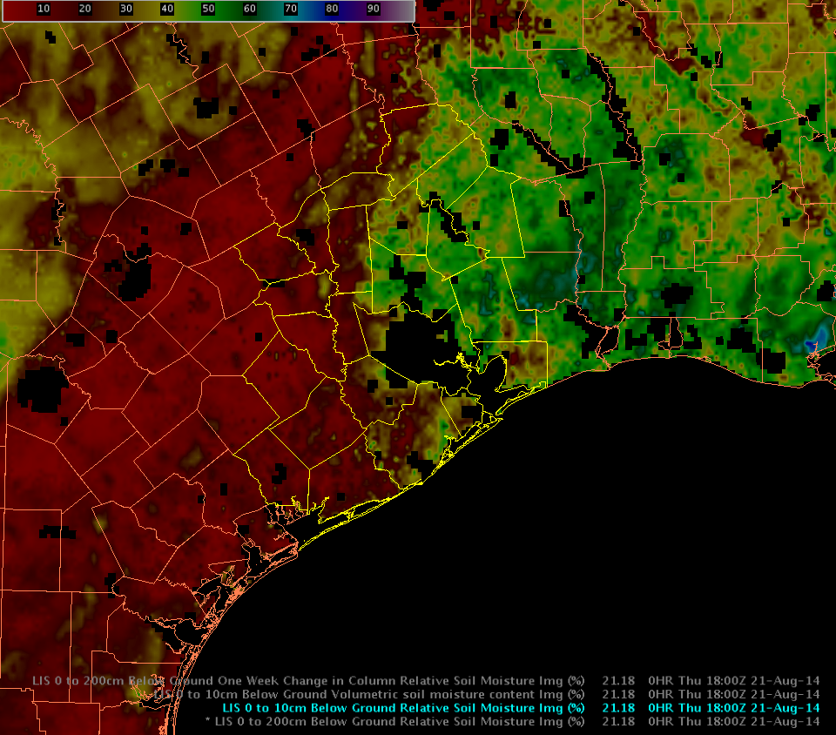
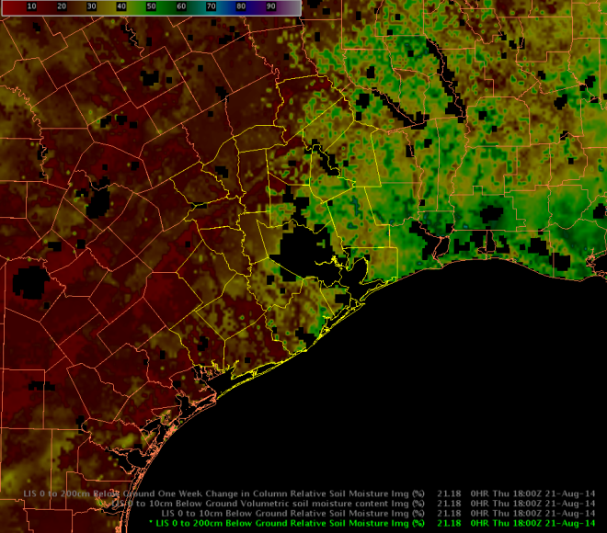
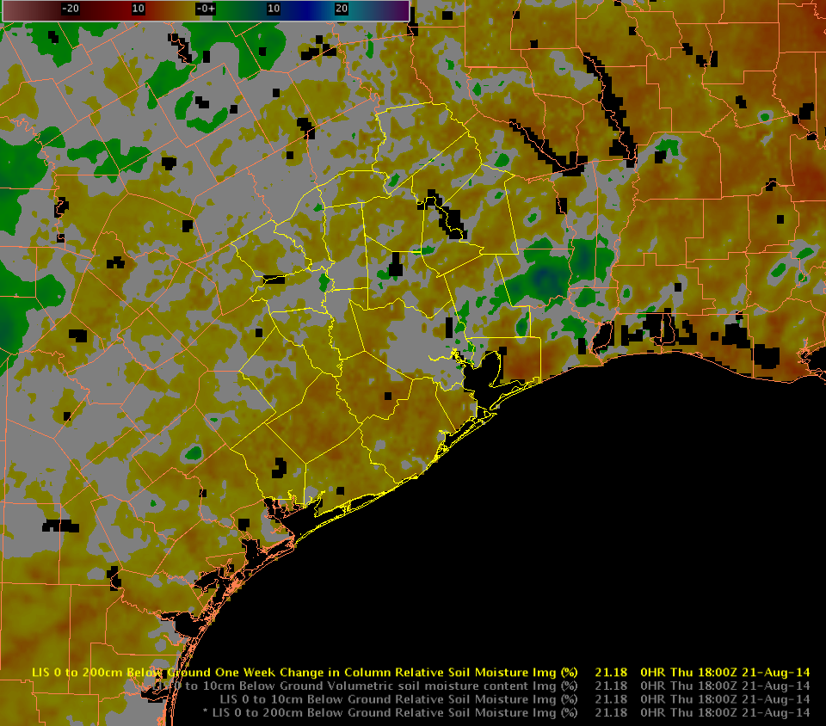
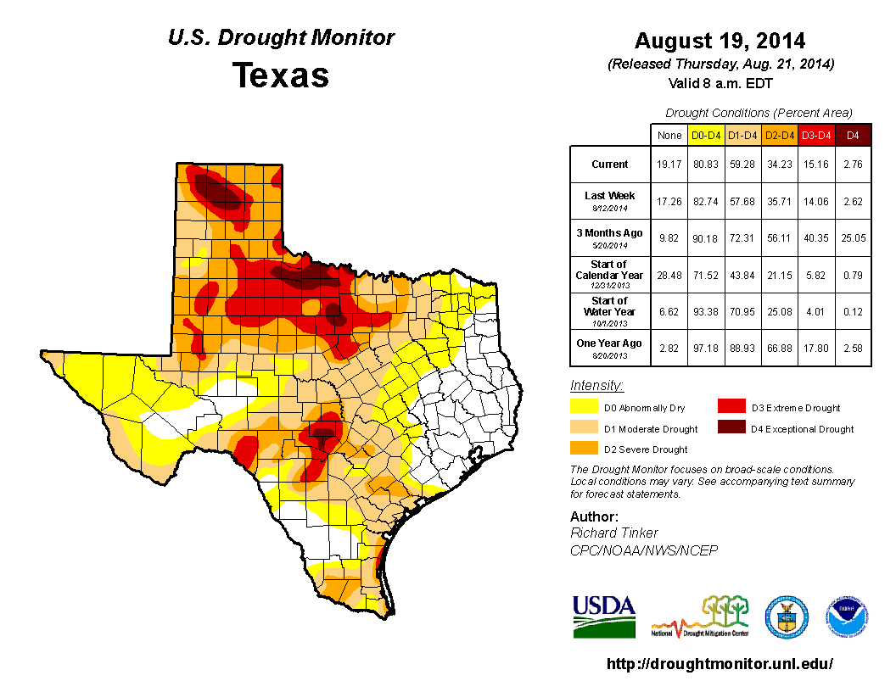
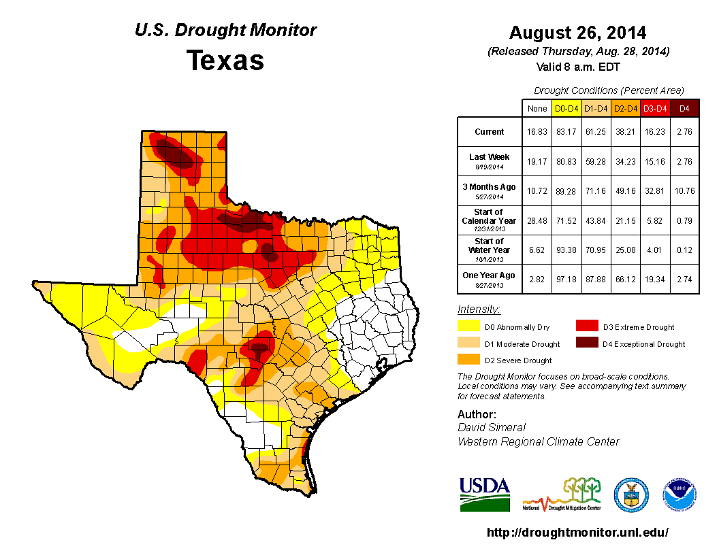

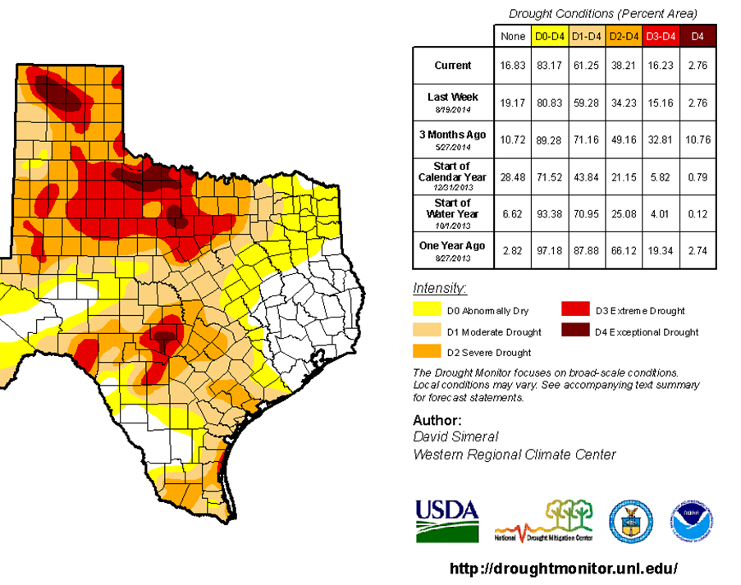
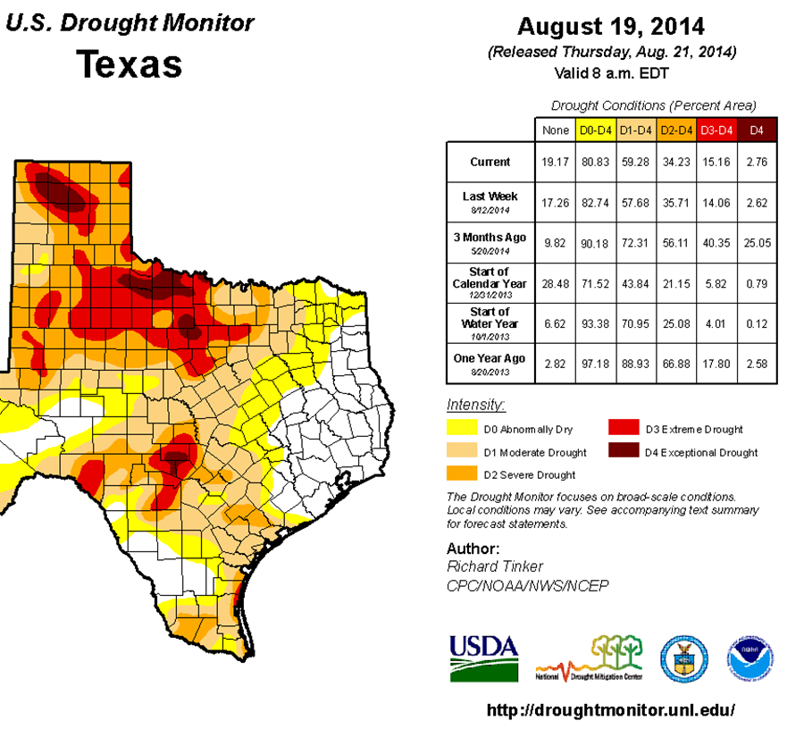

SPoRT-LIS 2014 Evaluation Example:
Minor adjustments to USDM categories
(b) 0-2m RSM
(c) 1-wk change
0-2m RSM
(a) 0-10 cm RSM
(a)
(b)

Slide 37
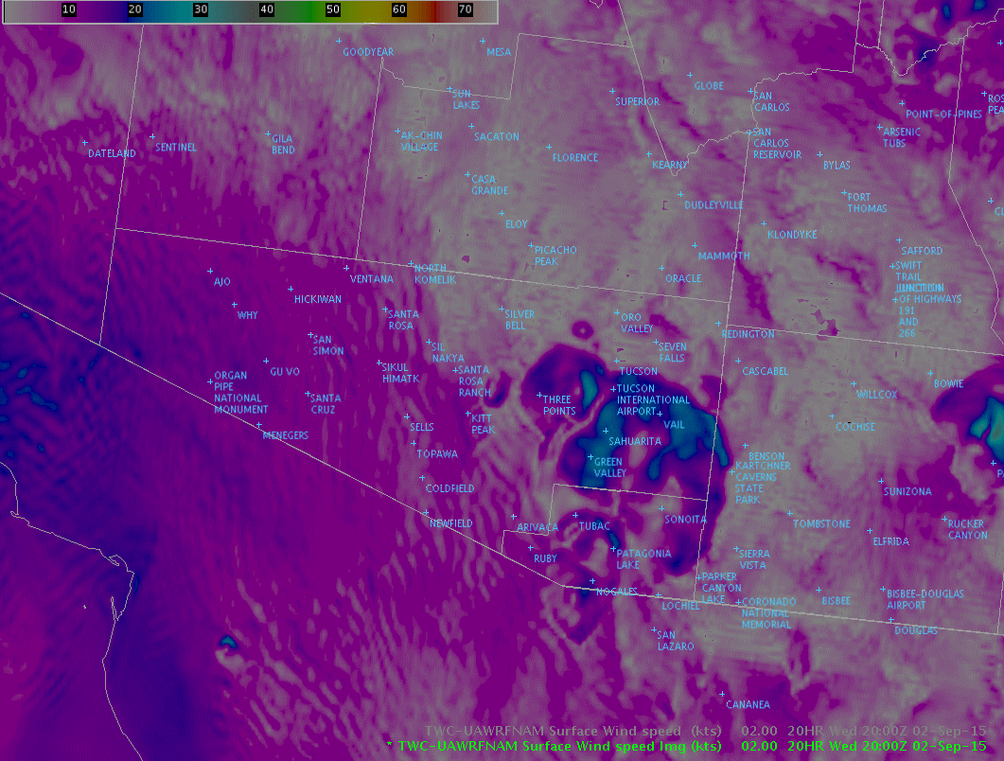
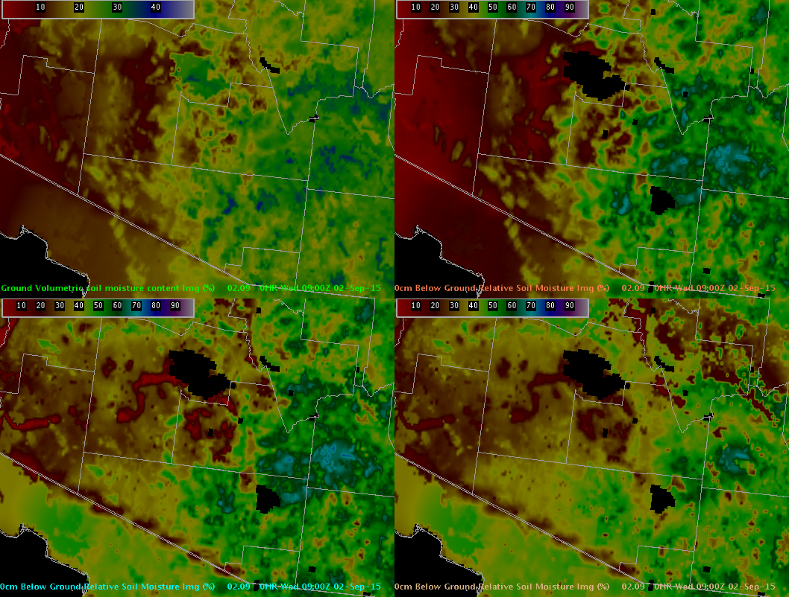
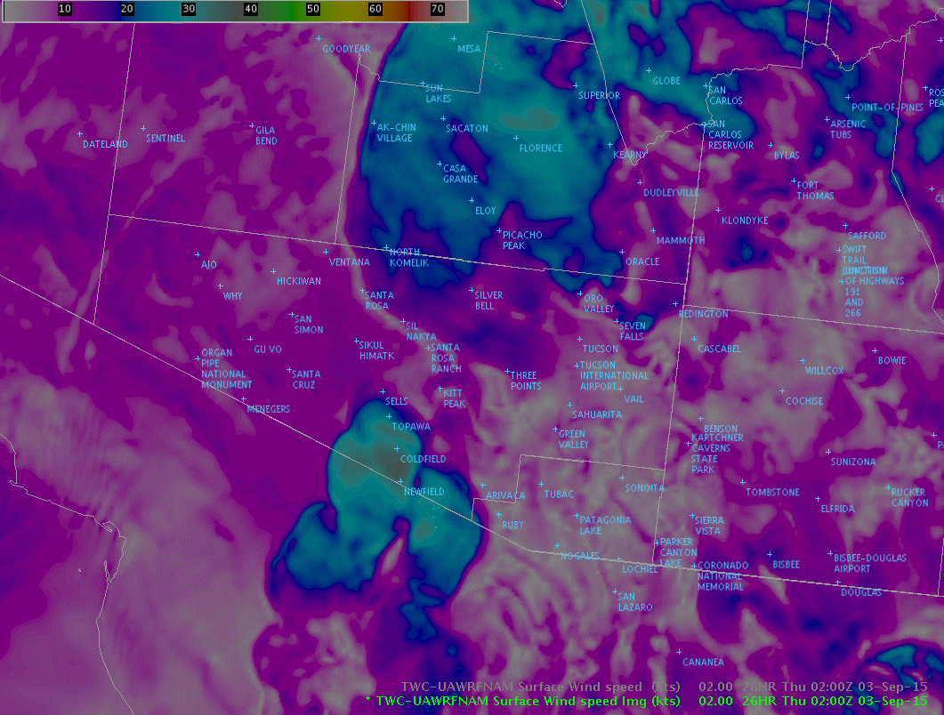
SPoRT-LIS 2015 Evaluation:
Flooding and Blowing Dust Outlooks (NWS TWC)
Simulated 10-m wind speed over SE AZ
PHX
PHX
TWC
TWC
TWC
0-10 cm Vol.
Soil Moisture
0-10 cm Rel.
Soil Moisture
Univ. of AZ WRF
20-22z 2 Sep 2015
PHX
PHX
PHX
TWC
TWC
40-100 cm Rel.
Soil Moisture
0-200 cm Rel.
Soil Moisture
TWC
(above) SPoRT-LIS at 09z 2 Sep 2015, as displayed in
NWS Tucson, AZ operational AWIPS II
Univ. of AZ WRF
02-04z 3 Sep 2015

Slide 38
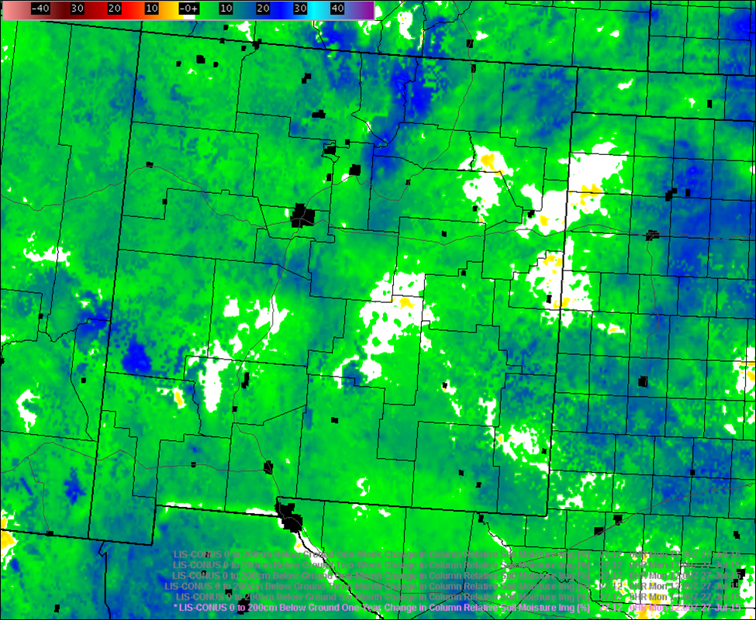
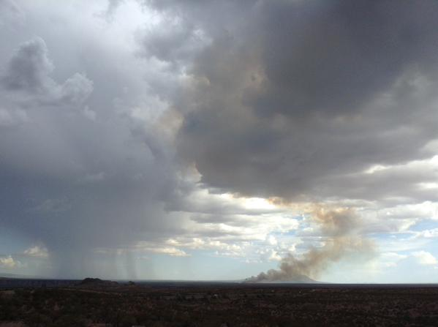
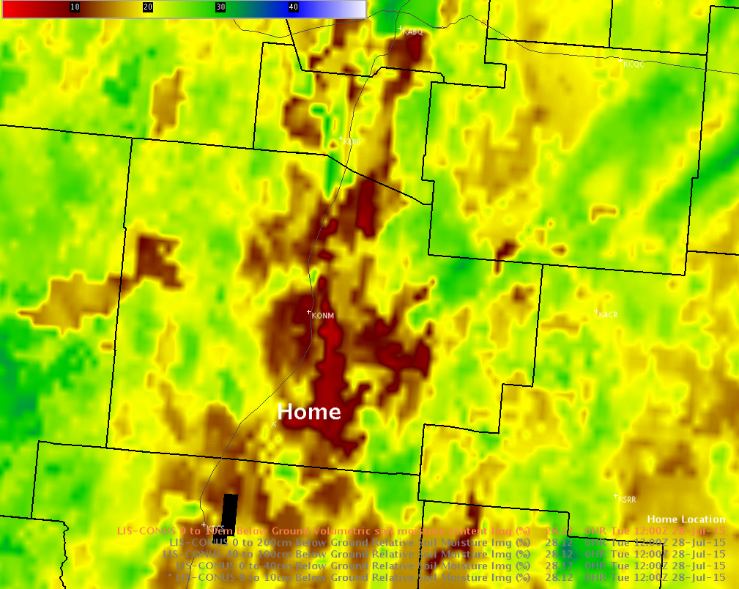
SPoRT-LIS 2015 Evaluation:
Soil Moisture Associated with Wildfire (NWS ABQ)
Fort Craig, NM wildfire at 830am 27 July 2015. Wildfire grew to ~700 acres over 2 days.
ABQ
(left) 1-yr change in SPoRT-LIS total column relative soil moisture, valid 12z 27 Jul 2015, as displayed in NWS Albuquerque, NM operational AWIPS II.
(right) 0-10 cm SPoRT-LIS volumetric soil moisture valid 12z 28 Jul 2015.
[Photo credit: Dave DuBois, NM state climatologist]

Slide 39
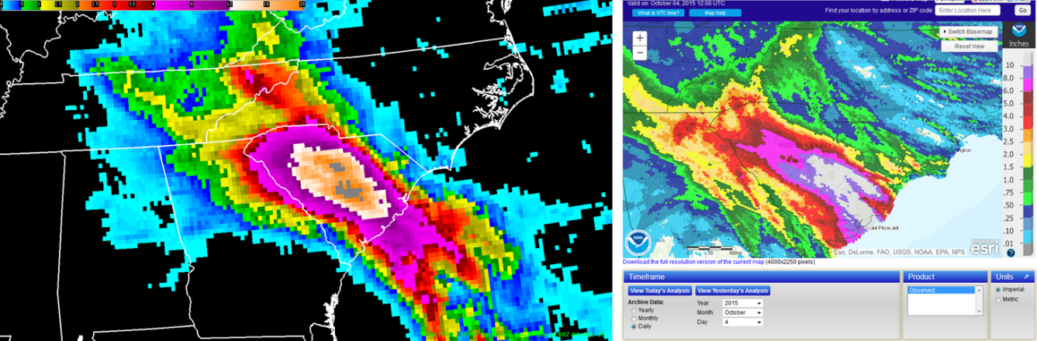
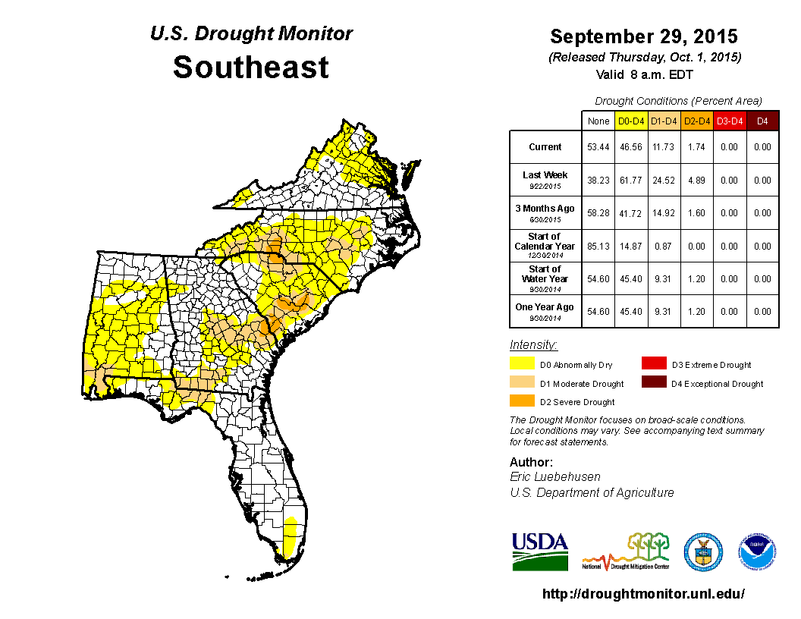
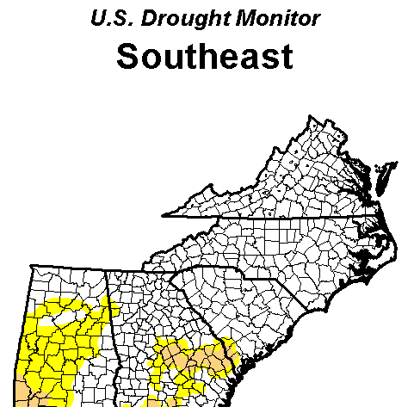
SPoRT-LIS 2015 Evaluation:
Soil Moisture Change in early Oct Flooding in South Carolina
1-day rainfall ending 12z 4 Oct:
NASA’s GPM satellite precipitation estimate captured 10-20”+ rainfall with some over-estimation (right)
GPM/IMERG
AHPS Rainfall
20”+
29 Sep “before”
drought map
6 Oct “after”
drought map

Slide 40
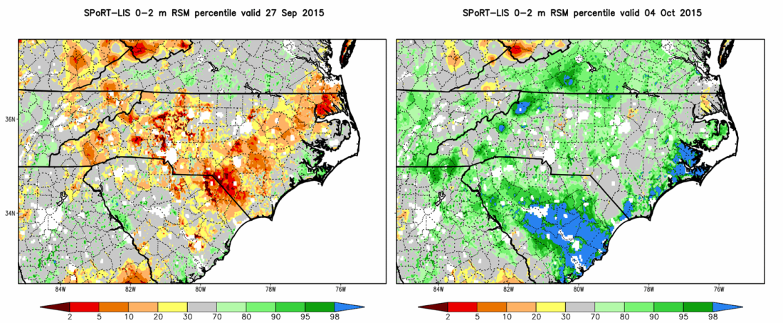
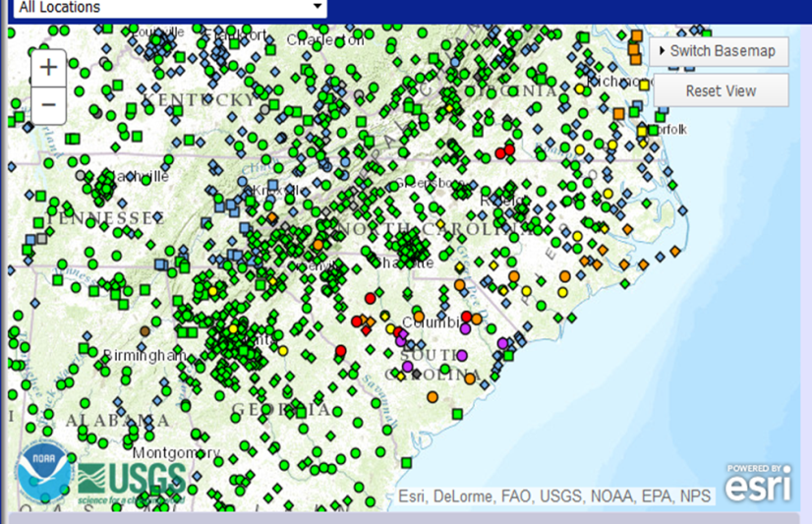
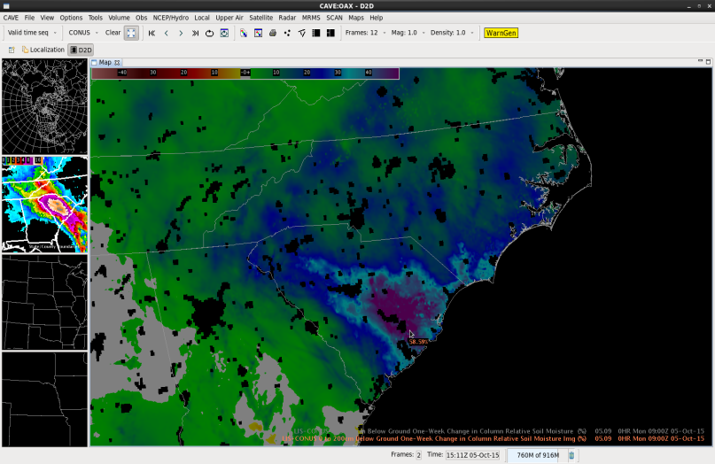

SPoRT-LIS 2015 Evaluation:
Soil Moisture Change in South Carolina Flooding, cont.
Total column relative soil moisture percentile before and after event (right images)
USGS river gauges indicating minor to major flooding (left);
One-week change in total column relative soil moisture displayed in NWS Huntsville
AWIPS II (right)
100-200%+
increase

Slide 41
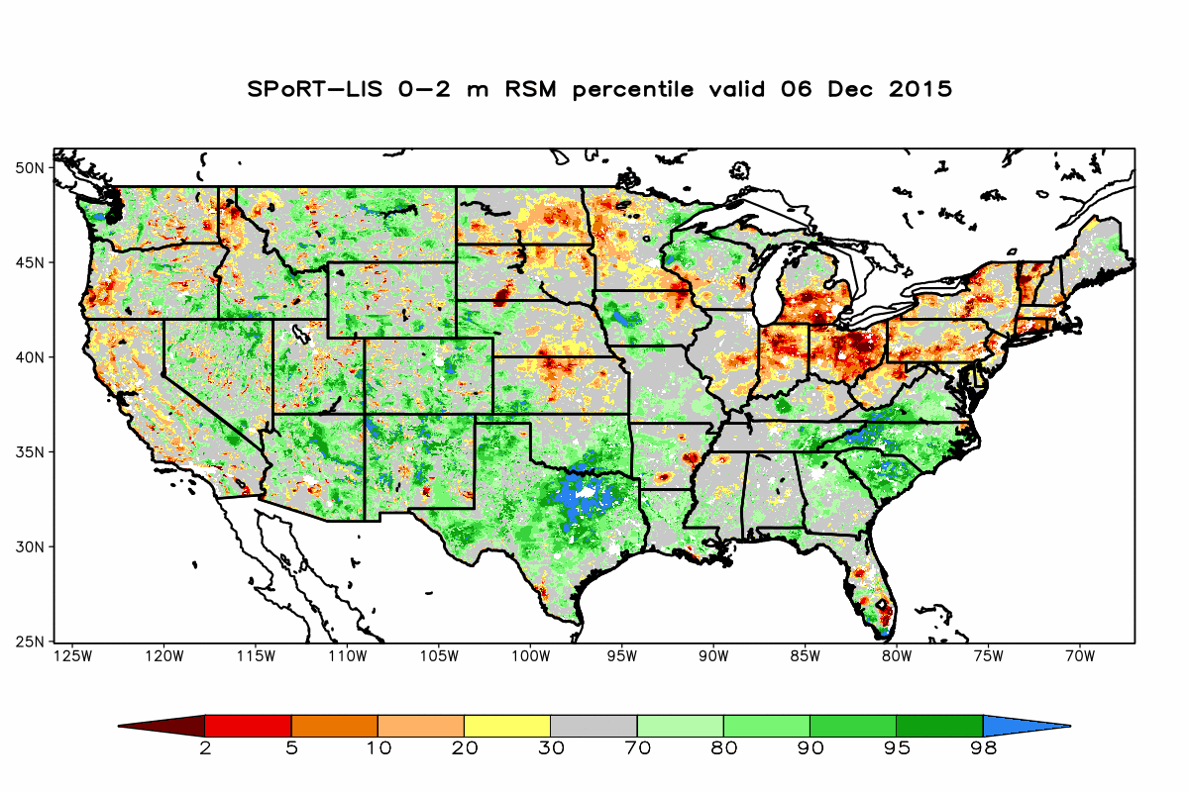
LIS-Noah 33-yr Soil Moisture Climatology
LIS-Noah run from Jan 1979 to Dec 2013
  CONUS+ domain at 0.03-deg resolution (~3 km)
  IGBP/MODIS 20-class land use, STATSGO 16-class soil
  MODIS/FPAR 30-sec resolution monthly GVF climatology (Barlage; from community WRF v3.5.1+)
  Atmos. forcing: NARR-based
  NLDAS-2 hourly data
  30+ year spin-up (1979-2010),
  then re-ran for 1979 to 1 Jan
  1981 to ensure soil equilibrium
  Restart on 1 Jan 1981 with
  output soil fields once daily
  Climatology spans 1 Jan 1981 to
  31 Dec 2013 for 33 years of data

Slide 42
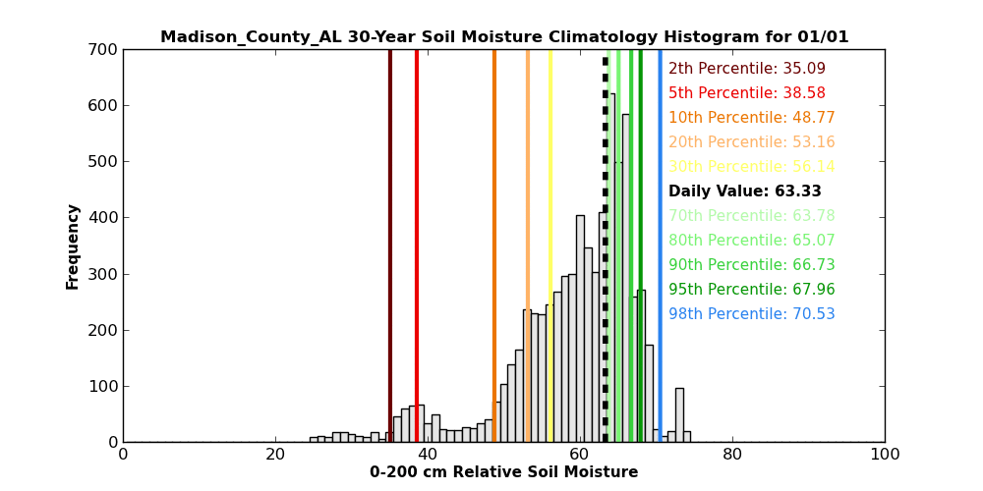


Daily Histogram Animations
N.AL
Cent. NM
SE AZ

Slide 43


Soil Moisture Percentile Validation
SPoRT-LIS 0-2 m RSM percentile on 21 Aug 2007
U.S. Drought Monitor Product valid 21 Aug 2007
NWUS
SGP
SEUS
Good correspondence in eastern half of the U.S. on 21 August 2007
LIS suggests soil moisture deficits extend NW of official USDM D4 category
LIS shows D4 proxy percentiles over western Great Lakes
Notes:
The images on this slide show the SPoRT-LIS percentile map from the 21st of August 2007, during the height of the exceptional drought in the Southeastern U.S. The percentile map shows good spatial correspondence to the U.S. Drought Monitor drought categories in the eastern half of the U.S., albeit with much greater spatial detail compared to the broader U.S. Drought Monitor product. The LIS percentile suggests more exceptionally dry soil moisture extending up to near St. Louis, and over the western Great Lakes region. Over the inter-mountain West, the relative soil moisture percentile is much noisier looking, given the more complex terrain and high-resolution of the product. Other factors play an important role in determining drought in the West besides anomalous soil moisture, such as snowpack and reservoir levels. The highlighted sub-regions in the left chart were used to validate the proxy relative soil moisture percentile as shown in the next slide.

Slide 44






Percentile Validation (% area in drought; 2006-2015)
LIS
SEUS
LIS
SGP
LIS
NWUS
USDM
SEUS
USDM
SGP
USDM
NWUS
Captures documented major droughts (SEUS in 2007; SGP in 2011 through 2014)
Generally captures the overall magnitude of total drought area
SEUS is noisier due to more frequent and scattered nature of precipitation, esp. in summer
Northwest is not as well represented because factors defining drought are
often different (future work will add snow water equivalent to climatology)
Notes:
This slide compares a decade-long time series from Summer 2006 to Summer 2015 of the LIS proxy percentile drought categories in the top row and the official U.S. Drought Monitor categories in the bottom row. Each time series denotes the area coverage of the five drought categories over the Southeastern U.S. in the left column, the Southern Great Plains in the middle row, and the Northwestern U.S. in the right column. It is evident that major drought episodes are captured quite well by the LIS percentile, particularly over the Southeast U.S. during 2007 to 2008, and the Southern Great Plains between 2011 and 2014. Over the Northwestern U.S. sub-region, the correspondence during this decade is not as strong, with the LIS percentile tending to underestimate areal coverage of low-end drought categories while simultaneously over-estimating the areal coverage of the more extreme D3 and D4 categories. This validation result further suggests the importance of other factors besides soil moisture anomalies when official drought categories are established in the Western United States.

Slide 45

Soil Moisture Percentile Validation, cont.
Percentiles compared to USDM from Jun 2006 – Sep 2015; weekly at 12z Tuesday
Bias depicts overall under-representation of lower drought categories and slight over-representation of higher drought categories
Correlations are strongest for lower drought categories and SEUS/SGP;
correlations diminish for higher drought categories and NWUS region
Best overall statistics in SEUS domain
Difference in mean area (SPoRT-LIS minus USDM)
Bias | D0 | D1 | D2 | D3 | D4
SEUS | -4.1 | 2.1 | 0.2 | 0.7 | 2.4
SGP | -19.8 | -14.0 | -12.5 | -6.6 | -1.2
NWUS | -17.4 | -8.6 | -4.5 | 1.4 | 2.6
Correlation | D0 | D1 | D2 | D3 | D4
SEUS | 0.89 | 0.87 | 0.85 | 0.83 | 0.72
SGP | 0.90 | 0.90 | 0.88 | 0.83 | 0.70
NWUS | 0.77 | 0.68 | 0.53 | 0.38 | 0.12
Notes:
The bias and correlation of the LIS percentile drought categories were generated against the U.S. Drought Monitor product for each sub-region, using rasterized versions of the weekly archived U.S. Drought Monitor maps. The bias results in the top table indicate the tendency for the LIS percentile product to under-represent the lower-level drought categories, mainly over the Southern Great Plains and Northwest U.S., while slightly over-estimating the areal coverage of higher drought categories in the Southeastern and Northwestern U.S. The strongest correlations between 0.8 and 0.9 are found for the lower drought categories and for the Southeastern U.S. and Southern Great Plains sub-regions. The best overall statistics occurred in the Southeastern U.S. region, suggesting that the U.S. Drought Monitor categories can be represented well by the LIS objective soil moisture percentiles.

Slide 46


WRF Cloud Microphysical Evaluation (3)
Conduct simulations for heavy precip events during OLYMPEX campaign.
Goal: Evaluate and improve newer, more advanced cloud microphysical schemes in WRF model.
  Current focus on Thompson, Morrison, Stony Brook, and P3 microphysics.
*No Chemistry/Aerosols*
1 km
3 km
9 km
Future Work
Conduct additional model runs for CalWater case studies
  MOZART aerosol scaled to CalWater measurements
  MOZART dust and/or pollution only
Use SPoRT AOD Composites to improve radiance assimilation in aerosol-prone regions

Slide 47


Assimilation of NUCAPS Profiles (1)
Satellite profiles are traditionally assimilated as rawinsonde observations and assigned rawinsonde errors which are unrepresentative for satellite profiles
Experiments were conducted to compare model runs
  No profile assimilation + conventional observations
  Profile assimilation with rawinsonde errors + conventional observations
  Profile assimilation with NUCAPS errors from Nalli et al. (2013) + conventional observations
Black: default GSI rawinsonde error cov
Green: NUCAPS error cov
Left: Temperature
Right: Water Vapor

Slide 48
Downscaling Assessment: Scoping the NASA Effort
Downscaling Assessment Questions
  Under ideal forcing conditions (e.g., high-quality re-analyses), how good is the RCM at replicating important weather and climate processes/phenomena?
  Under what conditions does downscaling (RCMs driven by GCMs)
  give valid results?
  Do high-resolution RCMs (5 km or finer) offer anything that can’t be obtained via today’s “high” but coarser resolution GCMs (25-50 km or coarser)?
Presented at 2015 WRF Users’ Workshop
High-level methodology
  (1) GCM & RCM Simulations
  (2) Observation-based model performance metrics
  (3) Methodology: 3-Step process for combining 1 & 2

Slide 49
Downscaling NASA Team Acknowledgement
Name | Affiliation | Name | Affiliation
Jonathan Case | ENSCO, Inc/MSFC | Paul Loikith | CalTech/JPL
Daniel Duffy | GSFC | William Putman | GSFC
Duane Waliser | JPL | Brent Roberts | MSFC
Takamichi Iguchi | UMD/GSFC | Joe Santanello | GSFC
Eric Kemp | SSAI/GSFC | Baijun Tian | JPL
Jinwon Kim | UCLA/JPL | Yudong Tian | UMD/GSFC
Kyo Lee | JPL | Di Wu | UMD/GSFC
Weile Wang | CSU/ARC | Brad Zavodsky | MSFC
Wei-Kuo Tao | GSFC | Bin Guan | UCLA/JPL
Kim Whitehall | JPL | Christa Peters-Lidard | GSFC
Max Suarez | GSFC | Tsengdar Lee | NASA HQ
William Gutowski* | Iowa State Univ. | Linda Mearns* | NCAR
Ruby Leung* | Pacific NW Nat’l Lab
*External project advisors

Slide 50
External Collaborations (2):
Real-time comparisons in RAP/HRRR model
2-m temperature and dew point differences:
VIIRS GVF minus MODIS climatology
Valid at 12 UTC 14 July 2016

Slide 51


External Collaborations (3):
TWC Verification Case Studies
Experiment 2 → NASA SPoRT SST (2 km) + GVF (4 km)
NASA SPORT GVF - WRF CLIMATOLOGY (%)
Verification Metar Sites (21)
Green Vegetation Difference → 12 UTC July 2, 2014

Slide 52

External Collaborations (4):
TWC Verification Case Studies
Experiment 2 → NASA SPoRT SST (2 km) + GVF (4 km)
VIIRS GVF
Model | RMSE (F) | Bias (F)
VIIRS GVF | 3.18 | -0.63
Baseline | 3.93 | -2.36
Large DF1 Impact at Night
Baseline
21 Metar Verification Sites → 12 UTC July 2, 2014 (48 hour)

