Slide 1


SPoRT Product Assessments
Geoffrey Stano, Kevin Fuell
Fifth Meeting of the Science Advisory Committee
18-20 November, 2009
National Space Science and Technology Center, Huntsville, AL
transitioning unique NASA data and research technologies to operations

Slide 2
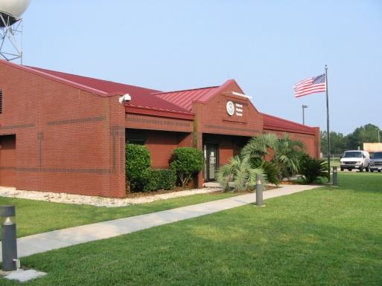
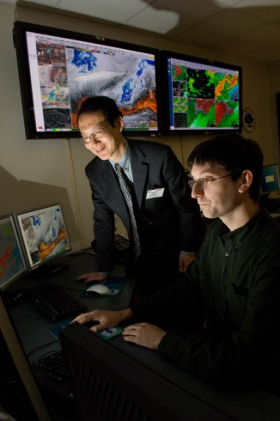
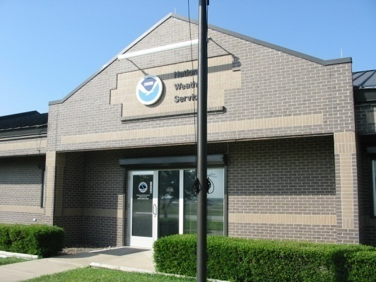
Importance of Assessments to SPoRT
SPoRT Mission:
  Transition unique observations and research capabilities … to improve regional short-term forecasts
Keys to Success:
  Link data to forecast problems
  Data not thrown over the fence
  Assessments improve success rate
    Understanding of forecast issues
    Understanding of product impact
  Fosters end user participation and buy-in
transitioning unique NASA data and research technologies to operations

Slide 3
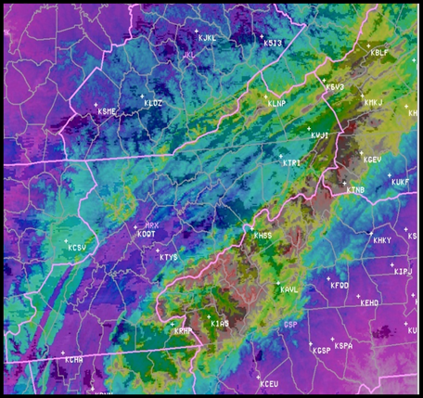
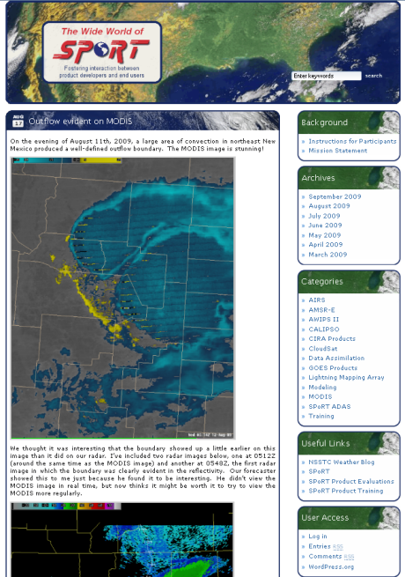
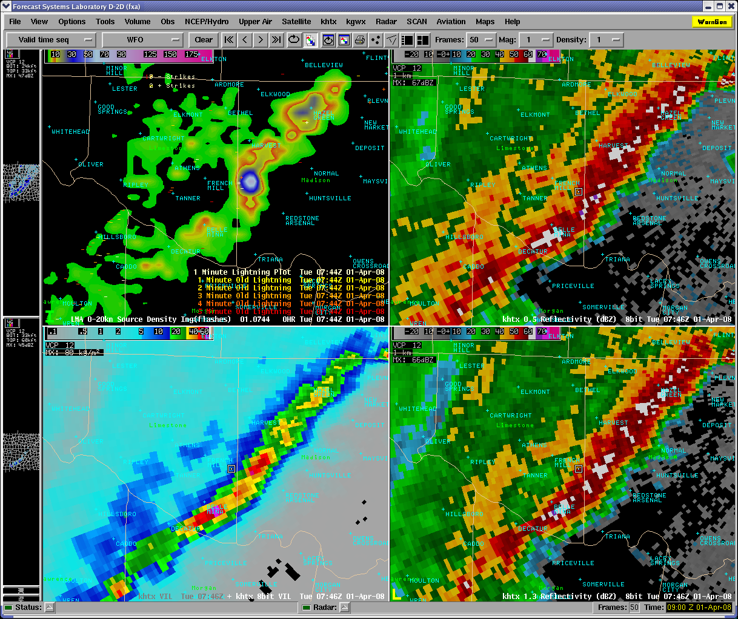
SPoRT Accomplishments
MODIS Fog and Topography
“SPoRT should be more proactive in fostering end user feedback” – SAC 2007
Several new activities undertaken
  Intensive product evaluation periods
    MODIS fog: Fall 2008 & 2009, Jan 2009
    MODIS false color: Winter 2008
    North Alabama Lightning Mapping Array: Spring 2009
  Wide World of SPoRT Blog
    Peer to peer feedback and evaluation
  Regular group discussions of applications
    Bi-monthly coordination calls
NALMA
SPoRT Blog
transitioning unique NASA data and research technologies to operations

Slide 4
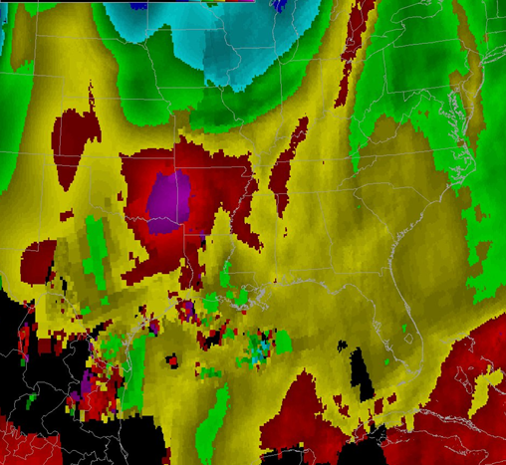
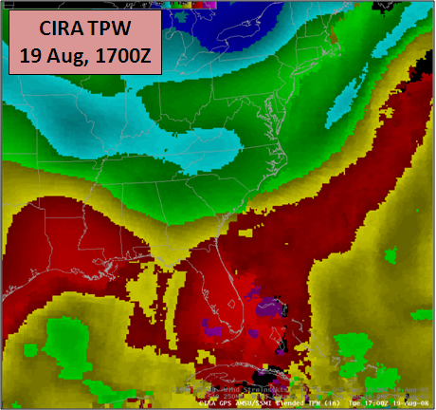
SPoRT Accomplishments
“…more site visits to partners …” – SAC 2007
SPoRT visits with partners
  9 Weather Forecast Offices
  Private: World Winds, Weather Channel
  Southern Region Headquarters and JPL
Visits are informative and beneficial
  Learn about local WFO concerns
  Directly led to improvements to end users
    Sped transition of MODIS SST composites
    Remote sensing needs for Albuquerque
    Enhancement to MODIS fog product
    Fix visualizations issues
Incorrect Display
Corrected Display
transitioning unique NASA data and research technologies to operations

Slide 5
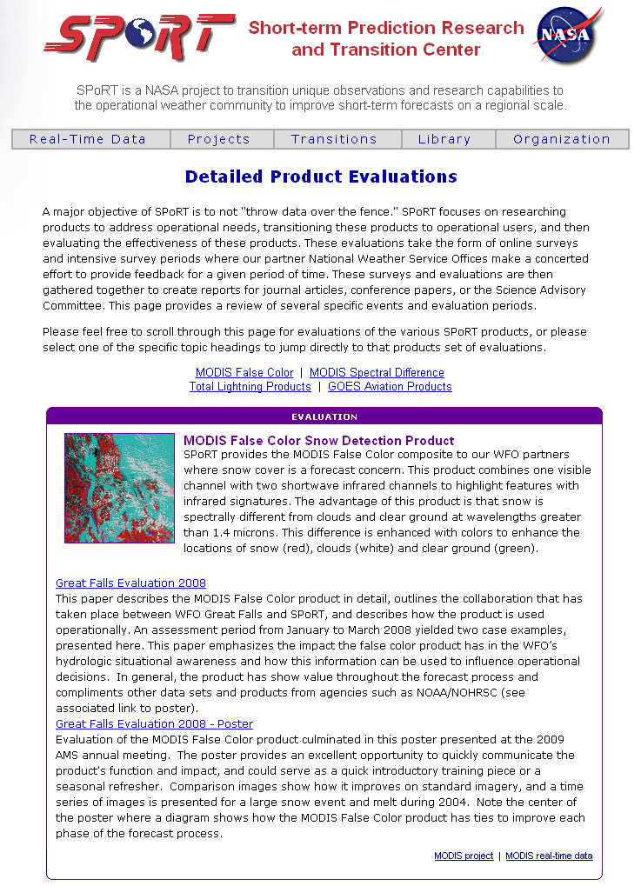
SPoRT Accomplishments
“How does SPoRT document transitions?” – SAC 2007
Evaluations on SPoRT web page
  Summaries of intensive study periods
More emphasis on written articles
  End users receive authorship
  Highlights SPoRT and partner collaboration
  AMS Annual Meeting conference articles
    MODIS false color – WFO Great Falls
    North Alabama LMA – WFO Huntsville
  Upcoming BAMS maproom paper
transitioning unique NASA data and research technologies to operations

Slide 6
The SPoRT Approach
Determine Forecast Issue
Match Forecast Issue to Product
Determine Training Needs
Evaluate Product Impact
Enhance the Product
Assessments integrated with entire transition process
Tailored to fit specific issues
  Product specific web surveys
    Lightning Mapping Array
    MODIS fog
    CIRA TPW
  More than just web surveys
    Wide World of SPoRT blog
    Site visits
    Questionnaires
Successful paradigm
  Value recognized by GOES-R Proving Ground
Is Product ready for 24/7 use by operational groups?
transitioning unique NASA data and research technologies to operations

Slide 7
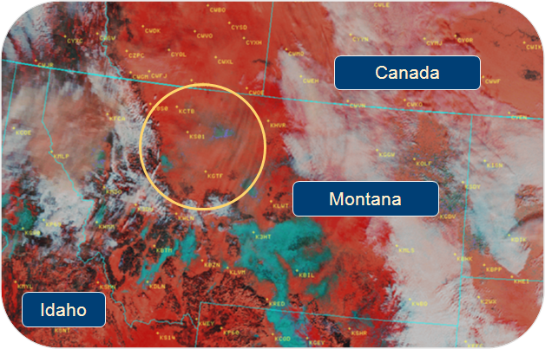
Impacts: MODIS False Color Product
Assessment modified to fit operational realities
  False color use more long-term
  Developed daily log
One on one discussion with forecaster
End user educated SPoRT on new uses
Discussion of new products
  Tie in with AMSR-E snow water equivalent
  Snow cover extent composite
Culminated in AMS Annual Meeting poster and paper
WFO Great Falls:
“The false color product has improved the assessment of flooding potential in post snow and ice events.”
transitioning unique NASA data and research technologies to operations

Slide 8
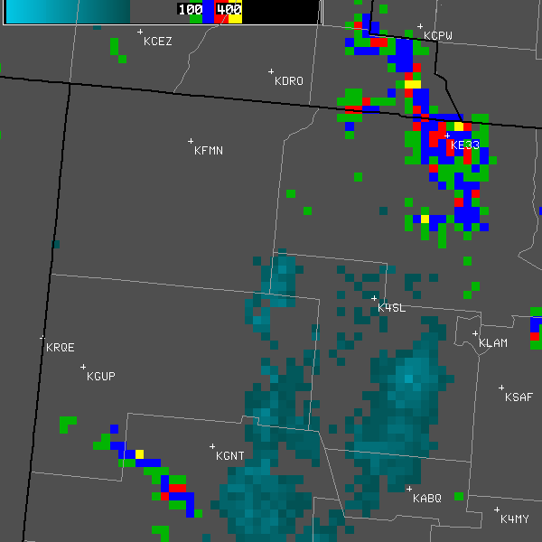
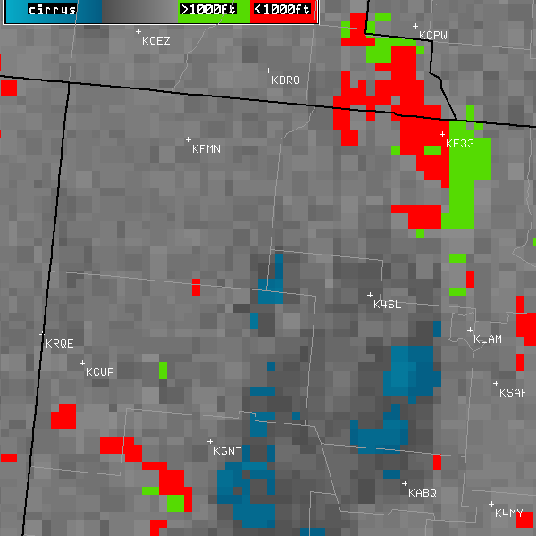
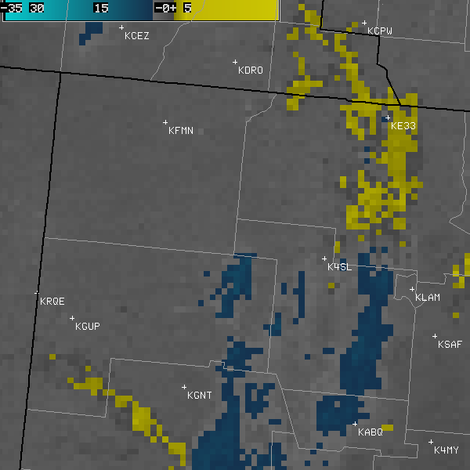
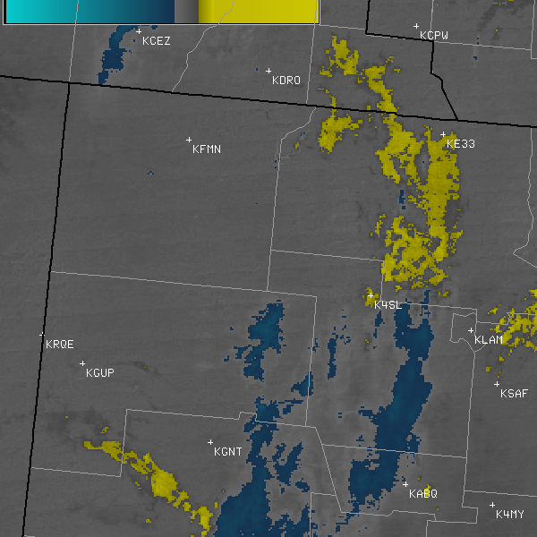
Impacts: MODIS Fog Product
Primarily web survey evaluation
  Used intensive study period
    Required discussions on fog climatology
  Supported by blog posts (MFL, MRX)
Set up by GOES Fog product evaluation
  NESDIS requested evaluation
  Led to the 2009 MODIS only assessment
End results
  Albuquerque evaluation summary
  Development of MODIS fog improvements
Fog Depth
Low Cloud Base
0515 Z
0521 Z
MODIS 4 km
MODIS 1 km
WFO Albuquerque: “Seeing where lower clouds and fog were developing made me much more confident that if lower clouds or fog did occur, it would not be until 10Z or after, as remained forecasted in the 06Z TAF.”
transitioning unique NASA data and research technologies to operations

Slide 9
Impacts: Lightning Mapping Array
Reinforced previous studies
Generated requests for more training
  Web science share session with MRX
  Discussion for new types of products
WFO Huntsville:“I believe the flash density rates were the primary factor in holding off on a warning.”
WFO Nashville: “the LMA often helps ‘tip the scales’ towards issuing a warning”
Spring Program GLM Proxy
  Needs to be flash-based
  Pseudo GLM created
LMA is mature product
  Familiar to end users
  Focus towards pseudo GLM and AWIPS II visualizations
Lightning jumps can be useful indicators of severe weather
transitioning unique NASA data and research technologies to operations

Slide 10
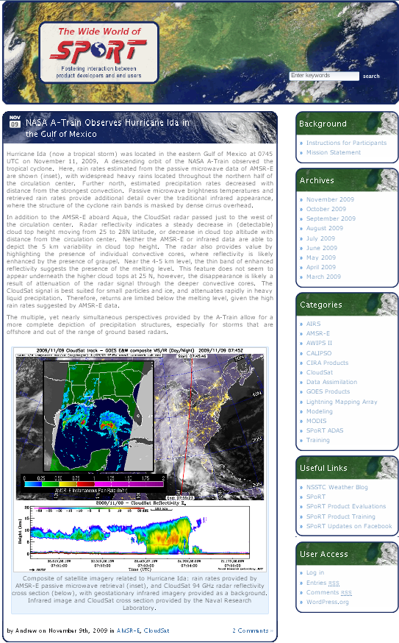
Impacts: Wide World of SPoRT Blog
Web surveys can be cumbersome
  Rigid structure
  No pictures
  Limited circulation
  Most effective with intensive studies
SPoRT Blog addresses these and promotes discussion of interesting cases
  Good for everyday use
  Interesting examples
  Other partners see product utility!
transitioning unique NASA data and research technologies to operations

Slide 11
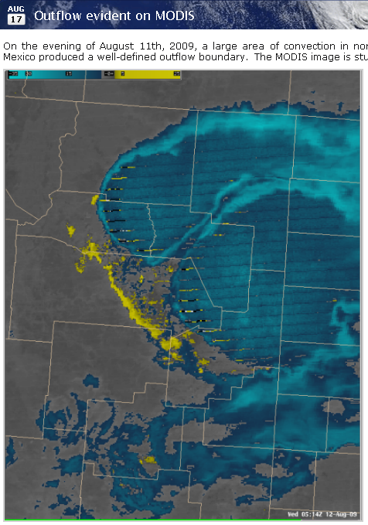
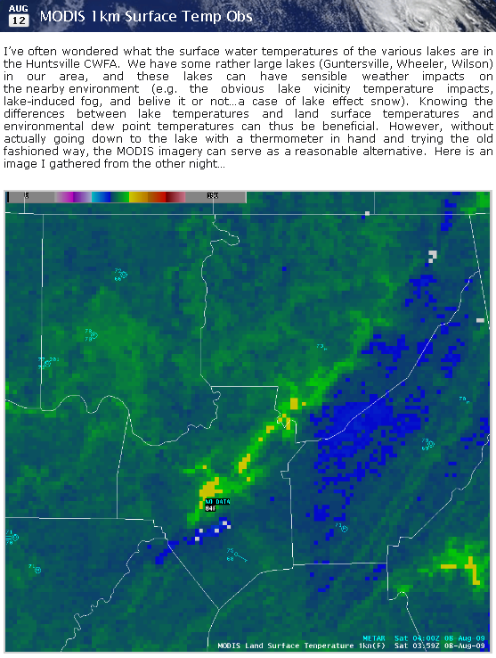
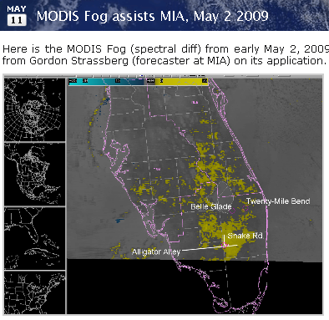
Impacts: Wide World of SPoRT Blog
Partners post interesting and informative cases
  ABQ: Outflow boundary with MODIS
  MFL: MODIS fog in the Everglades
  HUN: Lake versus land temperatures
  SPoRT can post entries for offices
    SMG: SST composite with visible image
    MOB: Model utility with MODIS SSTs
transitioning unique NASA data and research technologies to operations

Slide 12
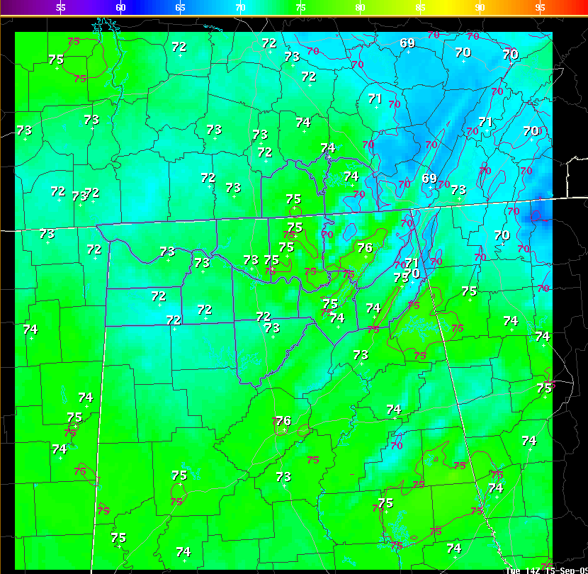
Impacts: Additional Results
MODIS in the GFE
Not all formal, but still important!
  Led to MODIS in the GFE
  Modified domains for products
What happens to the feedback?
  SPoRT Evaluation page – Mini report
  Conference and journal articles
    AMS Annual Meeting
    Southern Thunder Workshop
    Bulletin of the AMS
  Conclusions sent to product developers
    Ken Pryor (NESDIS), FAA, SPoRT developers
WFO Mobile: “… GFE approach could be helpful, in coastal regions to create a database stratified by flow regimes.”
WFO Miami: “Expanding the CIRA TPW domain is very useful for tracking moisture plumes.”
transitioning unique NASA data and research technologies to operations

Slide 13
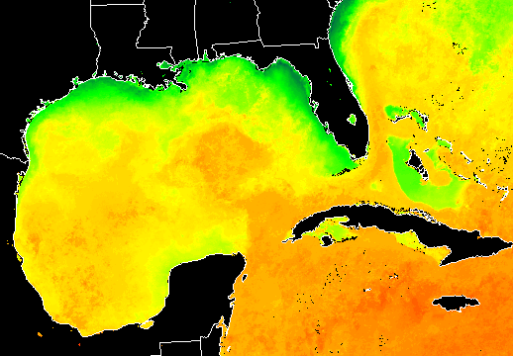
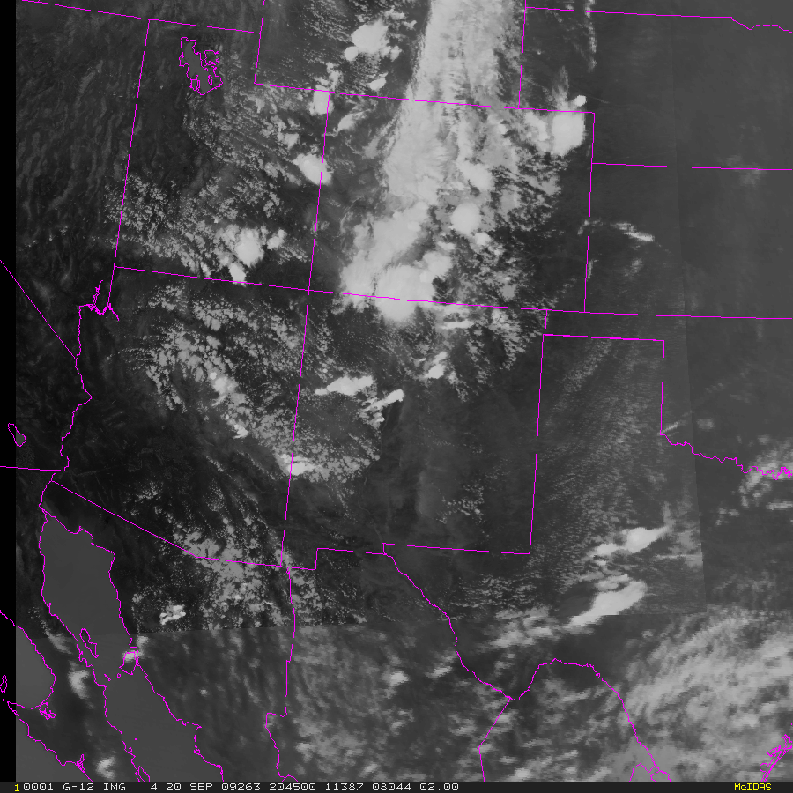
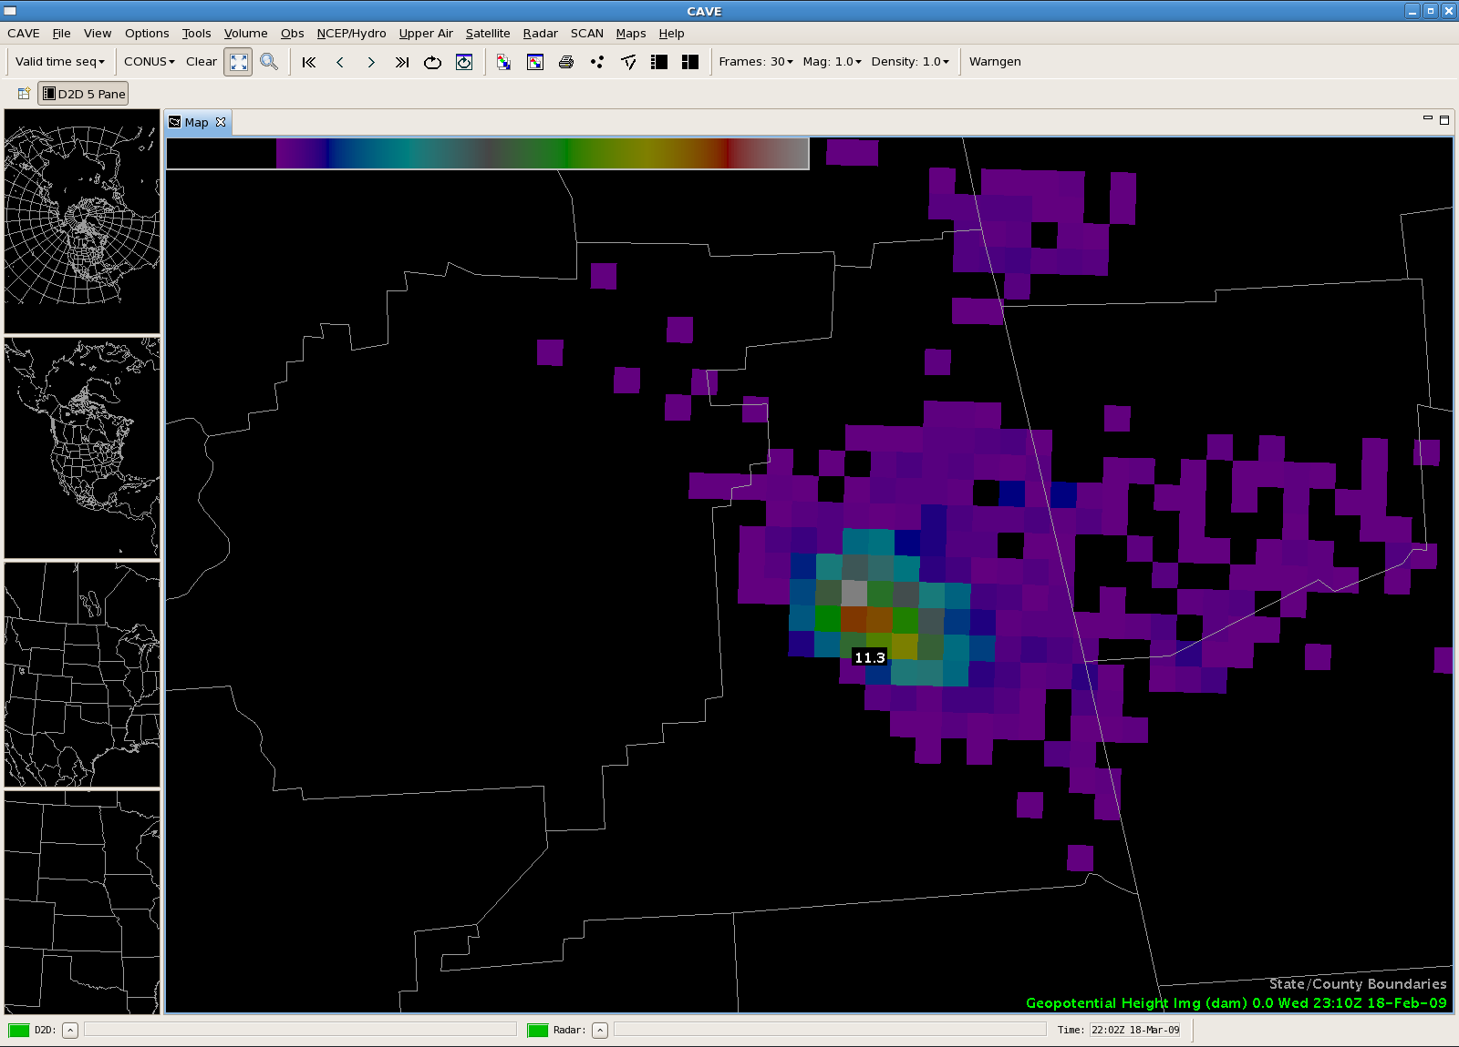
Future Work
Support GOES-R Proving Ground
AWIPS II
  Best visualizations with new technology
Encourage written evaluations
  Other metrics must be maintained
MODIS
  Enhanced MODIS sea surface temperature
  Enhanced MODIS spectral difference
Lightning Mapping Array
  1 versus 2 km, 1 versus 2 min
  Source density versus flash density
  New users: KSC LDAR and White Sands LMA
Enhanced SSTs
MODIS Hybrid
AWIPS II
transitioning unique NASA data and research technologies to operations

