Slide 1
NWS Mobile, AL Recent Partnership Experiences with NASA SPoRT
NASA SPoRT / NWS Workshop
3 - 4 March 2010
Science and Operations Officer
Jeffrey M. Medlin
National Weather Service Mobile, AL
Notes:
Self introduction and introduction of topic.

Slide 2
Presentation Outline
MOB WRF-NMM Model Description
MOB-WRF NMM Model Examples
NASA SPoRT Product Usage

Slide 3
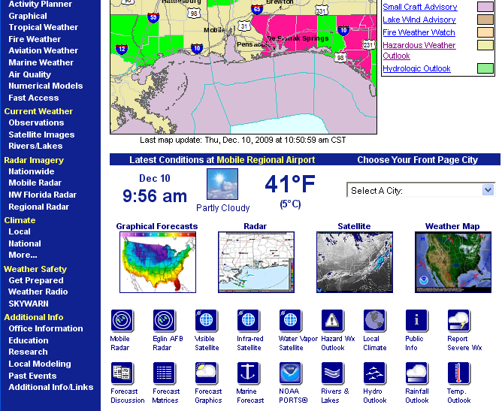
Public and Internal MOB WRF Access
HTML
- On the web -> http://www.srh.noaa.gov/mob/wrf.php

Slide 4
Model Description
GFS High Res. Tiles

Slide 5
Model Description
Pushin’ it hard!
2 h 16 min before post-processing
50 hPa

Slide 6
Model Description

Slide 7
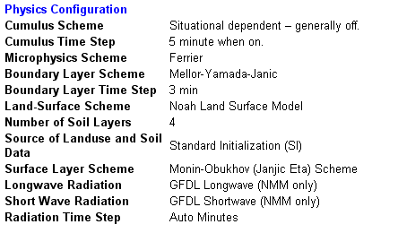
Model Description
Recall: Non-hydrostatic!
Soon to be LIS

Slide 8
Data Assimilation Local Analysis and Prediction System (LAPS) Hot Start
LAPS estimates cloud ice, snow mixing ratio, rain water mixing ratio and cloud water mixing ratio from radar reflectivity.
Above goes into vertical momentum equation and compensating vertical motions gradually adjust to wind field once integration begins.

Slide 9
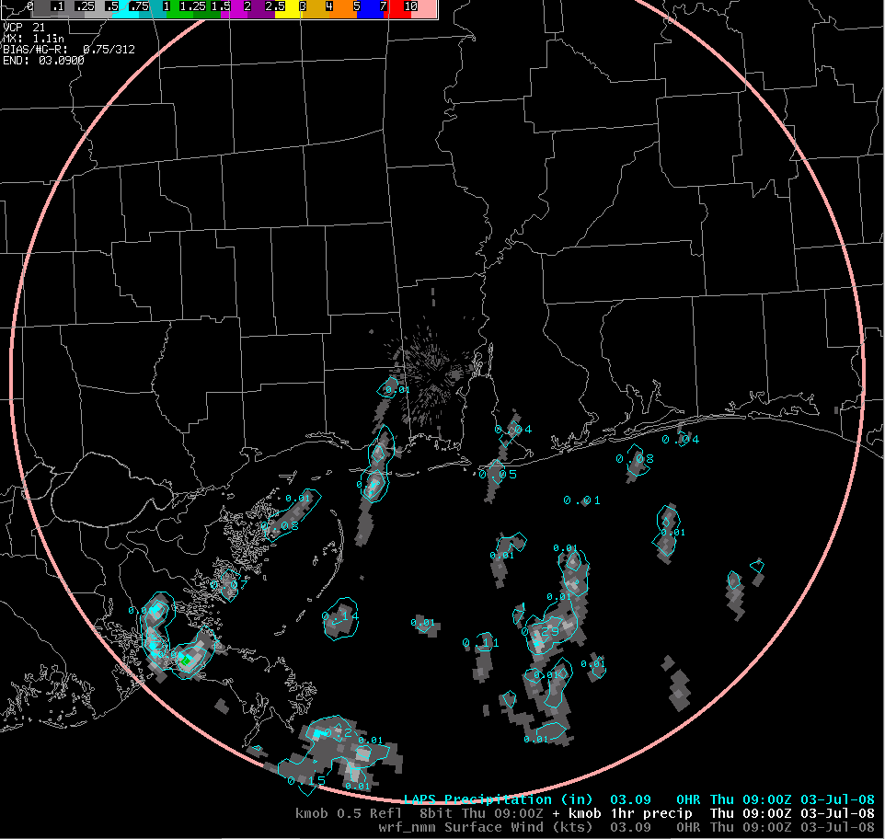
“LAPS Hot Start Example”
***Initialization with LAPS Radar***

Slide 10
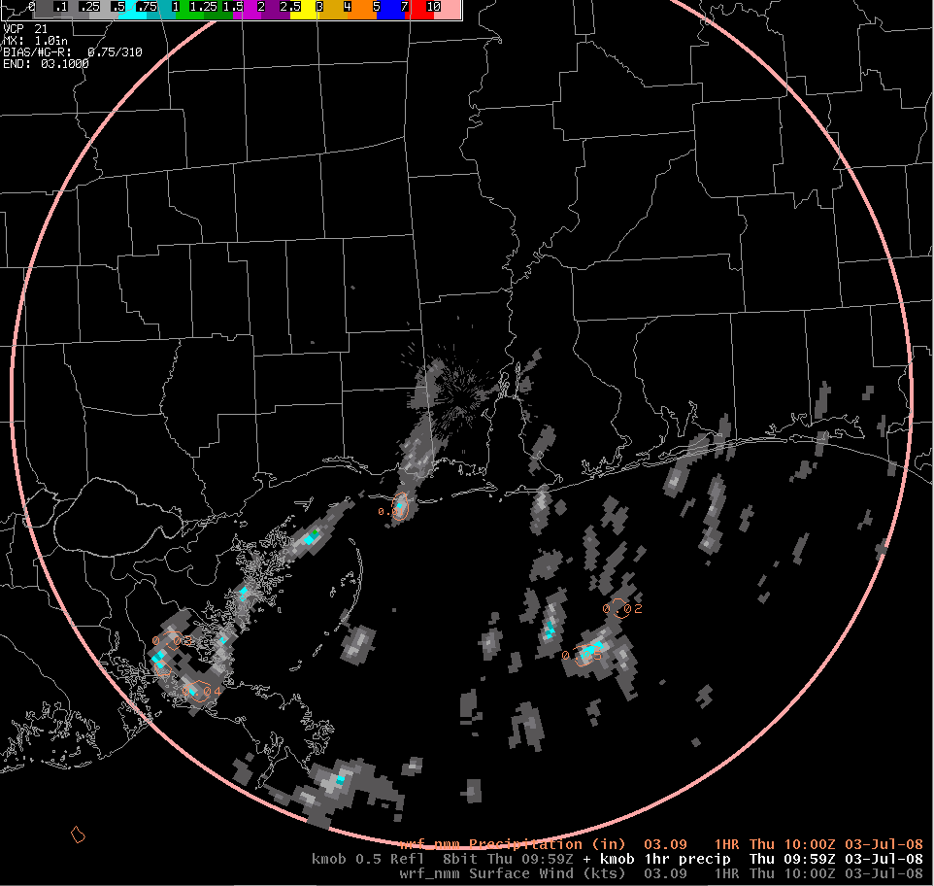
“LAPS Hot Start Example”
***One hour later and after ~600 time steps!***
WRF 1h Precipitation Accumulation
Usually lose that performance ‘bump’ by the fourth hour!

Slide 11
Data Assimilation MODIS SSTs
Locally produced GRaDS Script
***Assimilated into MOB WRF 4x/day

Slide 12
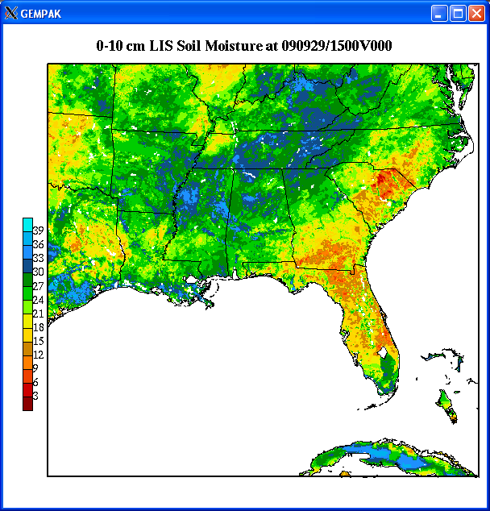
Data Assimilation MODIS SSTs
Incorporate LIS soon after v3.1 upgrade
Will also begin running ARW Core this Spring!
Cannot wait . . . Know this will make a
difference especially during Summer
Image Source: Jonathan Case

Slide 13
How has the WRF been used?
Have capitalized on greatly increased horizontal resolution sensible weather elements such as:
Radar reflectivity ***high impact events
1 h precipitation accumulation ***high impact events
10 m winds ***high impact events
2m T, Td, RH ***high impact events
Derived Fields (e.g., CAPE and Sr Helicity) ***high impact events
Capitalize on convenient d(Prog)/dt tool for precipitation. ***high impact events

Slide 14
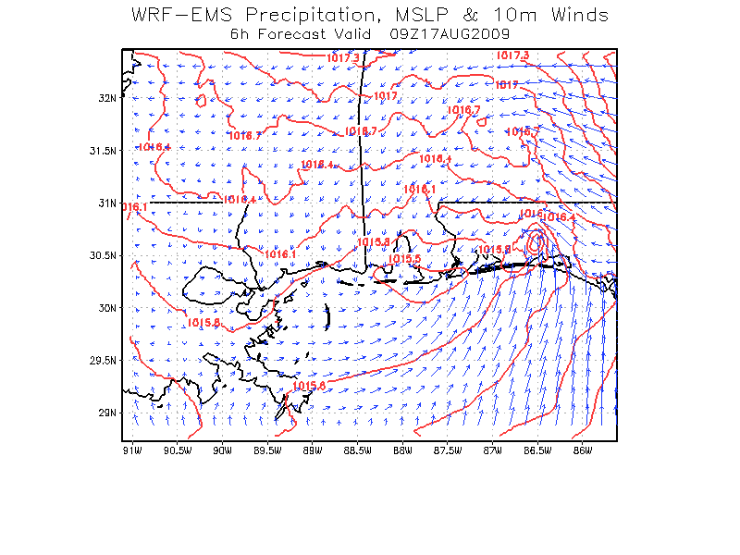
Examples Mobile, AL Case Study: T.S. Claudette -17 August 2009-
NWS Mobile, AL posted WRF results to SPoRT blog
WRF EMS version 3 using default MODIS SST option
Depicted small meso-low in vicinity of T.S. Claudette, further east where low actually made landfall
Surmised that MODIS SSTs helped produce this improvement over the large-scale models
SPoRT re-ran WRF EMS with RTG vs. MODIS SSTs
GFS Initial & BCs
Same domain as NWS Mobile

Slide 15
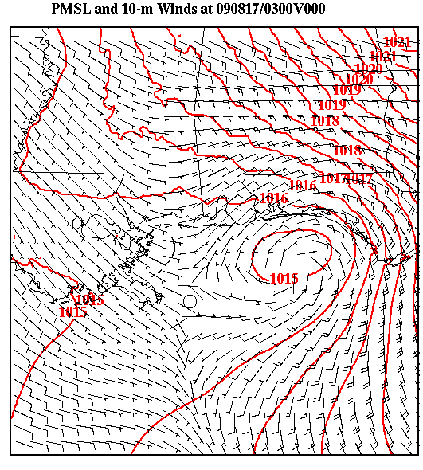
Examples Mobile, AL Case Study: T.S. Claudette (WRF Initial Condition)
RTG-> Low slightly too far southwest compared to actual location

Slide 16
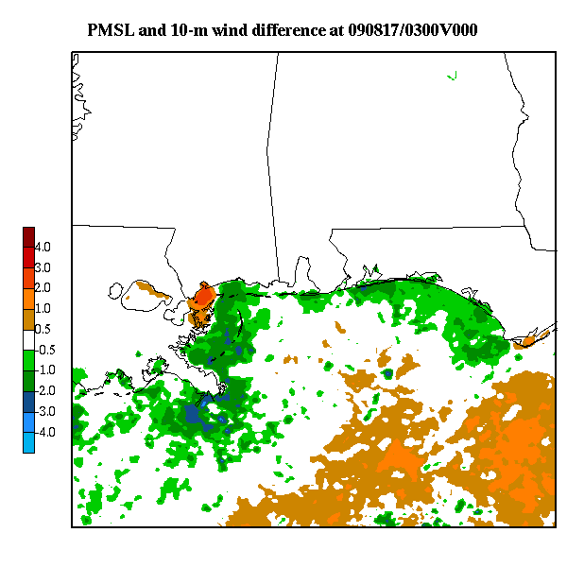
Examples Mobile, AL Case Study: T.S. Claudette (SST Differences)
Warmer SSTs offshore western Florida; cooler near-shore

Slide 17
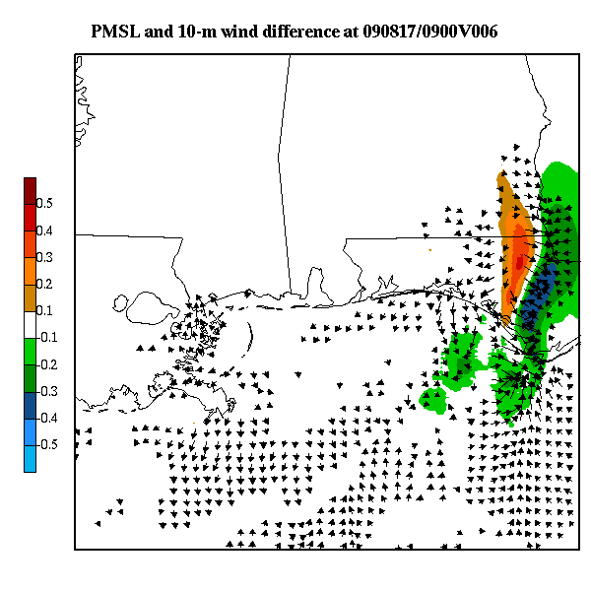
Examples Mobile, AL Case Study: T.S. Claudette (6-h PMSL and 10-m Wind Differences)
Cyclonic flow and PMSL couplet develop along SST gradient

Slide 18
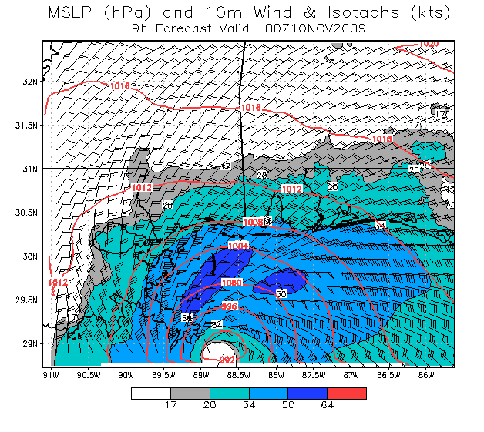
Examples T.S. Ida Simulation w/ MODIS SSTs (9 to 27 hour Forecast PMSL and 10-m Winds)
SOO Comments (Medlin)
Forecast very close on track and intensity
Weakening intensity toward landfall
Horizontal scale very similar to observed
Precluded tornado threat due to very stable air on northern periphery (not shown)

Slide 19
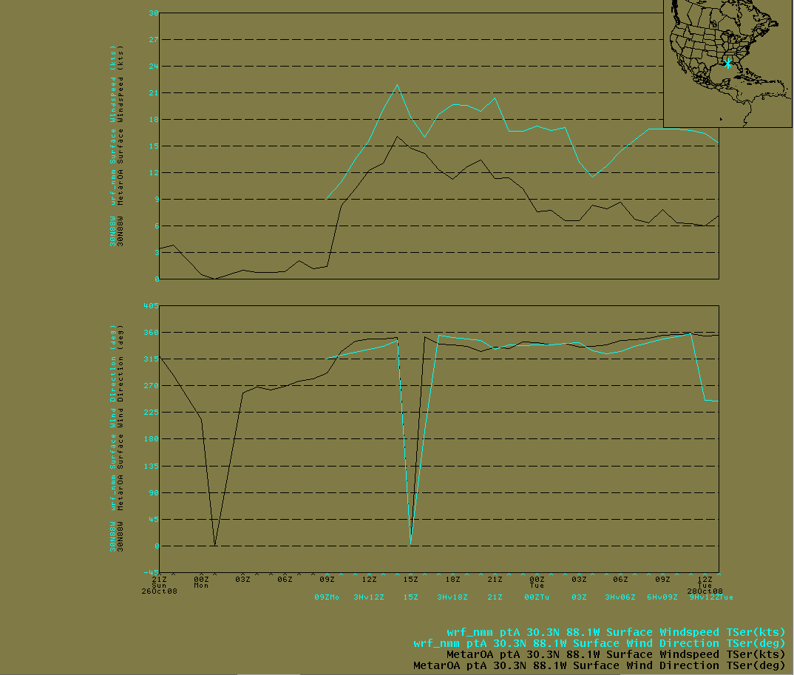
Example – Land Breeze – offshore drainage added to synoptic flow
DPIA1 - Wind Speed
DPIA1 - Wind Direction
Good luck catching the coarser with the GFS!
-This is what people want -

Slide 20
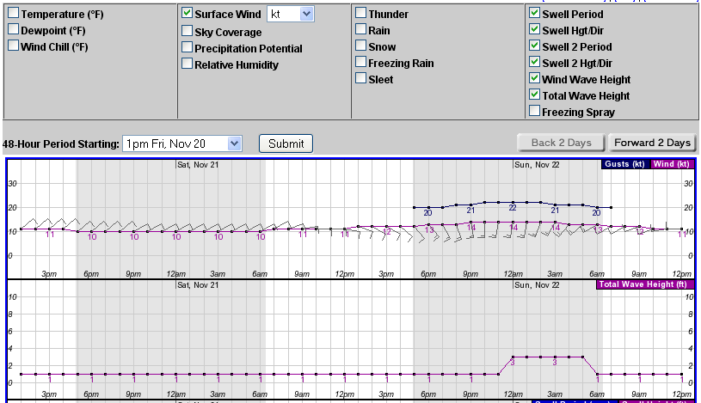
Example – Land Breeze – Offshore Drainage added to synoptic flow
Much better starting point for the “Point and click!” forecast in first 24 h!

Slide 21
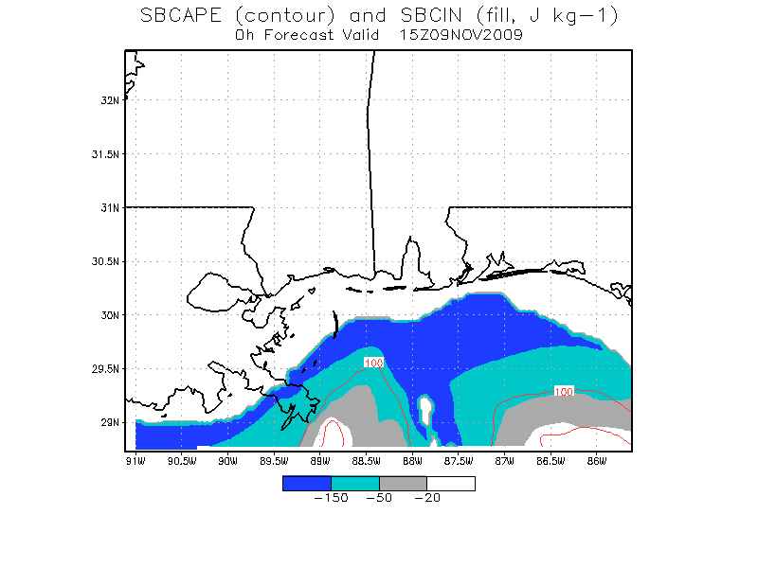
Example – T.S. Ida – no tornadoes! - Monitor vertical wind shear and thermodynamic instability characteristics closer to the scale they evolve and affect individual updraft evolution upon.
Shows CINH remained intact
potentially precluding tornadogenesis
from any developing mesocyclones!

Slide 22
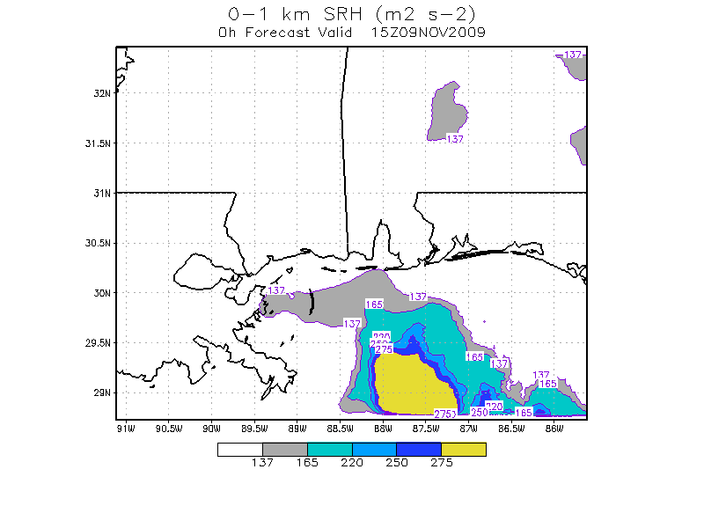
Example
Timing the developmental
onset of stronger VWS along
our coastal zones!

Slide 23
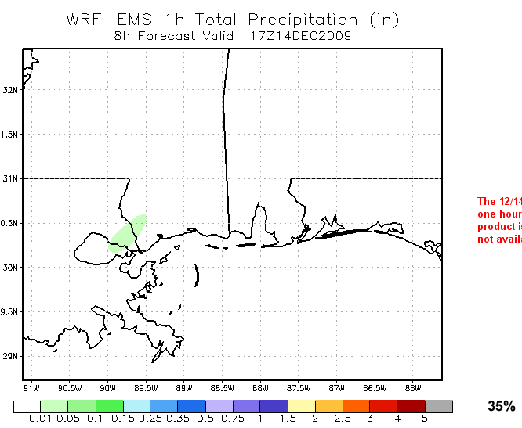
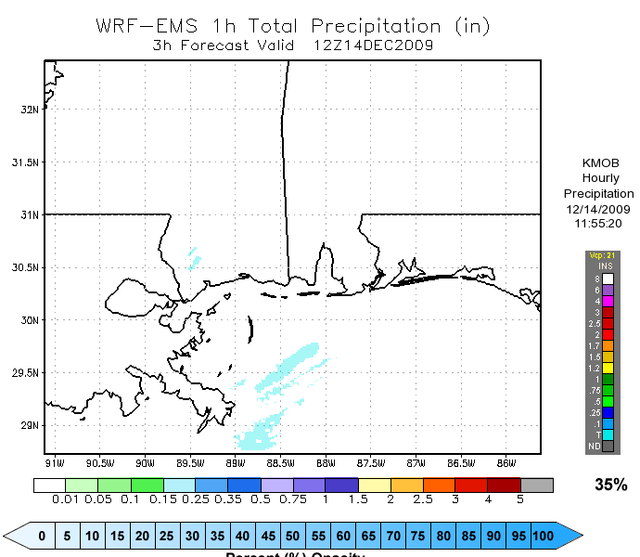
Known Limitations
Example - Slow spin-up of deep convection.
Monday, 14 Dec 2009 – 9Z Run

Slide 24
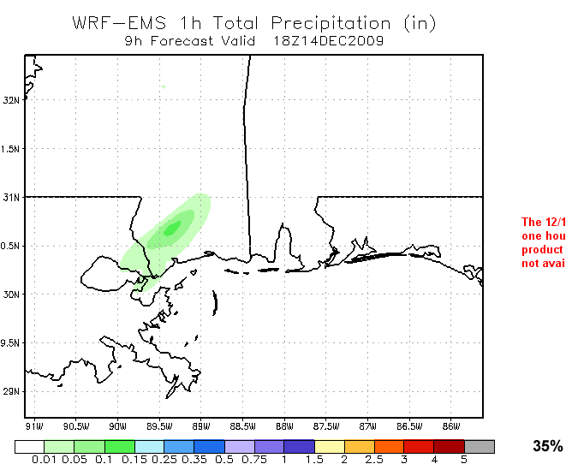
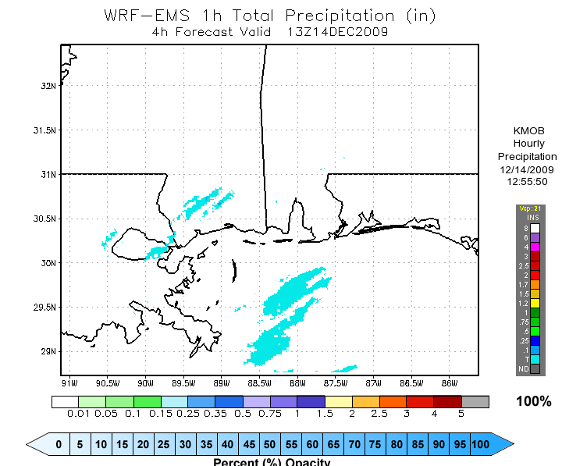
Known Limitations
Monday, 14 Dec 2009 – 9Z Run

Slide 25
Known Limitations
Model-generated thunderstorm downdraft becomes too dense causing unrealistic ‘cold pool’ propagation. ***Noticed this happens more often in Summer during NLY deep-layer mean flow events.
This also works more frequently the other way. Have observed cold pool to be too weak and lag behind deep convective MCS linear structures.
Noticed WRF has trouble saturating lower and middle troposphere with antecedent downstream deep-layer anticyclone.

Slide 26
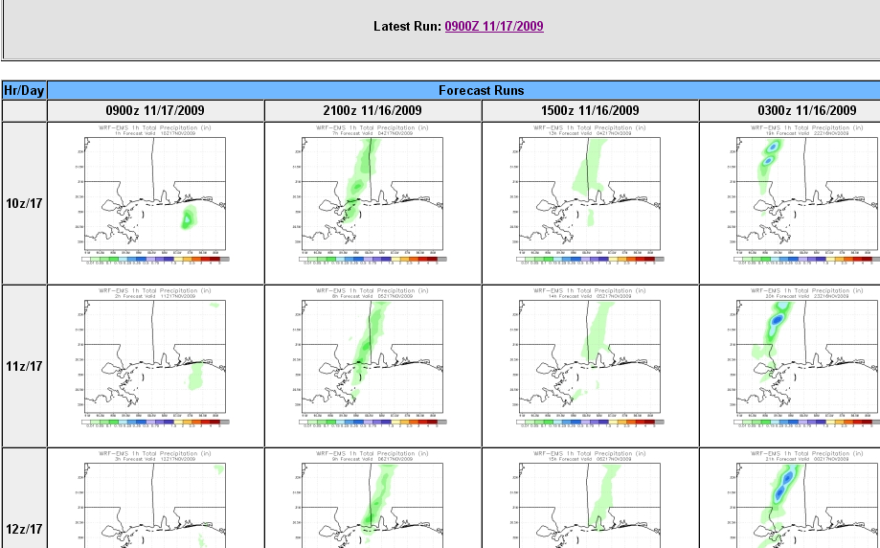
Web-based Visualization Enhancements
d(PROG)/dT
Using d(Prog)/dt to view four models at once for a single time

Slide 27
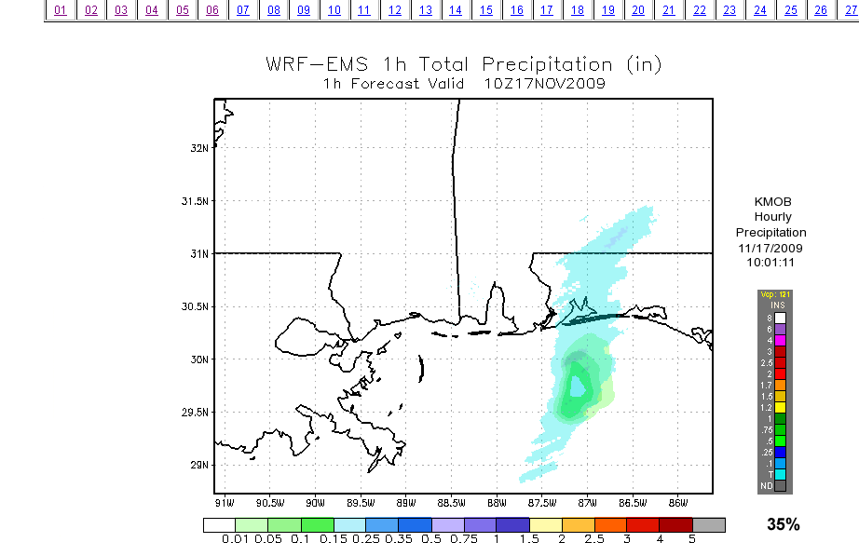
Ray’s Web-based Visualization Enhancements
Web-based Visualization Enhancements
***Toggle between Model-88D OHP***

Slide 28
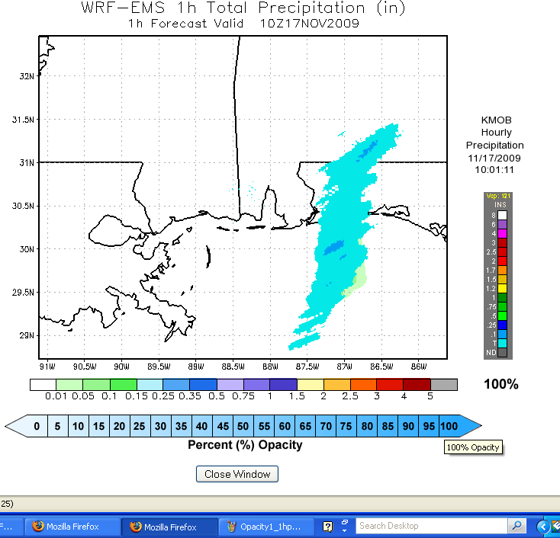
Web-based Visualization Enhancements

Slide 29
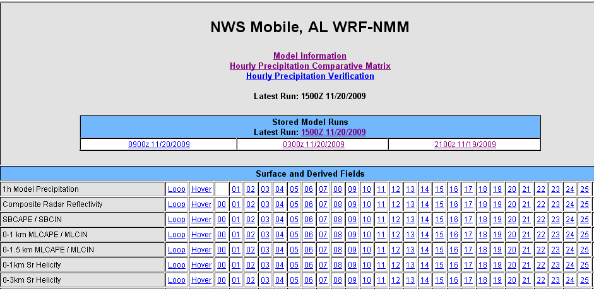
Future Plans
Expansion of Comparative Matrices (other fields)

Slide 30
Use of NASA SPoRT Products “Fair to Say”
Overwhelmingly, WFO MOB forecasters access MODIS products on AWIPS D2D.
SSTs also may accessed via MOB WRF Page.
The most accessed MODIS Products is the SST followed by the high resolution Aqua/Terra VIS passes.
Currently, using MODIS SSTs in GFE has not, as of yet, caught on. Most think of it as an ‘aid’ but not a staple.

Slide 31
Use of NASA SPoRT Products “Fair to Say”
Some are open-minded to using MODIS SSTs in GFE for sea-fog forecasting (NDFD T2m and U10m contours over MODIS SSTs as an image). Also, sea-breeze forecasting has applicability.
I feel MODIS SSTs given to the public on NWS Web pages may be the best benefit. Raises their awareness and ours.
AMSR-E – Products may be used with approaching tropical cyclone – otherwise GOES WV products dominate for now.
AWIPS ‘Red Banner’ idea to encourage greater use.

Slide 32
Use of NASA SPoRT Products “Fair to Say”
AWIPS ‘Red Banner’ idea to encourage greater use.
MODIS usage will increase when we start having more significant return flow events.
AMSR-E usage will increase if we constantly remind people to use it (exception: approaching tropical cyclone beyond radar range it will be primary).

Slide 33
Closing Remarks
Cannot say enough about the support we have been given from Kevin, Geoffrey and Jonathan.
Assimilation of NASA SPoRT data set(s) has and will continue to G-R-E-A-T-L-Y assist local modeling efforts – we need this to continue.
This is collaboration the way it ought to be carried out.
Thanks for everything!

