Slide 1
Convective initiation
Wfo miami

Slide 2
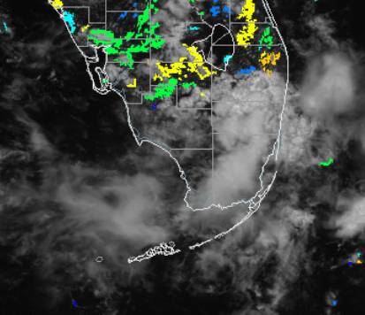
7/12/12 17:32
Case 1
Signal Strength Evolution
(True Lead time, white circles, is 30 minutes)
50-60 in Hendry and Glades county. 50 in North Collier county. 30 and 70 in Palm Beach county.
Storms affected the Palm Beach area and storms formed in Hendry and Collier later that afternoon.
= No convection was detected until 19:05. These storms originally formed just South of the area and eventually moved North into this area. The false lead time for this area was 93 minutes.
Glades
Hendry
Palm Beach
Collier
Broward
Monroe
Miami-Dade
Note: The evolution of the signal strength needs to be analyzed carefully not to attribute false long lead times to it.

Slide 3
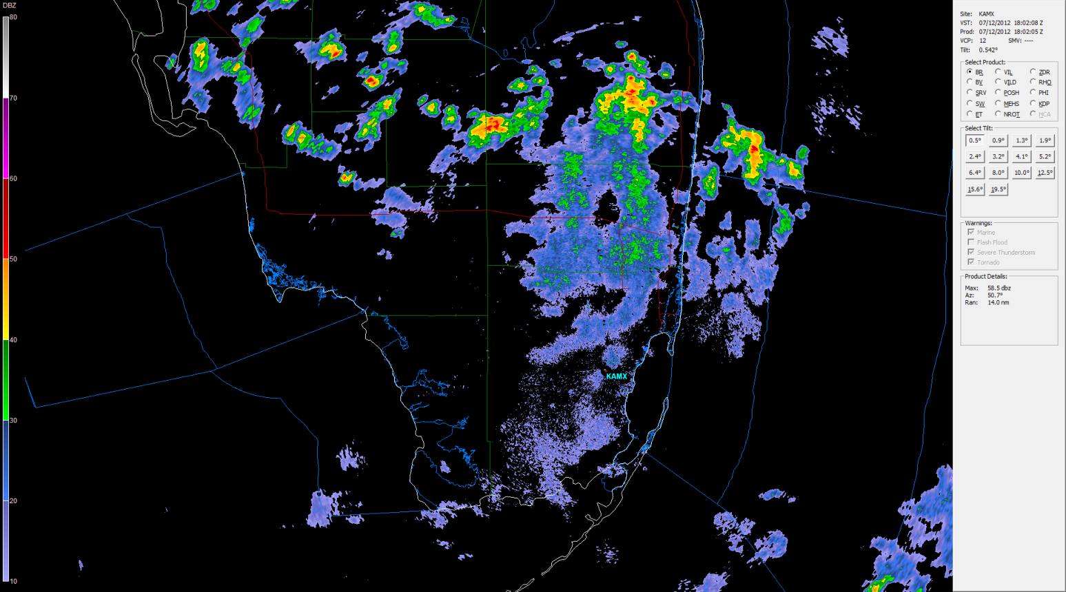
7/12/12 18:02 Radar Imagery
Case 1

Slide 4
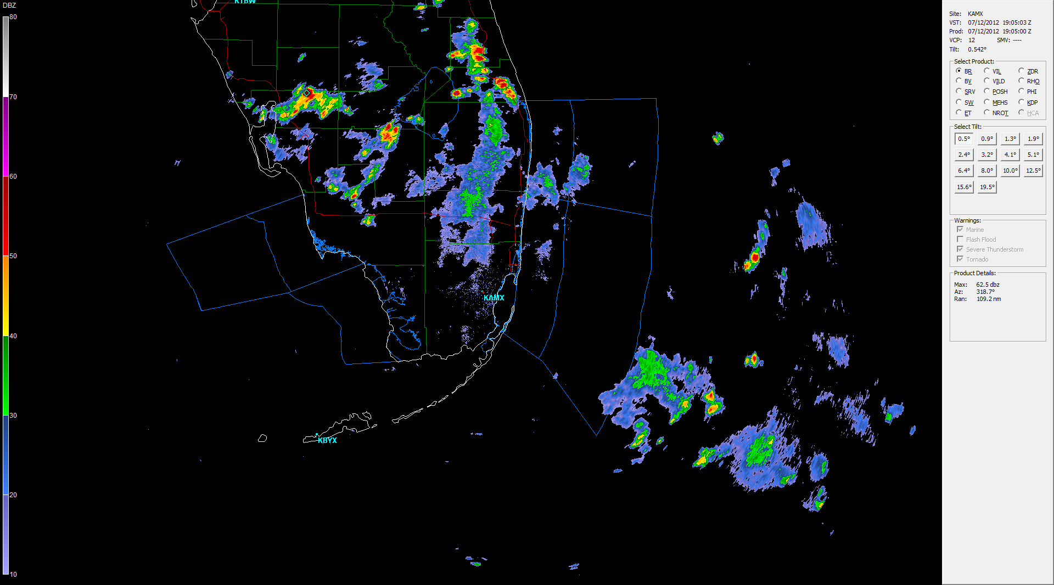
7/12/12 19:05 Radar imagery
Case 1

Slide 5
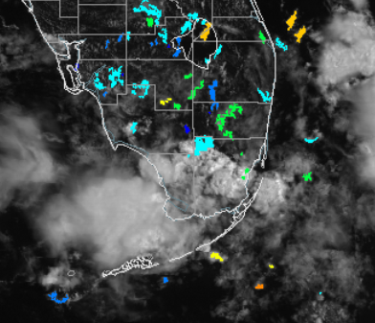
7/12/12 14:45
Case 2
Signal Strength Evolution
40 in Miami-Dade. 50 in Broward. 60 in Southern Hendry county.
Cloud cover slowly swept Miami and Fort Lauderdale which is why the signals went down.
=Didn’t see convection in this area until 16:26. The storms actually formed south of this area. False lead time for this area was 101 minutes.
=Didn’t see any convection in this area within a 2 hour period.
Glades
Hendry
Palm Beach
Collier
Broward
Miami-Dade
Monroe

Slide 6
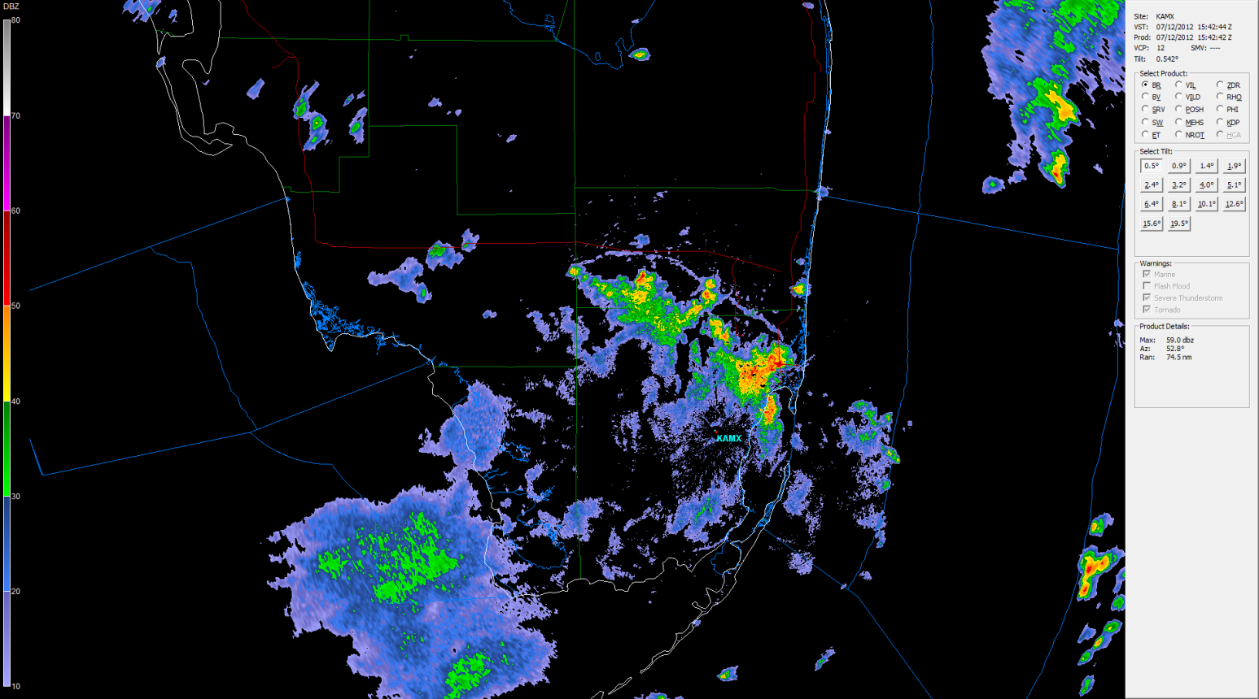
7/12/12 15:42 Radar imagery
Case 2

Slide 7
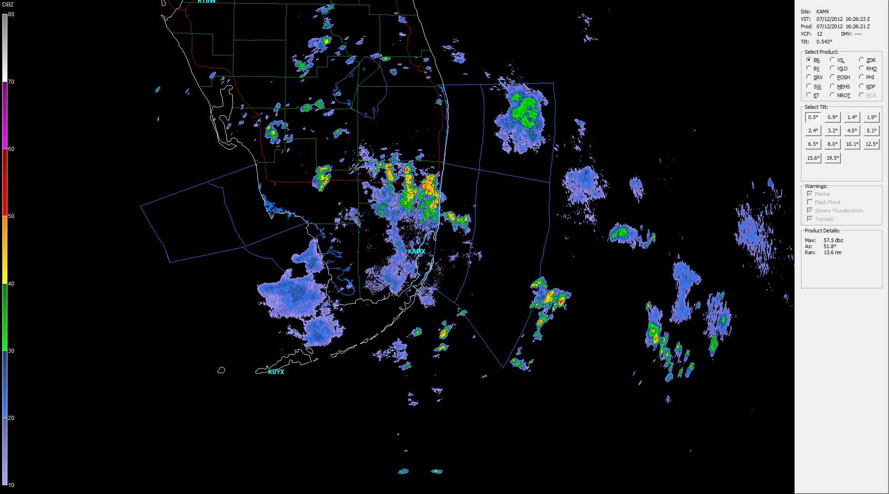
7/12/12 16:26 Radar Imagery
Case 2

Slide 8
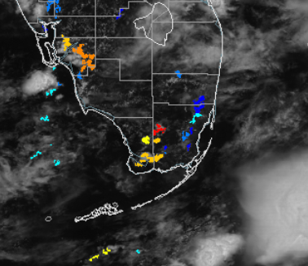
7/16/12 16:15
Case 3
Signal Strength Evolution
(True Lead time, white circles, is 15-20 minutes)
70-90 in West Miami-Dade county. 20-40 in East Miami-Dade county. 60-70 in Monroe county. 20 in Southern Broward county. 80 in Northern Collier county.
Signals strengthened for much of the region. Storms continued to develop in Miami-Dade and Collier county.
= No convection was seen until 18:05. The storms formed in this area. The false lead time for this area was 110
minutes.
Note: The evolution of the signal strength needs to be analyzed carefully not to attribute false long lead times to it.
Even with slow sea-breeze convection true lead times did not exceed 30 to 45 minutes.

Slide 9
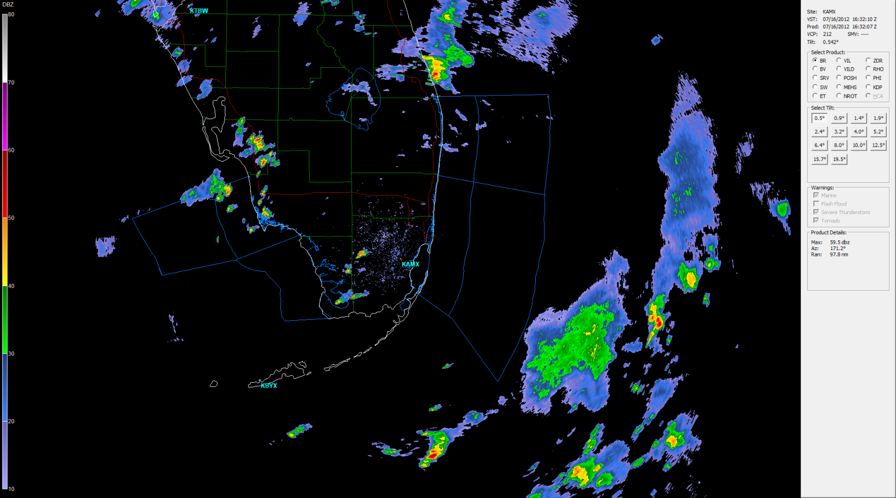
7/16/12 16:32 radar imagery
Case 3

Slide 10
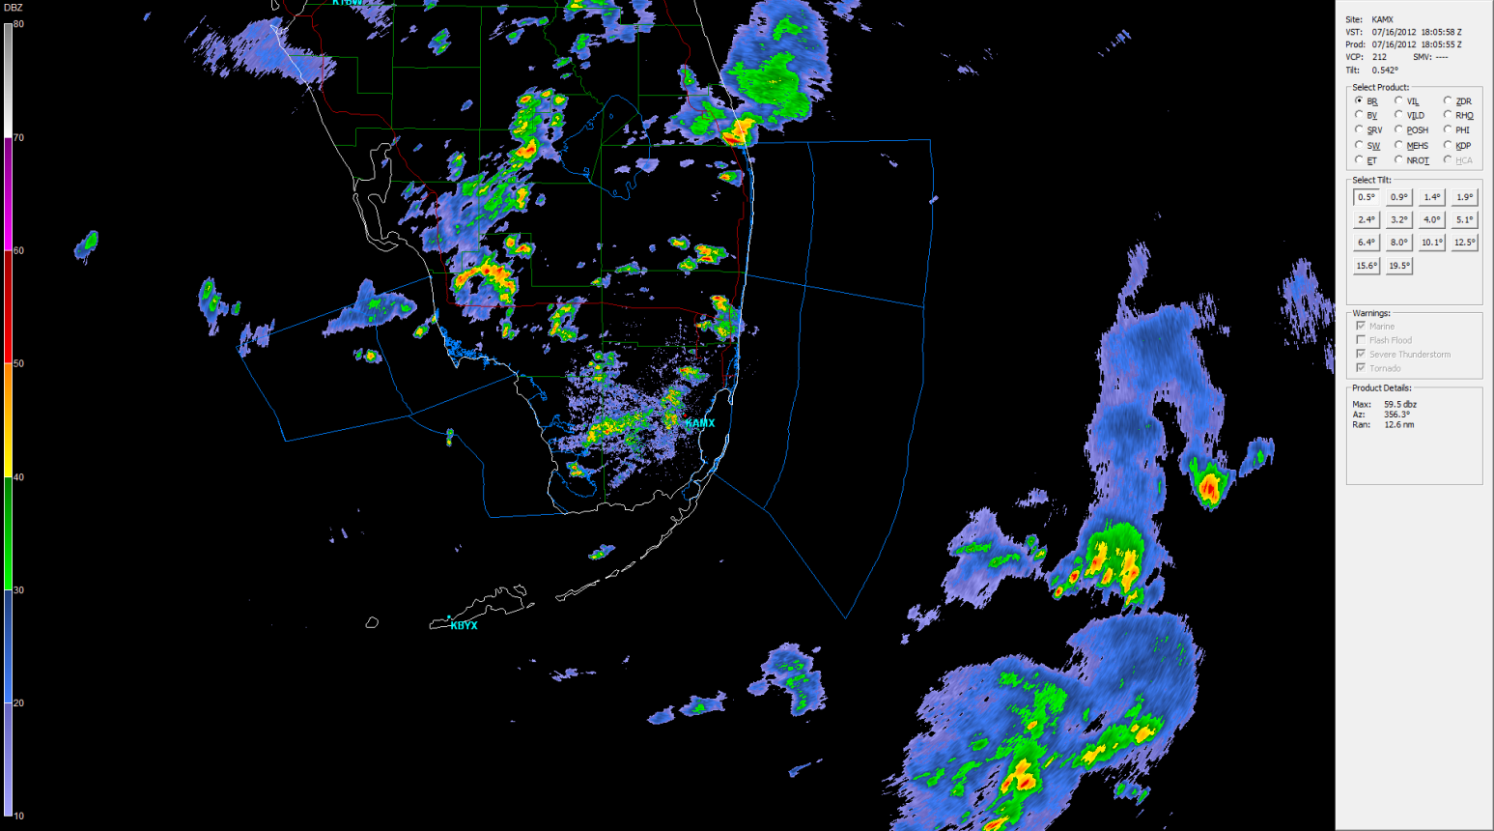
7/16/12 18:05 Radar imagery
Case 3

Slide 11
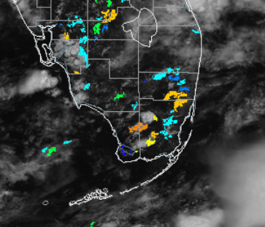
7/16/12 16:45
Case 4
Signal strength Evolution
40-80 in Miami-Dade county. 80 in Monroe county. 40-50 in Collier county. 50-70 in Glades county. 30-70 in Broward county.
Larger storms developed in Miami-Dade and Glades. Storms affected Collier and Western Miami-Dade.
= There was a little bit of convection on the right side of the large orange area but not anywhere else until 18:43. The storms eventually formed here. The false lead time was 118 minutes.
(True Lead time, white circles, is 15-20 minutes)
Glades
Hendry
Palm Beach
Broward
Collier
Monroe
Miami-Dade
Note: The evolution of the signal strength needs to be analyzed carefully not to attribute false long lead times to it.
The trend is important.

Slide 12
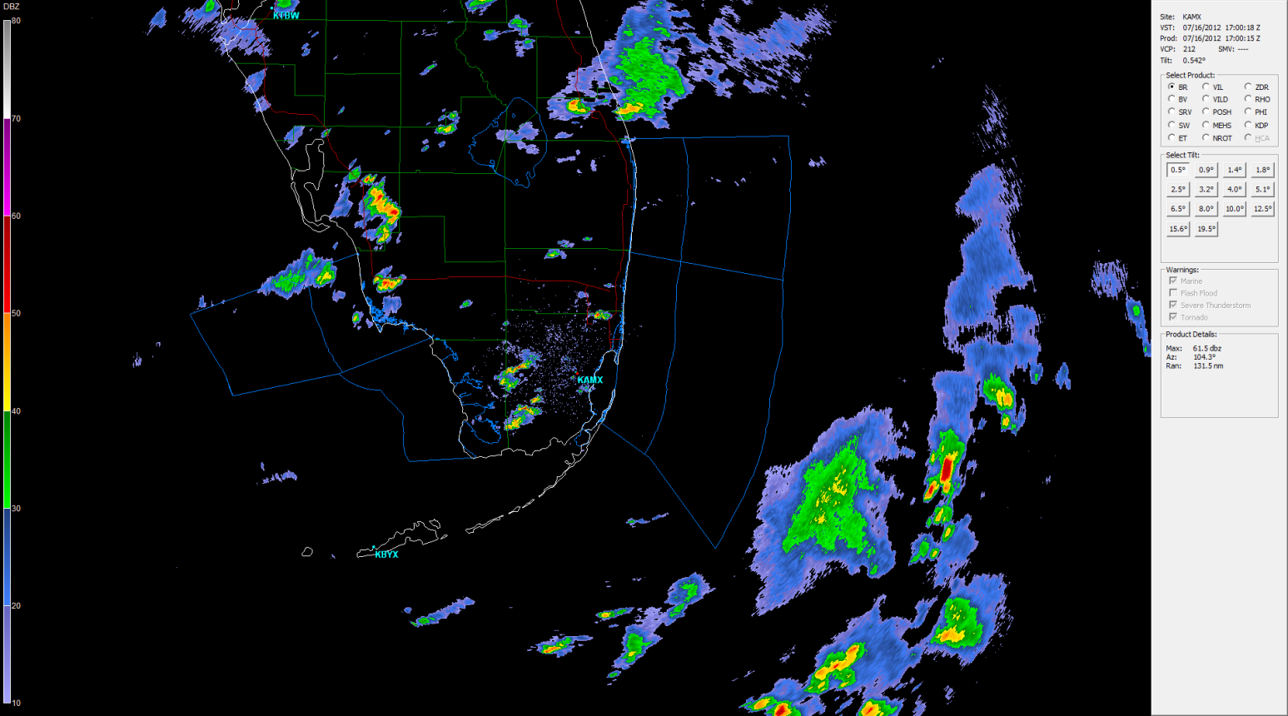
7/16/12 17:00 Radar imagery
Case 4

Slide 13
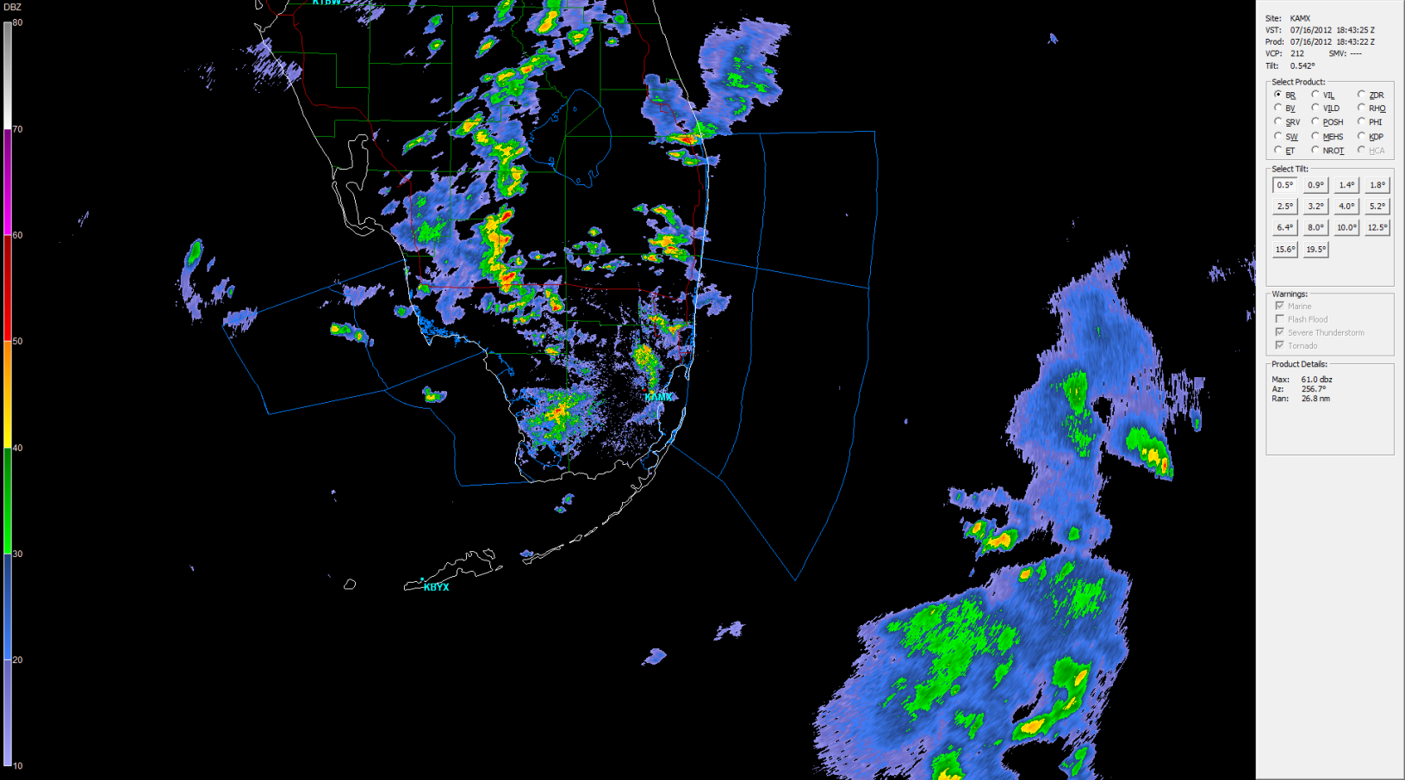
7/16/12 18:43 Radar imagery
Case 4

Slide 14
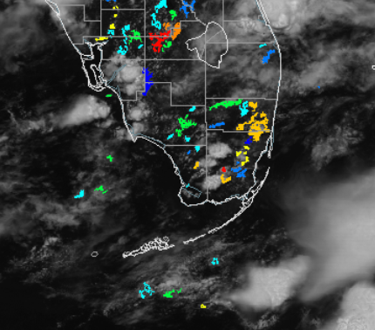
7/16/12 17:02
Case 5
Signal Strength Evolution
70 in most of Broward and in parts of Miami-Dade and Monroe. 60 in Eastern Miami-Dade. 90 in Western Miami-Dade and Glades. 50 in Collier and Northern Broward. 20 in Hendry.
Storms moved East in Miami-Dade, Collier, and Glades county. Chances of storms increased across the region. Storms formed a large line in western Miami-Dade.
= No convection was detected until 17:56. The storms formed in this area. The false lead time was 54 minutes.
(True Lead time, white circles, is 13-15 minutes)
Glades
Hendry
Palm Beach
Collier
Broward
Monroe
Miami-Dade
= No convection was detected until 19:02. The storms formed in this area. The false lead time was 2 hours.
Note: The evolution of the signal strength needs to be analyzed carefully not to attribute false long lead times to it.
The trend is important.

Slide 15
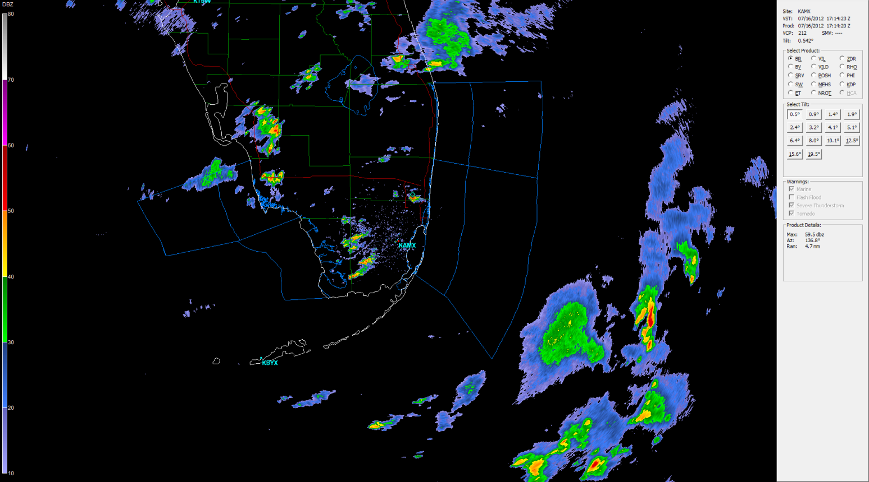
7/16/12 17:14 Radar imagery
Case 5

Slide 16
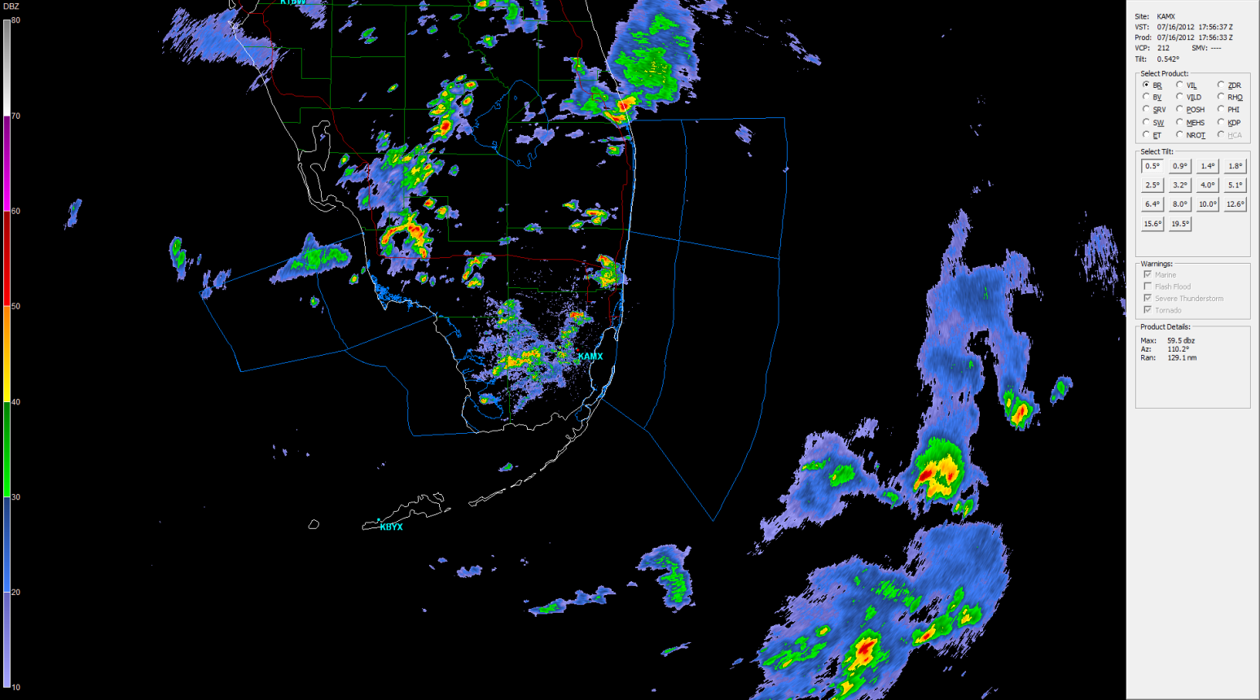
7/16/12 17:56 Radar imagery
Case 5

Slide 17
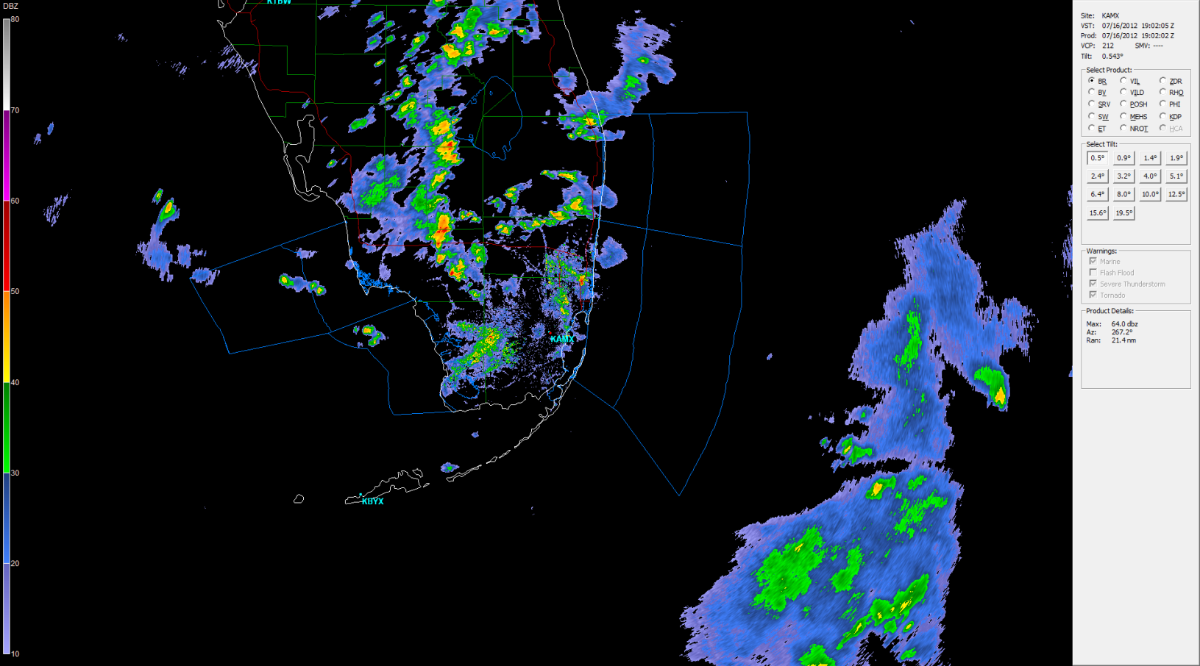
7/16/12 19:02 radar imagery
Case 5

