Slide 1
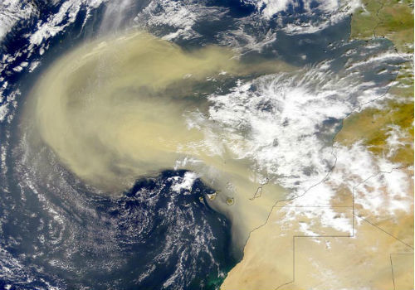
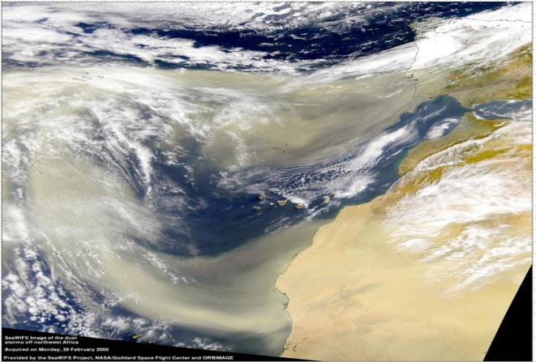
Characteristics Of The Saharan Dust Events Observed in The Month of July, 2012
At Miami Florida: Aerosol Physical Characteristics And Vertical Distribution
JERAL ESTUPINAN
National Weather Service, Miami, Florida
DAN GREGORIA
National Weather Service, Miami, Florida
ROBERTO ARIAS
University of Puerto Rico at Mayagüez

Slide 2
GOAL:
Goal: Quantify the Saharan dust events for the month of July 2012 at Miami
In terms of:
Aerosol Optical Depth (AOD)
PM2.5
LIDAR data

Slide 3
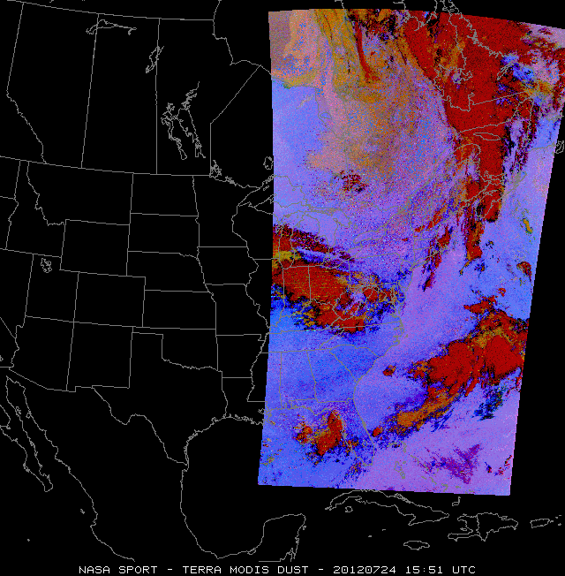
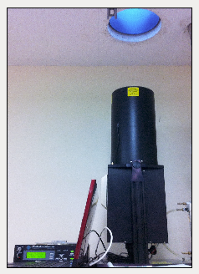
How are we doing this?

Slide 4
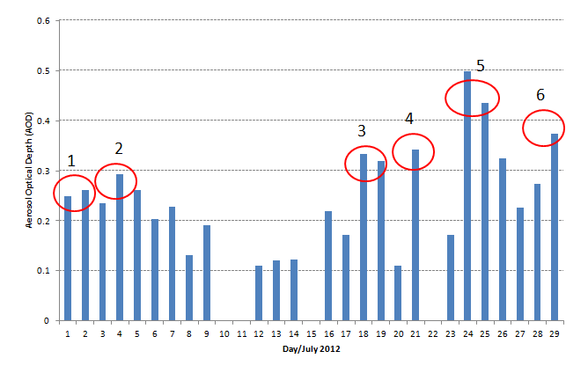
Six Saharan Dust Events in July 2012
Average daily AOD for the entire month of July of 2012 measured
from the AERONET network from Bay Biscayne, south of downtown Miami
500 nm

Slide 5
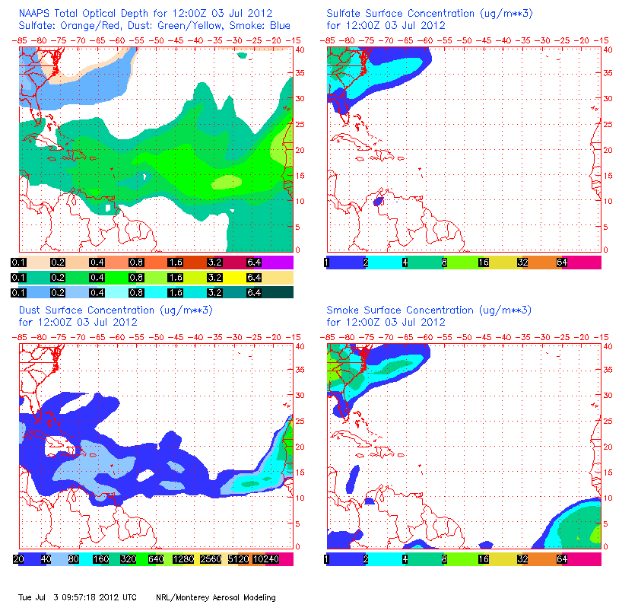
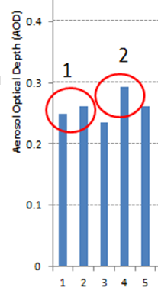
Six Saharan Dust Events in July 2012

Slide 6
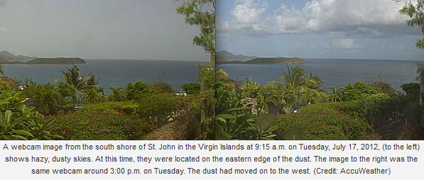
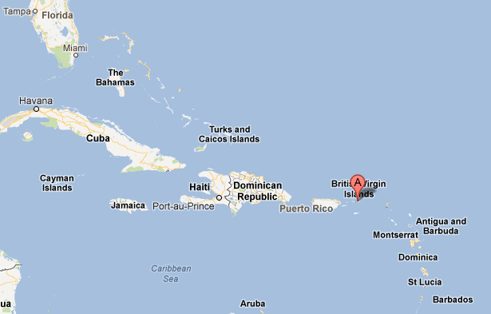
Approach of the dust to the Virgin Islands – July 17
July 17

Slide 7
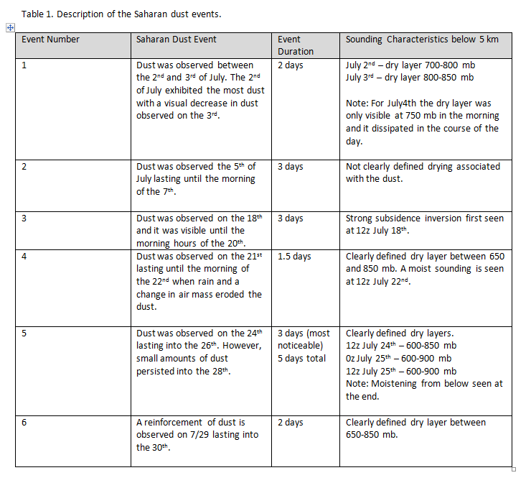

Slide 8
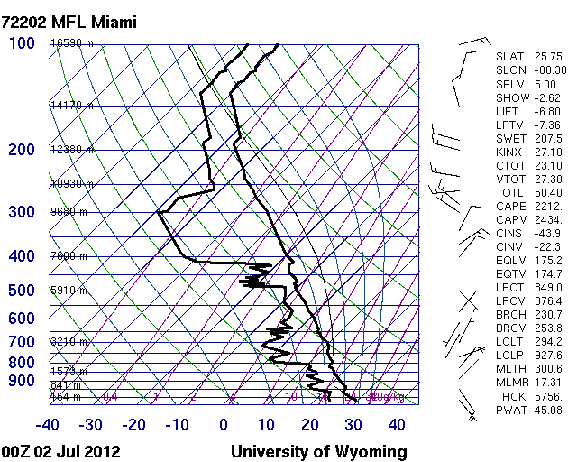
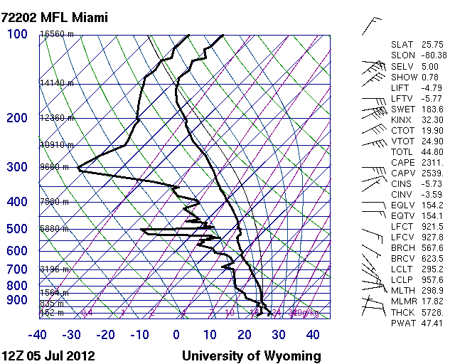
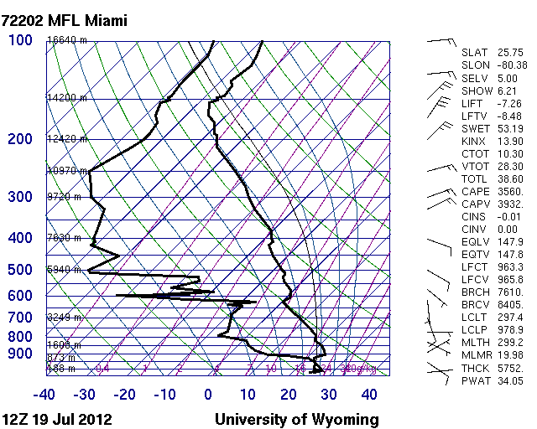
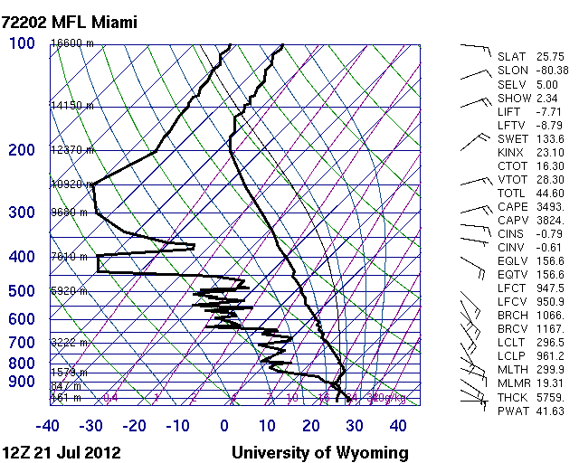
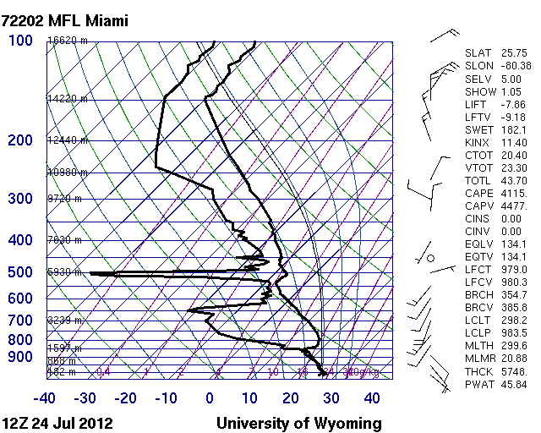
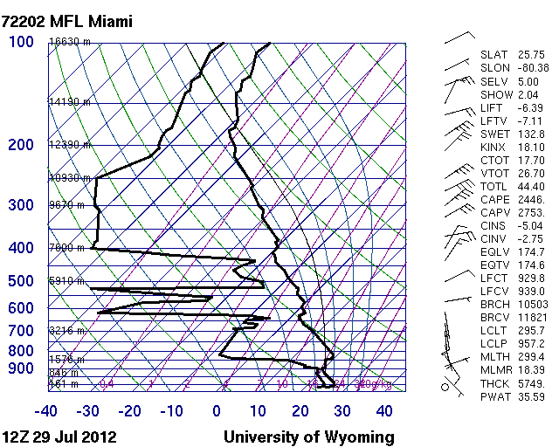
Soundings Showing Dry Layers

Slide 9
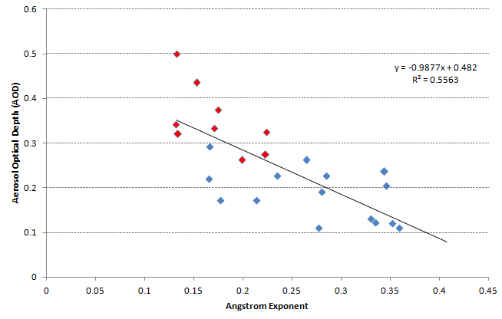
Angström values smaller than 0.25 and AOD larger than 0.25 accounts for almost all the dust events (red data points) indicating the presence of dust (larger particles, with larger optical depth).
The higher the aerosol optical depth the lower the Angström exponent

Slide 10
Angström exponent is the name of the exponent in the formula that is usually used to describe the dependency of the aerosol optical thickness, or aerosol extinction coefficient on wavelength.
Depending on particle size distribution, the spectral dependence of the aerosol optical thickness is given approximately by
The Angström exponent is inversely related to the average size of the particles in the aerosol: the smaller the particles, the larger the exponent. Thus, Angström exponent is a useful quantity to assess the particle size of atmospheric aerosols or clouds, and the wavelength dependence of the aerosol/cloud optical properties. For example, cloud droplet, usually with large sizes and thus very smaller Angström exponent (nearly zero), is spectrally neutral, which means, e.g., the optical depth does not change with wavelength.

Slide 11
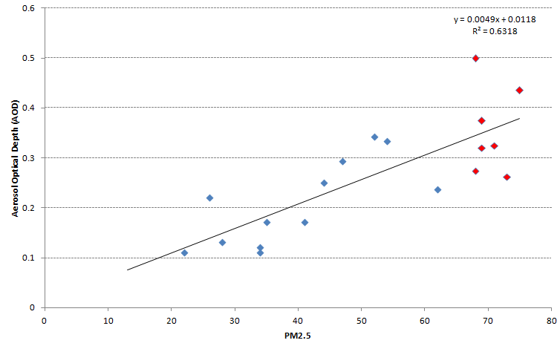
The average PM2.5 concentration for Saharan dust episodes during the month of July was 69.4 micrograms per cubic meter of air (µg/m³). For the days with no detectable Saharan dust the average PM2.5 concentration was 34.4 micrograms per cubic meter of air (µg/m³).
The day with the highest AOD (July 25th) corresponds to the highest PM2.5 of 75 micrograms per cubic meter of air (µg/m³). This suggests that a large portion of the PM2.5 particles measured at the surface come from the Saharan dust.

Slide 12
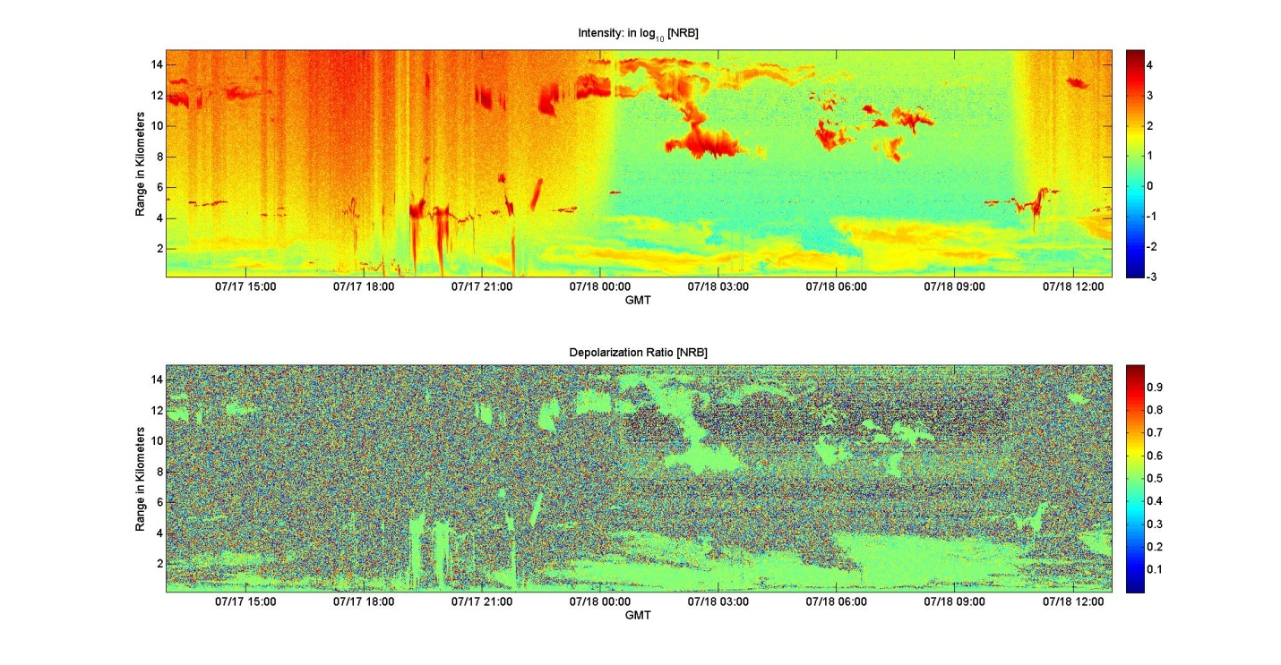
Arrival of the dust for July 18th (dust episode 3)

Slide 13
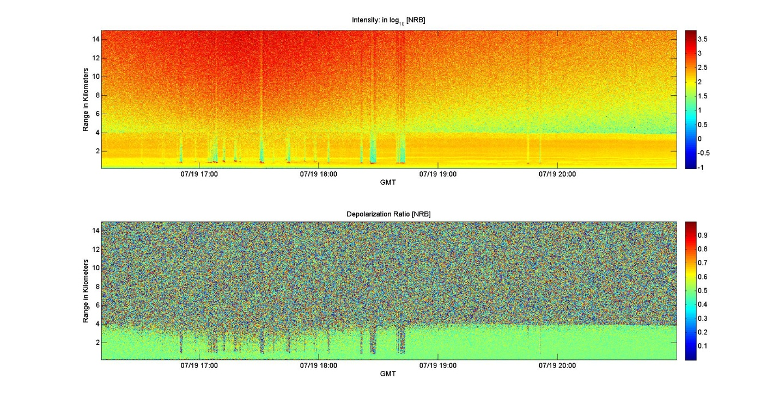
A more solid and uniform aerosol layer is observed on July 19th (dust episode 3)

Slide 14
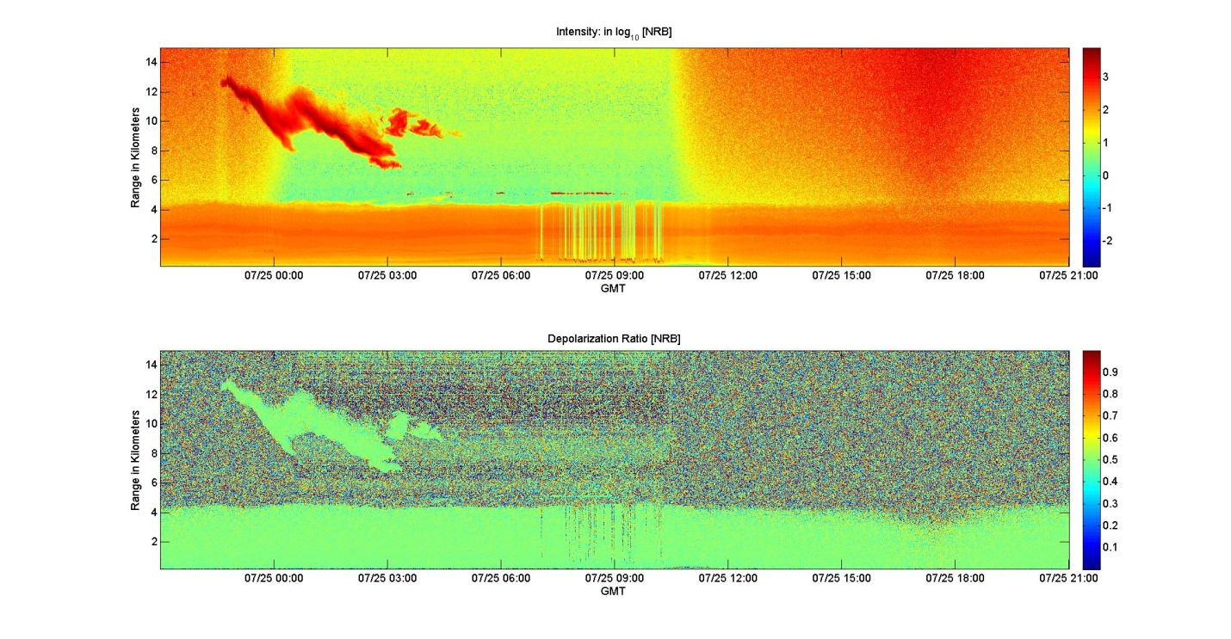
The strong Saharan dust event observed on July 25th shows a stronger return intensity, especially around an altitude of 3 km, than the intensity observed for previous Saharan dust events

Slide 15
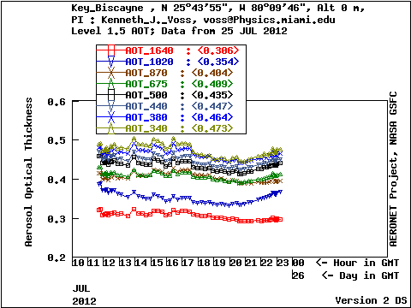
Aerosol Optical Depth – July 25 - 2012

Slide 16
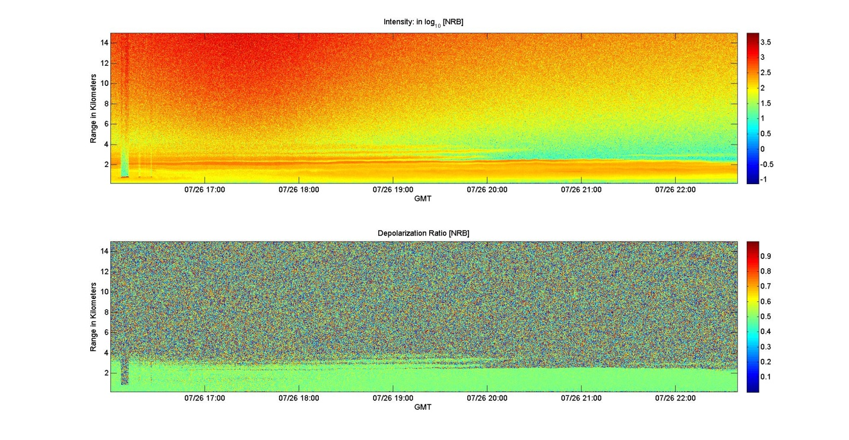
Event 5 (July 26) showed a gradual decrease in dust due to an air mass change. Presence of stratified layers and vanishing dust above 2 km after 20 UTC on July 26.

Slide 17
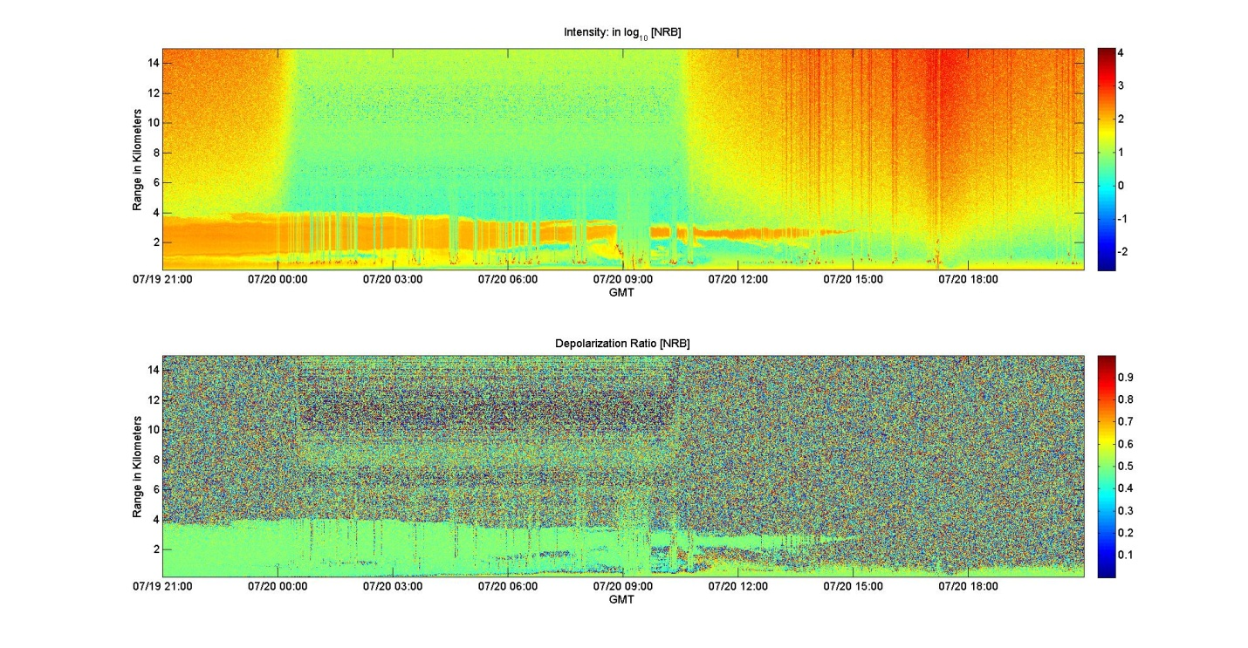
Event 3 ended with the intrusion of a few showers moving from the east associated with a change in air mass in the low levels. This was shown clearly with a decrease in dust in the low levels (July 20th).

Slide 18
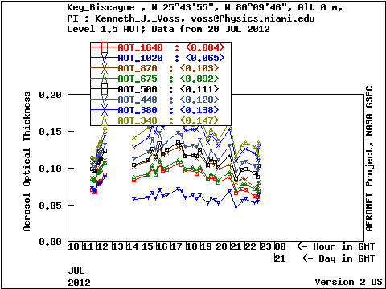
Aerosol Optical Depth – July 20 - 2012
Decrease in AOD

Slide 19
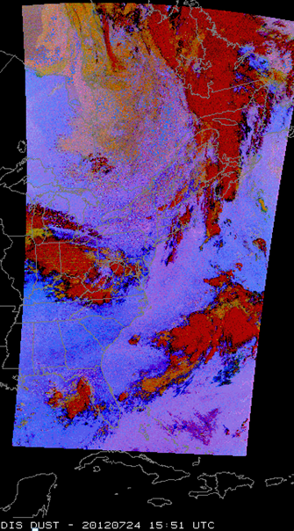
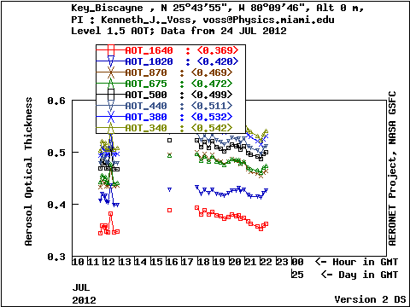
Six Saharan Dust Events in July 2012
in Miami, Florida
TERRA MODIS DUST – NASA SPORT 7/24/12
7/24
AOD (500nm)
July 24, 2012

Slide 20
Next day – July 25

Slide 21
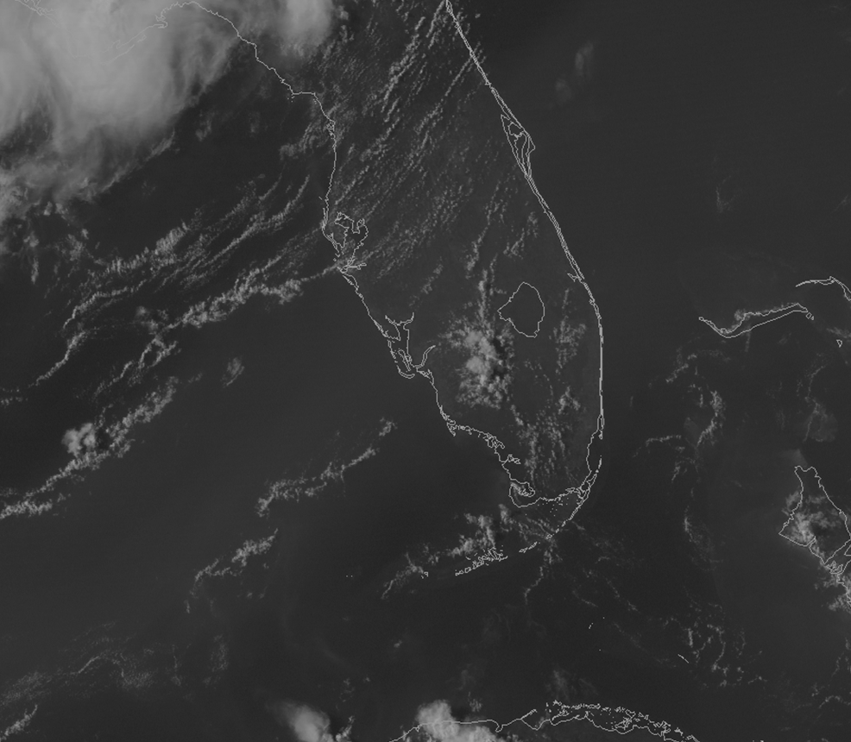
This MODIS GOES Hybrid Visible image taken on July 26, 2012 (2145 UTC) shows the presence of widespread Saharan dust indicated by the dull colors and diminished contrast.

Slide 22
Conclusions
The average daily AOD for days with Saharan dust was 0.333 with a maximum of 0.499 and a minimum of 0.262. The average daily AOD for days with no noticeable Saharan dust was 0.182 with a minimum of 0.11 and a maximum of 0.293
Angström values smaller than 0.25 and AOD larger than 0.25 account for almost all the dust events, indicating the presence of dust (larger particles, with larger optical depth)
The average PM2.5 concentration for Saharan dust episodes during the month of July was 69.4 micrograms per cubic meter of air (µg/m³). For the days with no detectable Saharan dust the average PM2.5 concentration was 34.4 micrograms per cubic meter of air (µg/m³).
The use of the LIDAR with polarization from the University of Miami South Florida’s Cloud-Aerosol-Rain Observatory (CAROb) was key to show the vertical characteristics of the Saharan dust. The Saharan dust extended from the surface to 4 km. The most intense event was observed between July 24 and 25th, showing dust up to 4.5 km with the densest layer between 2.5 to 3 km.

