Slide 1
AWIPS II Activities
SPoRT Virtual Workshop
13 February 2014
Transitioning unique data and research technologies to operations

Slide 2


Outline
Plug-ins
  Lightning Mapping Array
  Lightning Tracking Tool
Data:
  Land Information System
  Convective Initiation (UAHCI)
  Satellite data using Regionalsat plug-in
EPDT
  Building a community of AWIPS II developers

Slide 3
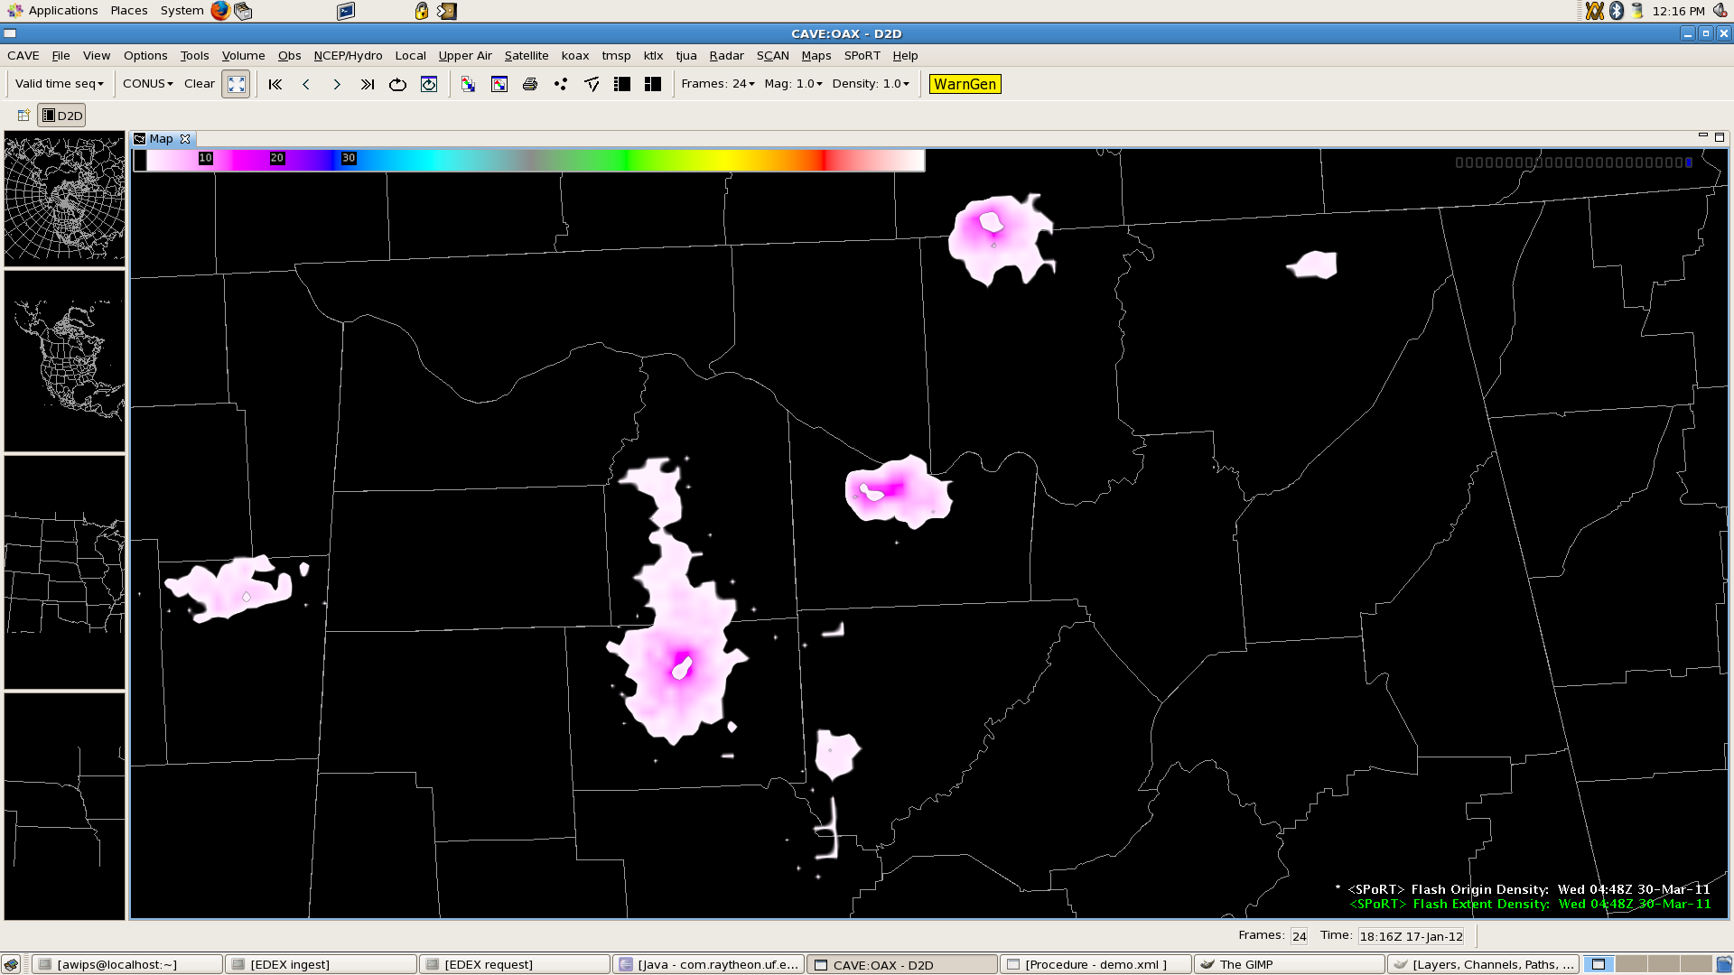

Lightning Mapping Array
Total lightning data from Lightning Mapping Arrays (LMAs)
LMA data is generated as ASCII, but we write as unique NetCDF
Helps with assessment of severe storms
Works for ground based networks and large-domain satellite-based products, such as GLM
Flash extent and flash origin density
Plug-in is currently in testing at several NWS Offices
Base-lined in 2014

Slide 4
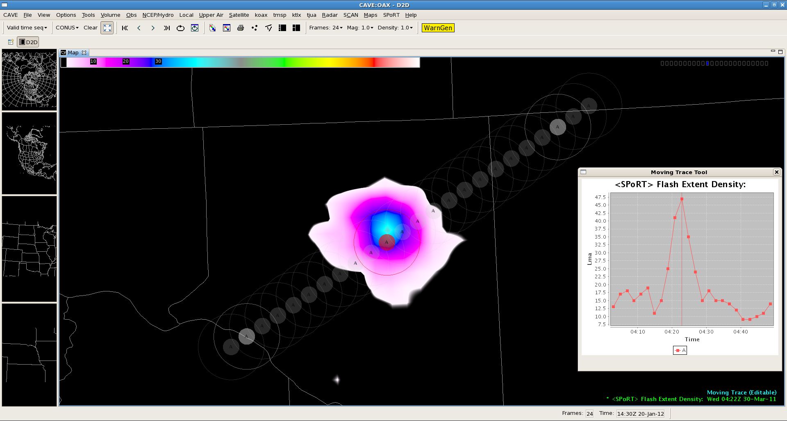
Lightning Tracking Tool
Total lightning jumps are at times related to severe weather. Forecasters need to quickly track several storms separately, tracking their intensity
Track multiple cells
Variable radii
Adjustable storm tracking
Color-coded chart for each data layer
Extrapolation for new data (frames)
Adjustments after Hazardous Weather Testbed (HWT) feedback
OPG testing May, 2014
Base-lined in 2014

Slide 5
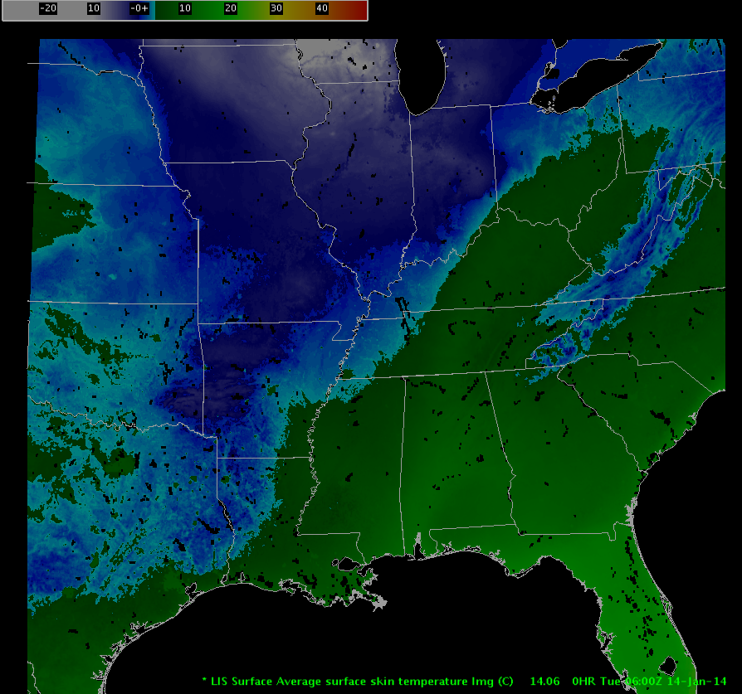
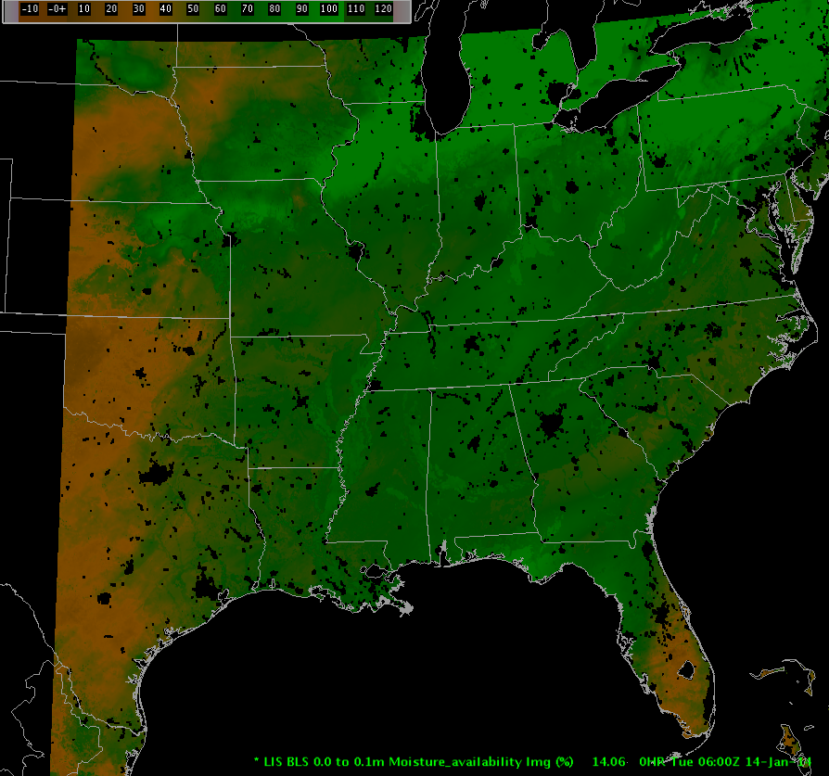

Land Information System(LIS)
Skin temperature
Soil Moisture Availability
Land Surface Data Assimilation System run at NASA SPoRT
Produces land information such as:
  Skin temperature
  Soil moisture availability
Currently in place as WFO Huntsville, AL for testing
Ingested using the grib2 plug-in

Slide 6
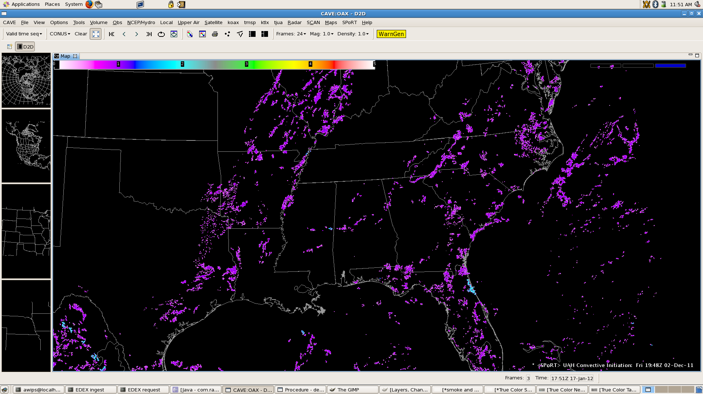
Convective Initiation
GOES-based data set generated at University Alabama Huntsville for short-term forecasts of convection
Ingested using the grib2 plug-in
GOES-East & GOES-West versions
UAH Convective Initiation (GOES-East)

Slide 7
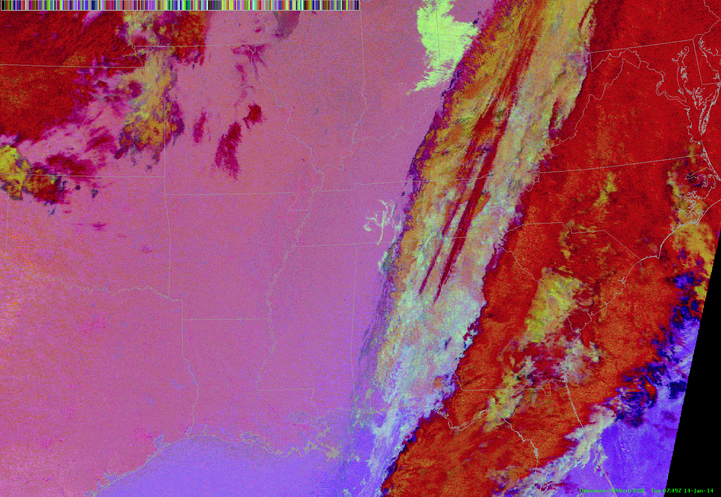
Satellite Data
MODIS Nighttime Microphysics RGB
Almost all SPoRT satellite data will be displayed in AWIPS II using the baselined plug-in, Regionalsat
Regionalsat works using the same netCDF files as AWIPS I
SPoRT is working to finalize all of its products
True 24-bit color will be supported
Currently WFO Huntsville is receiving:
-MODIS & VIIRS: Vis, LWIR, SWIR
-MODIS only: Water Vapor
-VIIRS only: DNB Rad., DNB Refl.
-MODIS & VIIRS RGBs: Nighttime Microphysics, True Color, Snow/Cloud
-MODIS RGB: Air Mass
-VIIRS RGB: DNB Rad., DNB Refl.

Slide 8
Experimental Products Development Team
Originally SPoRT formed EPDT internally to focus on:
  create advanced display capabilities for NASA research data in AWIPS II
  create training for AWIPS II development
Discovered broader need for AWIPS II development training within community
Funded jointly by GOES-R and NASA SPoRT
Bring together staff from NASA, NOAA’s CIs, and NWS to develop a critical mass of technical expertise (outside of Raytheon’s AWIPS II development team) which would focus on the development, demonstration, and transition of new plug-ins and tools to address the near-term needs of the GOES-R PG community
provide feedback to NWS and Raytheon on the external development process, including governance of locally developed AWIPS II software

Slide 9
Experimental Products Development Team
Past Meetings
Spring 2013 (Mar)– Group A – Hands-On Training
Fall 2013 (Sep)– Group A – Code Sprint
  Moving Meteogram, RGB, mPing, Mini-EDEX
Upcoming
Spring 2014 (Apr)– Group B – Hands-On Training
Fall 2014 (?)– Group B – Code Sprint

Slide 10
GOES-R Proving Ground
Lightning
  8+ LMAs (more on the way)
  Plug-ins (display and tracking) at 7 WFOs (via ATAN)
  Baselined Fall 2014
  In use Spring 2014 at HWT and OPG
GEO/LEO Hybrids (ABI Proxy)
  CONUS and Alaska partners and 2 NCs

Slide 11
JPSS Proving Ground
VIIRS DNB
  Evaluation completed with Front Range WFO partners
  Training efforts continue
Alaska
  Virtual Machines in use
  RGB Imagery for Aviation and Cloud Analysis Evaluation
  AWIPS II at Fairbanks: Products beginning to flow
  Training efforts continue
Hawaii
  Initial trip planned for Spring 2014

Slide 12
Questions

Slide 13
Future EPDT
Second learning workshop as follow-on to training for Group A
Merge Group A and Group B conference calls after Spring Meeting
Code Sprint in Fall 2014 for:
  Group A
  Group B

Slide 14
Group B
Group has been selected
  15 attendees
  Groups involved include:
    NWS SEC, NWS OH, NWS MDL, SSEC, CIRA, CIMMS/NSSL, NOAA GSD
Meeting planned for Spring, 2014
Conference calls have begun
Spring Meeting planned with learning similar to Spring 2013 meeting for Group A

Slide 15
EPDT Fall 2013 Meeting
Sept 24 - 26, 2013
Code Sprint format
EPDT subgroups worked on projects
  Moving Meteogram
  RGB Recipe
  mPing ingest and display
  Mini-EDEX
Significant progress and furthered learning

Slide 16
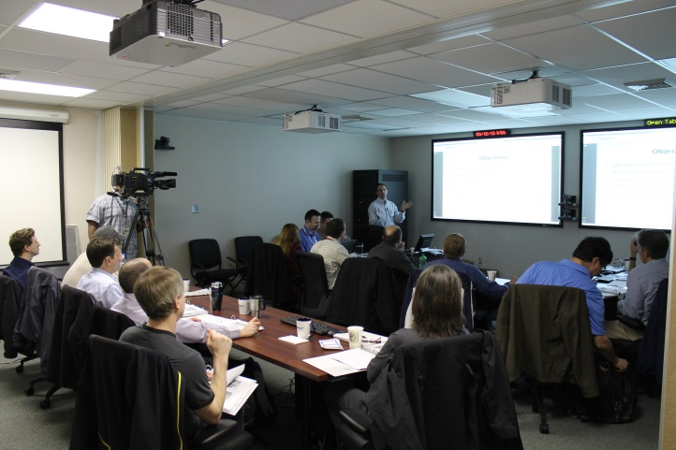
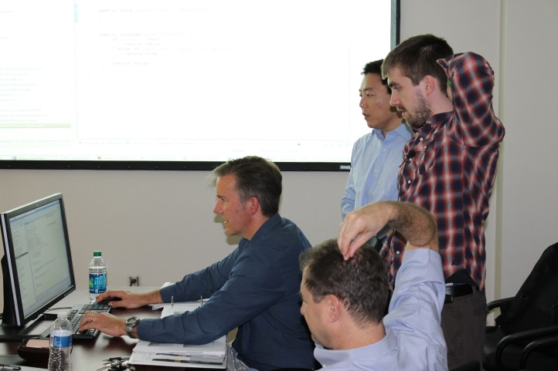
EPDT Spring 2013 meeting
Conference calls leading up to meeting.
March 12th- 14th, 2013
“Hands-on” Learning
Topics covering plug-in development from EDEX to CAVE.
Exercises
14 attendees
Feedback indicated a very successful meeting.
Training was recorded and provided back to NWS

Slide 17
Experimental Products Development Team
Hands-on team to learn by doing
Limited in size to facilitate small group learning and development activities – develop into a “train the trainer” team
One representative (each) from:
  NWS Regions
  NOAA Cooperative Institutes (and SPoRT)
  MDL and GSD
  Raytheon
  NWS SEC
  GOES-R PG AWIPS II developer
Organizational leads asked to nominate team member with appropriate qualifications
Team Lead: Jason Burks (NASA scientist and decision support system expert), formerly HUN WFO ITO
Advisor: Ed Mandel (NWS/OST SEC Development Branch Chief)
Bimonthly conference calls/ WebEx sessions
Biannual workshops at SPoRT AWIPS2 Development Facility

Slide 18
Experimental Products Development Team
Goal:
Bring together staff from NASA, NOAA’s CIs, and NWS to develop a critical mass of technical expertise (outside of Raytheon’s AWIPS II development team) which would focus on the development, demonstration, and transition of new plug-ins and tools to address the near-term needs of the GOES-R PG community
Objectives:
create a community environment to develop and share knowledge and expertise in the AWIPS Development Environment (ADE)
generate non-standard AWIPS II plug-ins for the ingest, analysis, and display of GOES-R proxy data in AWIPS II
provide feedback to NWS and Raytheon on the external development process, including governance of locally developed AWIPS II software

