Slide 1
TROPICS Proxy data
Ralf Bennartz
SSEC, UW-Madison
EES, Vanderbilt University

Slide 2
Overview
Two different sets of proxy data:
Simulated proxy data based on HNR simulations
FY-3C MWHS-2 overpasses over actual hurricanes from last four years

Slide 3
Simulated TROPICS data
We call them ‘Release 3’ proxy data.
Based on Nolan et al. HNR 30 Jul – 10 August 2005
Simulated full TROPICS 6-satellite constellation 30 degree inclination
Actual TROPICS observation geometry and channel settings
Use CRTM as radiative transfer model
In netCDF format, but not in final Level-1 file format (this will be ‘Release 4’).

Slide 4
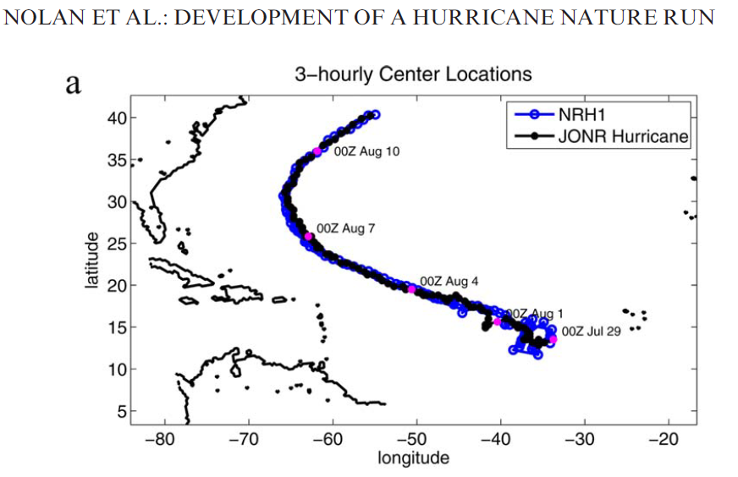
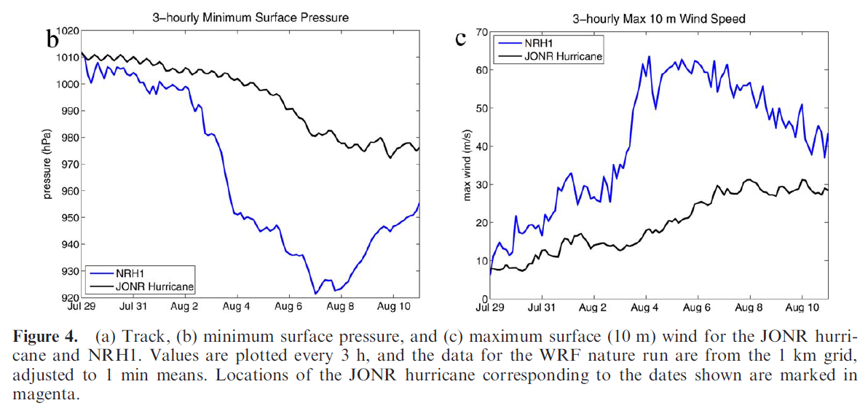
Hurricane WRF Nature Run 1
Black: D01 27-km Spacing (240 x 160 = 6000 km x 4000 km)
Red: D02 9-km Spacing (120 x 120 = 1044 km) Nested Grid
Blue: D03 3-km Spacing (240 x 240 = 700 km) Nested Grid
Green: D04 1-km Spacing ( 480 x 480 = 480 km) Nested Grid

Slide 6
RELEASE 3 PROXY DATA
Data available in 5-minute increments.
File-naming convention for individual TROPICS granules for Release 3:
tropics_222_01_DAY_009.2005_08_01_S1710_E1715.noise.nc
tropics_ <constellation> _ <satid> _DAY_ <day_number_in_orbit_simulation> . <HNR_YEAR> _ <HNR_MONTH> _ <HNR_DAY> _S <HNR_START_HHMM> _E <HNR_END_HHMM> .noise.nc

Slide 7
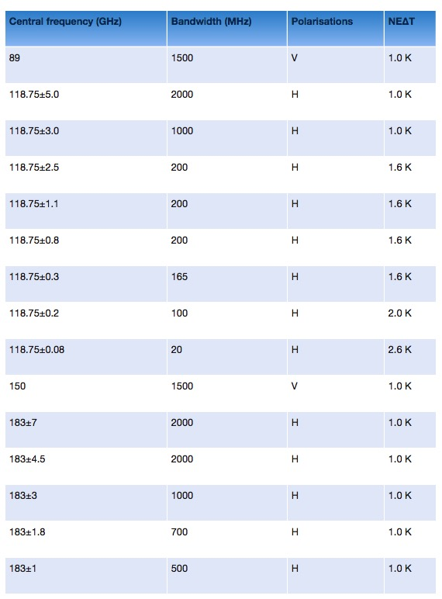
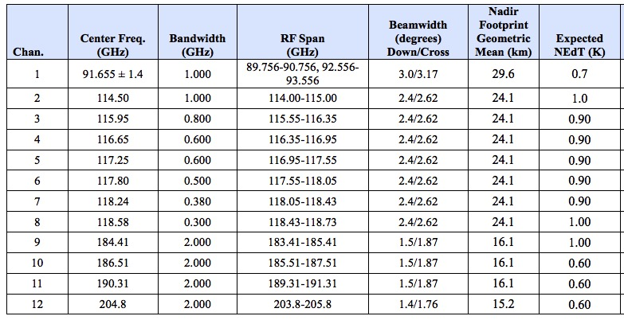
FY-3C as proxy for TROPICS
FY-3C MWHS-2 Channels
TROPICS channels

Slide 8
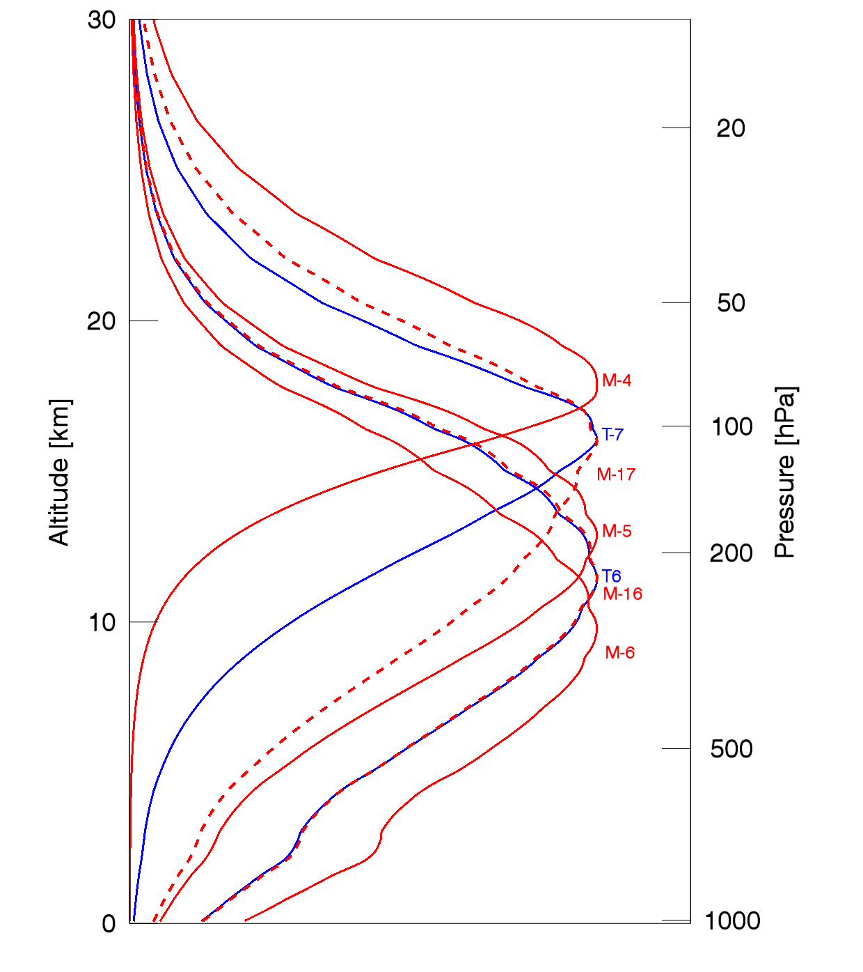
FY-3C as proxy for TROPICS
Weighting functions
O2 channels
TROPICS 6 = (CH5+CH6)/2 of MWHS-2. Excellent proxy
TROPICS 7 ~ (CH4+CH5)/2 of MWHS-2. Ok proxy.
WV channels:
TROPICS 11 ~= MWHS 15
TROPICS 10 ~~ MWHS 14
TROPICS 9 ~~ MWHS 11

Slide 9
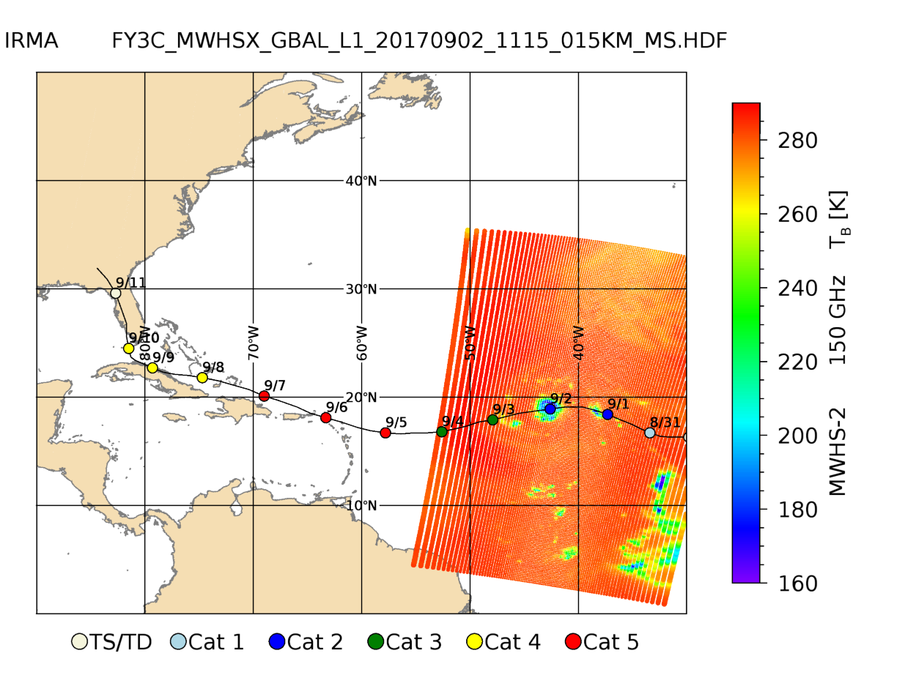
FY3C proxy data

Slide 10
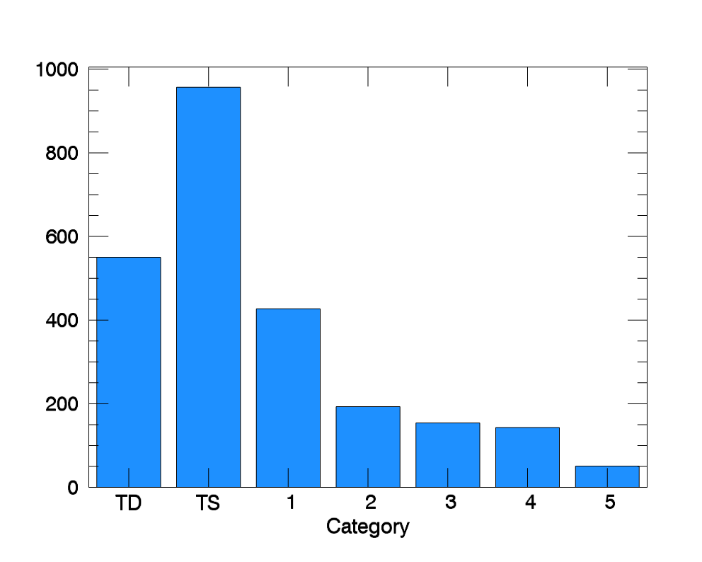
FY3C proxy data
Number of overpasses per tropical storm category

Slide 11
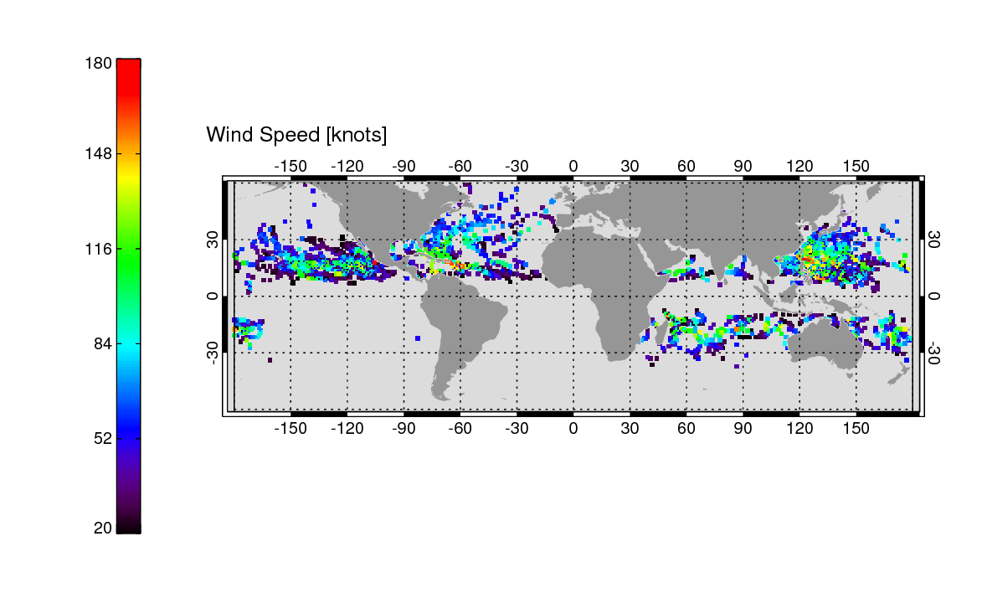
FY3C proxy data
Intensity and position of the 2475 cases

Slide 12
Contact Ralf Bennartz if you want to obtain the FY-3C data or the Release 3 HNR simulations.
ralf.bennartz@Vanderbilt.edu

