Slide 1
Hurricane Dorian and the Value of Real-Time Satellite Soundings
Rebekah Esmaili, Nadia Smith, Chris Barnet, Jason Dunion, Jonathan Zawislak, Lihang Zhou, Mitch D. Goldberg

Slide 2
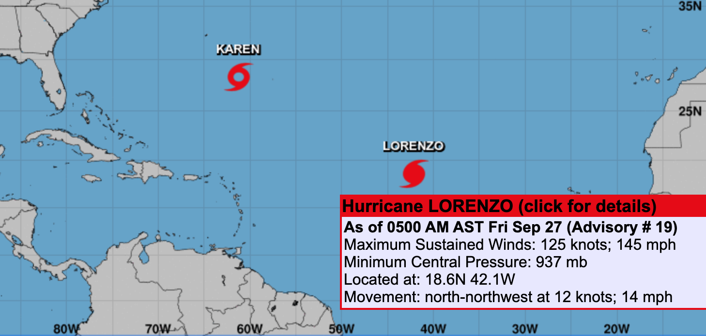
Reasons to Participate in the Hurricane Field Program
NUCAPS can provide information on Tropical Cyclone environment.
Gulfstream-IV (GIV) flights over Tropical Cyclones are not coordinated with satellite overpasses.
Connected with the Hurricane Research Division (HRD) to:
Gauge interest and provide feedback
Coordinate to time research flights with overpasses
Today’s NHC Outlook
NOAA Gulfstream IV
Notes:
Logistics of Hurricane flight/why
NUCAPS value → Situational Awareness
Flight value → Evaluate NUCAPS, learn about user needs
WIN-WIN! As Greg put it, it’s a helpful interaction for developers to work directly with users.

Slide 3
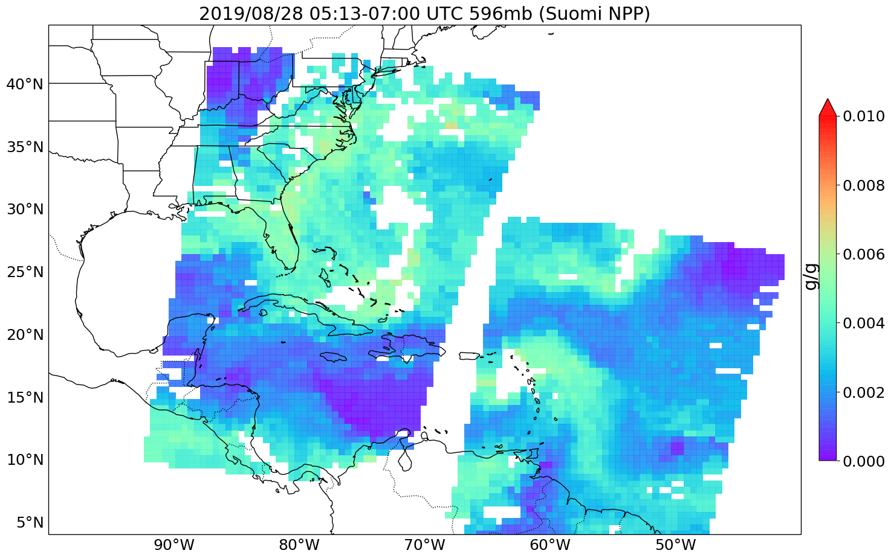
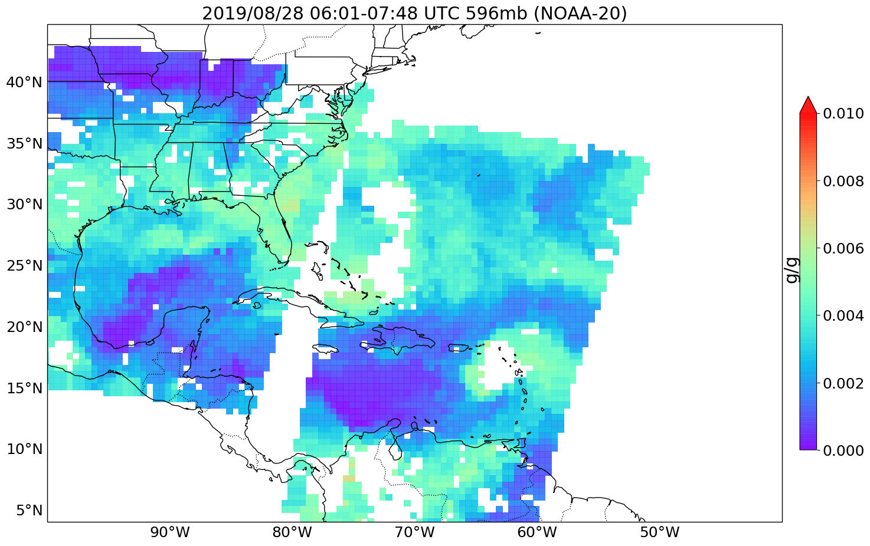
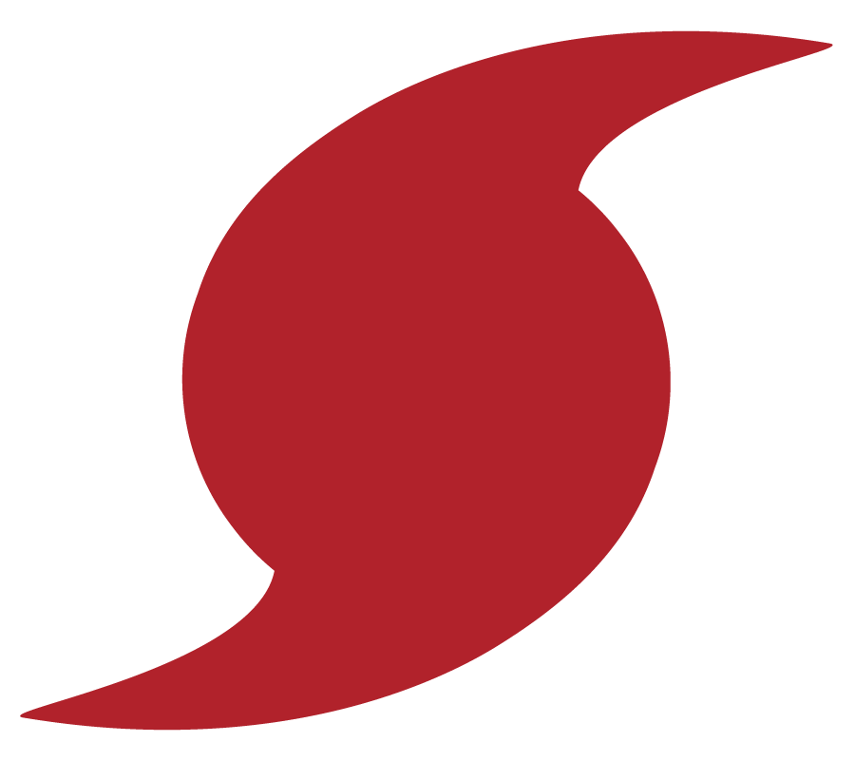
Real-time images to NOAA’s Hurricane Research Division in Miami to support Forecasts
Community Satellite Processing Package (CSPP) processes NUCAPS from Direct Broadcast sites – NUCAPS available w/in 20 mins of overpass
Hurricane Dorian: dry air entrainment modulated development and movement – increased uncertainty in forecast.
Below, NUCAPS captures dry air intrusion into then Tropical Cyclone Dorian.
NUCAPS 596 mb water vapor
NUCAPS 596 mb water vapor
Suomi NPP
NOAA-20
700 UTC
601 UTC
513 UTC
748 UTC
Dry air intrusion
Dry air intrusion
Hurricane Dorian
From CSPP direct broadcast from Miami and Puerto Rico
8/28/2019
Notes:
Direct broadcast + CSPP → Miami, Puerto Rico
Images w/in 20 mins of overpass

Slide 4
Suomi NPP
NOAA-20
NUCAPS retrievals are made from both Suomi NPP and NOAA-20, which have orbits 50 minutes apart.
Category 5 Hurricane Dorian was captured by Suomi NPP, but in an overpass gap during NOAA-20’s orbit.
Utilizing two satellites in operations ensures data availability at all locations.
NUCAPS 706 mb water vapor
NUCAPS 706 mb water vapor
AM Orbit
Gap in overpass
PM Orbit
Hurricane Dorian
From CSPP direct broadcast from Miami and Puerto Rico
9/2/2019

Slide 5
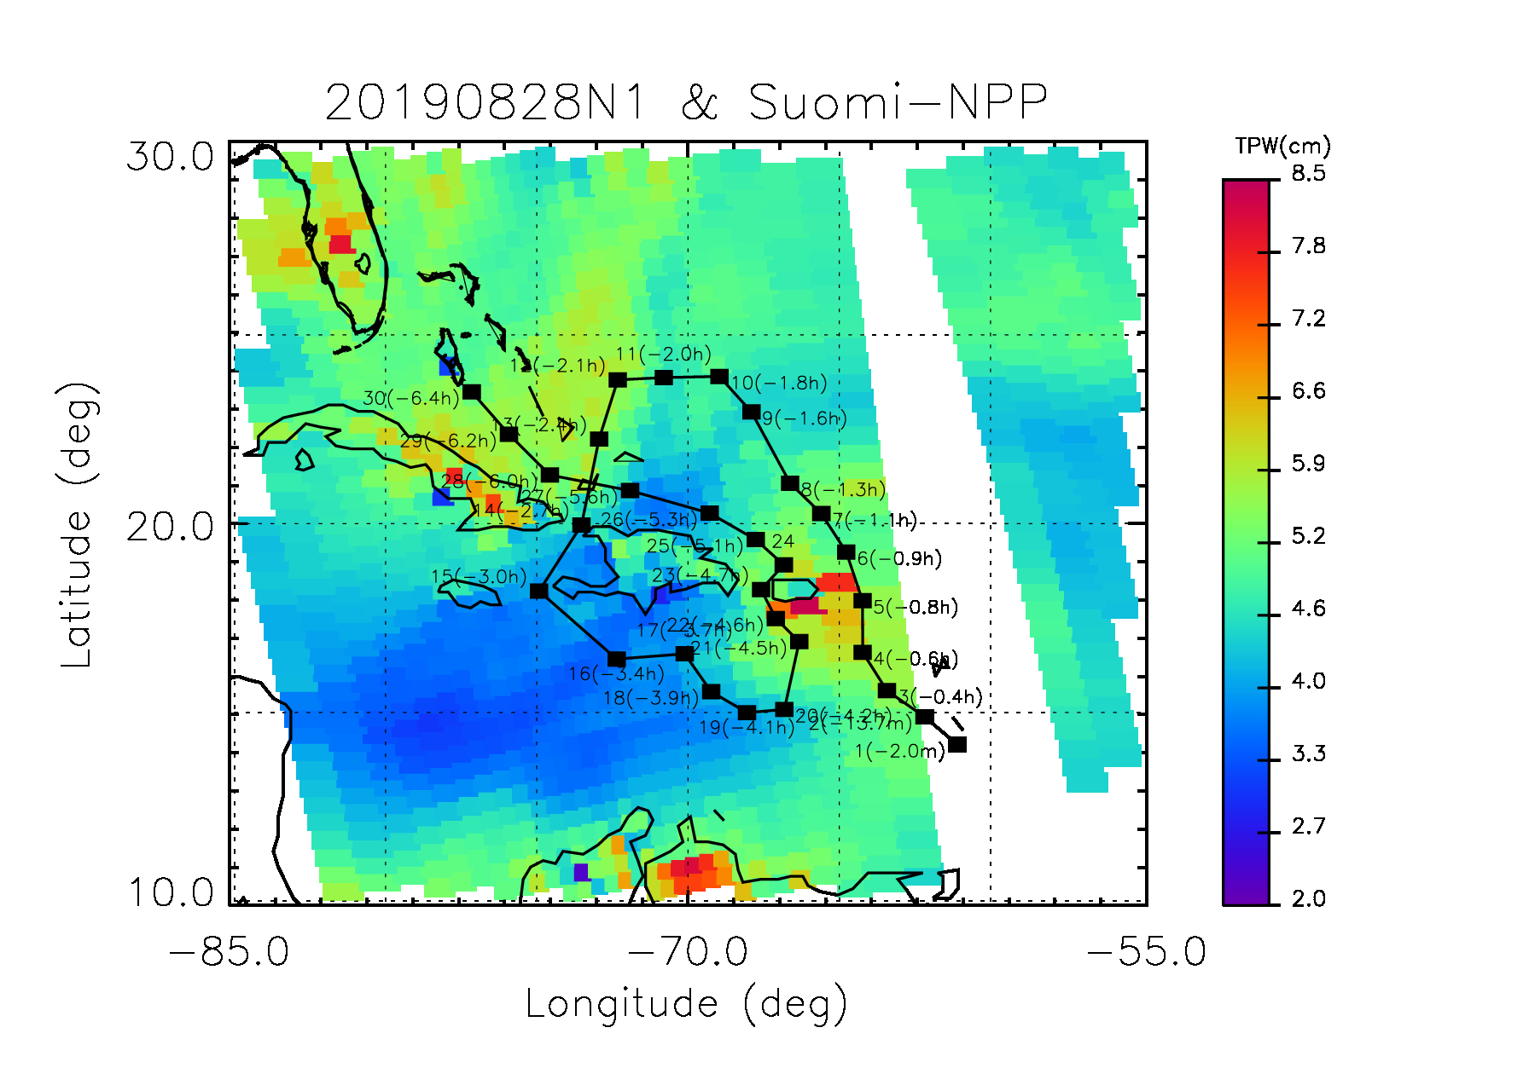
G-IV flights do not consider satellite overpasses in their timing
08/28/2019 Suomi NPP
Why should we coordinate flights?
Most GIV recon flights takeoff in morning and evening to be timed with the model runs.
At best, can only use a few of the dropsondes from the AM flight
Suomi NPP: 10 useful sondes
After 2 hours, the tropical atmosphere has already changed and the sondes are not comparable.
< 2 hours from overpass
18:54 UTC
Hurricane Dorian

Slide 6
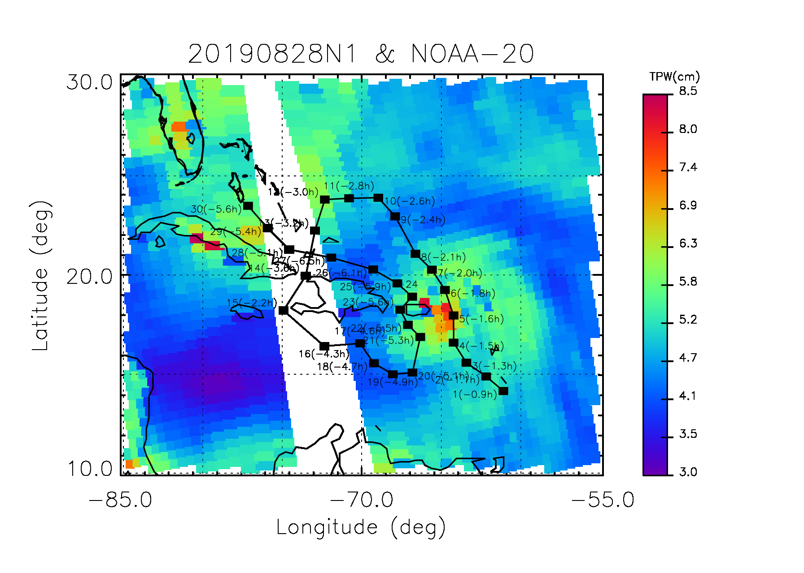
G-IV flights do not consider satellite overpasses in their timing
08/28/2019 NOAA-20
NOAA-20 overpass has coverage in the gap ☺
However, NOAA-20 is 50 mins earlier and has an even larger time mismatch than Suomi NPP ☹
NOAA-20: 7 useable sondes
< 2 hours from overpass
17:12 UTC
Hurricane Dorian
Notes:
Compare with NOAA-20 overpass timing → NOAA-20 overpass fills the gap, but 50 mins earlier, and further away from the flight).

Slide 7
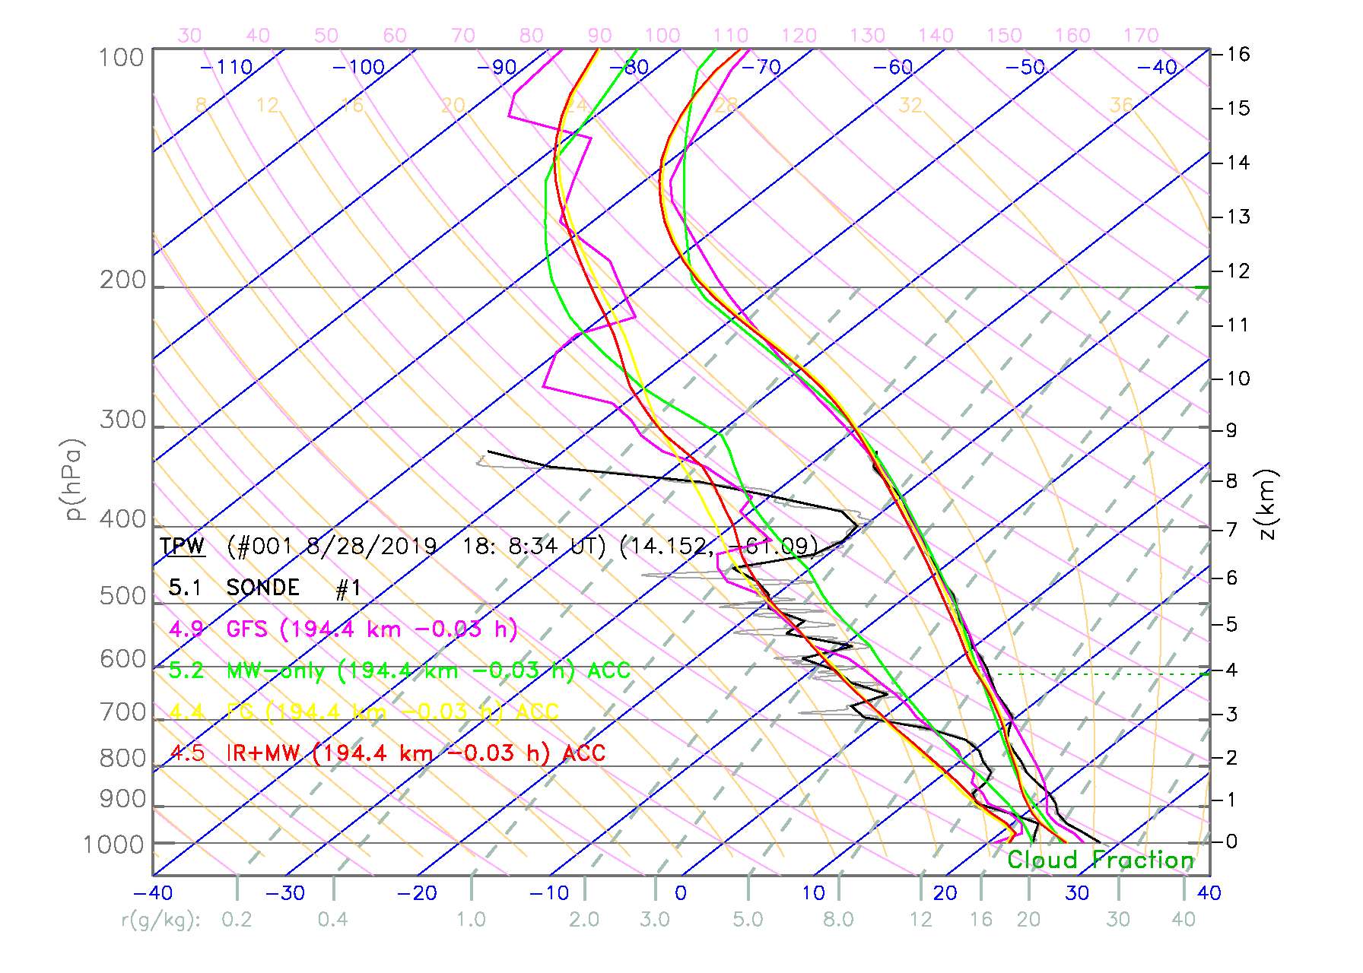
G-IV flights do not consider satellite overpasses in their timing
08/28/2019 Suomi NPP
NUCAPS
Dropsonde
GFS
Pressure (mb)
Temperature (°C)
Hurricane Dorian
-2 mins from overpass
190 km away from dropsonde
Notes:
Skew-T: how forecasters look at data;
Explain dif between T and Td. Can quickly estimate stability parameters/can see structure bc the x-axis is 2/3 the size, can see more structure.
Compare with NOAA-20 overpass timing (NOAA-20 overpass fills the gap, but 50 mins earlier, and further away from the flight).
Wrestling with space and time, specifically for forecasters.

Slide 8
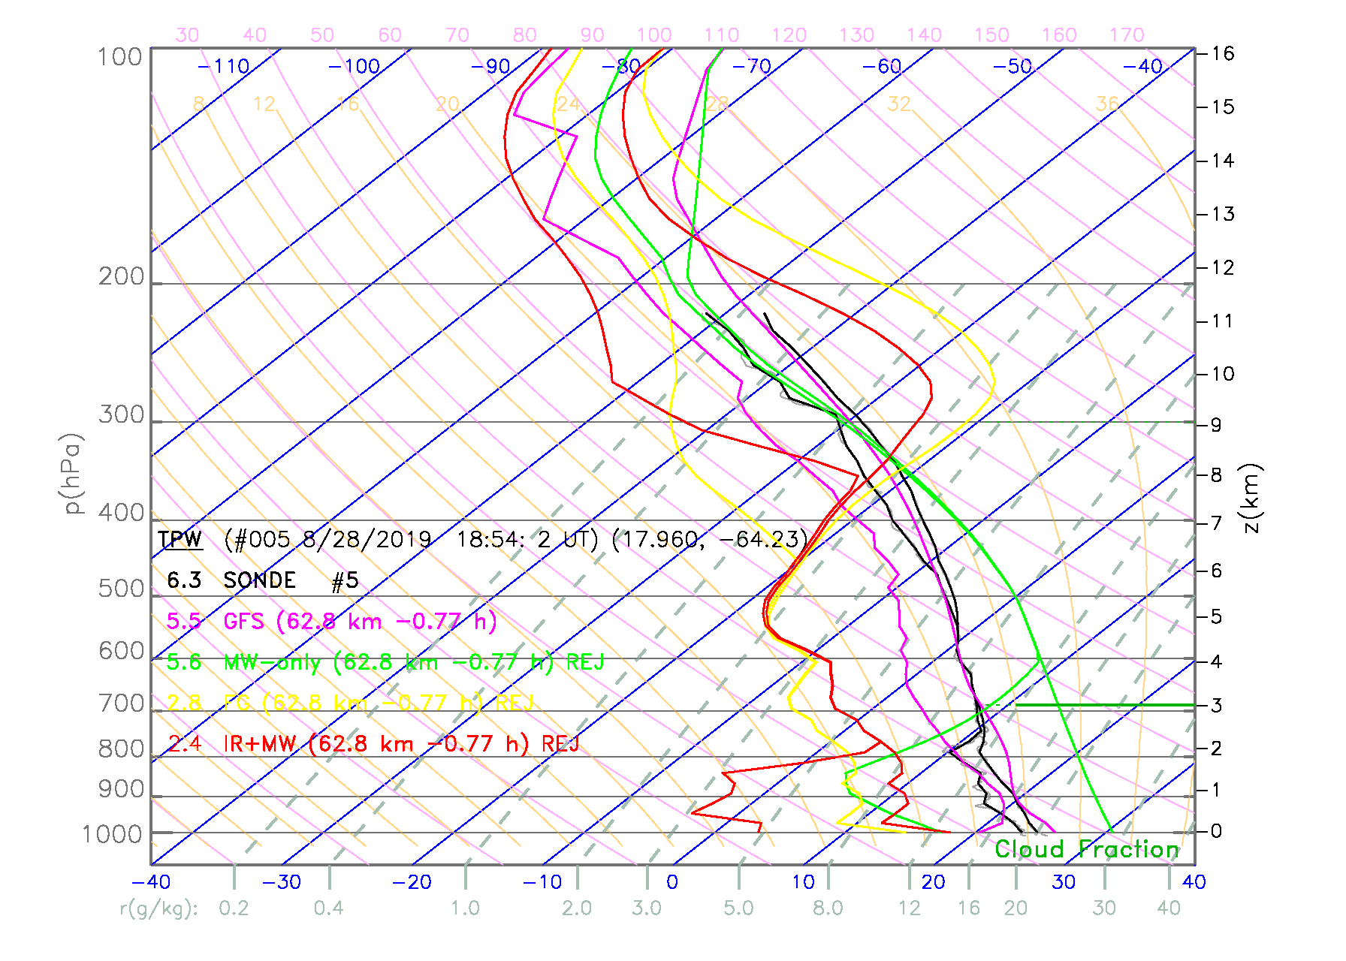
G-IV flights do not consider satellite overpasses in their timing
08/28/2019 Suomi NPP
Rejected
NUCAPS
Dropsonde
GFS
Pressure (mb)
Temperature (°C)
Hurricane Dorian
-48 mins from overpass
62 km away from dropsonde
Notes:
Obv rejected case, got the rain level right. Maybe value in that?
GFS also didn’t look good.

Slide 9
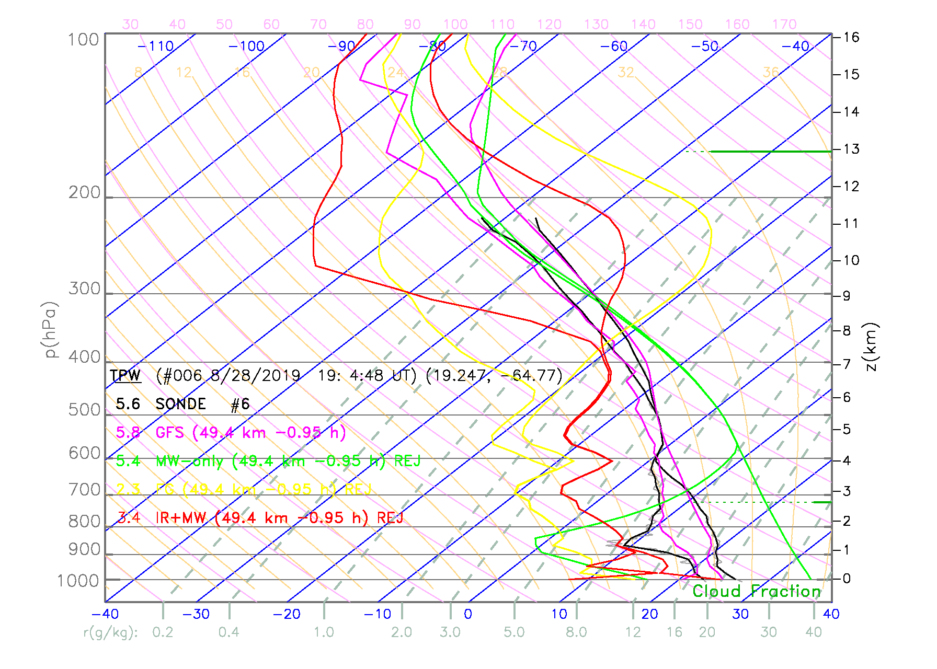
G-IV flights do not consider satellite overpasses in their timing
08/28/2019 Suomi NPP
Rejected
NUCAPS
Dropsonde
GFS
Pressure (mb)
Temperature (°C)
Hurricane Dorian
-54 mins from overpass
50 km away from dropsonde
Notes:
For NPP: Only 6/10 usable dropsondes (NOAA-20 further away)

Slide 10
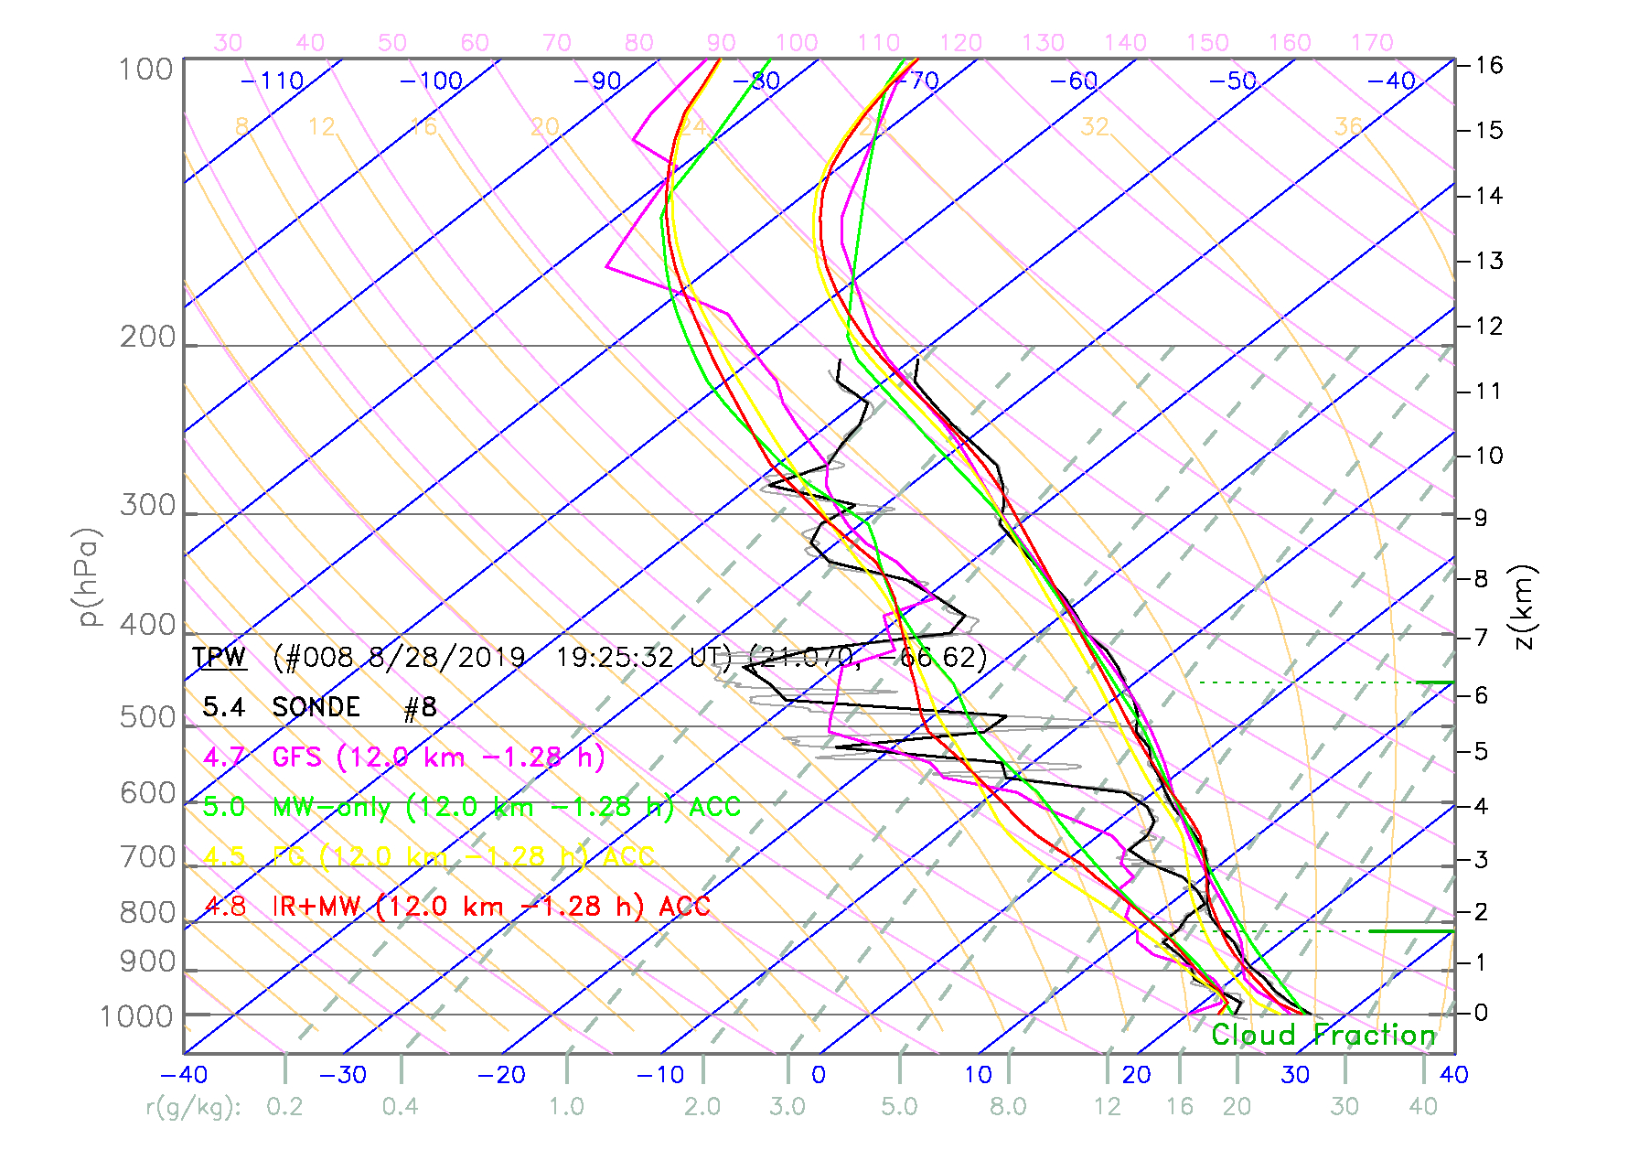
G-IV flights do not consider satellite overpasses in their timing
08/28/2019 Suomi NPP
NUCAPS
Dropsonde
GFS
Hurricane Dorian
-1.3 hours from overpass
12 km away from dropsonde
Notes:
GFS as the prior instead of the regression?
GFS = Closer structure.
NUCAPS == AIRSv5.9

Slide 11
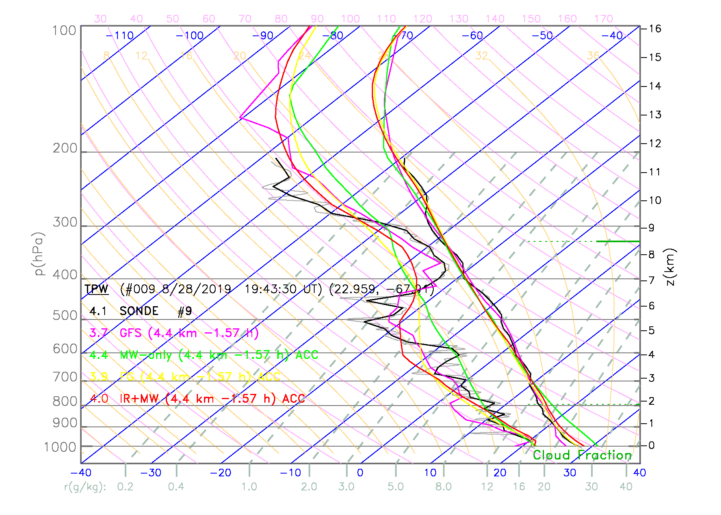
G-IV flights do not consider satellite overpasses in their timing
08/28/2019 Suomi NPP
NUCAPS
Dropsonde
GFS
Pressure (mb)
Temperature (°C)
Hurricane Dorian
-1.6 hours from overpass
4 km away from dropsonde

Slide 12
Working w/Hurricane Field Program = Flights Coordinated with Overpass ☺
Coordinated 97 (+17 remaining from last year) dropsonde purchase through JPSS program for joint objective SAL/Tropical Cyclone flight missions.
2018: Case was a pure SAL event
2019: Case where SAL interacting with a tropical cyclone, sample TC environment
NHC Goals
Satellite validation work
Targeting synoptic flow, a model sensitive region, for research
Circumnavigation of storm for National Hurricane Center operations
Our Goals
Introduce NHC users to NUCAPS
Determine the value of designing a new product type → Gather baseline evaluation metrics for a new product
Acquire test cases for future NUCAPS algorithm improvements for R2O
Notes:
Providing dropsondes enabled more research flights/data.

Slide 13
Hurricane Field Program 2018
Sampled Saharan Air Layer (SAL), a warm and dry pocket of air that originates over the Saharan Desert and propagates over the Atlantic. This can potentially suppress tropical cyclone formation.
SAL can be seen as the bright white areas in the GOES-16 WV imagery.
Gulfstream-IV flight patterns and take-off times will be adjusted to sample targets that maximize temporal and spatial overlap with overpasses by the NOAA-20 and Suomi NPP.
GPS dropsonde timed to be ≤1 hr and ≤50 km of collocated NUCAPS sounding granules.
NOAA-20
Suomi NPP
NUCAPS
4
2
0
-2
-4
Dropsonde
Time Difference (hours)
GOES-16 CH 8 6.2 μm (WV)
SAL
SAL
Notes:
Planned the small time difference.

Slide 14
Hurricane Field Program 2018
GOES-16 CH 8 6.2 μm (WV)
The SAL extends from 850-500mb, examining a strong case that goes to 200mb.
NUCAPS captures the dry layer feature well.
Dropsonde
NOAA-20 NUCAPS
Suomi NPP NUCAPS
Pressure (mb)
Relative Humidity (%)

Slide 15
Hurricane Field Program 2019
Quiet hurricane season followed by very active September made flight scheduling a challenge.
9/19/2019
9/12/2019
Source: CIRA, Washington Post
-9 days …
Jason Dunion (NHC) identified a research opportunity for a disturbance at the edge of a SAL near Cabo Verde. Later becomes Hurricane Jerry.
Source: VIIRS TrueColor RGB, NASA Worldview

Slide 16
Hurricane Field Program 2019
Hurricane Jerry
750mb Water Vapor (NOAA-20)
Like Dorian, dry air entrainment is playing a role in Jerry’s development.
Jerry was on the leading edge SAL, which can suppress hurricane development by forming an atmospheric inversion, which prevents air from rising and forming convection.
To the south, there is moist tropical air mass that is feeding the system, strengthening development.
18:51 Z
17:01 Z
Direct Broadcast NUCAPS visualization tool set-up for the field campaigns, http://sigma.umd.edu/resmaili/nucaps.html.

Slide 17
Successful Research Flight on 9/18
Hurricane Jerry
9/16 and 9/17 flights cancelled due to aircraft malfunction.
9/18: Final opportunity, all systems were a go.
The final pattern was partly a lawn-mower and circumnavigation (details).
35 dropsondes successfully deployed and timed with satellite overpasses.
Afterwards, Gulfstream-IV turned back over to NHC operations for recon flights as Jerry intensified into a Hurricane.
First Drop
Aircraft
Barbados
Jerry
Monitoring flight in real time. Data available within 20 minutes.
Notes:
Off the MTS system from an email halfway through the flight.

Slide 18
When G-IV flights consider satellite overpasses in their timing…
Hurricane Jerry
Suomi NPP
NOAA-20
TPW (cm)
TPW (cm)
+2.5hr
+3.3hr
+0.7 mins!
+6 mins!
Manually ran the NUCAPS science product using direct broadcast, able to generate match-ups every 20 minutes as the dropsonde data was made available.
Notes:
We wanted our overpass time to be in this region, we were exactly where we wanted to be.

Slide 19
When G-IV flights consider satellite overpasses in their timing…
Different location, best time match
Suomi NPP
NUCAPS
NOAA-20
Dropsonde
GFS
Pressure (mb)
Pressure (mb)
Temperature (°C)
Temperature (°C)
-6.0 mins from overpass
33 km away from dropsonde
-6.6 mins from overpass
6.6 km away from dropsonde
Notes:
GFS as the prior for this particular application?

Slide 20
When G-IV flights consider satellite overpasses in their timing…
Same location, two satellites
Suomi NPP
NUCAPS
NOAA-20
Dropsonde
GFS
Pressure (mb)
Pressure (mb)
Temperature (°C)
Temperature (°C)
-6.0 mins from overpass
33 km away from dropsonde
-55 mins from overpass
27.5 km away from dropsonde
Notes:
Have two satellites 50 mins apart at same location:
-- Two looks at the same place, can see how the environment changes:
-- Don’t expect a big change in the dry air mass -- Two different systems behaving the same
-- GFS dry air aloft changed

Slide 21
Outcomes of Flight
Flights enable feedback on the value (or lack thereof) of NUCAPS for Atlantic forecasting
Discuss the pros and cons of NUCAPS with NHC
Led to the successfully implemented of two approaches to direct broadcast for scientific field campaign support
On-line visualization tool to display Direct Broadcast NUCAPS
Manually running NUCAPS to generate dropsonde, GFS, and NUCAPS Skew-T’s in real time.
We acquired 35 dropsondes that can be used for evaluation and improvement of NUCAPS/Suomi NPP and NOAA-20
Today’s NHC Outlook
Still have 79 remaining dropsondes, so more flights possible this year. Otherwise, rollover to 2020.
Possible flight today/tomorrow over Lorenzo!
Notes:
O2R ← → R2O
Operationally relevant research
Will have science seminar at NHC discussing this work ~ December
Discussion, team, give/take

Slide 22
Extra Slides

Slide 23
Retrieval in Eye of Tropical Cyclone
Typhoon Soulik had 160 km eye
Eyes typically 30–65 kilometres
Dorian’s eye was ~ 60 km.
Suomi NPP NUCAPS Sounding within the eye of Soulik at 0350 UTC on 21 August 2018
Scott Lindstrom Blogpost: https://cimss.ssec.wisc.edu/goes/blog/archives/29379

