Slide 1
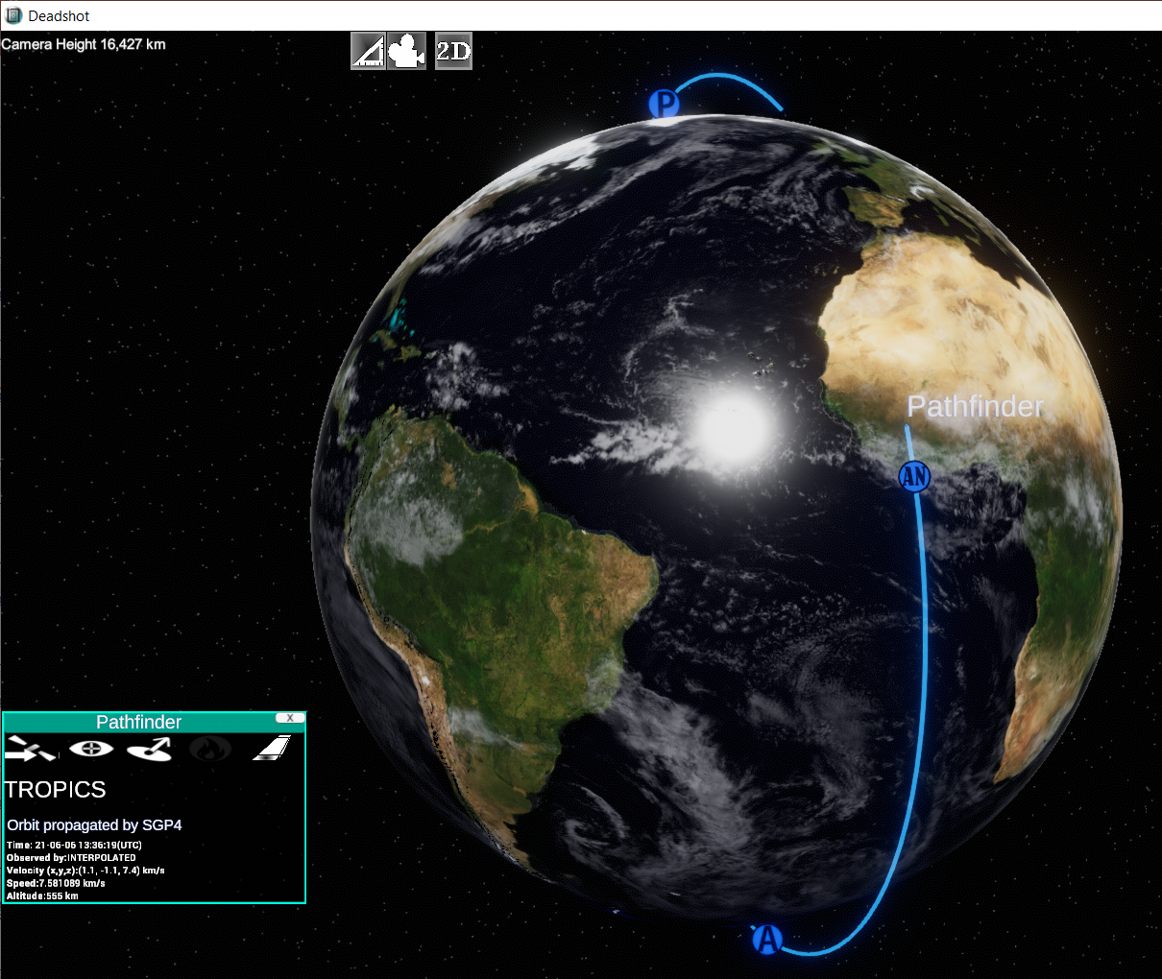
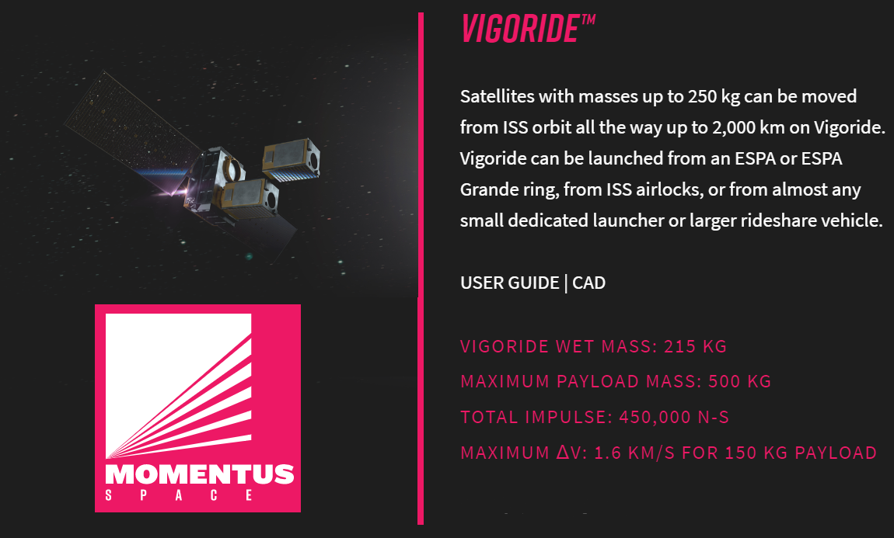
TROPICS Pathfinder Launch Awarded by NASA 7/30/2020
Launch Date: June 24, 2021
Momentus Space “Vigoride”
SpaceX Falcon 9 launch from KSC
Orbit parameters:
550 km altitude, circular
98° inclination (sun-synchronous)
13:30 Local Time of Ascending Node (LTAN)

Slide 2
